Slide 1
Objective:
Covid 19 Twitter Sentiment Analysis
After the measuring sentiment analysis, the graphical representation has been provided on the data. The data we have collected on twitter are based on two specified hashtag keywords, which are (“COVID-19, coronavirus”)
1. Get to know people’s sentiment towards the epidemic
2. Understand the sentiments of people on govt. decision to extend the lockdown
Experimental Investigation:
We tried data augmentation by exploding the tweets of very long size to get uniform size input, then we used bidirectional LSTM layers after embedding layer instead of conventional RNN model as they have problem (vanishing and exploding gradient).By using bidirectional LSTM model can understand pattern and sequence after and before a particular word because in english a choice of words and there order both affect the meaning of sentence .it can be in passive,active voice and may convey different meaning in both

Slide 2
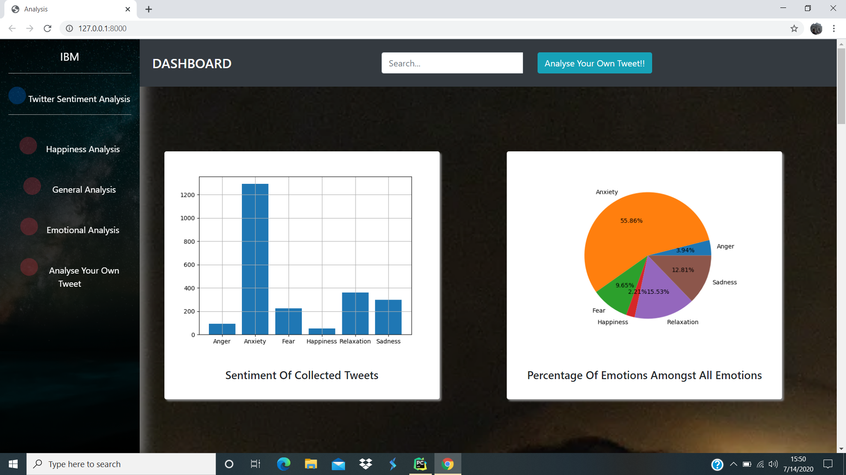
Some Glimpses of Dashboard

Slide 3
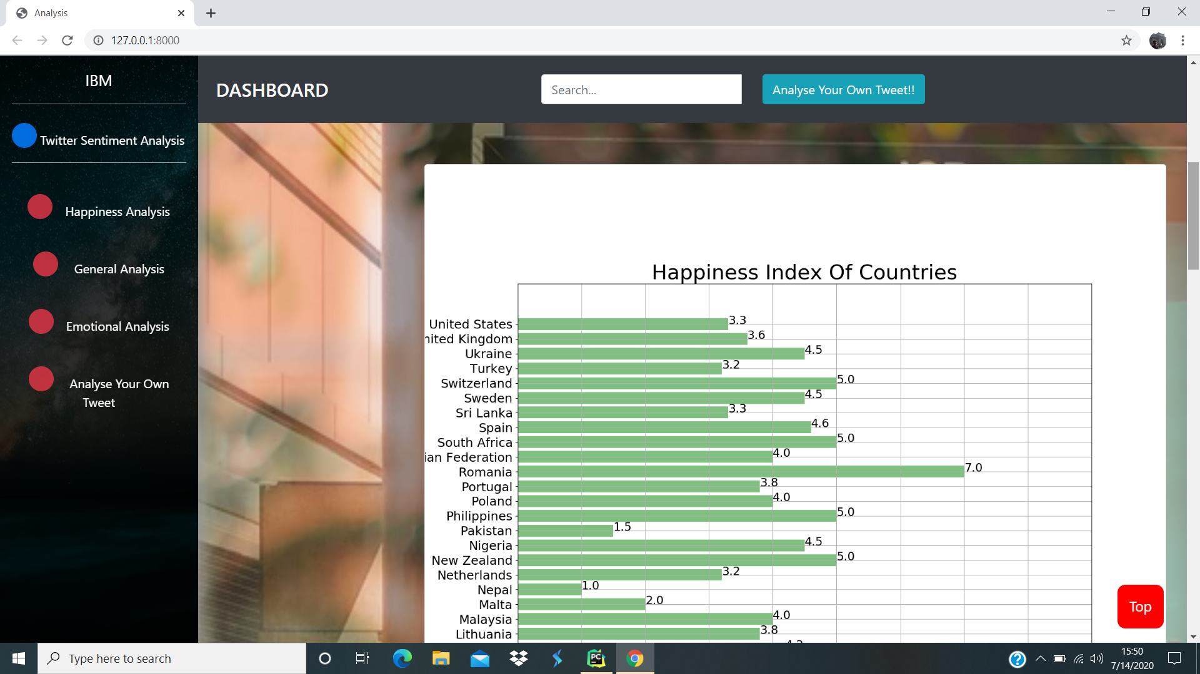

Slide 4
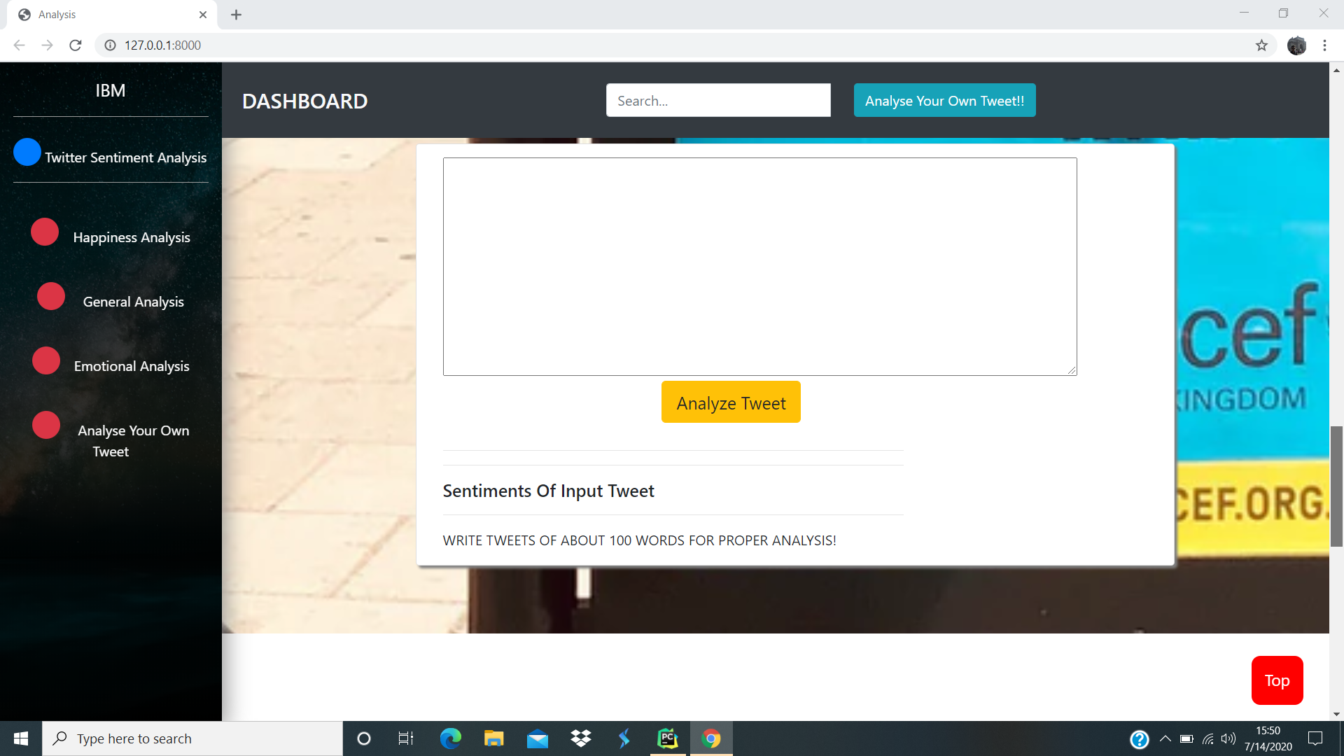

Slide 5
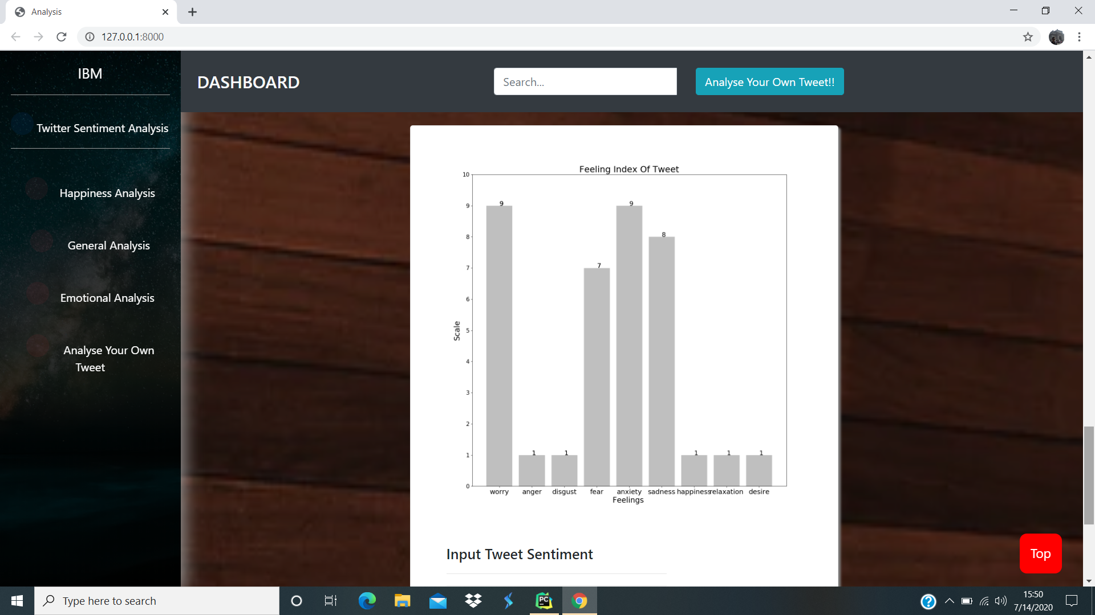

Slide 6
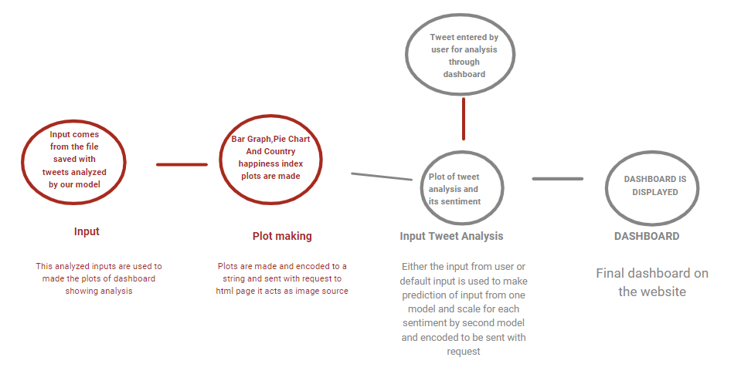
Working

Slide 7
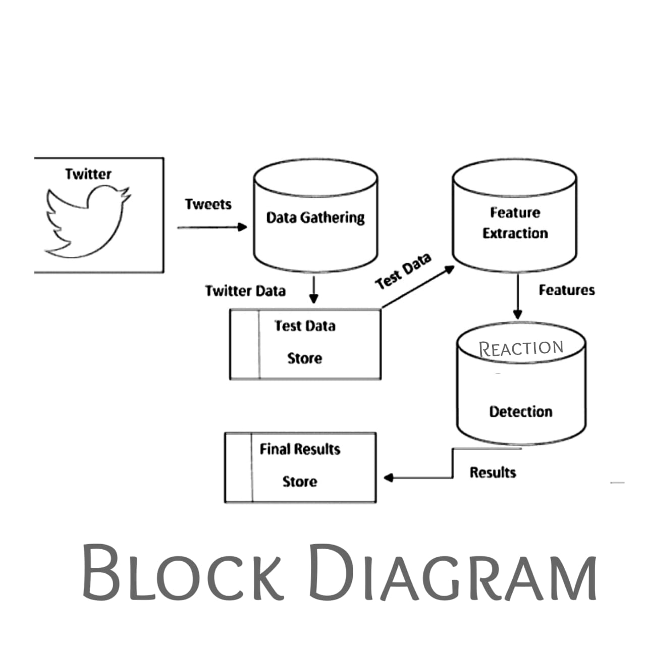

Slide 8
Future scope of work
1. We will use twaarc to extract tweets and show dynamic plots on our dashboard.
2. We will increase the perfection of our model by refining it as it has accuracy but its loss value can further be decreased with proper training.
3. We will increase region wise timeline analysis of how sentiment are changing with time in a particular region
Team Name: Helix Dynamics
Team Leader : Komal Pal
Team Member: Akash , Udisha, Aditya

