Slide 1
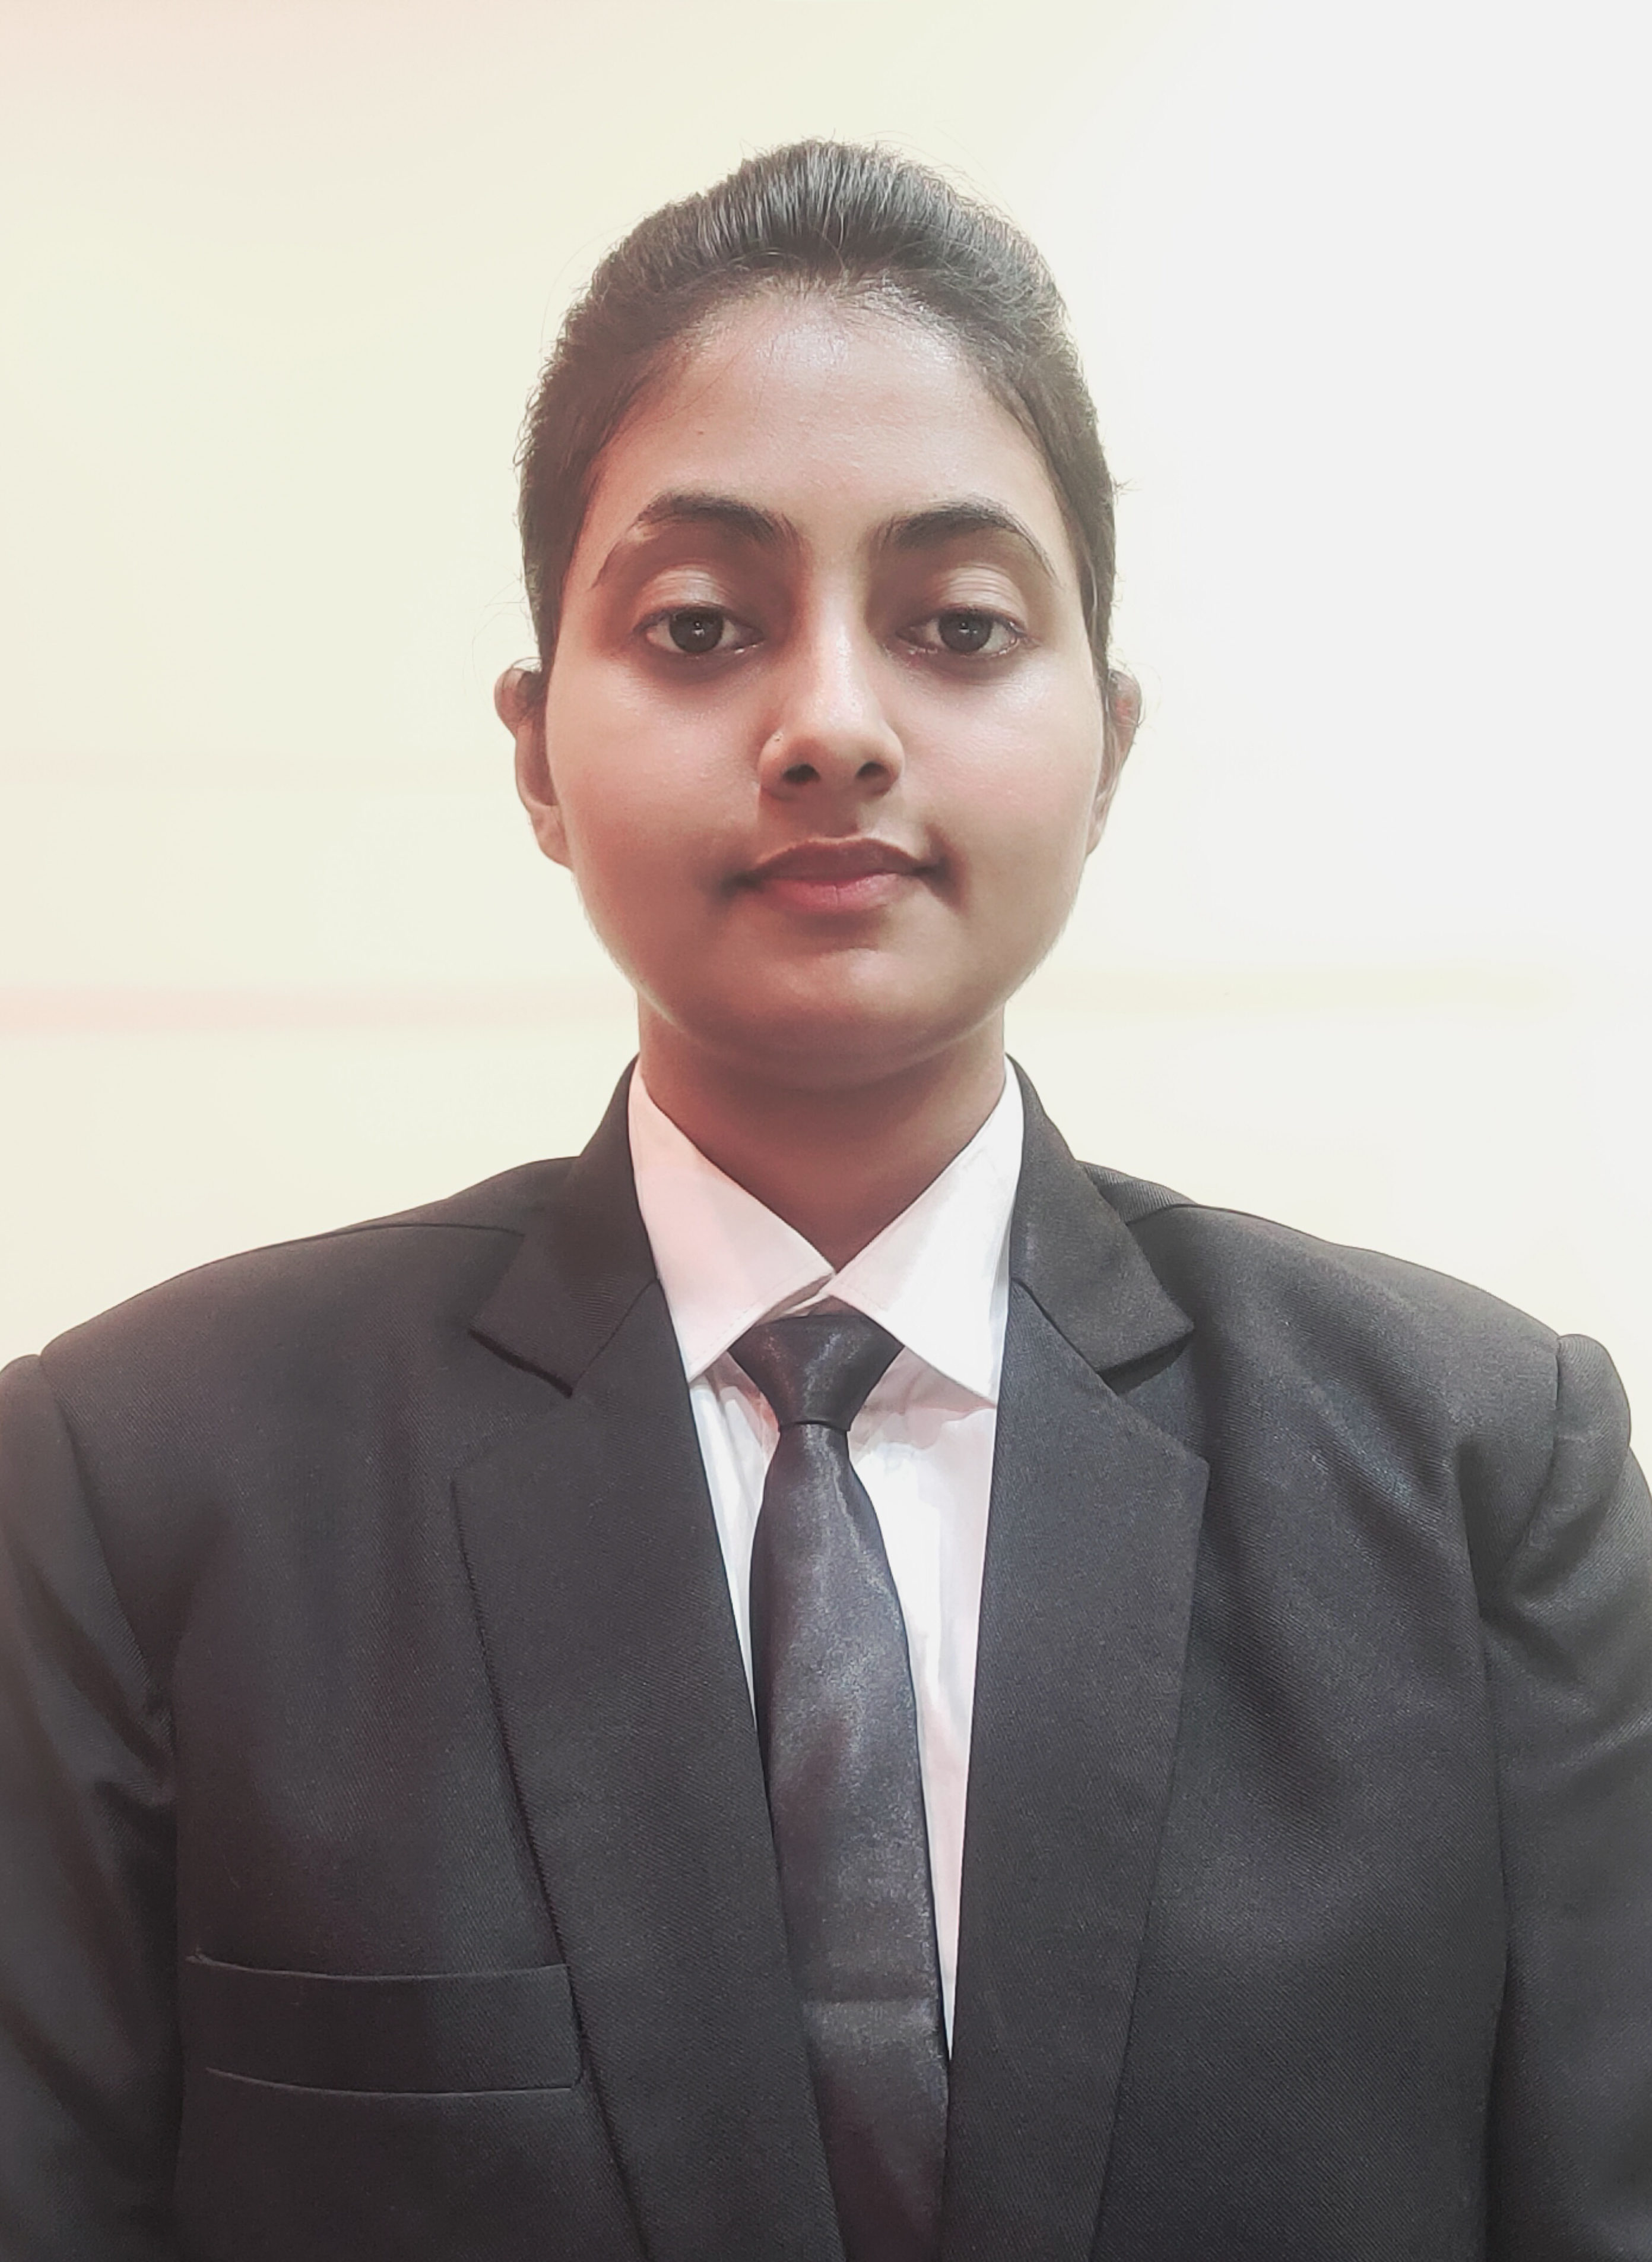

Komal Barnwal
Analyst/Software Engineer
Bachelor of Engineering
Computer Science : 2018 - 2022
Skills
Java 8 /J2EE | Java Basics, OOPS, Generics, Collections, Arrays, Loops, Lambda Exp, Stream API Junit, Mockito
Spring core | IOC & Dependency Injection, Autowire
Spring REST | REST controllers, Implementation of GET, POST, PUT & DELETE, Bean Validation & Exception Handling, Testing Services, Controller & Repository layer
Spring Data JPA | Implement DAO layer using spring Data repositories, Transaction Management
Spring Boot Microservices | Spring Boot Starters, annotations, Messaging Service, Sync/Async comms, Swagger API documents
Spring Cloud | Eureka, Netflix Ribbon, Feign Client, Netflix Hystrix & Config Server
React | Components, Hooks, Event handling
Database | MongoDB No SQL
UI Tech | HTML 5 & CSS 3,JavaScript
Tools | Git, Postman, Maven, IDE
Add On skills | Communications, Team management. Peer learning
Benguluru
komalbarnwal2016@gmail.com
+91 8340570639
A4
Full Stack Developer
Hands on experience in developing web pages using HTML5, CSS3, Object Oriented Java script, ES6 & Typescript, JSON.
Hands on experience in creating microservices with Springboot, Spring Cloud API Gateway, Eureka server, Rest Template , load balancing.
Implemented spring Boot and MongoDB in case study and upskilling knowledge continuously.
Proficient React developer with working knowledge on ReactJS(Hooks).
Experience in creating documentation with swagger and in unit testing using Junit, Mockito.
Deals and Coupon Finder Application
Completed end to end case study of Deals and coupons finder Application along with JWT authentication, Logger, Mongo, Eureka, PI Gateway and payment testing using Razorpay, Material-UI and React used for user interface.
Data Structures and Algorithms Self paced Course(GeeksforGeeks) (2020)
Completed ” Agile Software Development“ course at Coursera.
Completed “AWS CCP Certification”.

