Slide 1


DATA SCIENCE IN R PROJECT Analyzing the Healthcare cost and Utilization in Wisconsin hospitals
Simplilearn LMS
Komal Mohite

Slide 2

DATA SUMMARY
A nationwide survey of hospital costs conducted by the US Agency for Healthcare consists of hospital records of inpatient samples. The given data is restricted to the city of Wisconsin and relates to patients in the age group 0-17 years.

Slide 3
SOLUTION
BUSINESS PROBLEM
Perform a complete analysis of the data and find the variables/features that mainly affects the hospital costs and build and evaluate a predictive model to predict the same.
The agency wants to analyze the data to research on the healthcare costs and their utilization

Slide 4

DATASET
As the agency wants to analyse the data to research on the healthcare costs and their utilization, the independent and dependent variables are set as follows :
DEPENDENT/ TARGET VARIABLE :
TOTCHG
INDEPENDENT/PREDICTOR VARIABLE :
AGE
FEMALE
LOS
RACE
APRDRG
AGE : Age of the patient discharged
FEMALE : Binary variable that indicates if the patient is female
LOS : Length of stay, in days
RACE : Race of the patient (specified numerically)
TOTCHG : Hospital discharge costs
APRDRG : All Patient Refined Diagnosis Related Groups

Slide 5
OBJECTIVE
AGE
APRDRG
RACE
TOTCHG ~ AGE+FEMALE
LOS~ AGE+FEMALE+RACE
Find the age category of people who frequent the hospital and has the maximum expenditure.
Find the diagnosis related group that has maximum hospitalization and expenditure.
Analyze if the race of the patient is related to the hospitalization costs.
Analyze the severity of the hospital costs by age and gender for proper allocation of resources.
Find if the length of stay can be predicted from age, gender, and race.
TOTCHG ~ AGE + FEMALE + LOS + RACE + APRDRG
Perform a complete analysis to find the variable that mainly affects the hospital costs

Slide 6
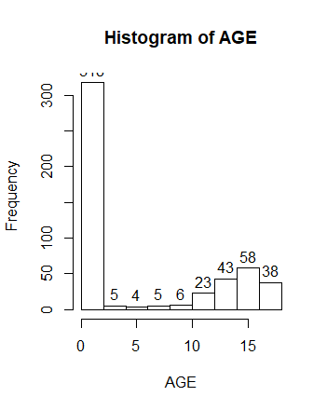

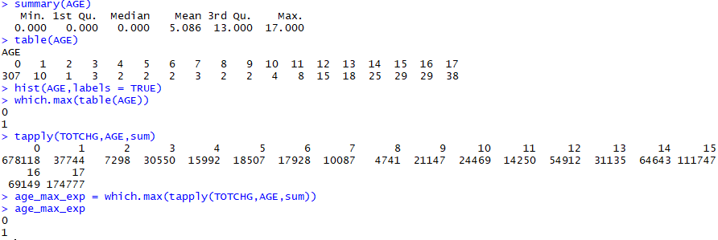
OBJECTIVE 1
Find the age category of people who frequent the hospital and has the maximum expenditure.
AGE 0 uses the hospital frequently
AGE 0 also makes the maximum hospital expenditure which is 678118
CONCLUSION

Slide 7
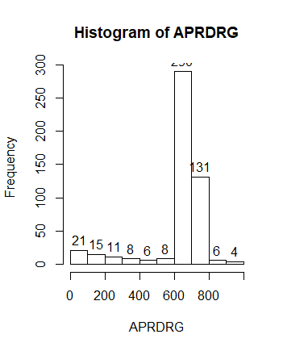
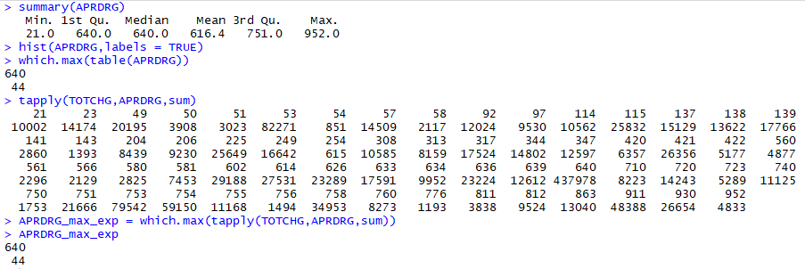
OBJECTIVE 2
Find the diagnosis related group that has maximum hospitalization and expenditure
CONCLUSION
Diagnosis related group that has maximum hospitalization : 640
Diagnosis related group 640 also has maximum hospitalization expenditure which is 437978

Slide 8
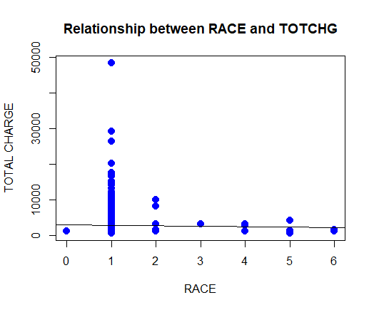
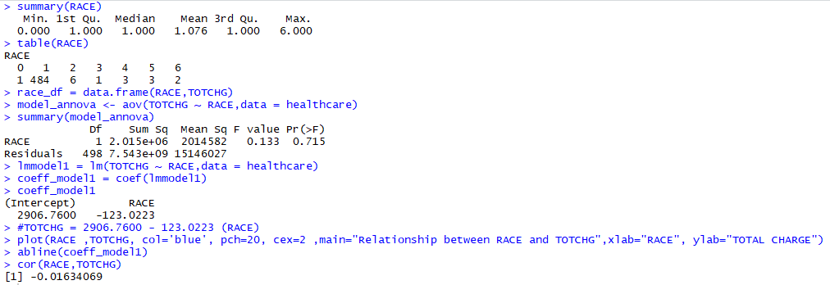
OBJECTIVE 3
Analyze if the race of the patient is related to the hospitalization costs to make sure that there is no malpractice.
ANALYSIS
H0: Race of patient is related to hospitalization costs.
Ha: No relation
As p-value(0.715) is very high compared to significance level(0.05),we reject null hypothesis H0.
Hence there is no relation between RACE and TOTCHG.
CONCLUSION

Slide 9
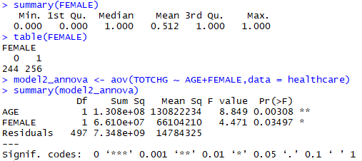
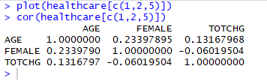
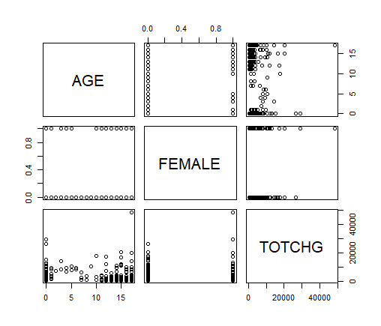
OBJECTIVE 4
Analyze the severity of the hospital costs by age and gender for proper allocation of resources.
FEMALE(gender) has p value<0.05 meaning it impacts costs.
AGE has lesser p value indicating more impact on costs.
The same can also be inferred from the scatter plot and pairwise correlation matrix.
ANALYSIS

Slide 10
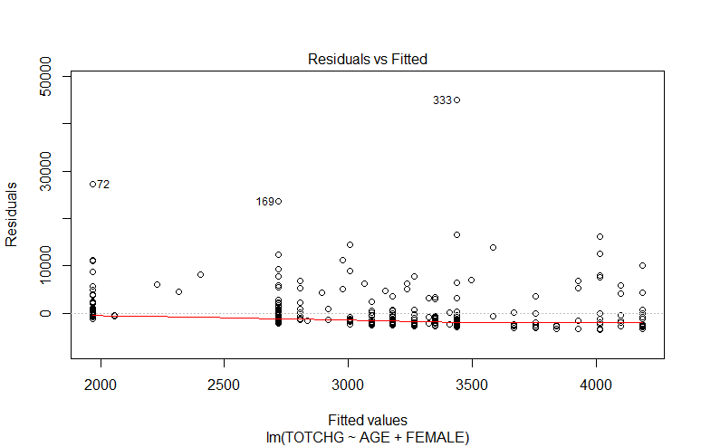
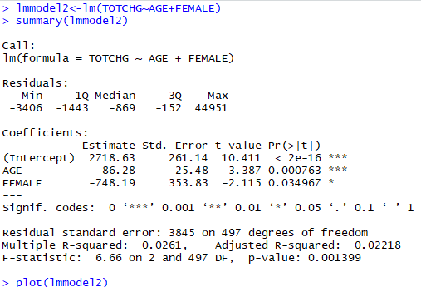
OBJECTIVE 4
.
This plot indicates that this model overpredicts values for cost
It also indicates outliers (72,169,333)
ANALYSIS

Slide 11
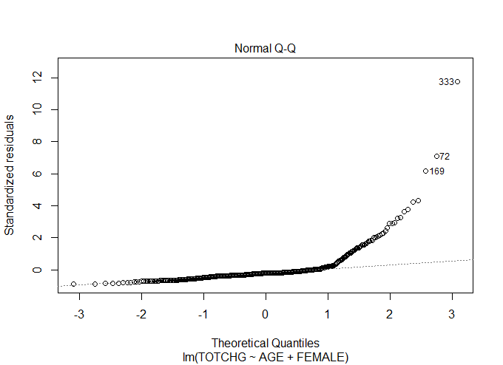
OBJECTIVE 4
.
Most of the points fall on the line but many points in higher quantile stray away from the line
Indicates our residuals do not follow Normal distribution.
ANALYSIS

Slide 12
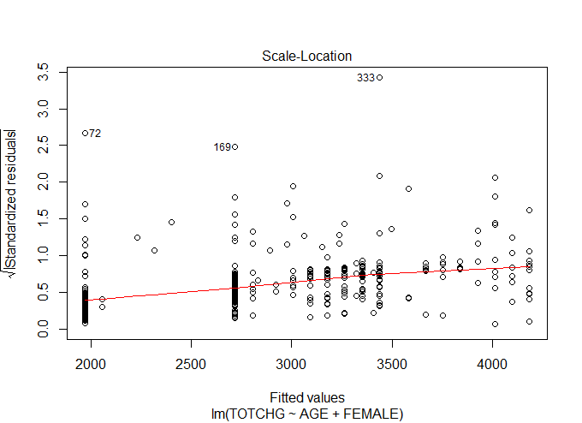
OBJECTIVE 4
.
This makes trends in residuals more evident and, from this plot, we can see that there is likely increasing trend in our residuals and therefore variance of residuals is not uniform across the range.
ANALYSIS

Slide 13
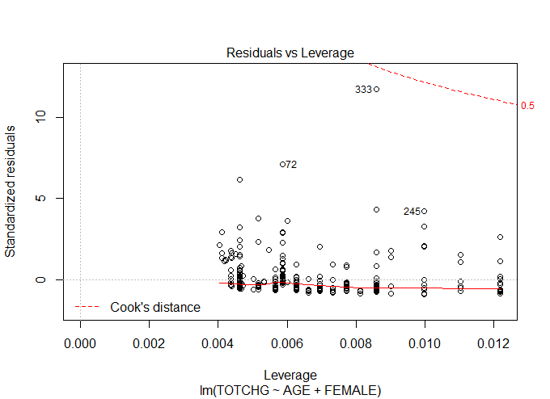
OBJECTIVE 4
.
Any point outside of Cook’s distance boundaries would be an outlier in the x direction. We can conclude that we have no outliers, although point 333 is close.
ANALYSIS

Slide 14
OBJECTIVE 4
Analyze the severity of the hospital costs by age and gender for proper allocation of resources.
P-value of AGE <0.05(very low p-value) indicating high significance. P-value of FEMALE is also <0.05 making it a significant variable.
However AGE and FEMALE alone used as predictors to predict TOTCHG does not result in a good model as the R- Squared is very low. i.e. only 26% variance in TOTCHG can be explained by this model.
CONCLUSION

Slide 15
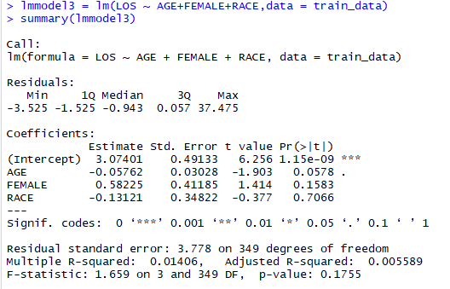
OBJECTIVE 5
Find if the length of stay (LOS) can be predicted from age, gender, and race.
The p-values for all the predictors are >0.05, indicating that none are significant.
Multiple R-squared: 0.01406, indicating that this model is able to explain the variance in LOS only by 14%.
Poor model to predict LOS
ANALYSIS
CONCLUSION

Slide 16
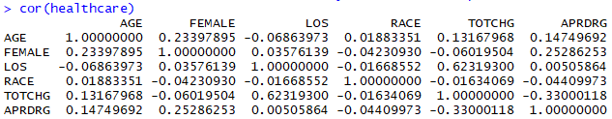
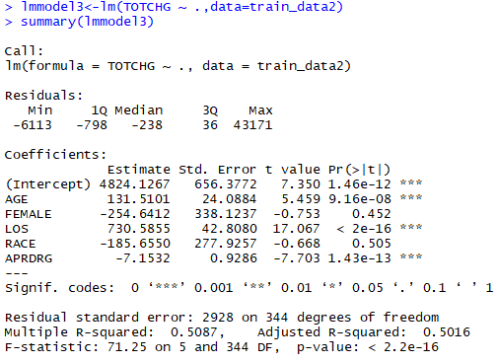
OBJECTIVE 6
Perform a complete analysis to find the variable that mainly affects the hospital costs
The pairwise correlation matrix indicates that LOS is the highest positively correlated variable to TOTCHG followed by APRDRG (negatively correlated) and AGE.
The p values for above stated variables are <0.05, making them significant.
According to estimate values, LOS maximum explains the variance in TOTCHG
LOS is the variable that mainly affects hospital costs followed by AGE and APRDRG.
ANALYSIS
CONCLUSION

Slide 17

Analysis Summary
AGE 0 uses the hospital frequently and makes the maximum hospital expenditure which is 678118 .
Diagnosis related group that has maximum hospitalization is 640 and the same also has maximum hospitalization expenditure which is 437978.
There is no relation between RACE and TOTCHG – No malpractice
AGE and FEMALE alone cannot be used as predictors to predict TOTCHG as it does not result in a good model.
AGE,FEMALE and RACE as predictors for LOS results in a poor model with R-Squared = 0.014
LOS is the variable that mainly affects hospital costs followed by AGE and APRDRG.
My Code

Slide 18


Thank You

