Slide 1
Asset Management System
High-Level & Low-Level Design with Flow & Database Architecture

Slide 2
Introduction
An Asset Management System helps track and manage assets across different locations, ensuring proper utilization, movement tracking, and inventory control.

Slide 3
Problem Statement
Develop an Asset Management System to store assets in multiple locations, track movements, update inventory counts, and generate reports for analysis.

Slide 4
Database Architecture
The system consists of multiple tables such as Asset, Category, Location, Status, AssetMovement, and InventoryCount, ensuring structured data storage and retrieval.

Slide 5
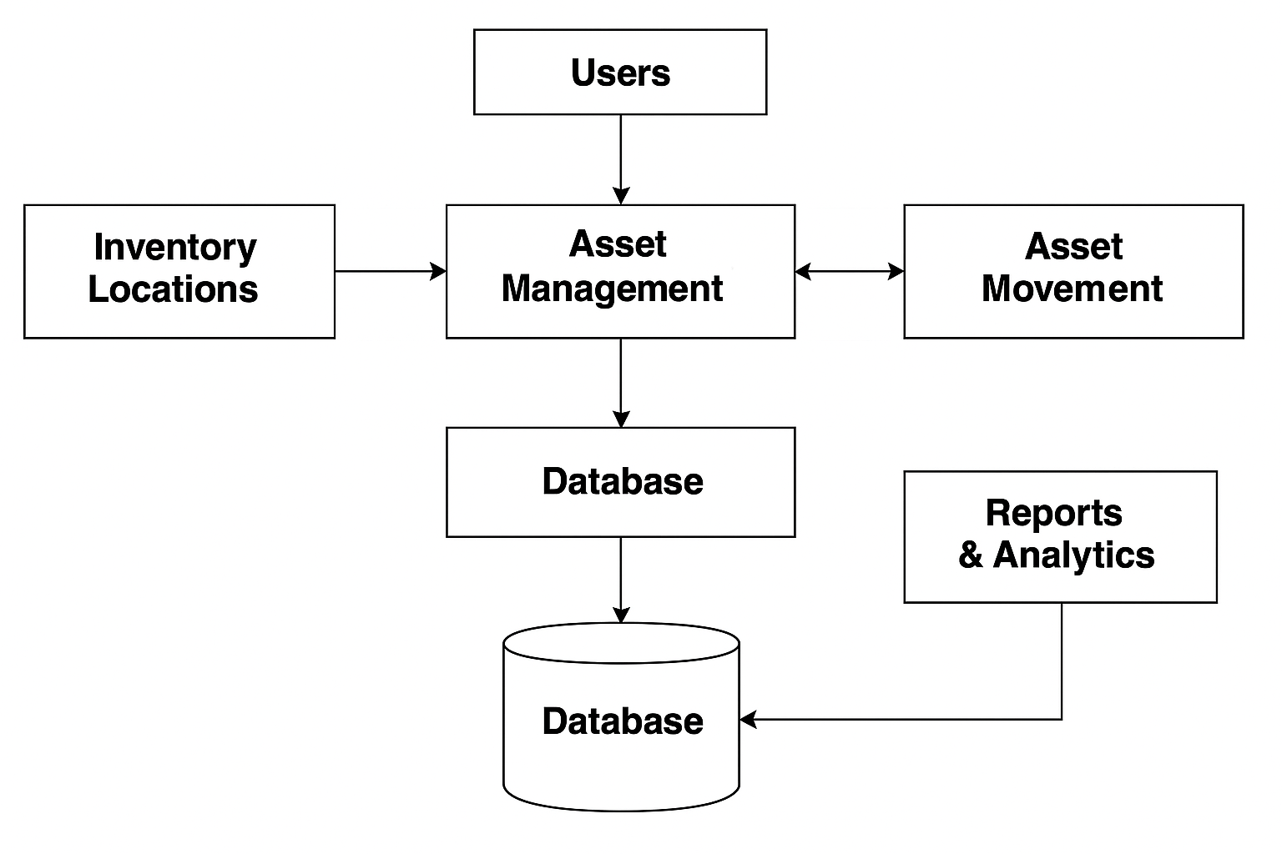
High-Level Diagram

Slide 6
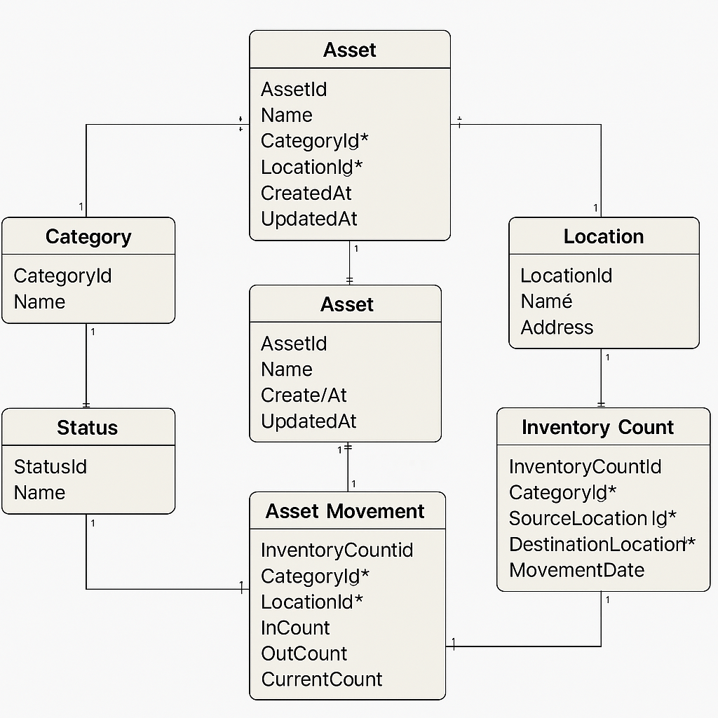
Low-Level Diagram

Slide 7
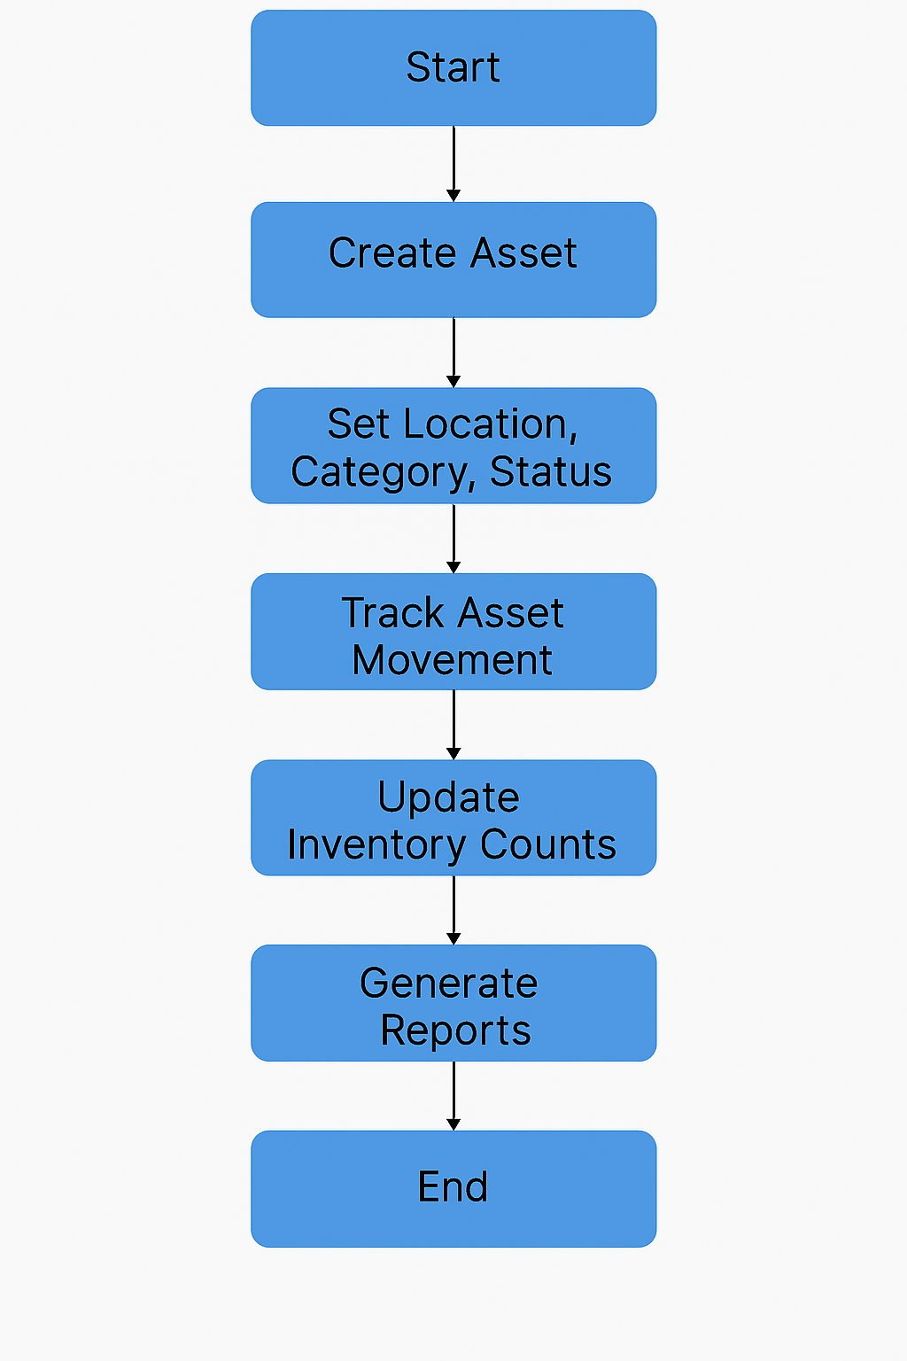
Flow Diagram

Slide 8
Functionality
- Asset Management (Add, Update, Delete Assets)
- Inventory Tracking
- Asset Movement Logging
- In & Out Count Management
- Search & Filtering
- Reports & Analytics
- Barcode/QR Code Scanning (Optional)

Slide 9
Conclusion
The Asset Management System efficiently tracks assets, updates inventory, and provides insights through reports, ensuring better resource management and decision-making.

