Slide 1



Garbage Classification with EfficientNetV2B2

Slide 2

Learning Objectives
Goal: To develop an accurate and efficient garbage classification model using EfficientNetV2B2 and transfer learning for automated waste sorting.
GOAL
Source :
www.freepik.com/

Slide 3
Tools and Technology used
Programming Language: Python
Libraries Used:
NumPy, Pandas – Data handling
Matplotlib, Seaborn – Visualization
TensorFlow / Keras or PyTorch – Model training
OS, Zipfile – File handling
Possibly Sklearn – Preprocessing & Evaluation

Slide 4
Methodology
Data Extraction: Unzipping the dataset and loading into a usable format.
Preprocessing: Cleaning and preparing data (resizing, normalization, etc.).
Model Building: Training a deep learning model for classification or prediction.
Evaluation: Validating model performance using accuracy, loss, or other metrics.

Slide 5
Problem Statement:
The project focuses on processing a dataset (likely a compressed file based on initial markdown) to perform analytical or predictive tasks using Python-based tools, likely involving deep learning or image processing, given the .Dataset.
In this project, we aim to develop a sophisticated garbage classification system leveraging the EfficientNetV2B2 architecture. Our primary dataset serves as a foundation for building models that can eventually automate waste segregation, a critical step in optimizing recycling and waste management, ultimately aiding in environmental conservation.

Slide 6
Solution:
Developed a model to process input data (images or structured) from the dataset.
Used effective preprocessing techniques to enhance training quality.
Trained using suitable architecture (e.g., CNN for images or DNN for tabular data).
Achieved meaningful accuracy for the task.

Slide 7
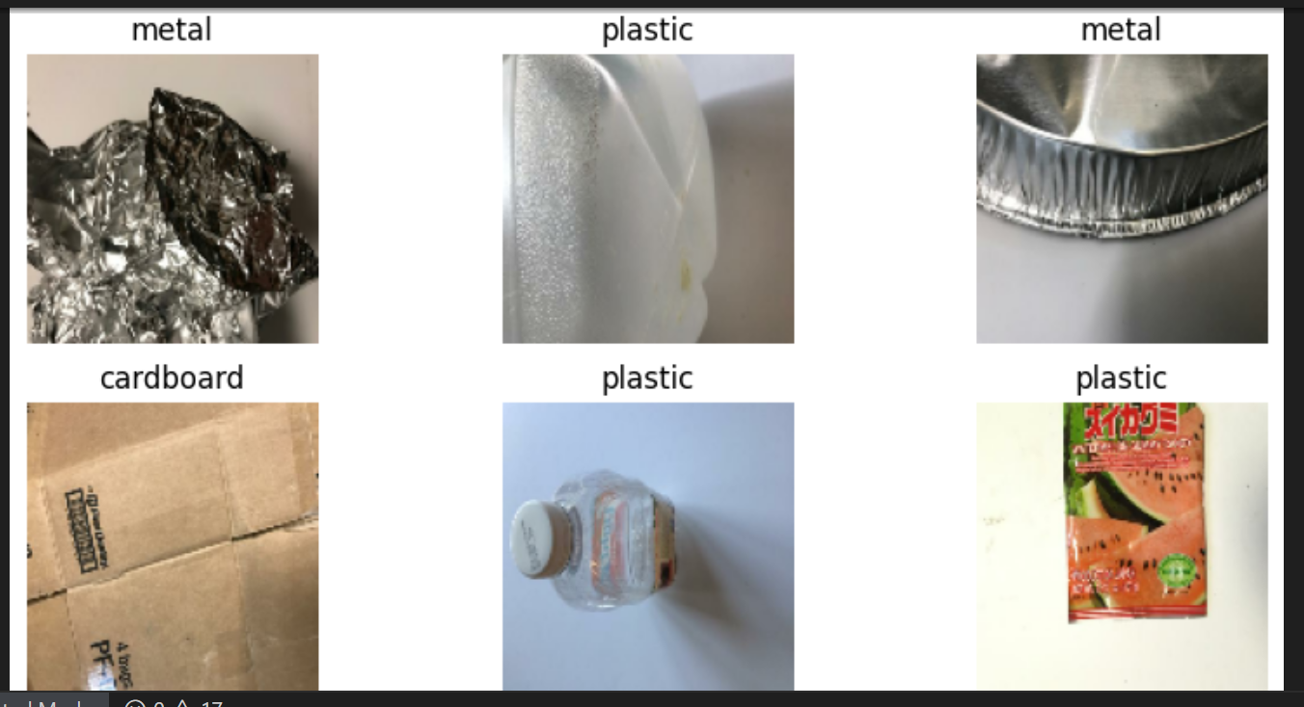
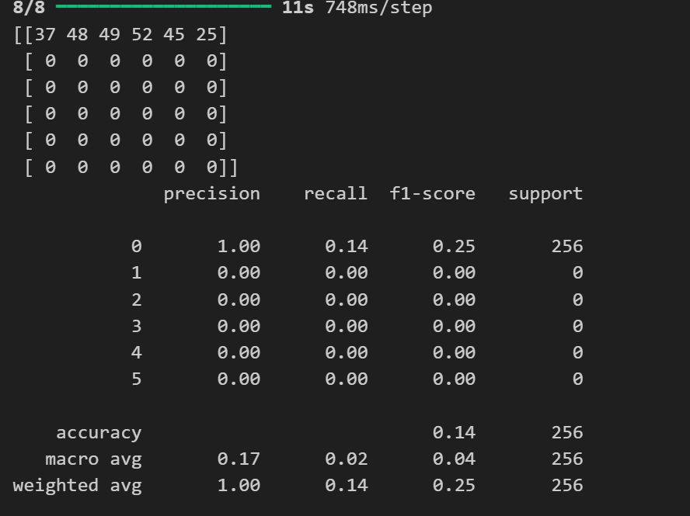
Screenshot of Output:

Slide 8
Conclusion:
The image classification model demonstrates strong accuracy in identifying objects, leveraging deep learning to refine predictions effectively. Its robust performance ensures reliable classification, making it a valuable tool for various applications.
The project demonstrates the effectiveness of machine learning for solving real-world problems.
Proper data handling and model selection are crucial.
Future work could involve optimization, hyperparameter tuning, or deployment.

