Slide 1

Healthcare Analytics for Doctor Visits_TIRTC
SIDDHANI KOMALI ALEKHYA

Slide 2

PROBLEM STATEMENT
Healthcare providers generate large amounts of patient and visit data, but patterns in doctor visits can be difficult to identify manually.
This project analyzes doctor-visit data to understand how visit frequency varies with factors such as gender, age, illness, health status, income and healthcare coverage.
The analysis aims to present clear data-driven insights that can support healthcare planning and resource management.

Slide 3
Project Description
Dataset contains 5,190 records and 13 columns, including doctor visits, gender, age, income, illness, health and healthcare coverage variables.
The data was explored and analyzed using Python-based data analytics techniques.
Pandas and NumPy were used for data loading, cleaning and statistical analysis.
Matplotlib and Seaborn were used to visualize visit patterns and demographic distributions.
The final analysis highlights relationships between doctor visits and important patient characteristics.

Slide 4

WHO ARE THE END USERS?
Doctors and healthcare professionals – understand patterns in patient visits.
Hospital and healthcare administrators – support resource and service planning.
Public health planners – identify population-level healthcare usage patterns.
Healthcare data analysts and researchers – explore relationships in healthcare datasets.

Slide 5

Technology Used
  Python
  Pandas
  Numpy
  Matplotlib
  Seaborn

Slide 6

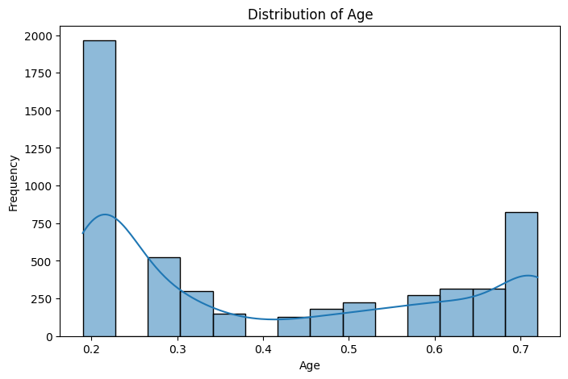
RESULTS
[Add screen shots of your code ]
https://github.com/Komali-2593/Healthcare-Analytics-for-Doctor-Visits

Slide 7
Thank you
.
.

