Slide 1

Malla Reddy Engineering College for Women
UGC Autonomous Institution
Accredited by NBA & NAAC with A+ Grade
Approved by AICTE , Affiliated to JNTUH , ISO 9001:2015 Certified Institution
Maisammaguda , Dhulapally , Secunderabad-500100
Title of the Idea : "Empowering Navigation and Communication in Rural and Congested Regions Using Deep Learning Technologies"
Name of the Guide : M. Chandra Rao sir
Name of the Student : Komali
Kanishka
Yoshita
Branch & Year : AIML-B & II/II
Roll Number : 23RH1A66C2
23RH1A66A8
23RH1A66A9

Slide 2
Enhancing Traffic Sign Detection and Voice Assistance in Rural Areas & heavy Traffic Using Deep Learning
INTRODUCTION
Traffic signs are crucial for providing essential information to drivers, such as speed limits, stop signs, and directional indicators.
However, drivers often miss or misinterpret these signs, leading to accidents.
To address this issue, researchers have developed systems that use deep learning techniques to recognize traffic signs and provide real-time voice assistance to drivers.
Our aim is to enhance the system to work efficiently in rural areas and places with heavy traffic, improving overall road safety.

Slide 3
Enhancing Traffic Sign Detection and Voice Assistance in Rural Areas & heavy Traffic Using Deep Learning
PROBLEM STATEMENT
Background: In rural and densely populated urban areas, navigating and communicating effectively can be challenging due to limited infrastructure, high traffic congestion, and inadequate access to advanced technologies. These regions often suffer from poor connectivity, lack of real-time navigation aids, and inefficient communication channels, impacting both residents and visitors. The rise of deep learning technologies presents an opportunity to address these challenges by providing innovative solutions that enhance navigation and communication.
Problem Statement: How can deep learning technologies be leveraged to improve navigation and communication in rural and congested regions, thereby enhancing accessibility, safety, and overall quality of life for inhabitants and travelers?

Slide 4
Enhancing Traffic Sign Detection and Voice Assistance in Rural Areas & heavy Traffic Using Deep Learning
Objectives
Develop Real-Time Navigation Systems: Create deep learning-based navigation systems that provide accurate, real-time route guidance, considering traffic conditions, road quality, and other factors specific to rural and congested areas.
Enhance Communication Infrastructure: Design and implement communication solutions using deep learning that ensure reliable and efficient connectivity, even in areas with poor network coverage.
Improve Accessibility: Ensure that the developed technologies are user-friendly, affordable, and accessible to the local population, including those with limited technical knowledge.
Promote Safety: Integrate safety features within the navigation and communication systems, such as real-time traffic alerts, emergency assistance, and hazard detection.
Facilitate Community Engagement: Develop platforms that encourage community participation, allowing residents to contribute data and feedback to continuously improve the systems.

Slide 5
Enhancing Traffic Sign Detection and Voice Assistance in Rural Areas & heavy Traffic Using Deep Learning
EXISTING SYSTEM
OUTCOMES OF EXISTING :
Traffic Sign Detection: Current models using Convolutional Neural Networks (CNNs) for detecting and classifying traffic signs.
Voice Assistance: Existing systems providing real-time voice alerts based on detected traffic signs
DISADVANTAGES
Rural areas
Congested areas

Slide 6
Enhancing Traffic Sign Detection and Voice Assistance in Rural Areas & heavy Traffic Using Deep Learning
PROPOSED SYSTEM
OUTCOMES OF PROPOSED :
Enhanced Traffic Sign Detection: Improved models to detect traffic signs in rural areas with varying conditions (e.g., poor lighting, weather changes).
Advanced Voice Assistance: Integration of voice alerts with real-time traffic updates and navigation assistance in heavy traffic areas
ADVANTAGES:
Works in Rural areas
Recognises Congested areas

Slide 7
Enhancing Traffic Sign Detection and Voice Assistance in Rural Areas & heavy Traffic Using Deep Learning
METHODOLOGY AND IMPLEMENTATION
Methodology and Implementation:
Data Collection: Gather images of traffic signs from rural and urban areas.
Data Preprocessing: Augment data to include various conditions (e.g., different lighting, weather).
Model Training: Train CNN models on the augmented dataset.
Integration: Integrate the trained model with a voice assistant system.
Testing: Test the system in both rural and heavy traffic environments.
Deployment: Deploy the system on portable devices for real-time use.

Slide 8
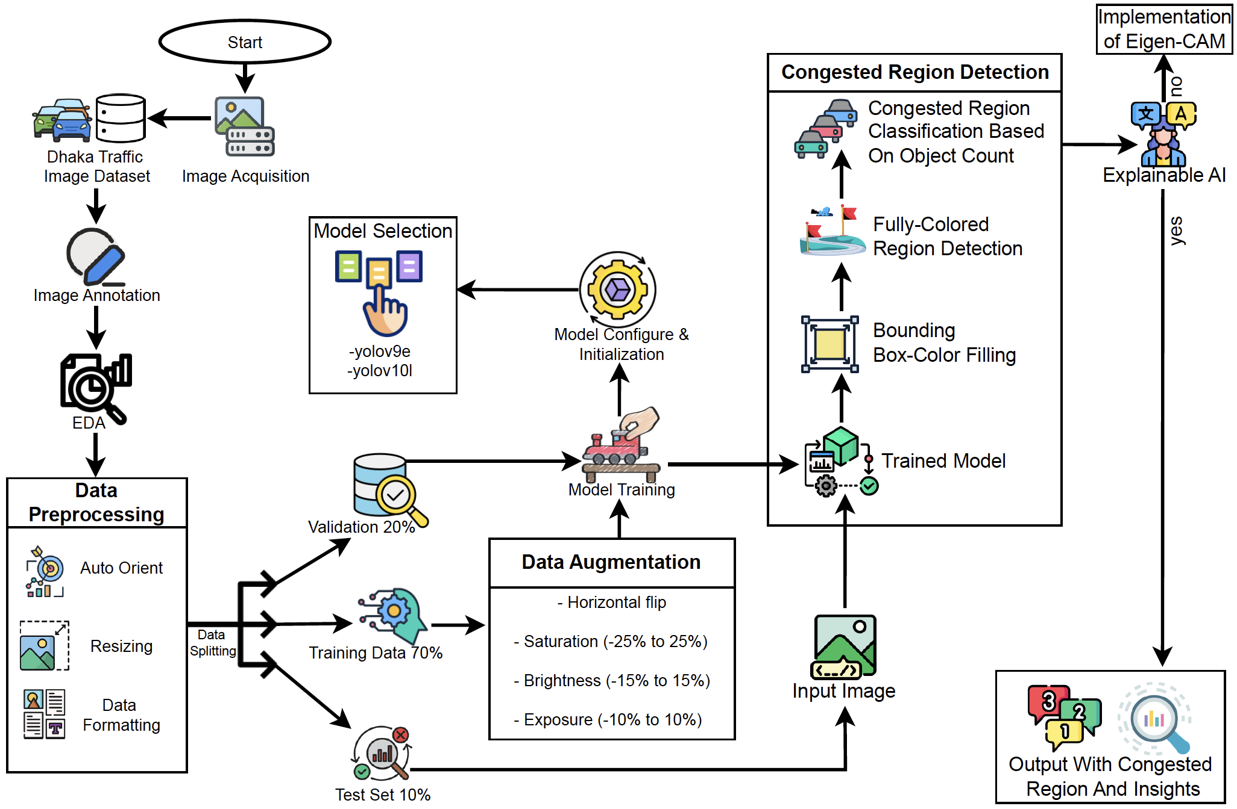
Enhancing Traffic Sign Detection and Voice Assistance in Rural Areas & heavy Traffic Using Deep Learning
BLOCK DIAGRAM

Slide 9
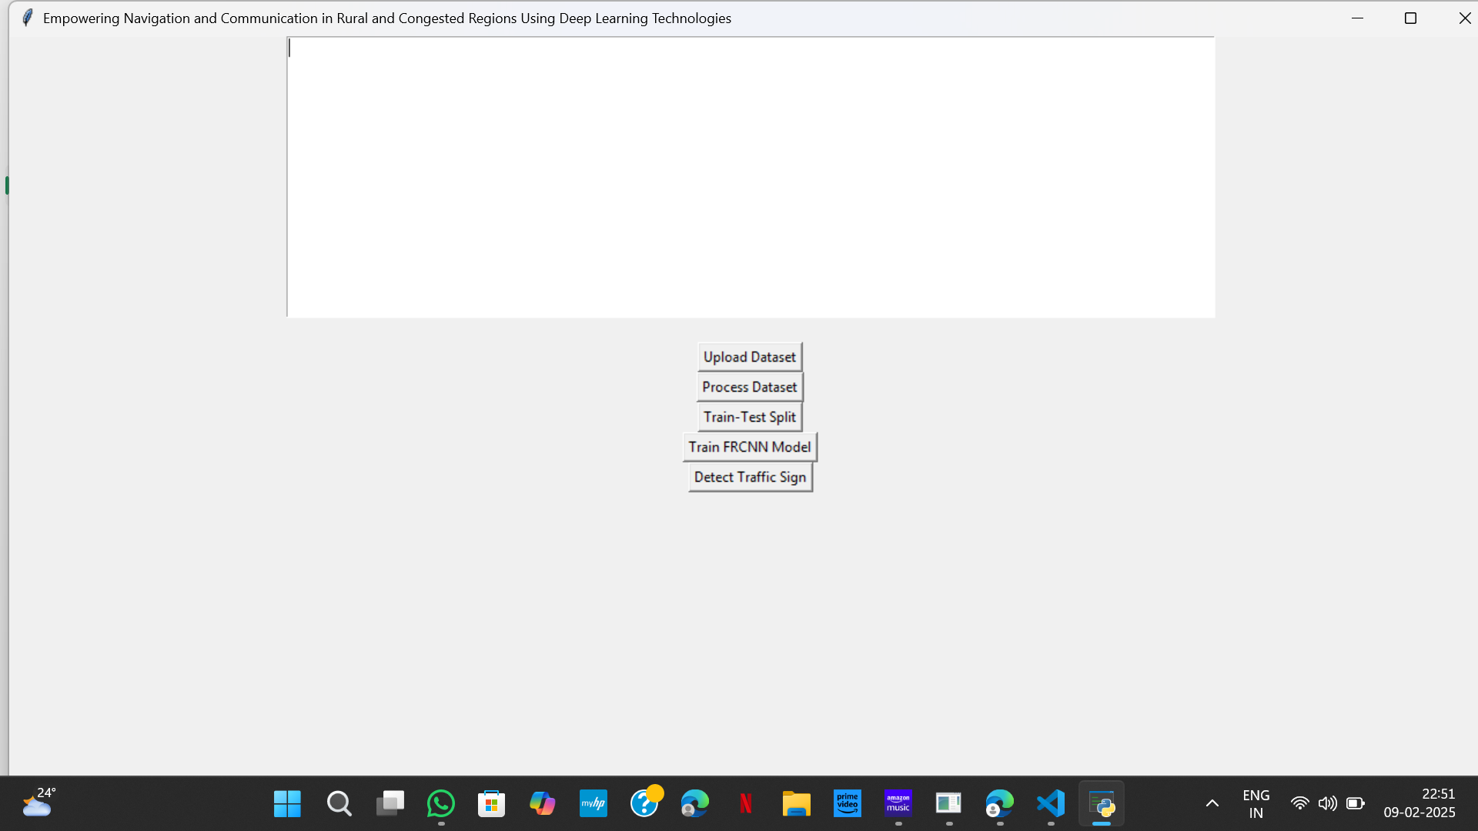
Enhancing Traffic Sign Detection and Voice Assistance in Rural Areas & heavy Traffic Using Deep Learning
RESULT

Slide 10
Enhancing Traffic Sign Detection and Voice Assistance in Rural Areas & heavy Traffic Using Deep Learning
FUTURE SCOPE
Rural Areas: Improve road safety by providing accurate traffic sign detection in less monitored areas.
Heavy Traffic Areas: Assist drivers in navigating through congested traffic with timely voice alerts.
Future Work: Expand the system to include more traffic signs, integrate with autonomous vehicles, and improve voice recognition accuracy.

Slide 11
Enhancing Traffic Sign Detection and Voice Assistance in Rural Areas & heavy Traffic Using Deep Learning
CONCLUSION
The enhanced Traffic Sign Detection and Voice Assistance system using deep learning aims to significantly improve road safety.
Integrates advanced CNN models for accurate traffic sign detection and NLP for real-time voice alerts.
Ensures drivers are well-informed and can react promptly to various traffic situations.
Addresses unique challenges in rural areas, such as the lack of traffic signs, by incorporating alternative solutions like GPS integration, crowdsourced data, and local landmarks.
Extends the utility and effectiveness of the project in diverse environments.
Contributes to the broader goal of creating safer road environments for everyone.

