Slide 1

Enterprise Resource Planning System
Presented By:-
Komalpreet ,
Manpreet Kaur
1632619,1632621
CSE 7th

Slide 2
Content
Introduction To Project.
Objectives of Project.
Existing System.
Proposed System.
Technologies and supported OS used in Project.
Hardware & Software Used.
Modules.
DFD
Snapshots

Slide 3
Introduction to Project
Enterprise Resource Planning System is a web based application . The main objective to develop this project is to create a platform which is student as well as Teacher friendly. This project will not only ease the workload on students but also reduce the burden of Teachers among their students.
Enterprise Resource Planning system is the perfect solution to deal with problems like:
1.Maintaining the Student attendance record.
2.Generating assignments.
3.To keep track on attendance as per Students.
4. To deal with MST’s and a lot more.
This project is one such area of specialization that involves Students and Teachers engaging on the interactive platform for their respective needs for purposes.

Slide 4
Objectives of Project
To provides the facility to the students to keep track on their attendance on regular basis by keeping the entire attendance system online, thus eliminate contradiction.
Our application also has the feature of generating assignments online so that it is being received by each student.
To Share any official information will become be easy through this platform.
This system will provide previous MST’s and Final Exam’s question papers section ally by semester according to respective subject.
Students can easily post their queries and any other student or even Teacher may give the solution etc.

Slide 5
Existing System
At present, there’s no such platform where a student and Teachers can collectively interact other than WhatsApp group (which is considered as a non-formal platform).
There’s no online based system provided by the management that provides a student to keep track on his/her attendance and because of which students suffers through a lot of difficulties complaining about displaying less number of attended lectures than actually attended and thus increases the burden on teachers for the same.
Not only the attendance but there are many hurdles that a student and teachers has to face throughout the session.

Slide 6
Proposed System
This application will provide a common platform (which has not been implemented at present in the organization) collectively to students and teachers to interact on with number of facilities available.

Slide 7
Technologies Used:
HTML: Page layout has been designed in HTML.
CSS: CSS has been used for all the designing part.
JavaScript: All the animations and validation task has been developed by JavaScript.
Python: All the business logic has been implemented in Python.
MySQL: MySQL database has been used as database for the project.
Django: Project has been developed over the Django Framework.

Slide 8
Supported Operating System:
We can configure this project on following operating system.
Windows : This project can easily be configured on windows operating system. For running this project on Windows system, you will have to install Python 3.7,Django .
Linux : We can run this project also on all versions of Linux operating system
Mac : We can also easily configured this project on Mac operating system.

Slide 9
HARDWARE REQUIREMENTS:-
Processor : Intel Dual Core or Higher
RAM : 4 GB or higher
Disk space : 1 GB or higher
SOFTWARE REQUIREMENTS:-
Pycharm
Anaconda
SQLite3
Brackets
Adobe Photoshop , Corel Draw

Slide 10
Modules In The Project:
Admin User
These are the functionality performed by the Admin users:
Login for Admin
Dashboard for Admin user
Add Subjects
Manage Complains
Manage User
Manage Teacher

Slide 11
Modules In The Project:
Student User
Student login
Student Assignment
Student Attendance
Student MST Result
Complain Box
Upload Images
Change password
Teacher User
Teacher login
Manage Assignment
Manage Attendance
Manage MST Result
Change password

Slide 12
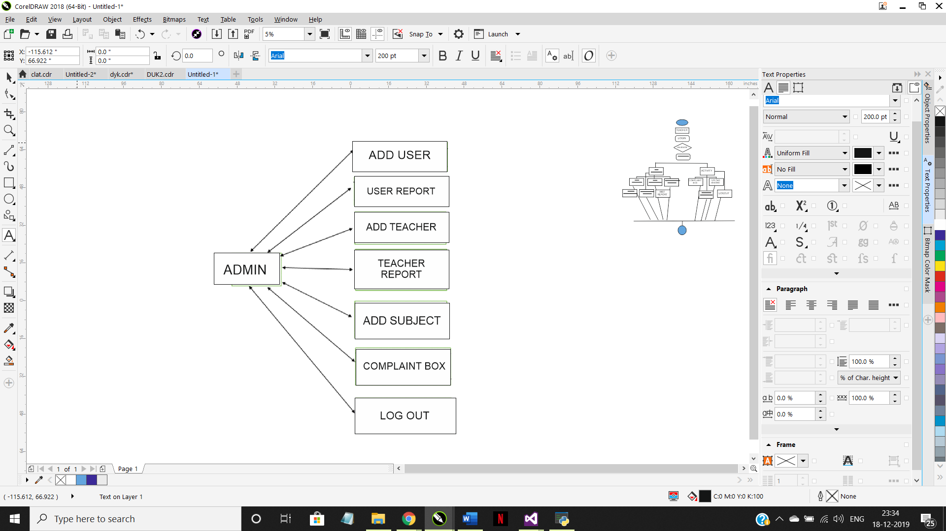
Data Flow diagram(DFD)

Slide 13

Data Flow diagram(DFD)

Slide 14
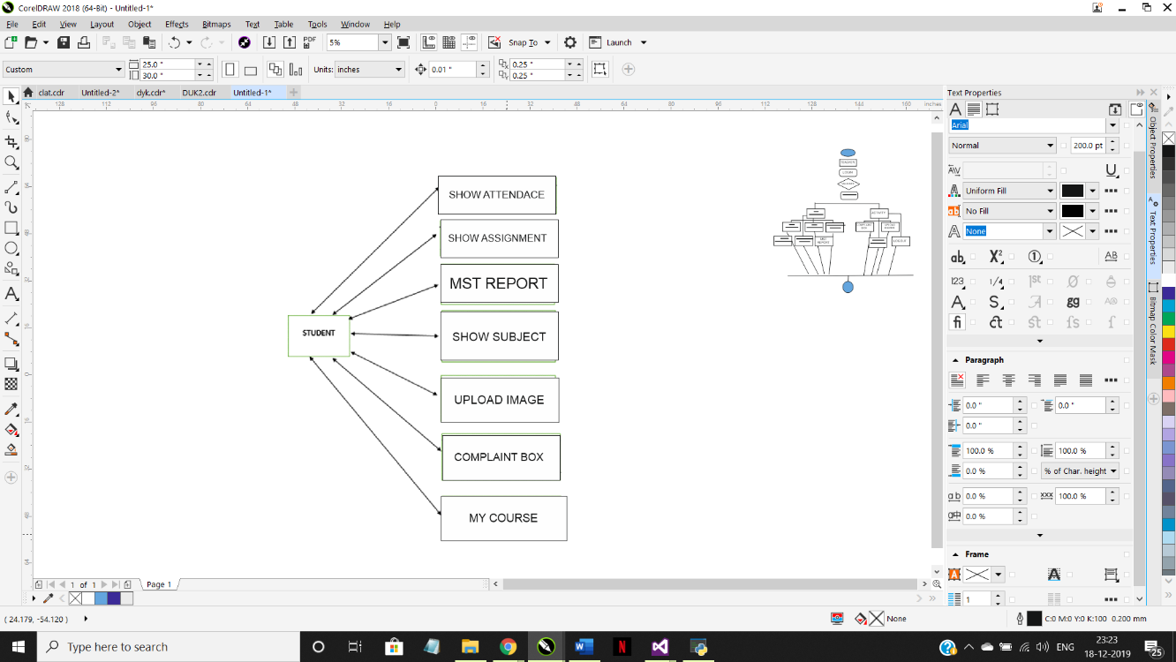
Data Flow diagram(DFD)

Slide 15
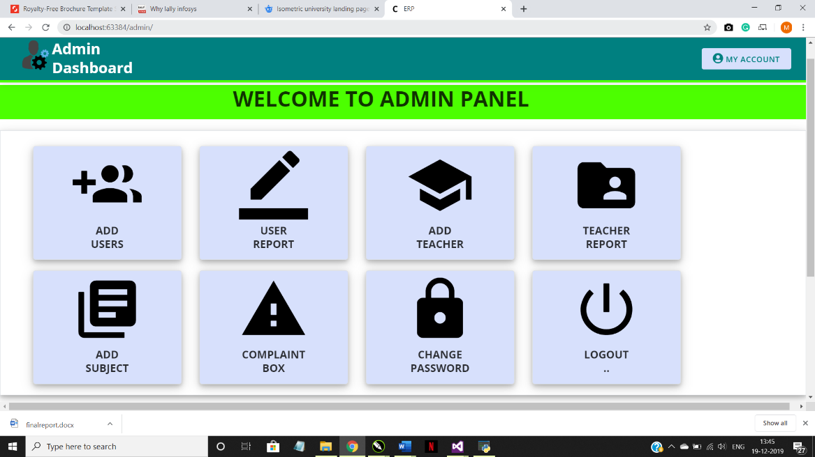
Snapshots
Admin Module:
Homepage:

Slide 16
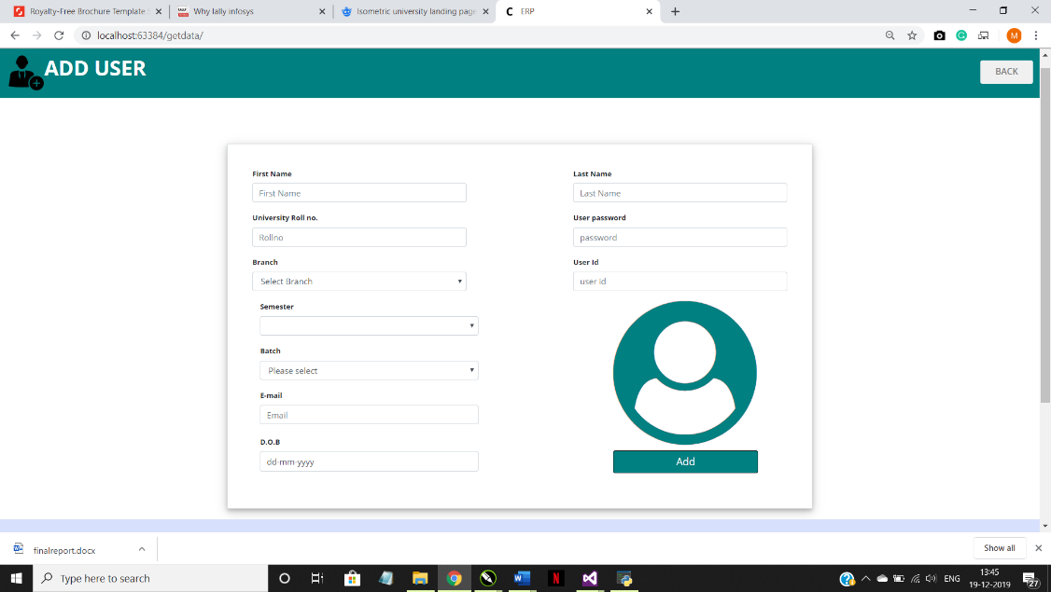
Snapshots
Add User:

Slide 17
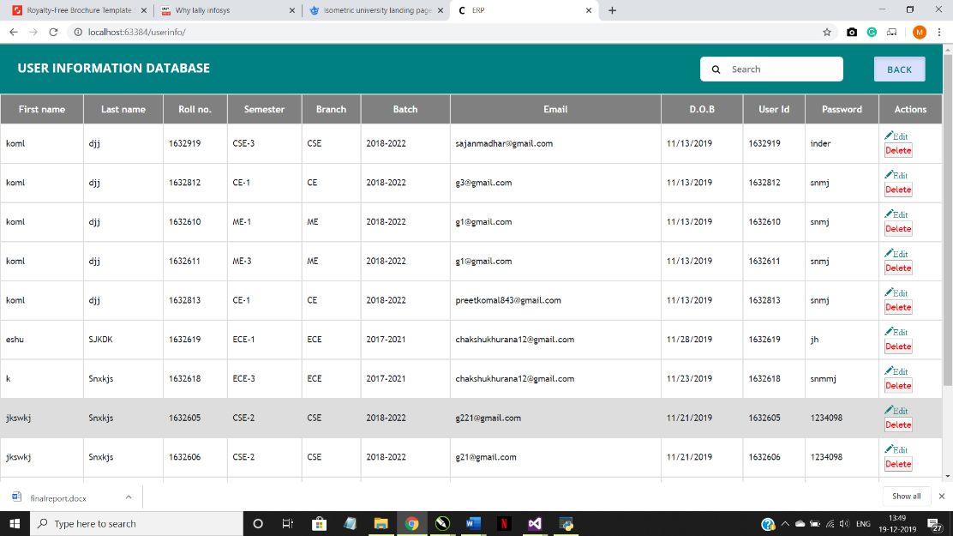
Snapshots
User Report:

Slide 18
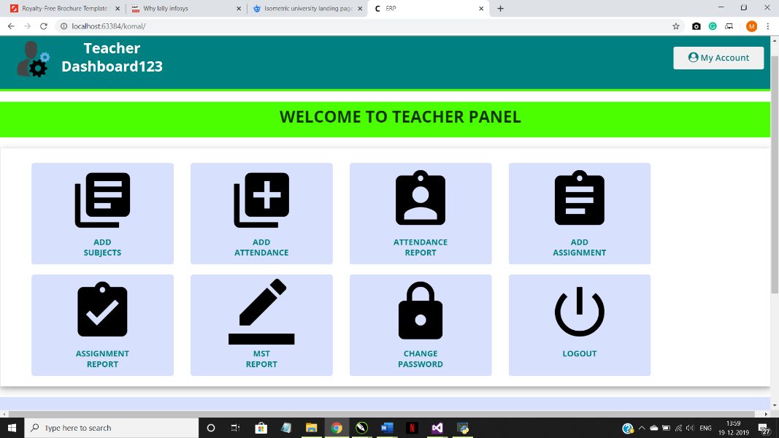
Snapshots
Teacher Module:

Slide 19
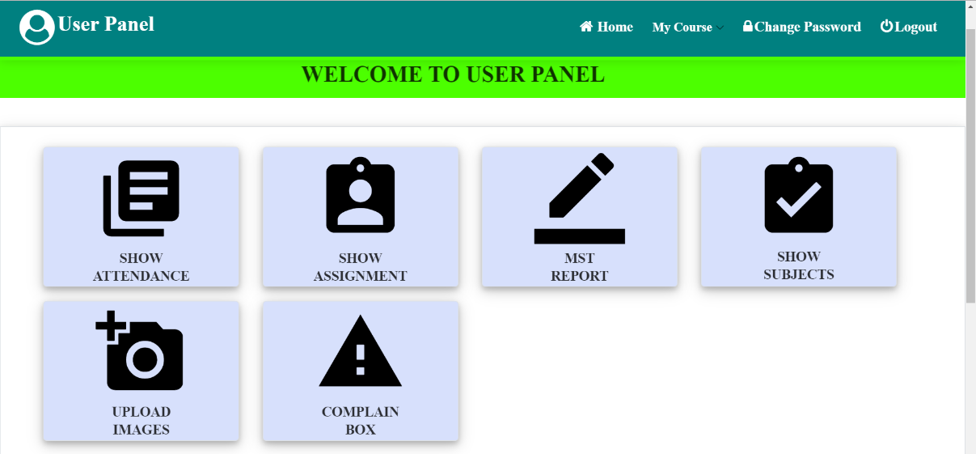
Snapshots
Student Module:

Slide 20
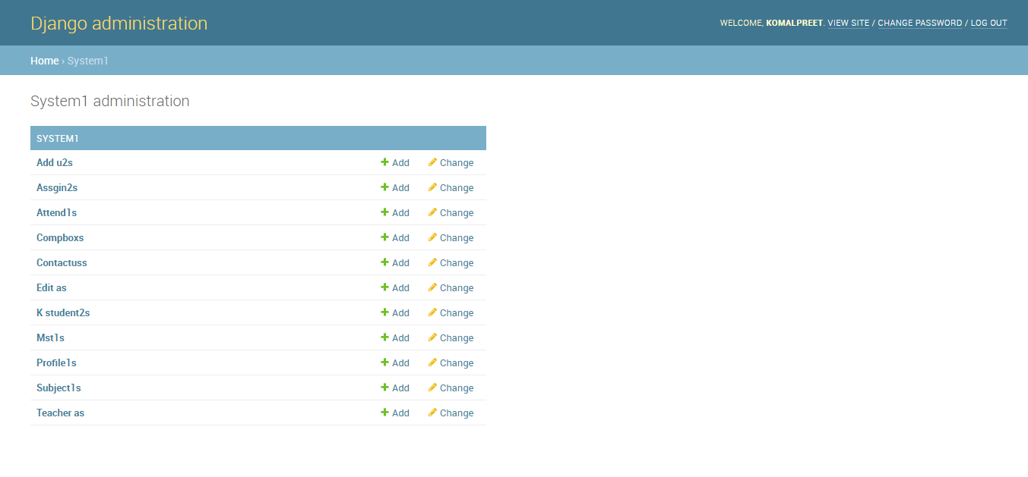
Snapshots
SQLite:

Slide 21
THANK
YOU

