Slide 1



21MAT204 MATHEMATICS FOR INTELLIGENT SYSTEMS-3
FINAL PROJECT PRESENTATION

Slide 2
BATCH-A GROUP-11
Pamidimukkala Sri Sabari Sai Keerthana(CB.EN.U4AIE21038)
Pasumarthy Komal Sai Anurag(CB.EN.U4AIE21039)
Udayagiri Varun(CB.EN.U4AIE21071)
Sejal Singh(CB.EN.U4AIE21061)

Slide 3
KERNEL METHODS AND ITS APPLICATIONS

Slide 4

TABLE OF CONTENTS
1
INTRODUCTION TO KERNEL METHODS
2
TYPES OF KERNEL METHODS AND ITS IMPLEMENTATION
3
APPLICATIONS OF KERNEL METHODS

Slide 5


1
INTRODUCTION

Slide 6
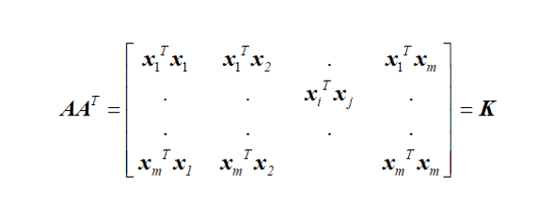
Kernel methods are a class of algorithms used in machine learning and pattern recognition.
They operate by mapping the input data into a high-dimensional feature space, where it becomes linearly separable.
Let us know about few important terms regarding the kernels:
1.Kernel function
2. Kernel Space
3.Hyper plane

Slide 7
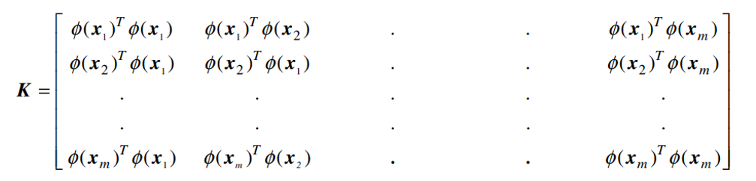
In terms of Non-Linear data
In order for a non-linear decision surface to turn into a linear equation in a higher number of dimension spaces, Kernel Function often changes the training set of data.
φ (.) x A non-linear mapping function that maps input vector x into a high dimensional feature vector
Each data point x; can be mapped into a higher-dimensional space using the function φ(.), and the maximum separating hyperplane in that space can then be used as a classifier

Slide 8
2
TYPES OF KERNEL METHODS

Slide 9
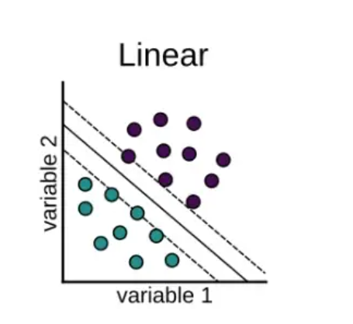
Linear Kernel
When the data can be split using a single line, or when it is linearly separable, a linear kernel is utilised
The linear kernel is good when there is a lot of features.
If there are two kernels named x1 and x2, the linear kernel can be defined by the dot product of the two vectors:
K(x1, x2) = x1 . x2

Slide 10
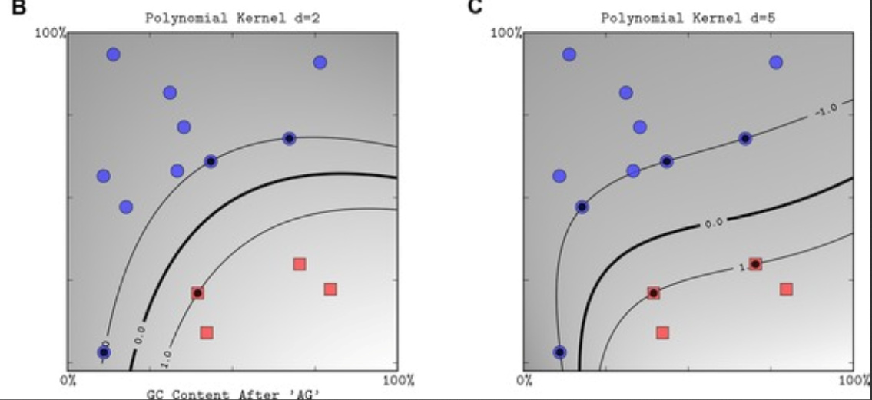
Polynomial Kernel
The polynomial kernel, a kernel function in machine learning that is frequently used with support vector machines (SVMs) , represents the similarity of vectors (training samples) in a feature space over polynomials of the original variables, enabling the learning of non-linear models
K(x₁, x₂) = (x₁ . x₂ + c)^{d}

Slide 11

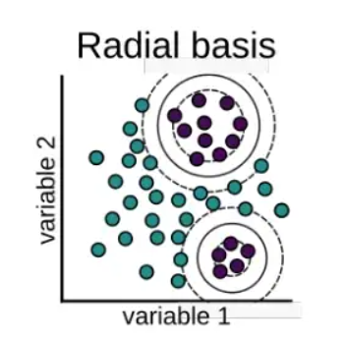
RBF Kernel
A RBF (Radial Basis Function) kernel is employed in place of the conventional linear kernel
It presumes that the boundaries between the various classes are linear and are defined by a straight line

Slide 12
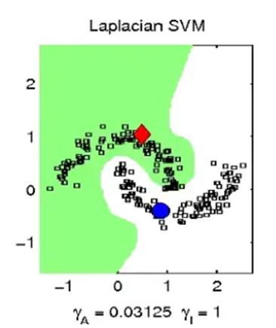
Laplacian Kernel
A kernel function utilised in many machine learning techniques, including support vector machines (SVMs) and Gaussian processes, is the Laplace kernel
K(x,y) =exp(-||x-y||/σ)

Slide 13
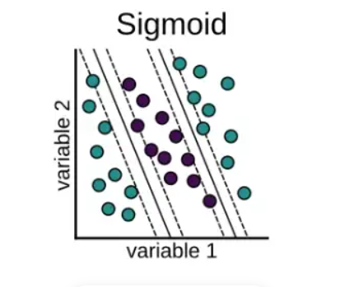
Sigmoid Kernel
The sigmoid kernel, is utilised in neural networks and support vector machines (SVMs), among other machine learning algorithms
K(x,y) =tanh(k(xy)+c)

Slide 14
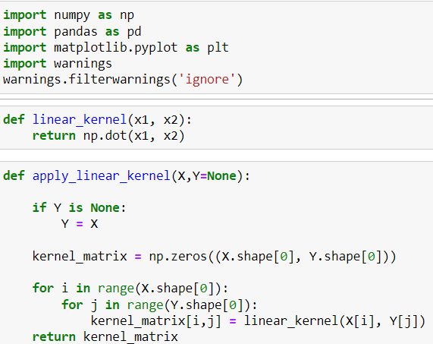
IMPLEMENTATION OF LINEAR KERNEL

Slide 15
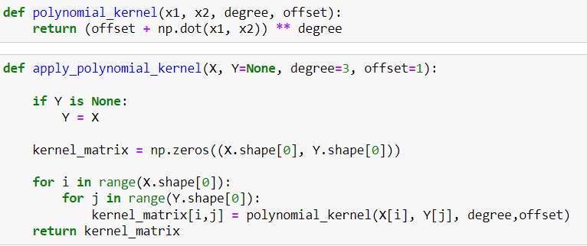
IMPLEMENTATION OF POLYNOMIAL KERNEL

Slide 16
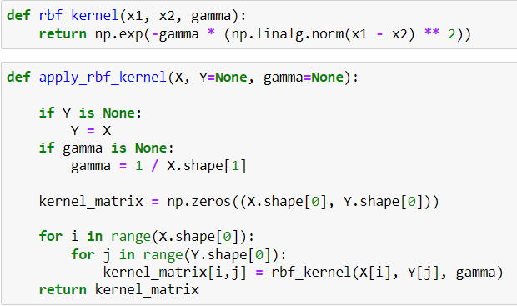
IMPLEMENTATION OF RBF KERNEL

Slide 17
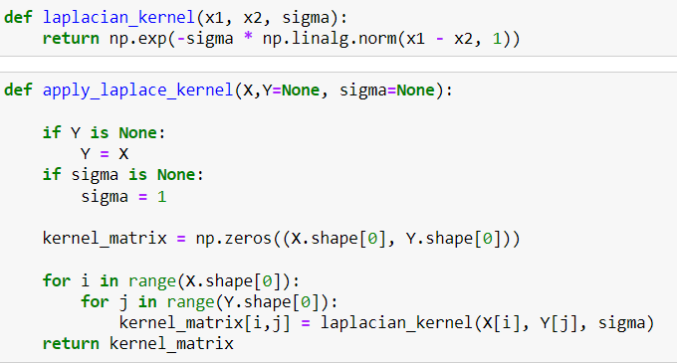
IMPLEMENTATION OF LAPLACE KERNEL

Slide 18
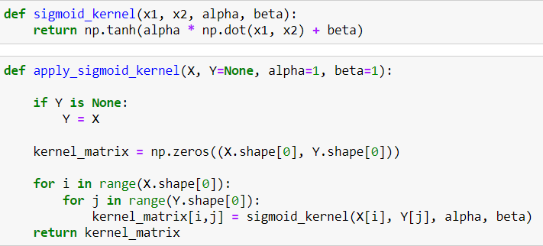
IMPLEMENTATION OF SIGMOID KERNEL

Slide 19
3
APPLICATIONS OF KERNEL

Slide 20
Kernel application in SVM
Kernel methods are particularly useful in classifying non-linear data because they allow for the separation of non-linearly separable data in a high-dimensional feature space.
One common application of kernel methods is in support vector machines (SVMs), which are a type of supervised learning algorithm used for classification.
SVMs use a kernel function to map the input data into a higher-dimensional feature space, where a linear boundary can be found to separate the classes.
By choosing a suitable kernel function, it is possible to classify non-linearly separable data with high accuracy.

Slide 21
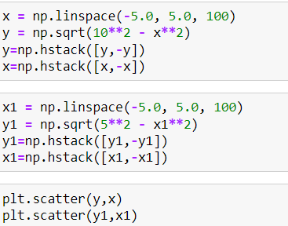
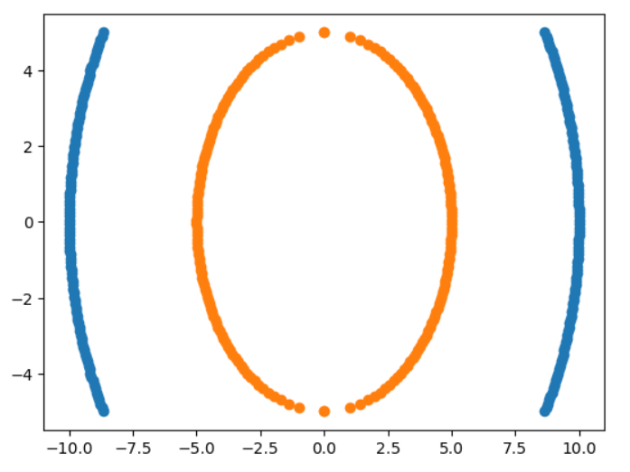
CODE IMPLEMENTATION
Creating a non-linearly separable dataset:

Slide 22
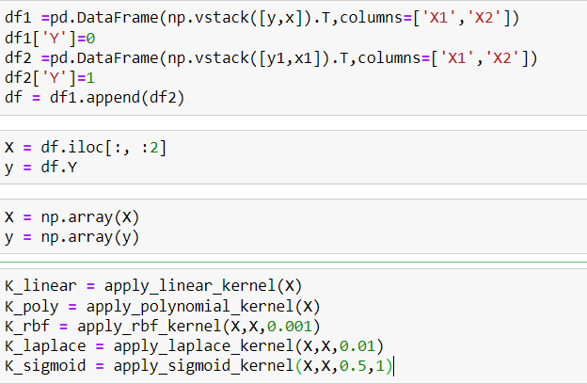
CODE IMPLEMENTATION

Slide 23
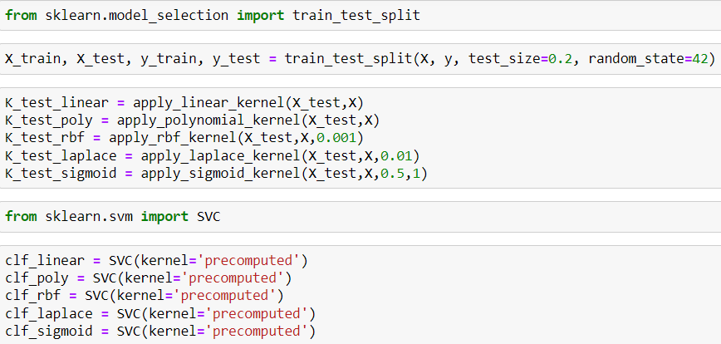
CODE IMPLEMENTATION

Slide 24
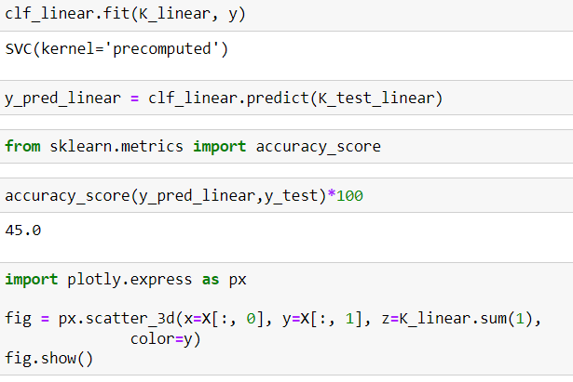
IMPLEMENTATION USING LINEAR KERNEL:

Slide 25
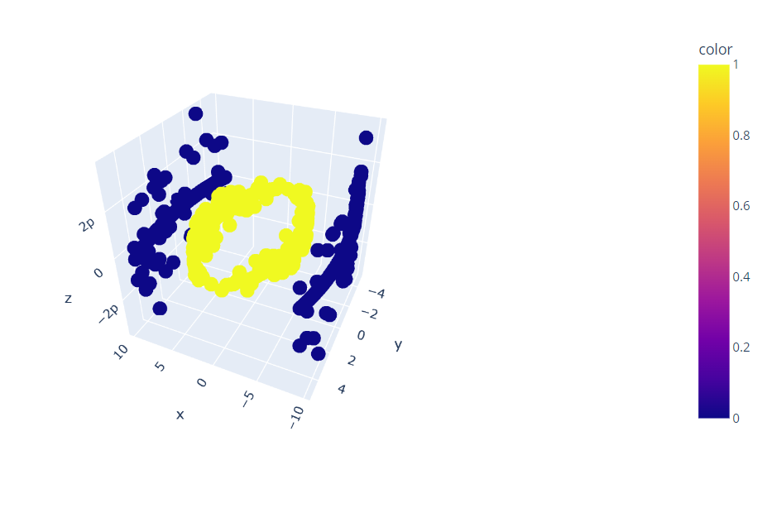
3D VISUALISATION

Slide 26
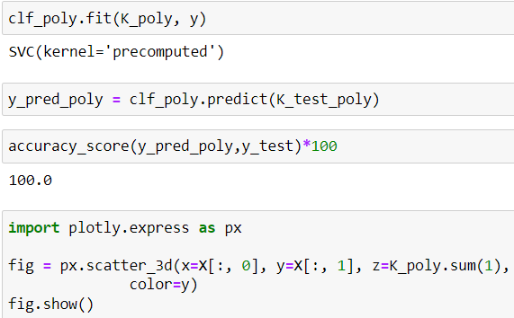
IMPLEMENTATION USING POLYNOMIAL KERNEL

Slide 27
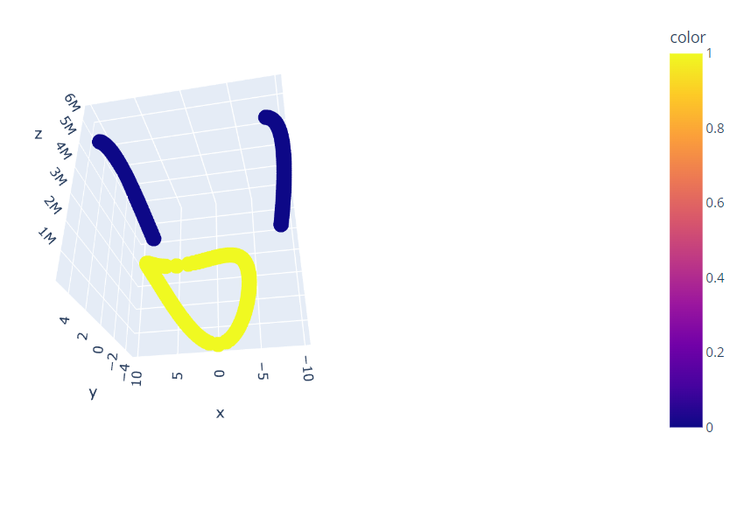
3D VISUALISATION

Slide 28
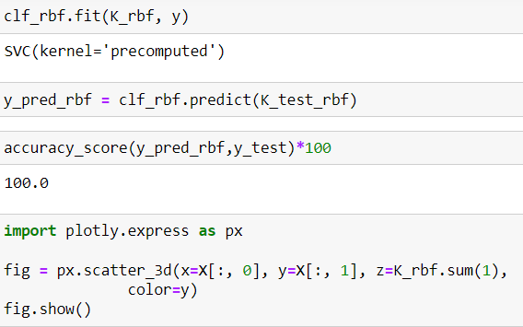
Classification using RBF kernels

Slide 29
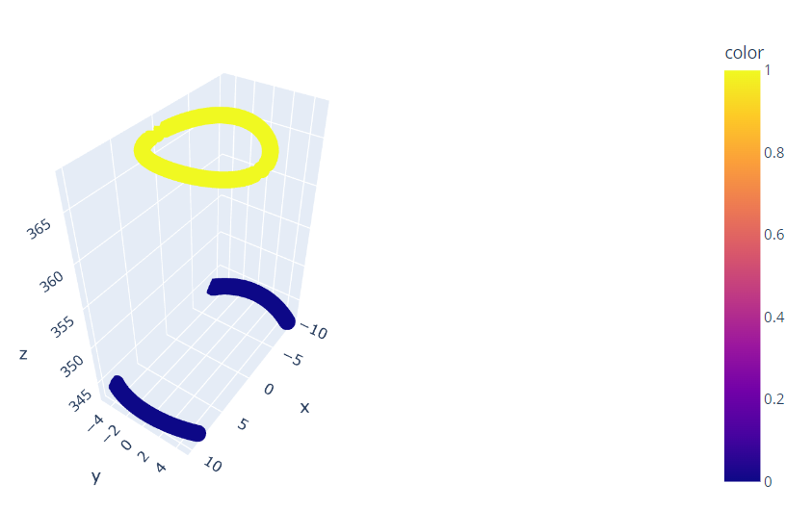
3D VISUALISATION

Slide 30
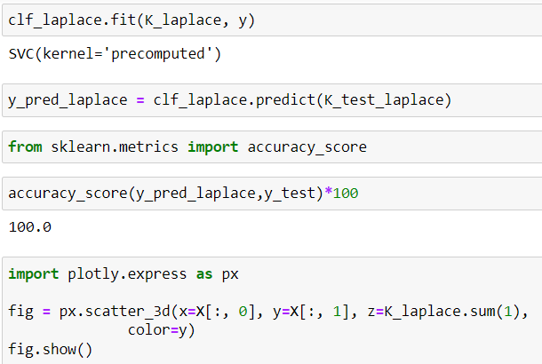
Classification using Laplace kernel

Slide 31
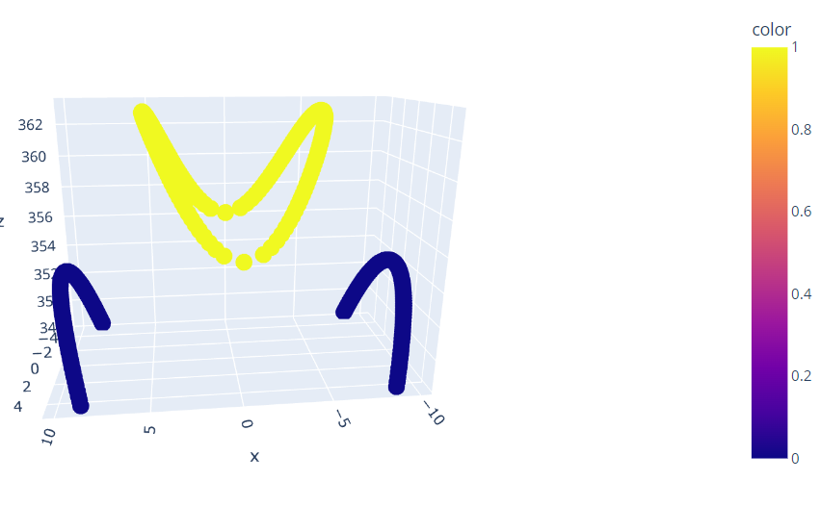
3D VISUALISATION

Slide 32
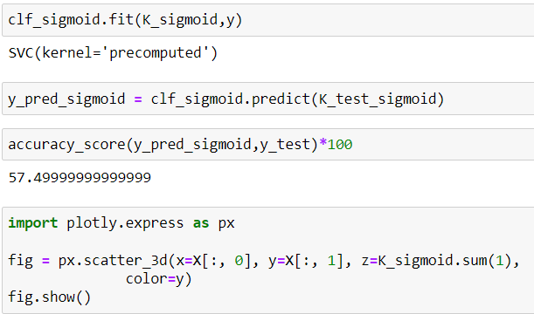
Classification using Sigmoid Kernel

Slide 33
CODE IMPLEMENTATION

Slide 34
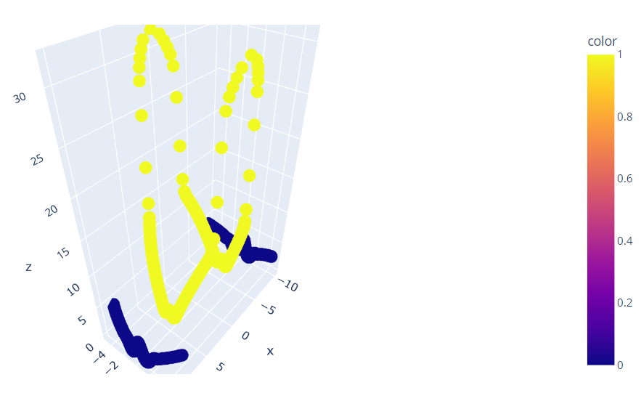
CODE IMPLEMENTATION

Slide 35
APPLICATION OF KERNELS IN PCA
Principal Components Analysis is arguably one of the most important algorithms used in data preprocessing for dimensionality reduction, in a large number of applications
Kernel PCA was developed in an effort to help with the classification of data whose decision boundaries are described by non-linear function
The eigenvalues and eigenvectors of the kernel matrix and these are the new principal components of the m-dimensional space where we mapped our original variables into.
The kernel trick is called this way because the kernel function (matrix) enables us to get to the eigenvalues and eigenvector without actually calculating ϕ(x) explicitly.

Slide 36
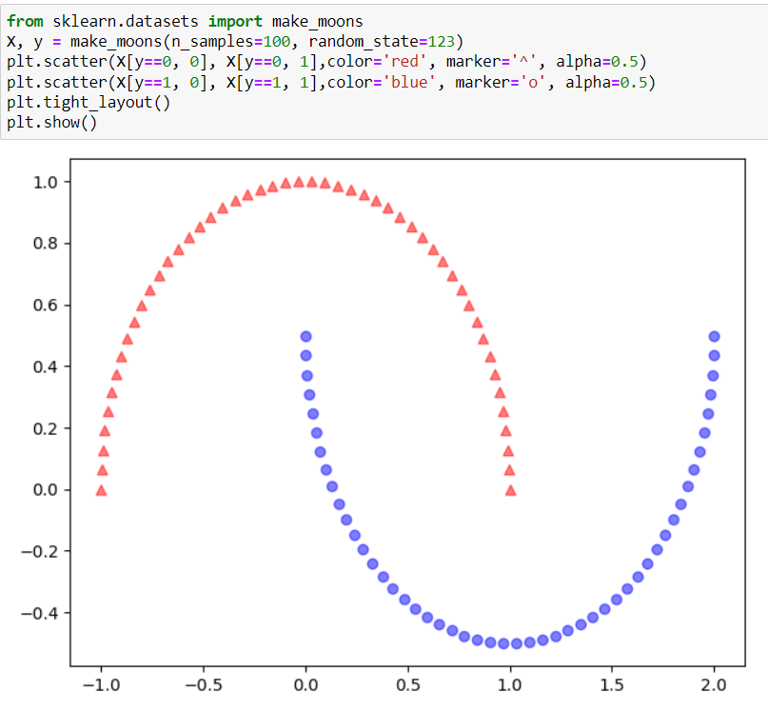
CODE IMPLEMENTATION

Slide 37
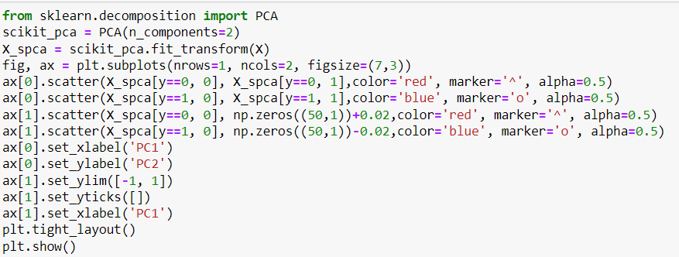
CODE IMPLEMENTATION

Slide 38
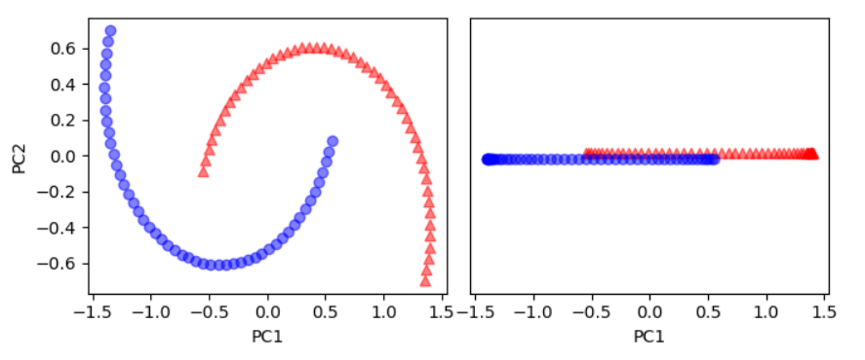
CODE IMPLEMENTATION

Slide 39
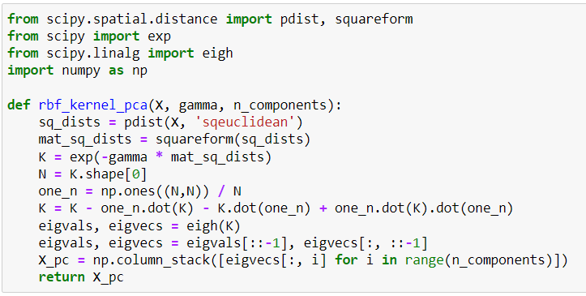
CODE IMPLEMENTATION

Slide 40
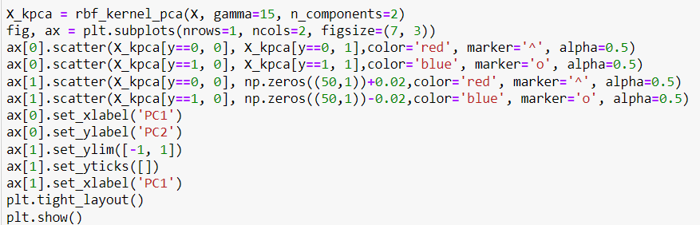
CODE IMPLEMENTATION

Slide 41
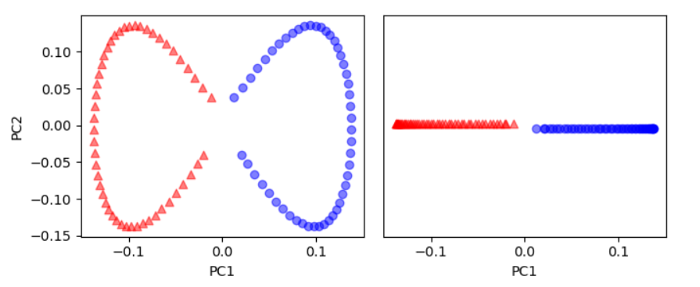
CODE IMPLEMENTATION

Slide 42


CONCLUSION

Slide 43
The task of kernel functions, is to project the data into an higher dimensionally plane and make the data linearly separable for classification.
Classifying them and using that data in the machine learning models, deep learning models and dimensionality reduction etc.,
In SVM
In PCA
Kernel function that it helps us in mapping the data into a higher dimensional plane.

Slide 44
THANK YOU
SPECIAL THANKS TO
Dr. Neethu Mohan mam for the guidance and the information provided for the project

