Slide 1


Slide 2

BIG ADS
(Advertising portal)
By:

Slide 3
INTRODUCTION
Big ads is the advertising company for Hubli-Dharwad people.
They provide the packages according to needs of the customers
such as - Advertisement in portal
- Advertisement via sms
- Advertise via paper/magazine
Customer details can be updated instantly.

Slide 4

Objective
To provide an dynamic website and web application to our client. This system provides a portal for the advertisement of the client data, based on their requirement and highlight the citizens regarding different services available in their city and also provides to maintain their basic activities such as client details maintenance, sms account management and evenly placing of the advertisement according to the client needs.

Slide 5

EXISTING SYSTEM
Presently they have services in Goa. Where they are advertising by the name goabigads.com, but that website is not dynamic in nature and also they are using printing media, so they are planning to design an application which should be user friendly to support all their functionalities for Hubli-Dharwad portal.

Slide 6
PROPOSED SYSTEM
We have developed portal which is dynamic.
We have provided an option for customer register through our portal.
It provides options to add data of the customer in different categories.
Packages and their notification will be sent via sms to the clients when payments are done.
Visting places of the city will be displayed.

Slide 7
MODULES
Advertisement
Billing
Customer management
Sms management

Slide 8
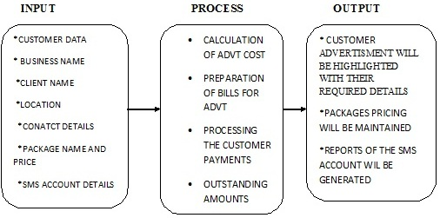
PROCESS LOGIC

Slide 9
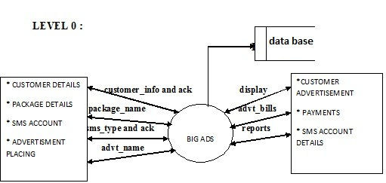
LEVEL 0

Slide 10
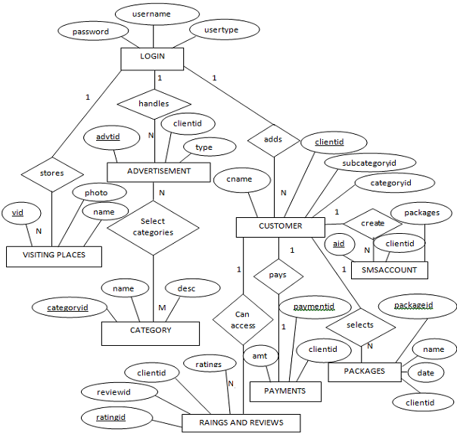
E-R DIAGRAM

Slide 11
TOOL/PLATFORM FOR LANGUAGE TO BE USED
HARDWARE REQUIREMENT
Processor: Pentium III and above
Hard disk: 40 GB and above
Ram: 512mb or 1GB and above
SOFTWARE REQUIREMENT
Operating system: windowsxp/ windows7/windows 8.1
Front end: html,css,dreamviewer
Backend: mysql
Platform/middleware: php
Web server: wampserver

Slide 12
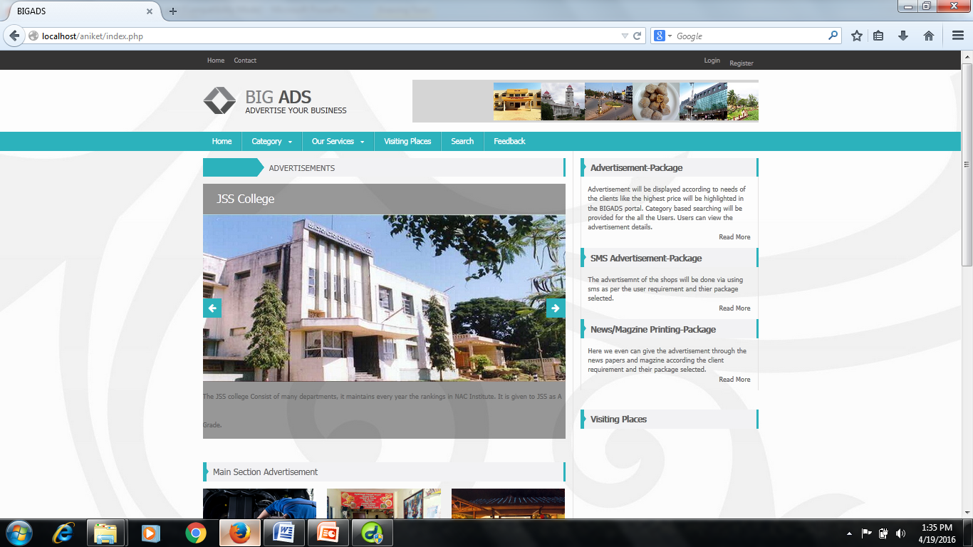
SCREEN SHOTS
HOME PAGE

Slide 13
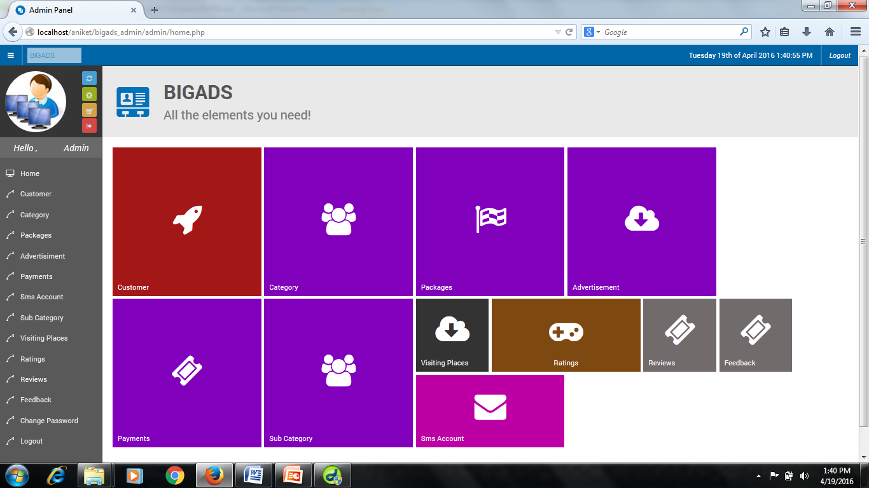
ADMIN PAGE

Slide 14
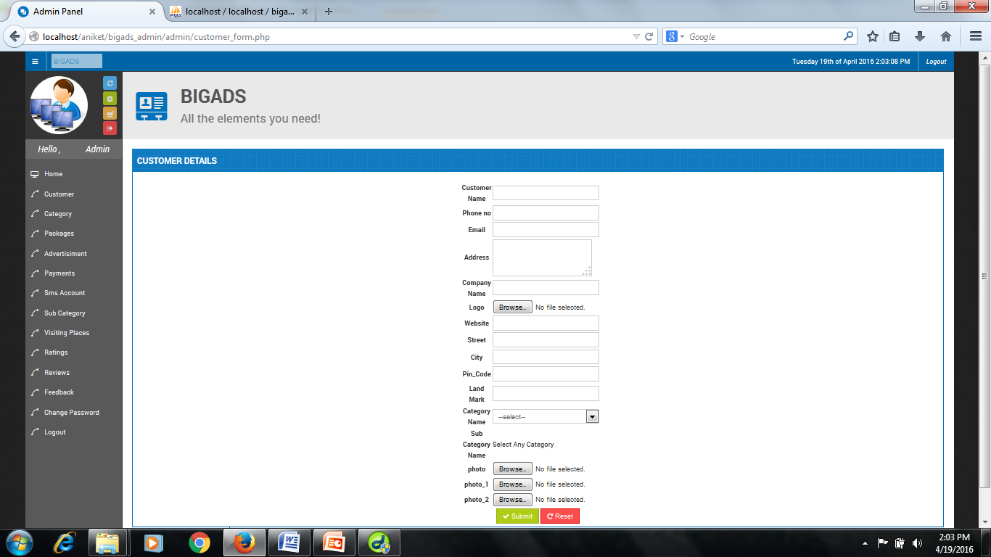
FORM PAGE

Slide 15
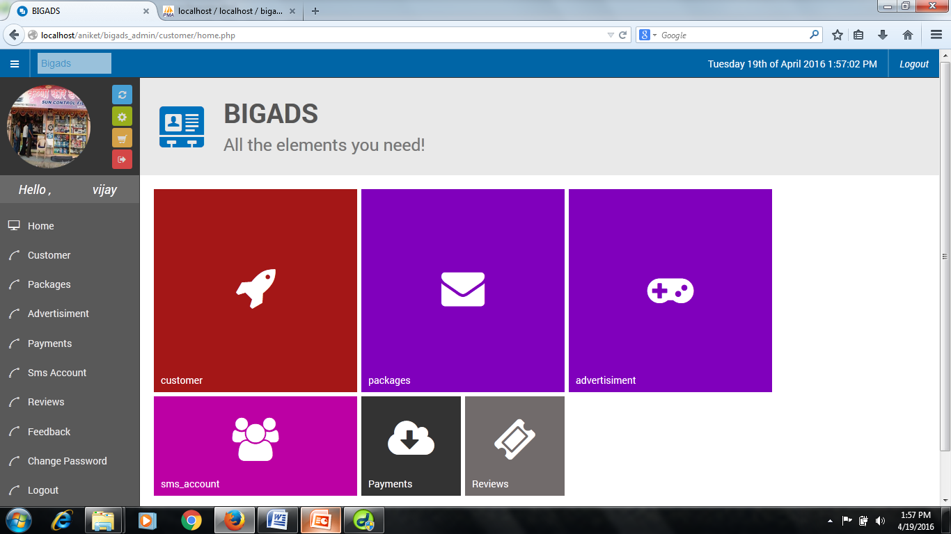
CUSTOMER PAGE

Slide 16
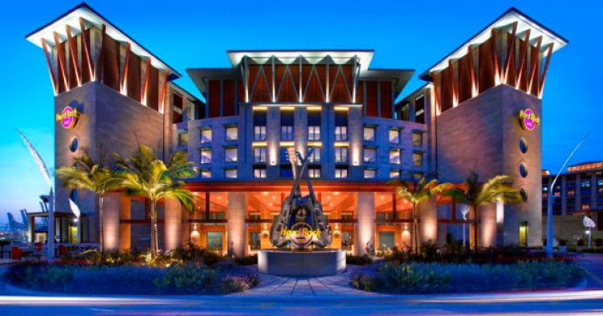

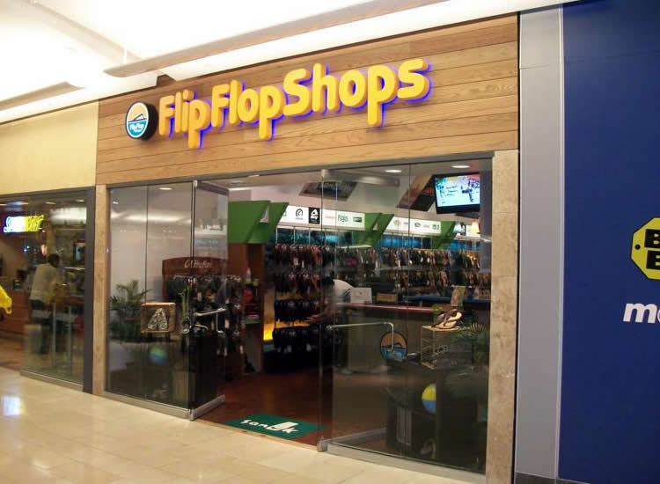

Sample output
Categories
Hotels Shops | Hospitals schools

Slide 17
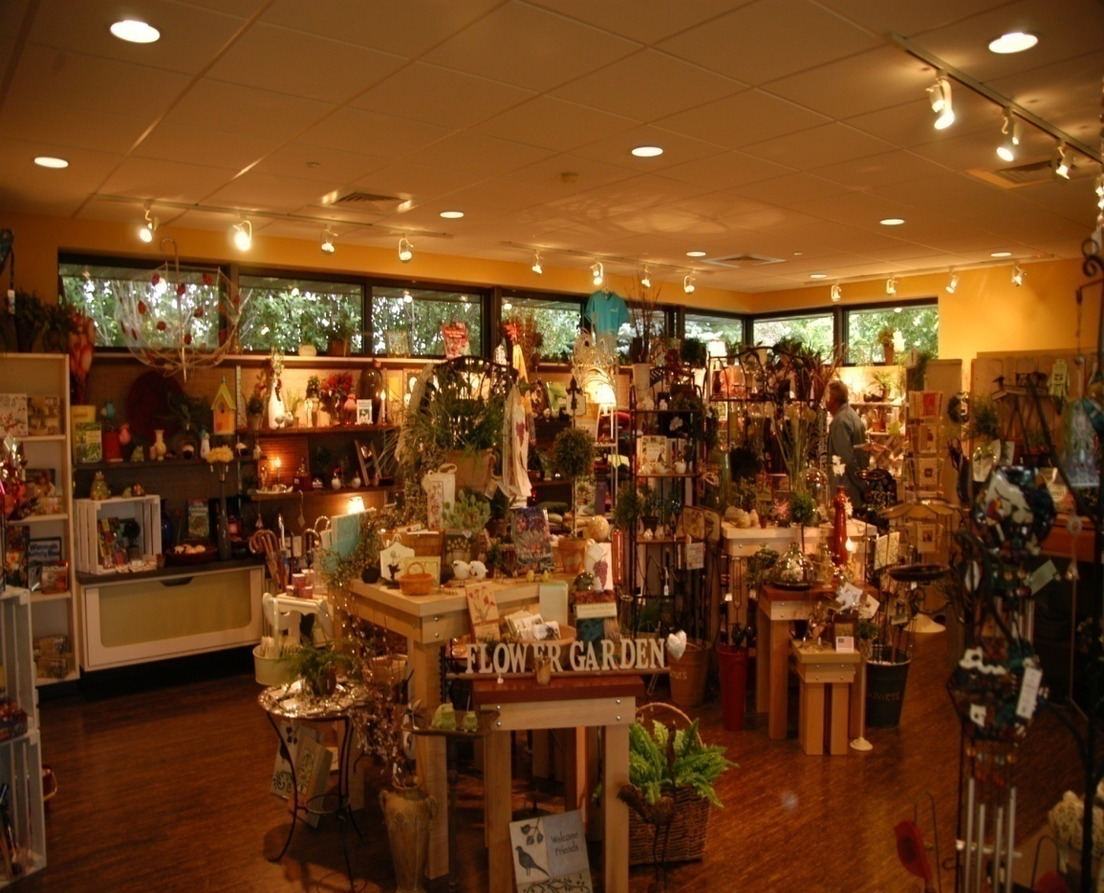
Shops
Ganesh books shop
paradise gift center
Guru sports shop
Samsung café

Slide 18
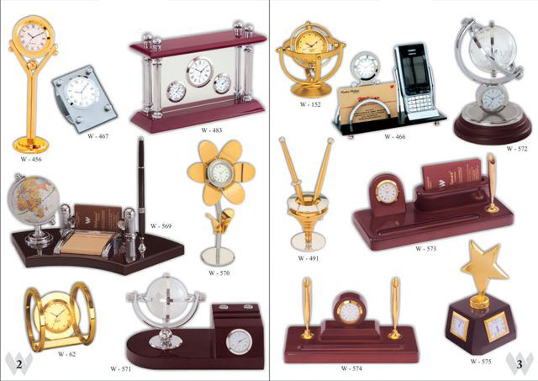
Paradise gift center
*Products available
*Contact details
ph no:8888888888 email:paradise@gmail.com

Slide 19
LIMITATION OF THE PROJECT
This portal cannot be used offline
Details of the account will be managed but not the sms procedures.
Limited to only hubli-dharwad customers.

Slide 20
SCOPE OR FUTURE APPLICATION
Android and IOS application can be developed in this.
Online payment gateway can be included.
It helps to overcome the problems which would be occurred in the advertising media .
This system can be extended to many users as the user needs.

Slide 21
Thank you

