Slide 1

News-Corner
A React Application
By Sanket Sonowal
This Photo by Unknown author is licensed under CC BY.

Slide 2

News-Corner
News-Corner is a news website that provides popular news from all around the world at one place.
It fetches news from Webhose using the "Enriched News" API for providing the most relevant news data from the top 50,000+ global news sources.

Slide 3
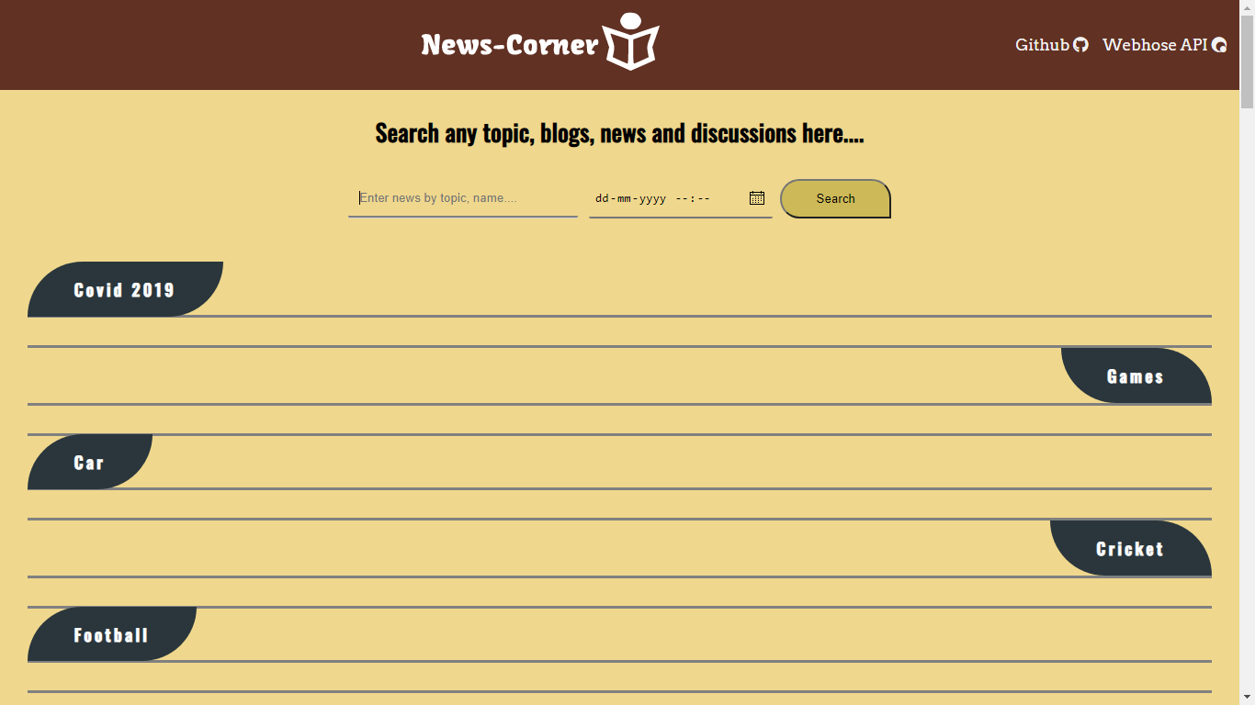
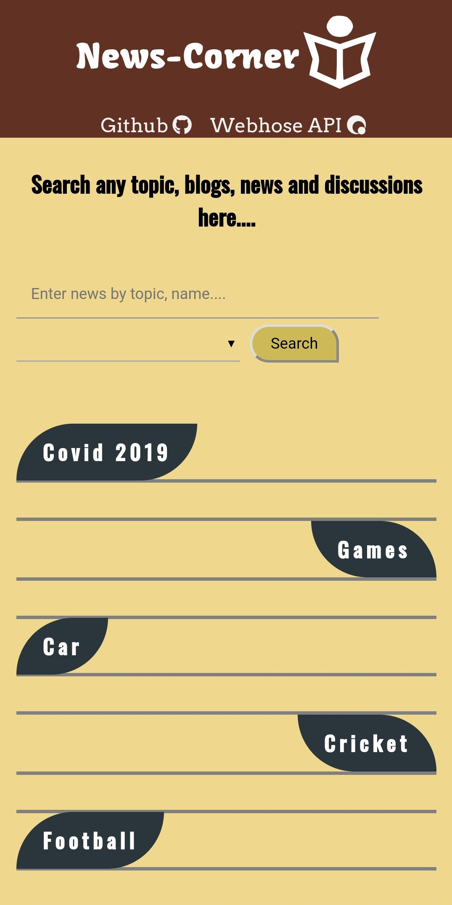
Website Structure
Desktop Website
Mobile Website

Slide 4


Header Section
This section is the main navigation bar which includes:
"News-Corner" main website logo
Webhose API link (Documentation)
GitHub Repository link (Source Code)

Slide 5
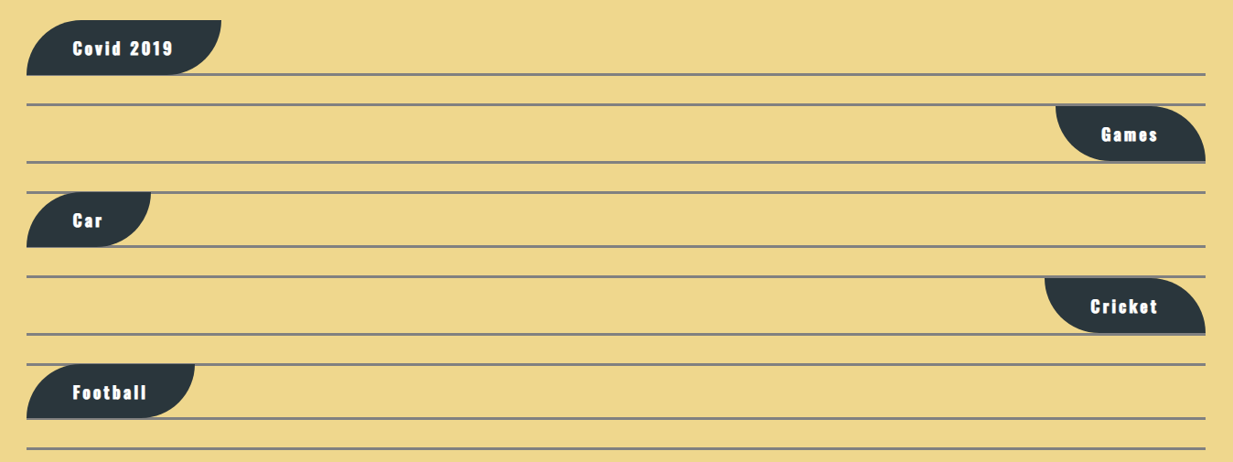
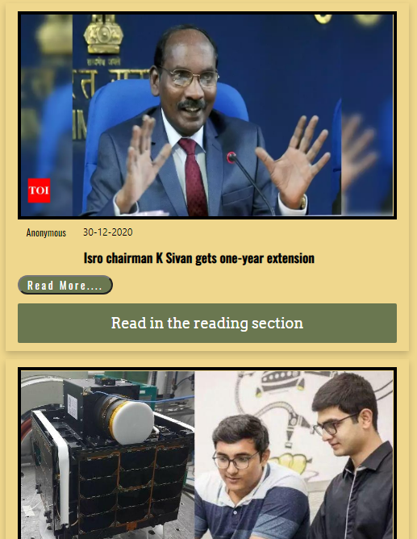

Body Section
This section is divided into three parts:
Search Section
Recent News Section
Search Result Section

Slide 6
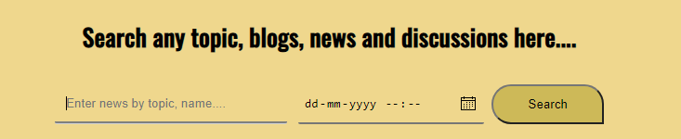
Search Section
This section takes input as query from user and searches news based on the query. Under this section:
Input Search Field
Datetime Selector
Search Button

Slide 7
Recent News Section
This section displays the recent news based on the predefined topics:
COVID-2019
Games
Car
Cricket
Football

Slide 8
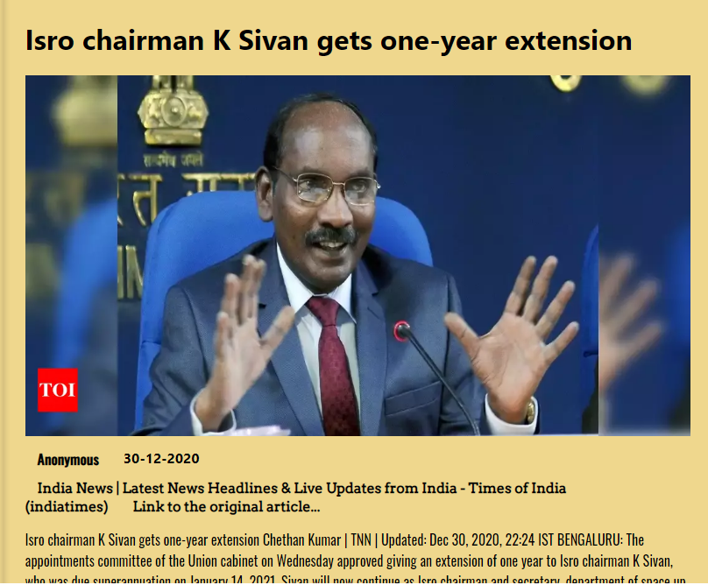
Search Result Section
This section displays result news which is returned from the user's search query. This section is divided into:
Result Section
Reading Section

Slide 9

Footer Section
This section contains some information about the website, rights etc.

Slide 10



Flow of the Website (with Code)
Search Query by user
Search Result

Slide 11
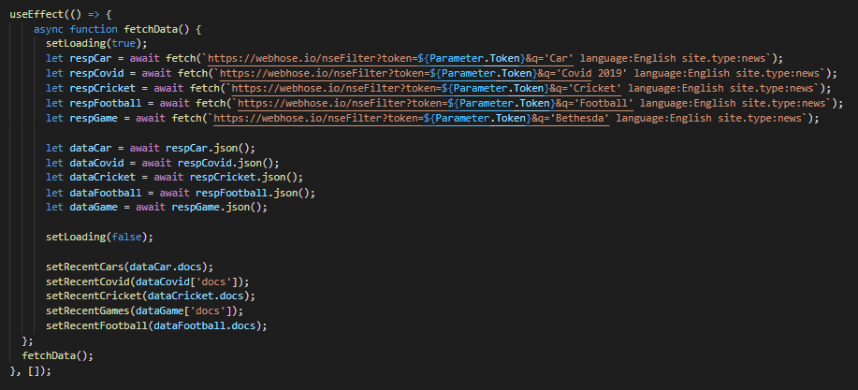
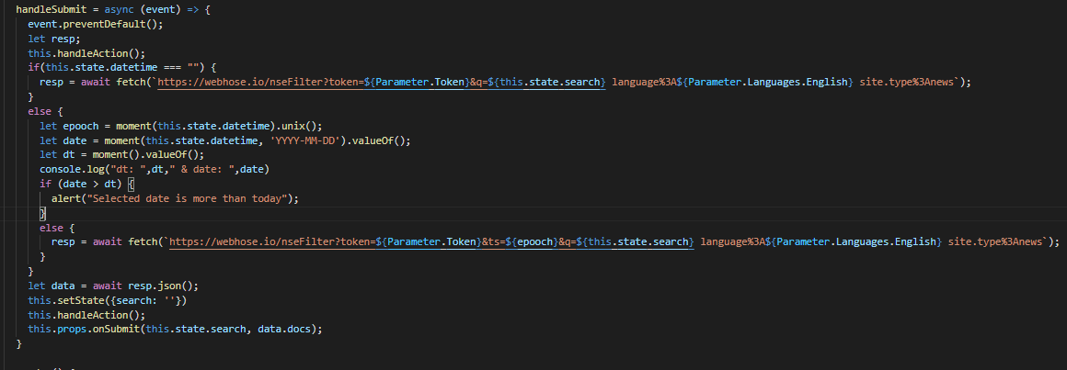
Major Flow of data on the website
Recent News based on the predefined topics
News returned from the user search query

Slide 12
Recent News based on the predefined topics
The code contains both presentational as well as container components.
The components are like this:
Container component
RecentList
Presentational component
RecentContainer
RecentCard
Recent List
This function fetches data every time the page loads with pre-filled URL.
Recent Container
This function receives data from the RecentList component and divides it into different array based on the topic.
Recent Card
This function receives data from the RecentContiainer and displays it as a list of cards

Slide 13
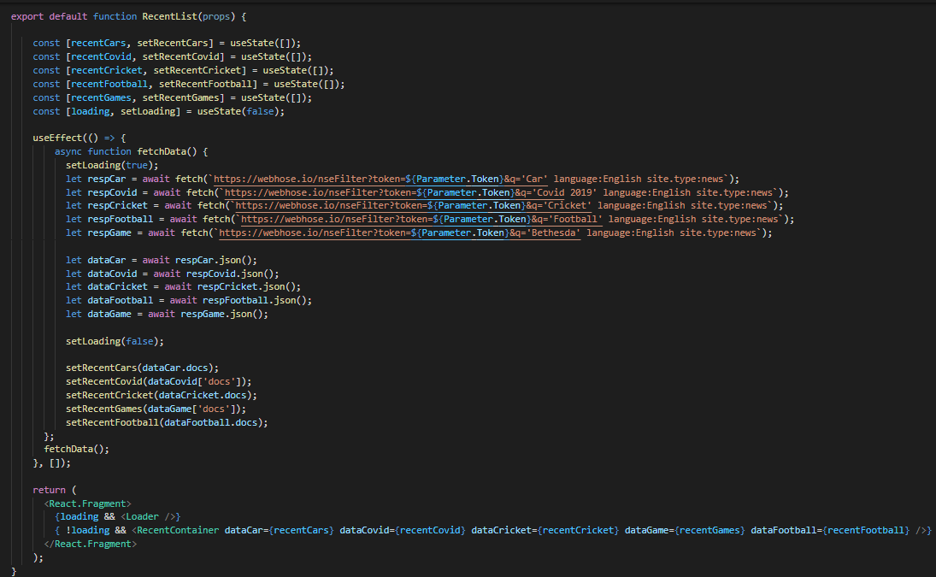
Recent List
Recent List is a container component that responsible for fetching data from pre-filled URL and converting the response in JSON format and then passing the response to Recent Container for display.

Slide 14
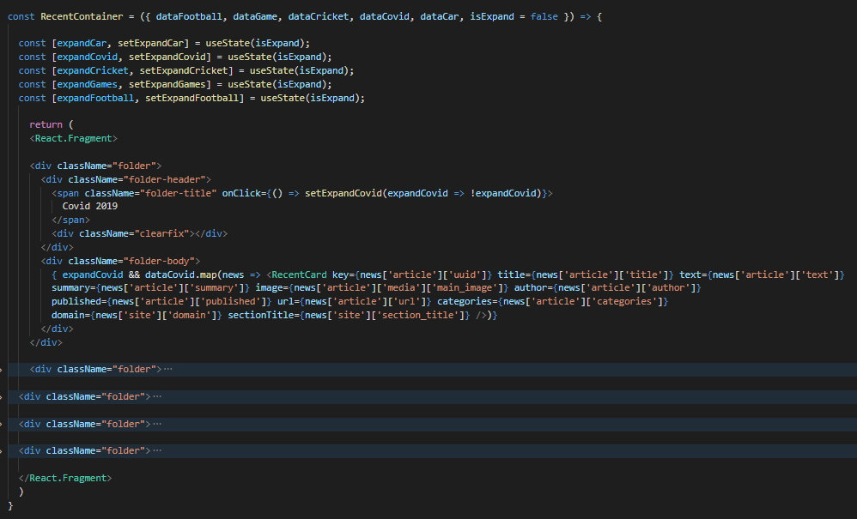
Recent Container
Recent Container is a presentational component that is responsible for filter data into respective groups aka topics received from the Recent List component and passed it on to the Recent Card component for display.

Slide 15
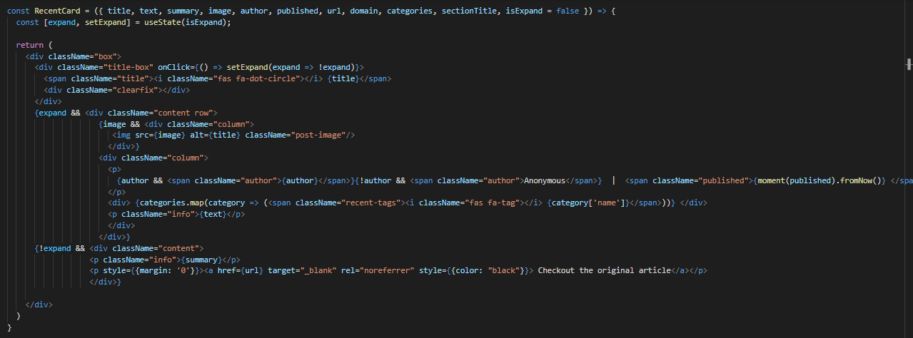
Recent Card
Recent Card is a presentational component that is responsible for displaying data in a structure format to user just like a news article. It has two phases:
Title + Summary: Responsible for providing a gist of the article.
Title + Detailed Text: Responsible for providing a complete detail about the article.

Slide 16
News returned from the user search query
The code is divided into presentational and container components.
The components are like this:
Container component
SearchFeed
Presentational component
NewsList
NewsContainer
NewsCard
ReadingSection
Search Feed
This class takes query from the user, append it in the URL and fetches data.
News List
This function receives data from Search Feed.
News Container
This function receives data from News List.
News Card
Reading Section
It is divided into 2 parts i.e., News Card and Reading Section.
This function receives data from News Container and displays it in a list of cards.
This function displays data based on user action.

Slide 17
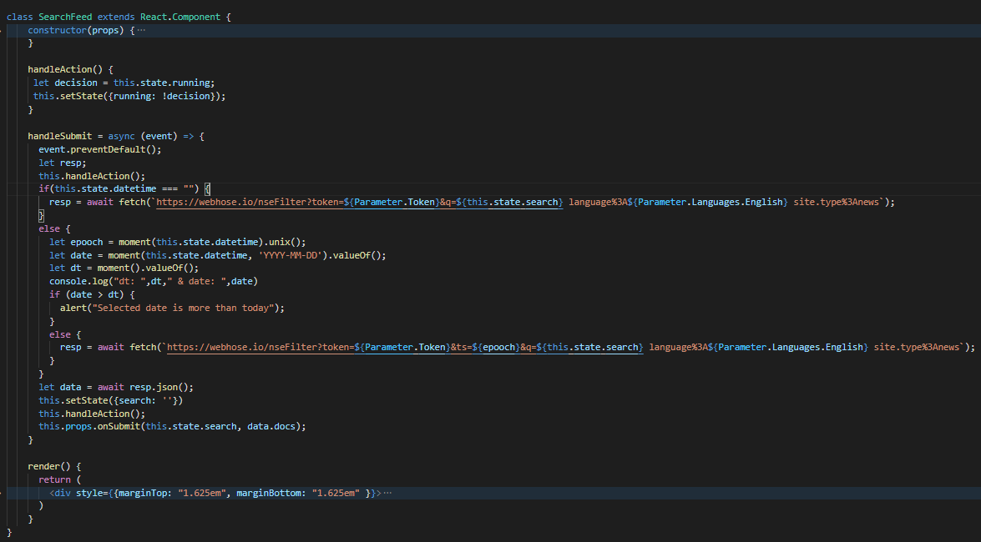
Search Feed
Search Feed is a container component that is responsible for fetching news based on the user’s query and converting the response in JSON format and passing it to the News List for display.
User can search news with or without using a date.

Slide 18
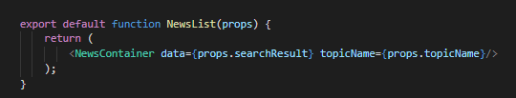
News List
News List is a presentational component that is responsible for passing data to News Container.

Slide 19
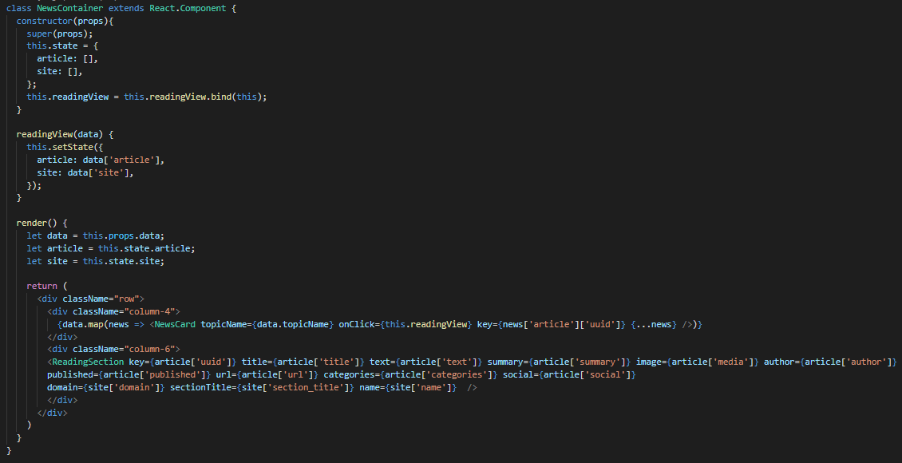
News Container
News Container is a presentational component that is responsible for displaying data to the user, received from the News List in the result section i.e., News Card. It is divided into two section:
Result Section: It contains a list of cards of fetched news and provides a gist of the article.
Reading Section: It gives a detailed information about the article.

Slide 20
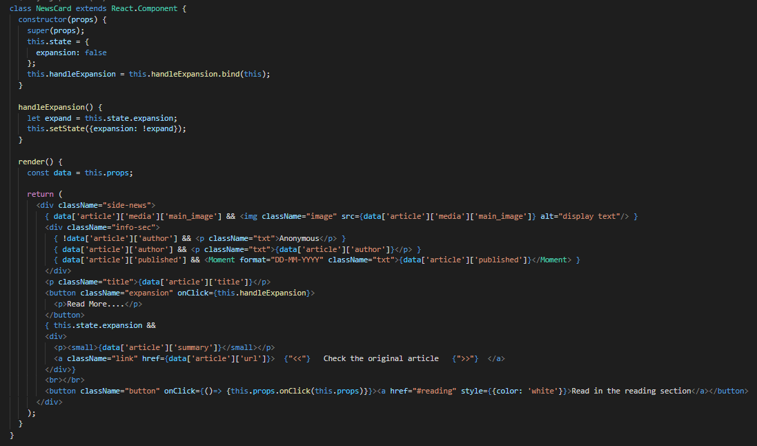
News Card
News Card is a presentational component that is responsible for displaying data to the user in a list of cards format.

Slide 21
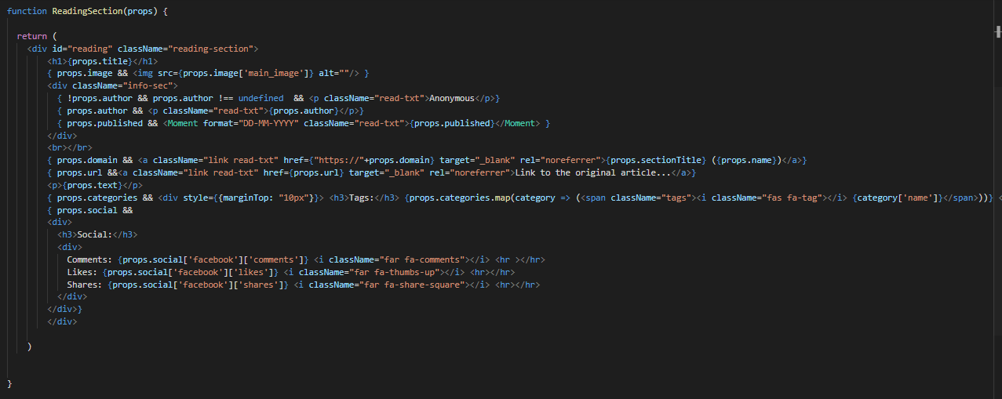
Reading Section
Reading Section is a presentational component that is responsible for displaying detailed data about an article clicked by the user in the Result Section.

