Slide 1
Final Project Presentation
1052. Data Science in Practice
Yang-Ming Lin
Notes:
Hi,everyone!
I’m YangMing
I am going to present my final project

Slide 2
OUTLINE
Input -
Modeling -
Your Goal/Output -
Demo -
OUTLINE
Notes:
Here is today’s outline
I am going to follow professor‘s requirement to present my work
Input , Modeling, Output and Demo

Slide 3
Input
Data source
Kaggle
IBM HR Analytics Employee Attrition & Performance
Input format
CSV
Any preprocessing?
No missing data
https://www.kaggle.com/pavansubhasht/ibm-hr-analytics-attrition-dataset
Notes:
First Input part
My dataset is IBM HR analytics employee attrition and performance.
It is going to predict which employee will quit
This dataset has many variables about employees’ detail like department , education and so on
The dataset format is csv
And I don’t need to do any preprocess because it has no missing data
And every variable can be put into my model

Slide 4
Modeling
Which method do you use?
random forest r package
What is a null model for comparison?
AUC = 0.5
Notes:
I use random forest r package as my method
I think my null model is AUC equal 0.5
Because it is a classification problem and the bad performance is random guess
So I think AUC equal 0.5 will be my null model

Slide 5
Modeling
How do your perform evaluation?
Cross Validation
mean decrease gini
Is your improvement significant?
Before : All variable
After : All except Department
Notes:
I use cross validation and mean decrease gini to evaluation my model
But it did not significantly work .

Slide 6
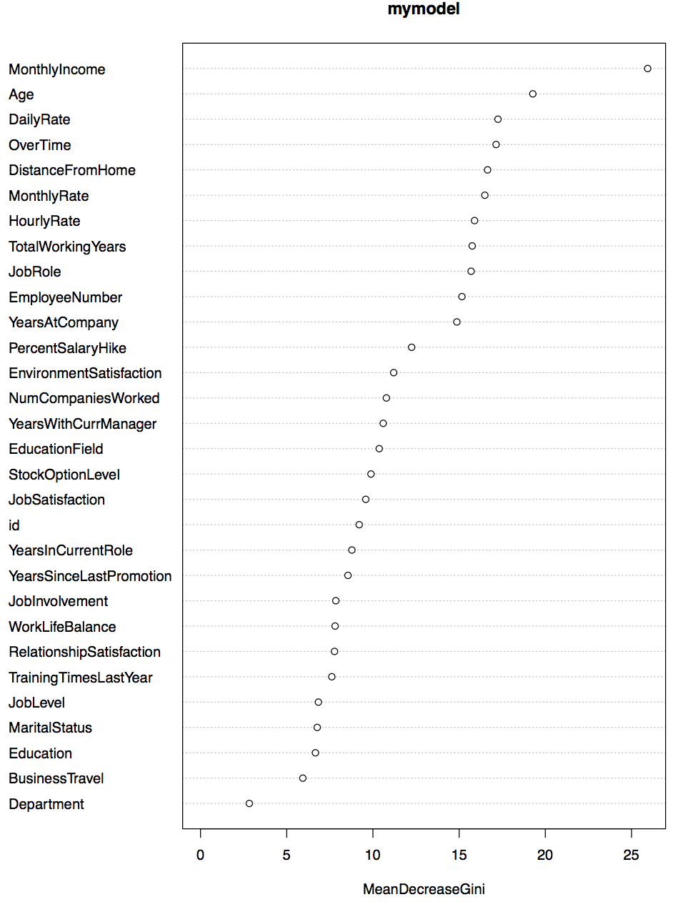
Modeling
mean decrease gini
Notes:
Here is mean decrease gini plot
We can see this department is out of distribution
So I decided not to use this variable

Slide 7
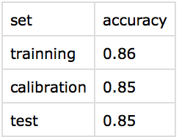
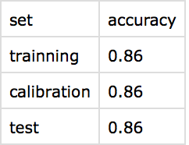
Output
How about performance?
Notes:
But this improvement is not significant
Maybe I should use less more variables

Slide 8
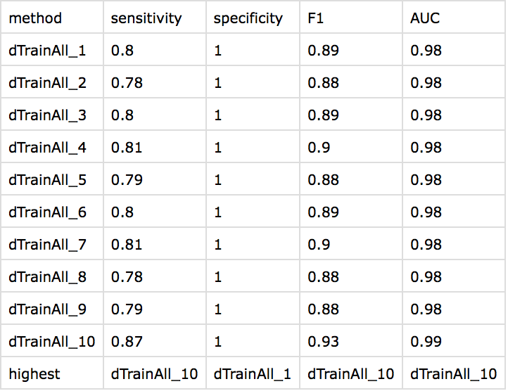
Output
How about performance?
Notes:
Here is the performance of my ten fold training dataset
My AUC performance is significantly better than null model

Slide 9
Output
Demo
On-line visualization
Shiny : https://yangminglin.shinyapps.io/final_project/
Rmarkdown : http://www.cs.nccu.edu.tw/~g10532/FinalProject_rmarkdown.html
How do you document your project?
Github : https://github.com/Komegaga/1052DataScience/
Rmarkdown
Notes:
I also put my result onto shiny and my code on github

Slide 10
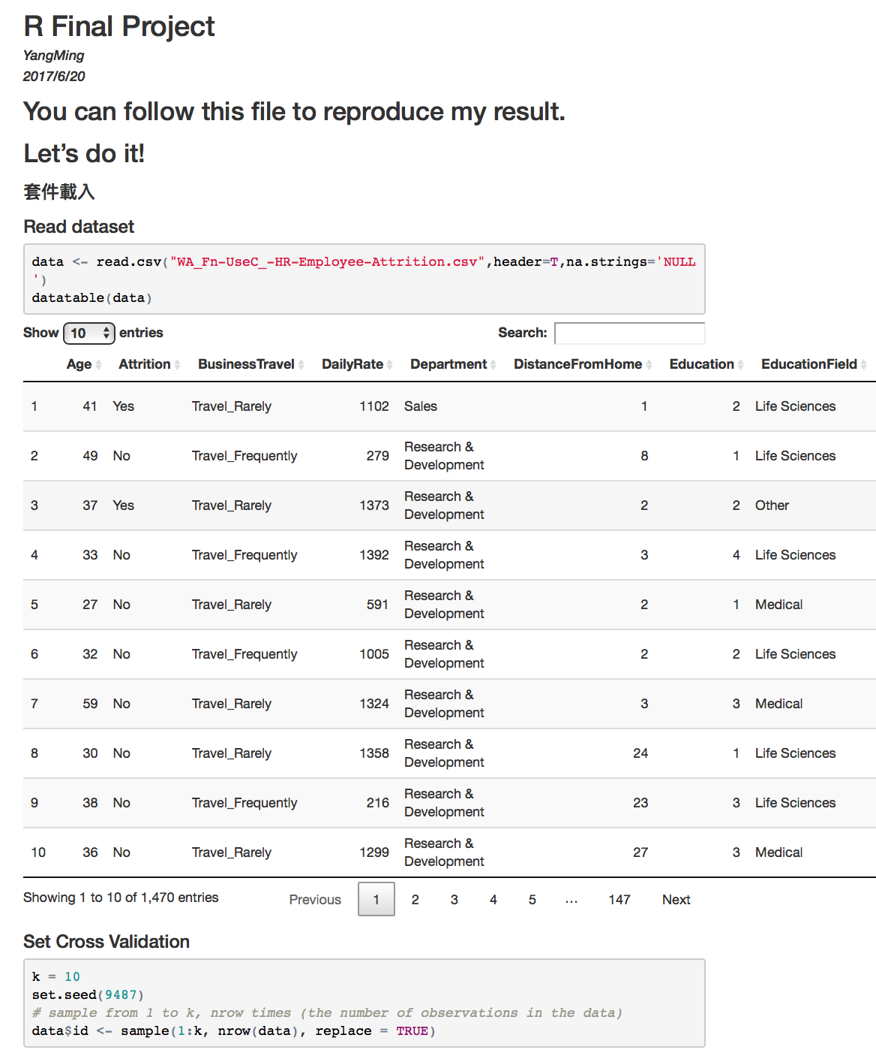
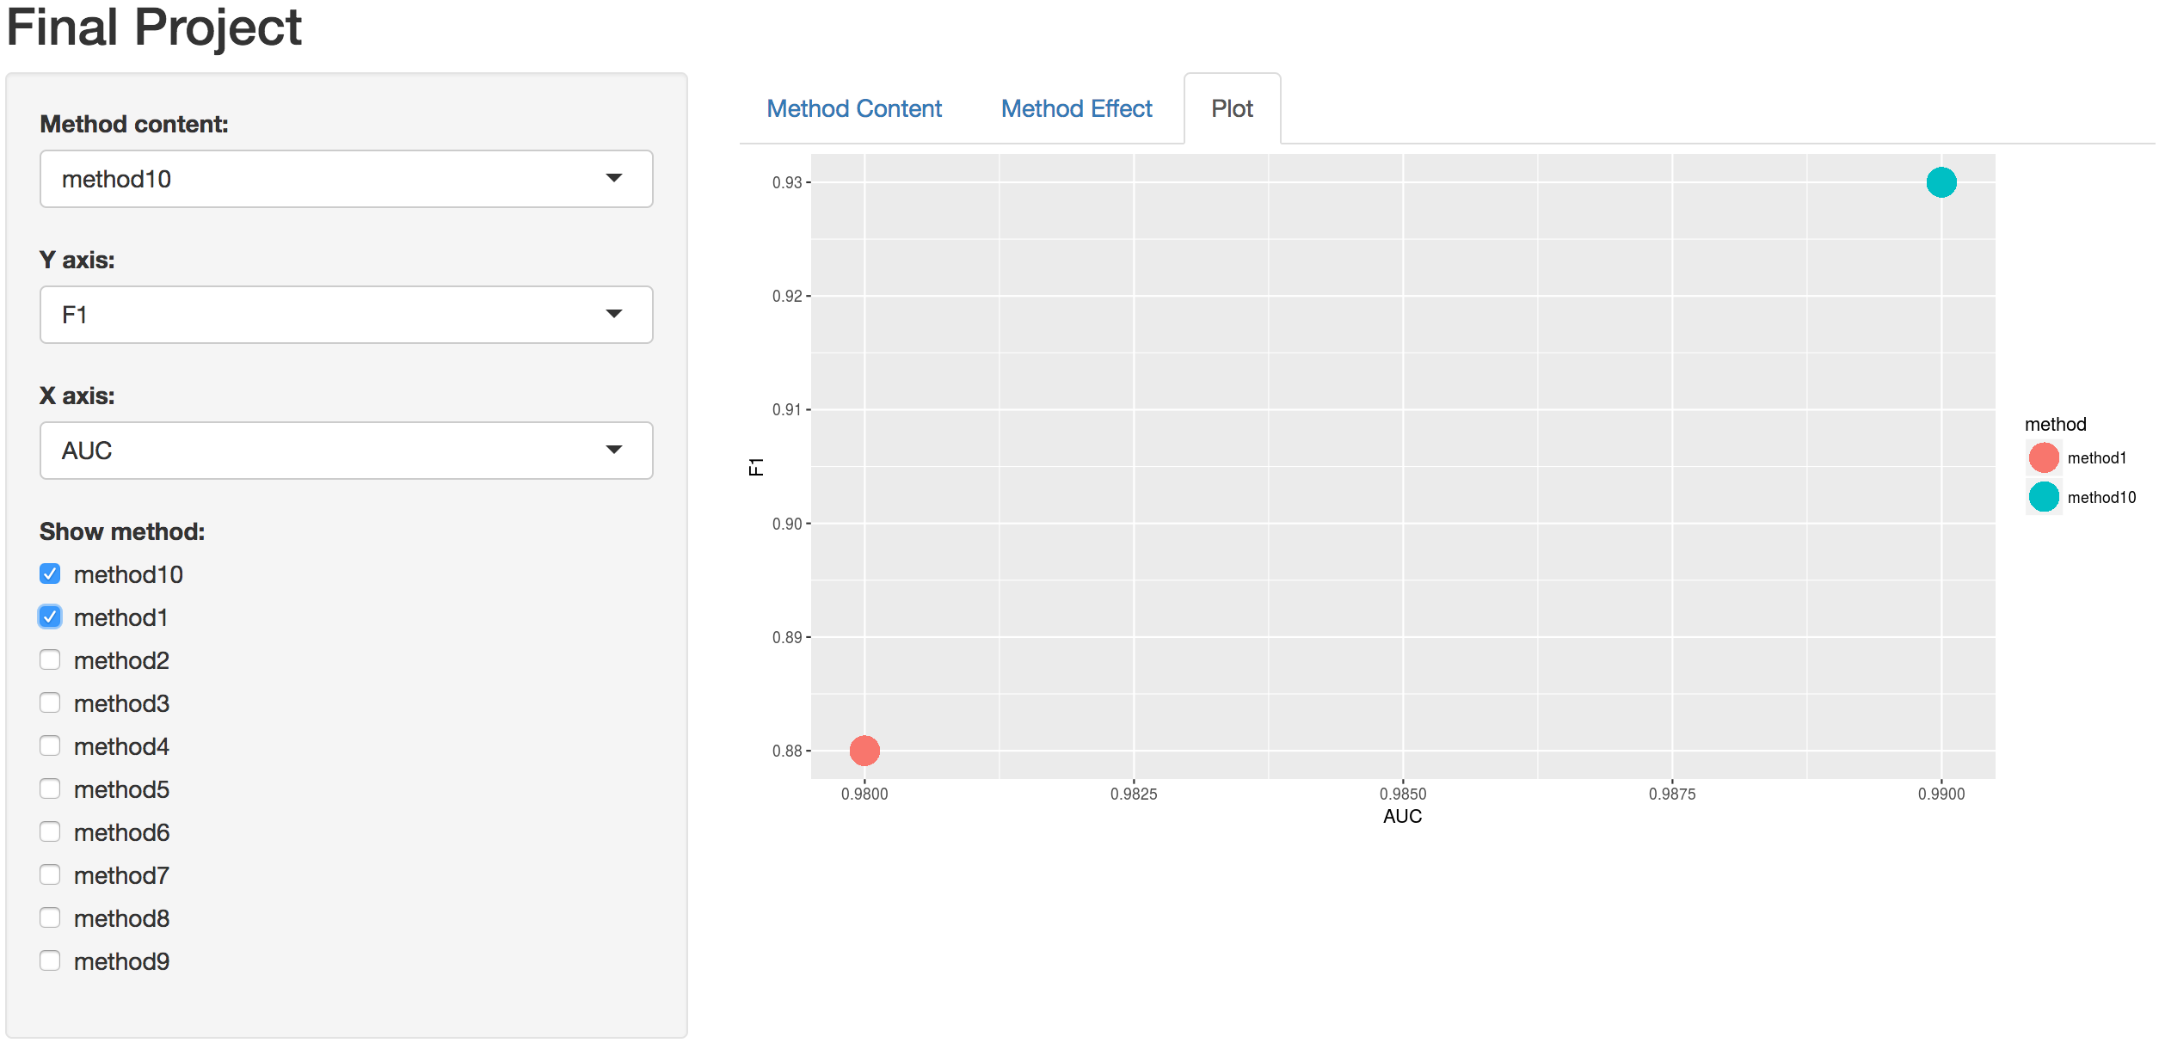
Output
Shiny
Rmarkdown
Notes:
Here is the picture of my shiny and rmarkdown html

Slide 11
Output
Demo
How to reproduce your result?
Download from my github link
Follow readme file
What is the challenge part of your project?
Decide the dataset
Integrate my homework code
Visualization
Notes:
It is very easy to reproduce my result
Just downloading it from github and follow the readme file or
You can see the rmarkdown html
Last part what is the most challengeing part of my project?
I think
First, deciding the dataset
Kaggle has many datasets and different topics
It’s hard to decide what to do
Second
Most code of my final project is from the homework
I have integrate them into one file
It is a big work
Third
There are too many visualization package to select and it takes a lot of time to understand every package document

Slide 12
Thanks for listening!
1052. Data Science in Practice
Yang-Ming Lin
Notes:
Thank you very much!
Any questions?

