Slide 1
Final Project Presentation
1052. Data Science in Practice
Yang-Ming Lin
Notes:
Hi,everyone

Slide 2
OUTLINE
Input -
Modeling -
Your Goal/Output -
Demo -
OUTLINE

Slide 3
Input
Data source
Kaggle
IBM HR Analytics Employee Attrition & Performance
Input format
CSV
Any preprocessing?
No missing data
https://www.kaggle.com/pavansubhasht/ibm-hr-analytics-attrition-dataset

Slide 4
Modeling
Which method do you use?
random forest r package
What is a null model for comparison?
AUC = 0.5

Slide 5
Modeling
How do your perform evaluation?
Cross Validation
mean decrease gini
Is your improvement significant?
Accuracy : 0.85 -> 0.86

Slide 6
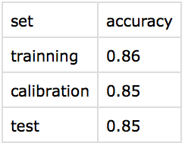
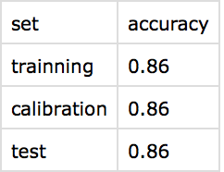
Output
How about performance?

Slide 7
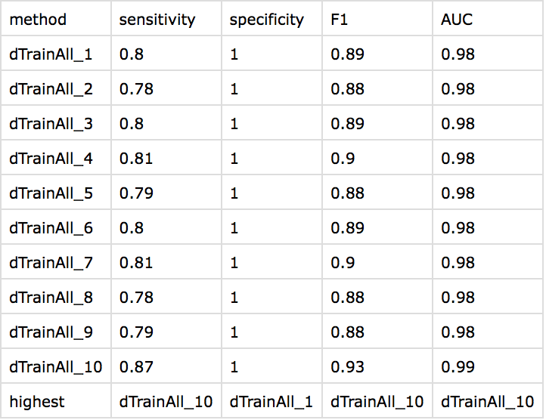
Output
How about performance?

Slide 8
Output
Demo
On-line visualization : Shiny
https://yangminglin.shinyapps.io/final_project/
How do you document your project?
Github : https://github.com/Komegaga/1052DataScience/

Slide 9
Output
Demo
How to reproduce your result?
Download from my github link
Follow readme file
What is the challenge part of your project?
Decide the dataset
Integrate my homework code
Visualization

