Slide 1

Personalize Expedia Hotel Searcheses
Team member:
林洋名 (105753032) 藍逵原 (105753035) 楊琪琪 (105300265)

Slide 2
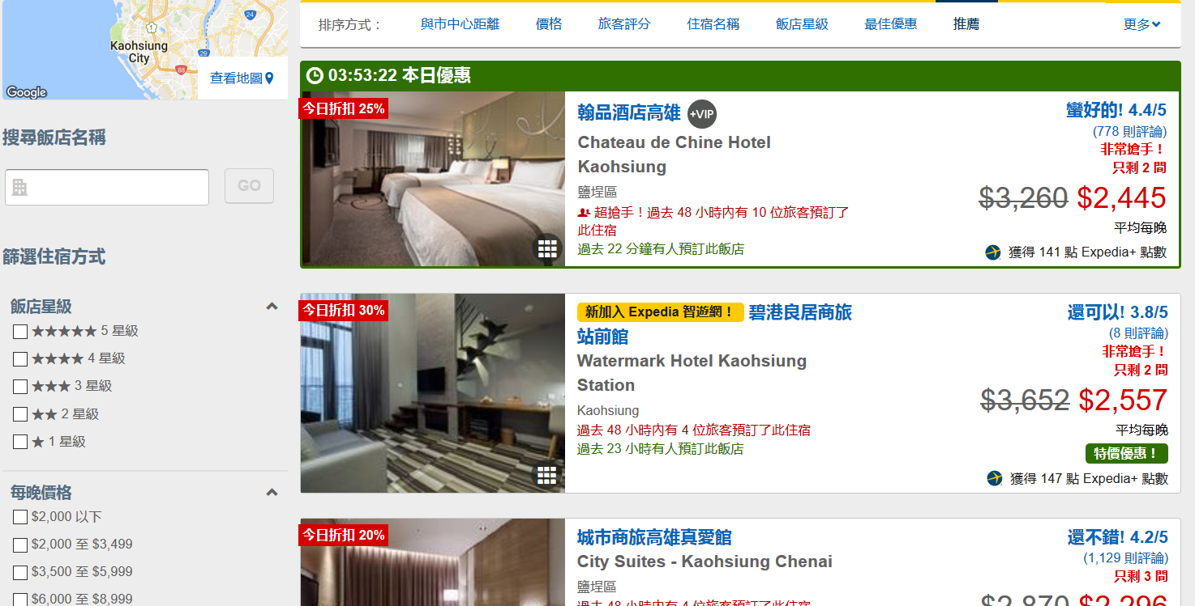
OBJECTIVE
To find out what features can increase the click through rate (CTR)
To use those selected features to predict the future CTR

Slide 3
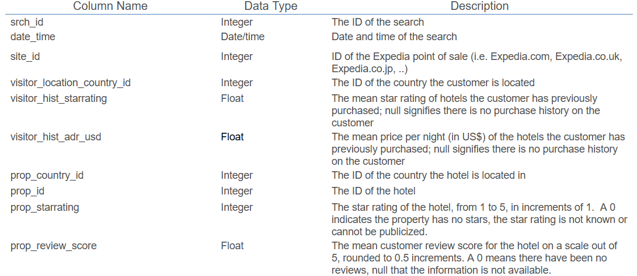
Data around hotel searches
What data we have?
Search criteria
Hotel characteristics
Users information
Competitors information

Slide 4
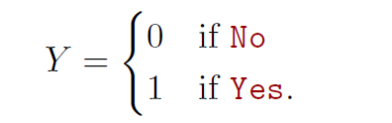
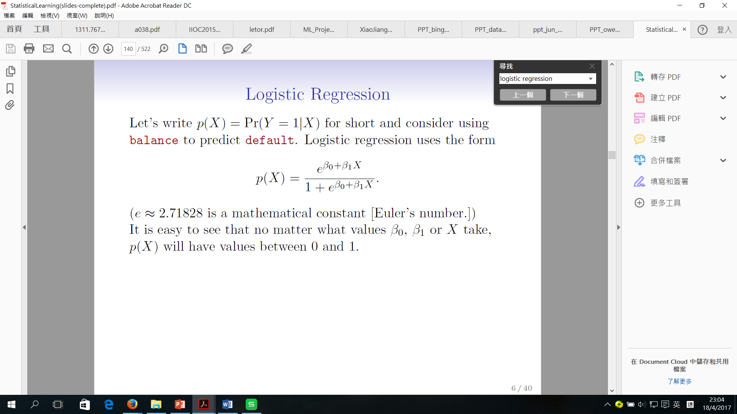
Model selection
Logistic Regression
Popular for classicification
Y= Clik_bool
1: the user click the hotel on the recommended list
0: the user doesn’t click the hotel on the recommended list
The form:

Slide 5
Model selection
Backward Stepwise selection
Start with all variables (51 variables) in the model
Remove the variable with the largest p-value (the least statistically significant)
Reform the new (p-1)-variable model and the variable with the largest p-value is removed
Continue until a stopping rule is reached.
At last, the remaining variables have a significant p-value defined by some significance threshold

Slide 6

Model selection
Backward Stepwise selection
It requires that the number of sample n is larger than the number of variables P.
Our dataset:
The no. of variables p : 51
The no. of sample n : 20,000
The no. of sample n > the no. of variables
Backward Stepwise selection

Slide 7
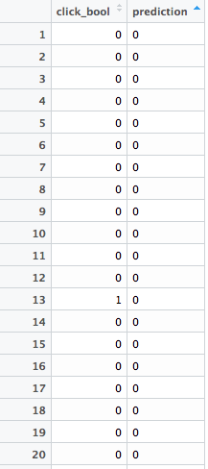
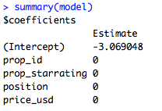
The challenges
Too much data: cannot run the model
Too few data(e.g. 20,000 = 4.7 MB): the result is abnormal

Slide 8
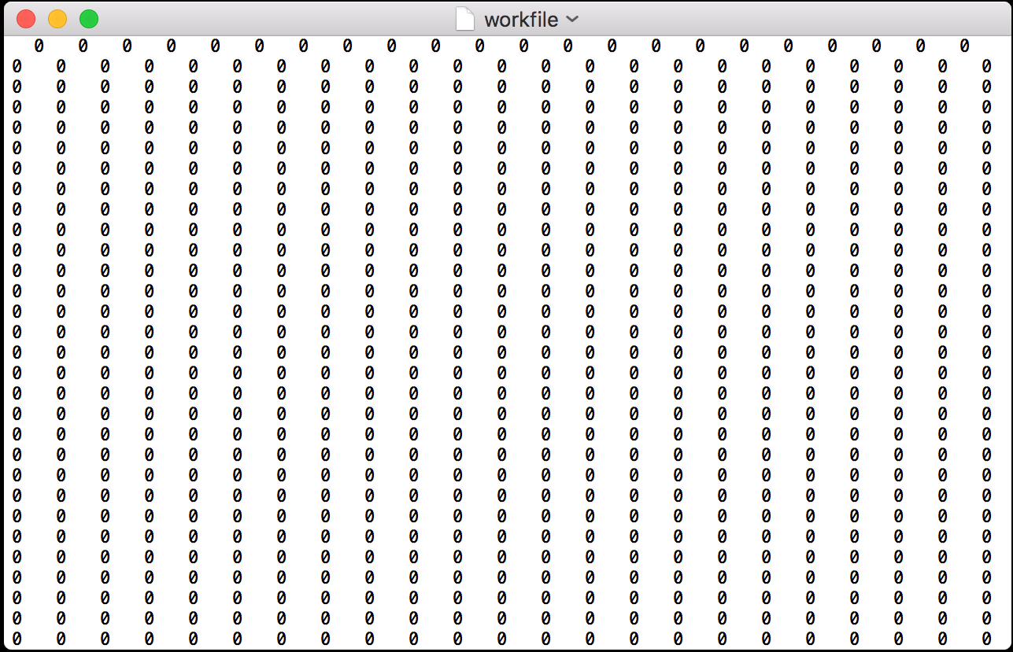
What we try
To use 7 features to run the logistic regression model
1st try : site_id visitor, _location_country_id, visitor_hist_starrating,
prop_id prop_starrating, position, price_usd, srch_query_affinity_score
2nd try : prop_id, prop_starrating, prop_review_score, position, price_usd,
promotion_flag, srch_room_count
Result:
All the prediction value are zero

Slide 9


What we try
1st result:
2nd result:
Both test error are small, but all of the prediction are zero

Slide 10
Lastly, we found that……
The probability of click_bool=1 is too low
The prediction value: click_bool=0

