Slide 1

Personalize Expedia Hotel Searches -CTR forecast & interference factor
Team member:
林洋名 (105753032) 藍逵原 (105753035) 楊琪琪 (105300265)

Slide 2
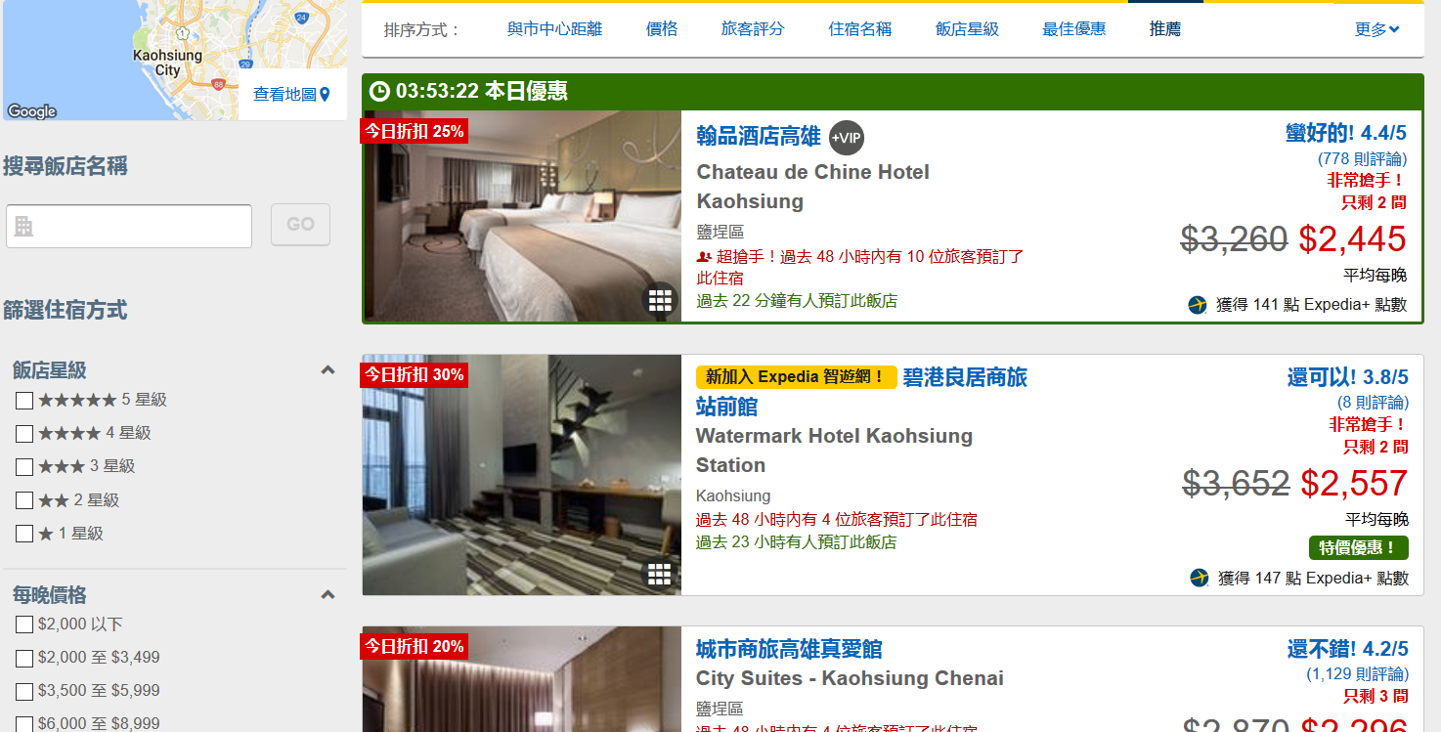
OBJECTIVE
To find out what features can increase the click through rate (CTR)
To use those selected features to predict the future CTR
To find out the external factor intervening the sales revenue

Slide 3
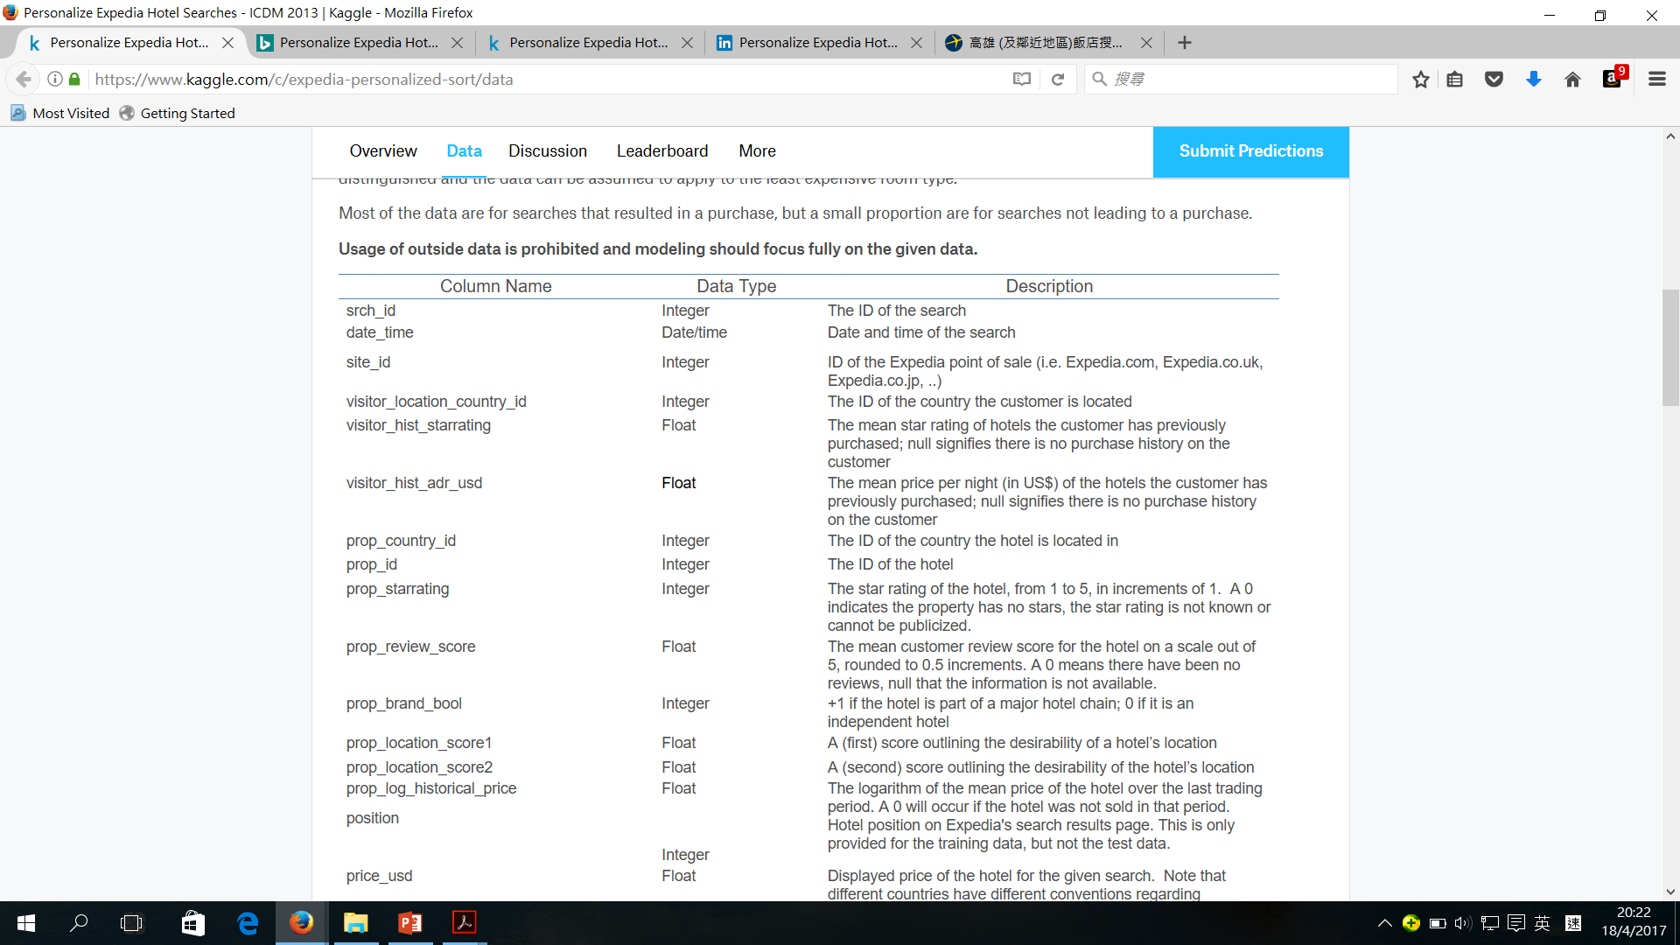
Data around hotel searches
What data we have?
Search criteria
Hotel characteristics
Users information
Competitors information

Slide 4
The problem we met before
Imbalanced Classes in the dataset of Expedia
Forecast: All the prediction value of CTR are zero

Slide 5
Before analysis…
Resampling the Dataset
To use all the data of CTR=1
To choose the data of CTR=0 randomly
The amount of data(CTR=1) = The amount of data(CTR=0)

Slide 6
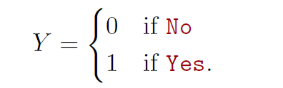
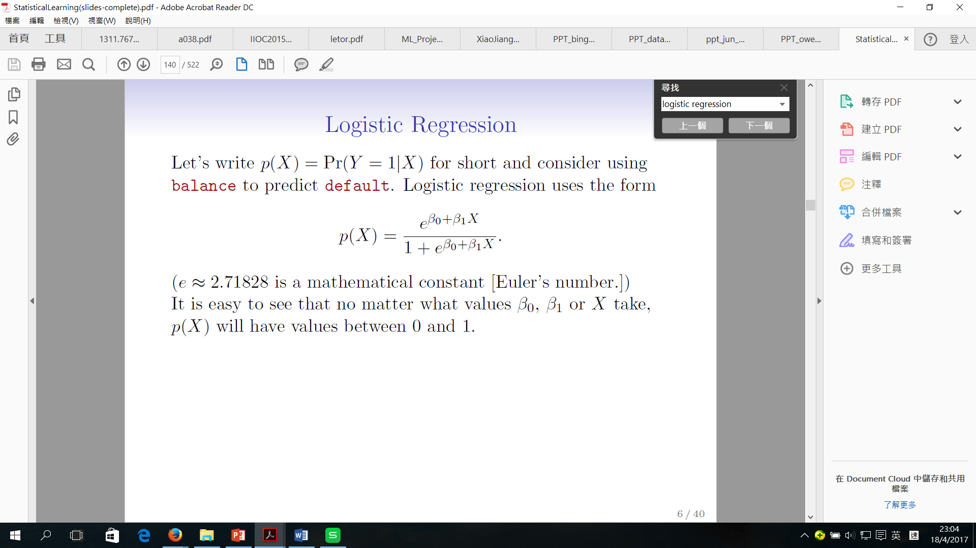
Model selection
Logistic Regression
Popular for classification
Y= Clik_bool (CTR)
1: the user click the hotel on the recommended list
0: the user doesn’t click the hotel on the recommended list
The form:

Slide 7
X-variables selection
Backward Stepwise selection
Start with all variables (50 variables) in the model
Threshold: p-value < 0.05
Remove the variable with the p-value that is larger than 0.05 (the less statistically significant)
Reform the new model with the remaining x-variables
Continue until a stopping rule is reached.
At last, the remaining variables have a significant p-value defined by some significance threshold

Slide 8
Before x-variables selection…
Our dataset:
The no. of variables p : 50
The no. of sample n : 553,186
All of 50 x-variables are included:
Area under PR = 0.895035412145
Area under ROC = 0.738827657991
Test Error = 0.297701423686 0.3

Slide 9
During x-variables selection…
Stage 1: all of 50 variables included
Stage 2: 26 variables included (p-value < 0.05)
"visitor_hist_starrating" , "prop_country_id“ , "prop_starrating" , "prop_review_score" , "prop_brand_bool“ , "prop_location_score1" , "prop_location_score2" , "prop_log_historical_price" , "position" , "promotion_flag" , "srch_length_of_stay" , "srch_booking_window" , "srch_adults_count" , "srch_children_count" , "srch_room_count" , "srch_query_affinity_score" , "random_bool" , "comp2_rate“ , "comp3_rate" , "comp4_rate“ , "comp5_rate" , "comp5_inv" , "comp6_rate" , "comp7_rate“ , "comp7_inv" , "comp8_rate"

Slide 10
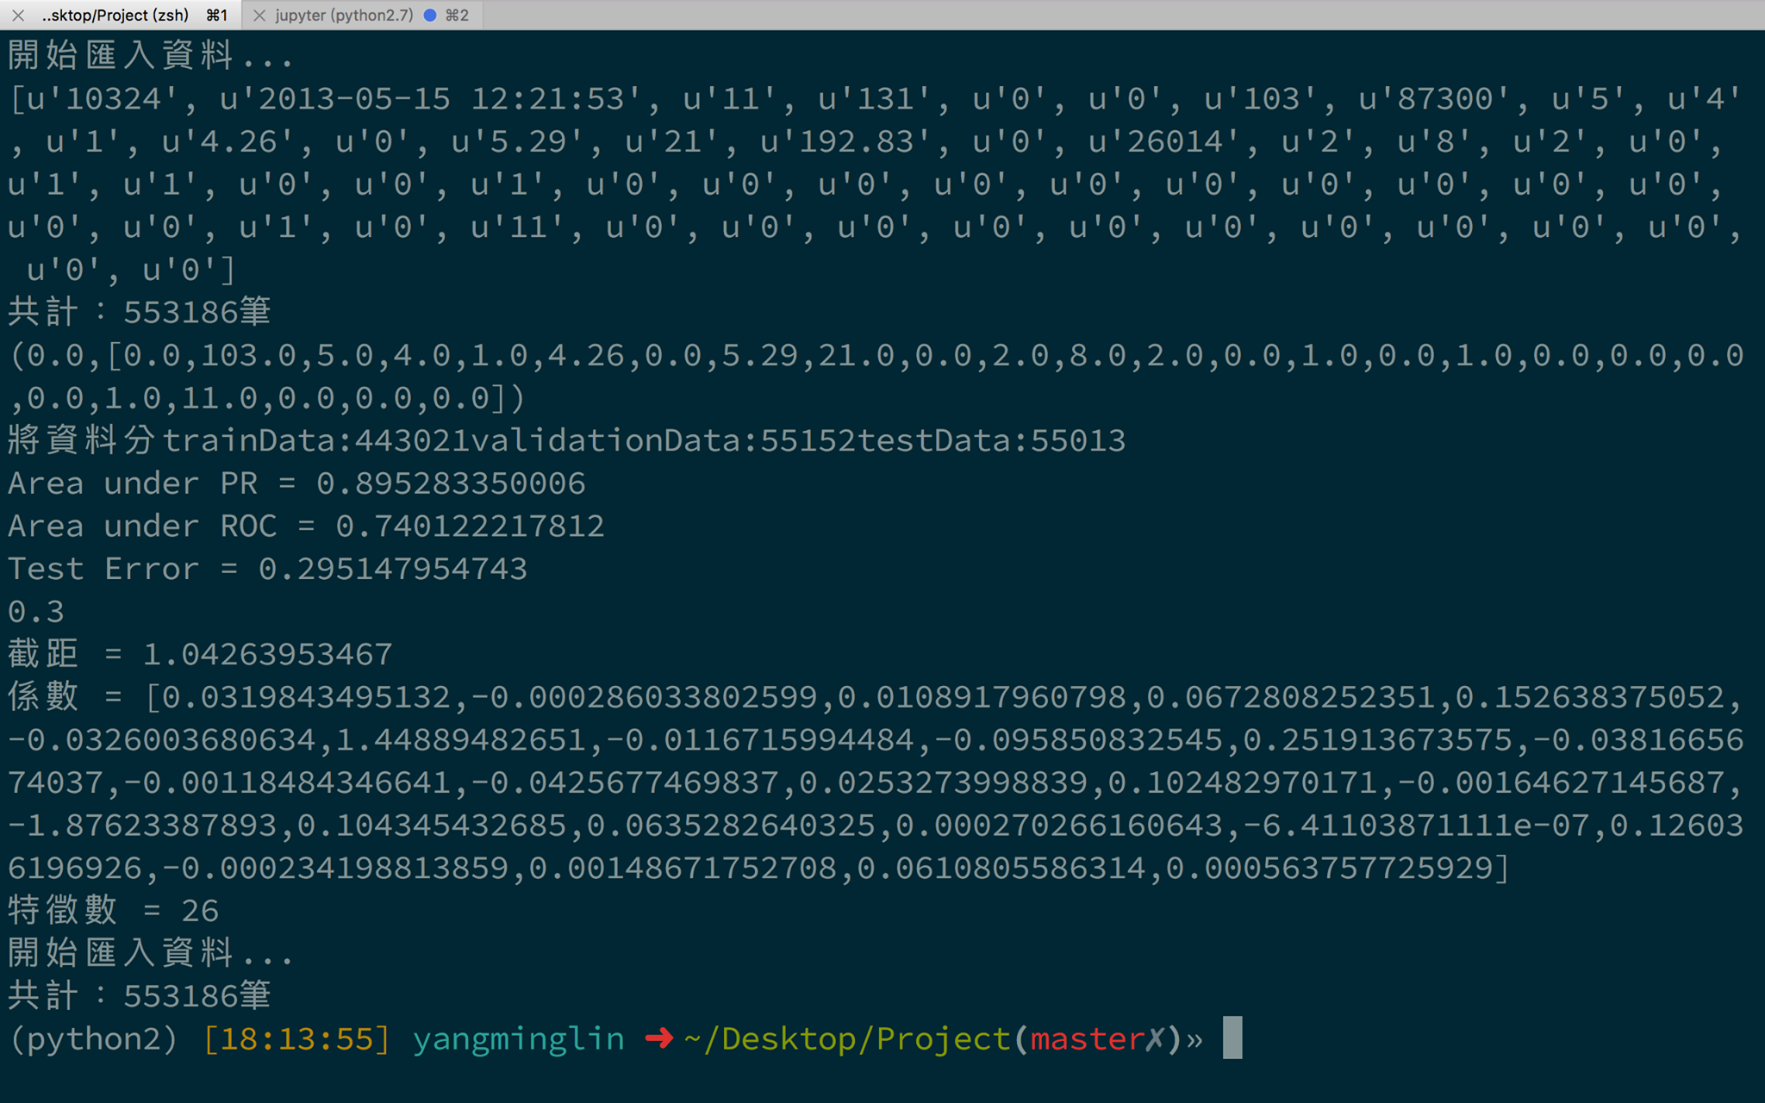
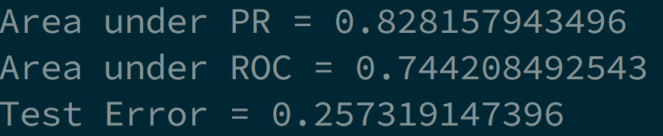
After x-variables selection…

Slide 11
After x-variables selection…
Compared to the result of model with all of 50 variables:
Higher PR
Higher ROC
Lower Test error

Slide 12
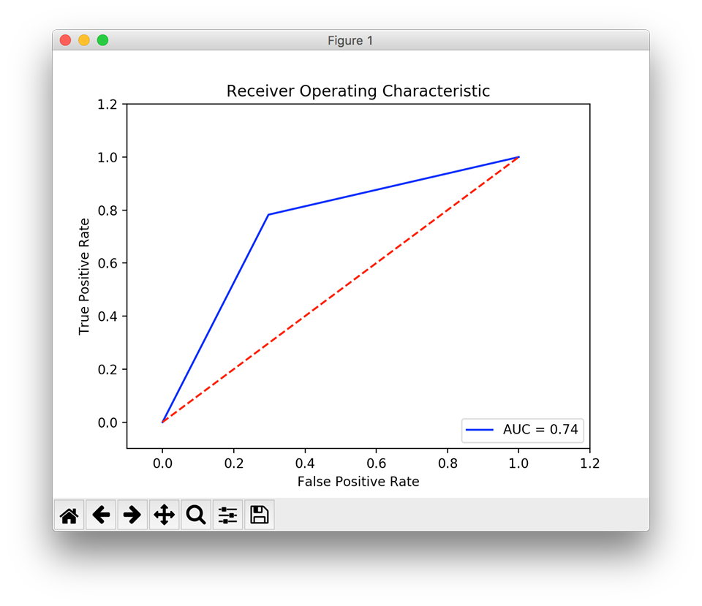
The result

Slide 13
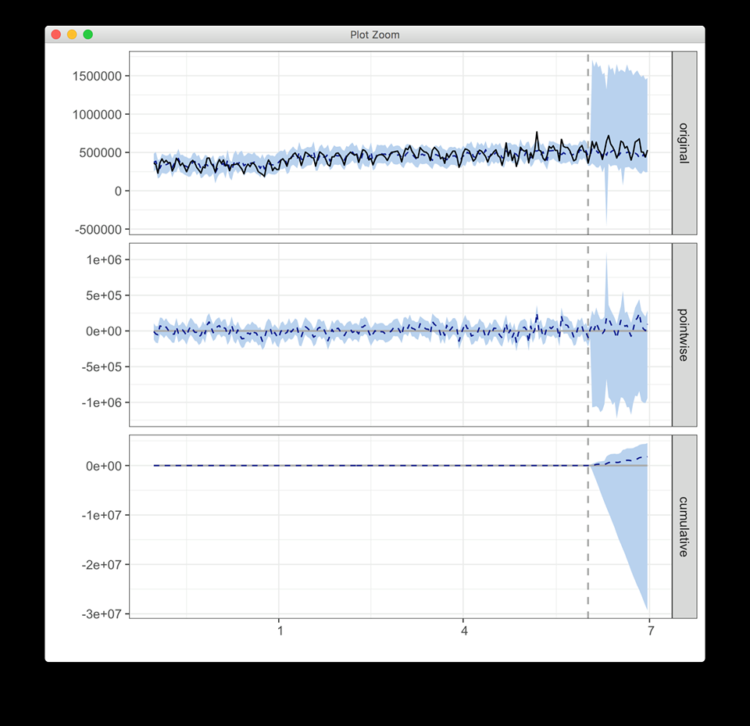
Causal Impact
Time period:
2012/11/01-2013/06/30
The time period with interference factor:
20130601-20130630

Slide 14
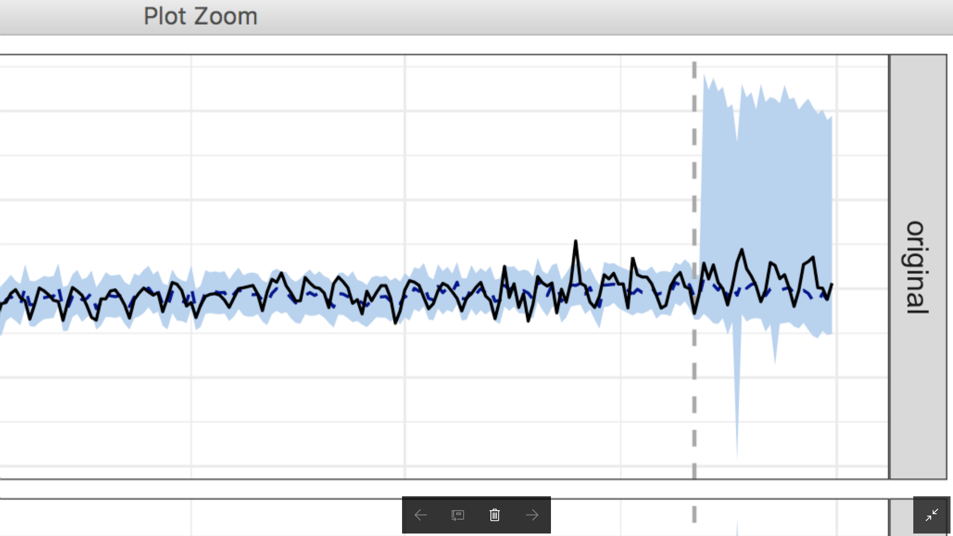
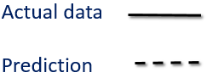
Causal Impact
Actual data > Prediction

Slide 15
External factor
http://std.stheadline.com/daily/news-content.php?id=254619&target=2
大酒店復甦勢頭乍現 2013-05-03財經
大酒店（045）旗下的半島酒店遍布歐美、亞洲，愛好生活享受的港人，對該集團應不會陌生。大酒店跟隨大市回軟，由3月初約13.64元反覆回落至昨日收市12.68元。大酒店4月底公布的首季業績亮麗，尤以香港地區業務獨佔鰲頭，客房入住率上升至84%，平均房租上升34%，至6212元，不過市場未有大反應。 大酒店3月中公布去年全年業績後，美銀美林將該股目標價由12.3元上調至13.2元，指其收入及利潤好過預期，但擔心美國酒店業務仍有困難，維持「跑輸大市」評級。高盛則將目標價由9.2元調升至9.45元，嫌派息低，維持「沽售」評級。 可喜的是，該公司今年首季的美國地區業務有改善，入住率升至64%，平均房租亦升6%，復甦勢頭乍現，值得重新評估。該公司末期息每股派0.1元，5月7日除淨，派息與同業香格里拉（069）相若，但市盈率約12倍，比香格里拉之16倍吸引。大酒店去年完成了多幢物業翻新工程，預期好處今年會逐漸反映，不妨趁低收集。

Slide 16
External factor
Well performance of business of Hotel, e.g. Peninsula
The visitors of hotel increase
More people booked the hotel through Expedia
Actual revenue of Expedia > Prediction of revenue

Slide 17
END

