Slide 1

Holistic Lifestyle Patterns and Wellbeing Across Adults
Presented By:
Potla Manasvi Reddy,
Monica Tejaswi Kommareddy

Slide 2
Research Question:
To what extent can a combination of lifestyle behaviors such as diet, physical activity, sleep habits, stress management, and social interaction, along with demographic factors like age and gender, help predict overall wellbeing and life satisfaction in adults?

Slide 3
Guiding Framework:
Positive Psychology: Focuses on improving wellbeing through consistent habit formation.
Behavioral Science: Considers lifestyle choices as predictors of life satisfaction.
Public Health Principles: Supports preventative strategies to improve quality of life.
Dimensions of Wellbeing:
Healthy Body – exercise and nutrition
Healthy Mind – stress management and sleep quality
Connection – social relationships and impact
Expertise – growth and achievement
Meaning – sense of purpose

Slide 4
Dataset:
Title: Lifestyle and Wellbeing Data
Source: Kaggle, survey responses originally collected from Authentic- Happiness.com.
Dimensions: Contains 15,977 survey responses with 24 attributes covering lifestyle behaviors, social engagement, personal achievement, and wellbeing outcomes.
Type of Data/Variables:
Lifestyle Factors: Nutrition, physical activity, sleep, stress, and social interaction
Demographics: Age and gender
Outcome: Life satisfaction and overall wellbeing scores

Slide 5
Data Cleaning and Preparation:
Verified Integrity: Used .info() and .isnull().sum(). Result: No missing values found.
Irrelevant Data: The Timestamp column was removed as it is not needed for this analysis.
Encoded Categorical Data: GENDER and BMI_RANGE were identified and converted into dummy variables for numerical analysis.
Checked Duplicates: Verified dataset for duplicate entries or invalid values; none were detected.
Final Status: The dataset is clean, complete, and ready for modeling.

Slide 6
EDA: Demographic Distributions:
GENDER:
Women ( 9858 / 61.7% )
Men ( 6114 / 38.3% )

Slide 7
EDA: Demographic Distributions:
Range 1 ( 9413 / 58.94% )
Range 2 (6559 / 41.06% )

Slide 8
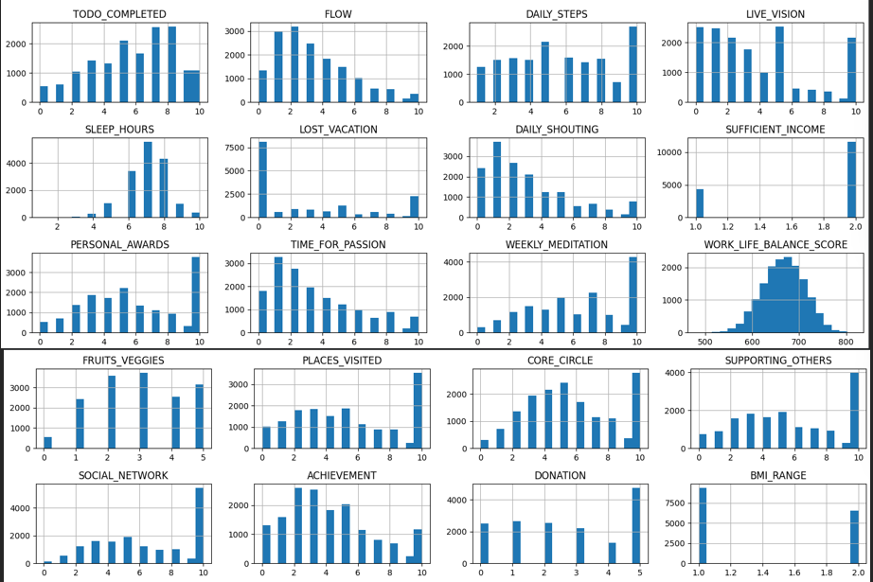
EDA: Feature Distributions

Slide 9
EDA: Feature Distributions
Numeric Feature Exploration
Histograms were generated for all numeric lifestyle variables to understand their distributions.
The data is generally well-distributed.
Some variables, like LOST_VACATION, are logically skewed towards zero.
The target variable, WORK_LIFE_BALANCE_SCORE, appears to be normally distributed, which is ideal for regression analysis.

Slide 10
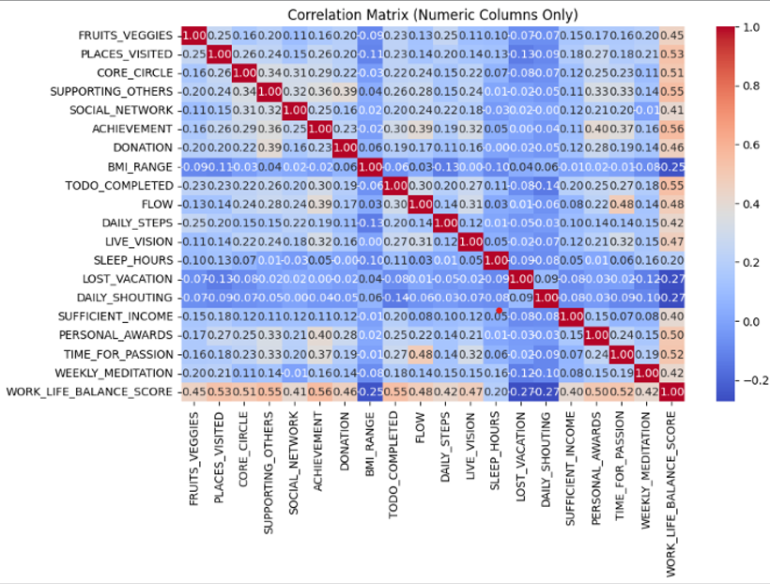
EDA: Correlation Analysis

Slide 11
EDA: Correlation Analysis
A correlation matrix was computed for all numeric columns to identify relationships between variables.
Strong positive relationships were found among wellbeing, achievement (ACHIEVEMENT), and social engagement (SOCIAL_NETWORK, SUPPORTING_OTHERS) features.
This confirms that these factors are intertwined and are suitable for inclusion in predictive modeling.

Slide 12
Variables Used:
Predictors (X):
Lifestyle + demographic variables
Outcome (Y):
WORK_LIFE_BALANCE_SCORE

Slide 13
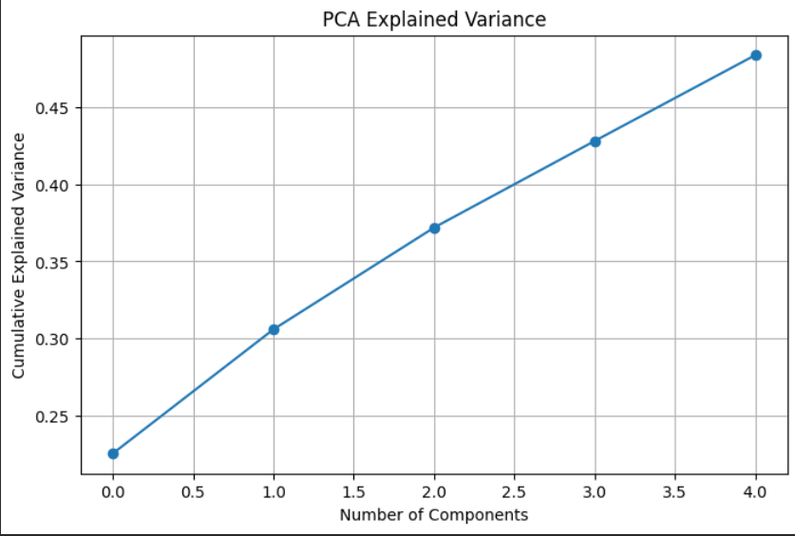
Principal Component Analysis: Explained Variance:

Slide 14
Principal Component Analysis: Explained Variance:
PC1: Explained 22.5% of the total variance.
PC2: Explained 8.0% of the total variance.
PC3: Explained 6.6% of the total variance.
PC4 & PC5: Each explained 5.6% of the total variance.
Cumulative Variance: The first five components captured approximately 48% of the total variance, confirming the data contains several independent behavioral dimensions.

Slide 15
Regression Model Results:
The R² value indicates that the model explains 95.6% of the variability in work-life balance. This is a very strong result for a lifestyle survey dataset and suggests the predictor variables carry significant informational value.
Mean Squared Error (MSE): 88.07
Mean Absolute Error (MAE): 8.22
Regression MSE: 88.07095735967155 Regression R2: 0.9556683804112612 Regression MAE: 8.219107222992019

Slide 16
Regression: Most Influential Predictors
Top Positive Predictors
SUFFICIENT_INCOME: Emphasizes financial security.
DAILY_STEPS: Highlights the value of physical movement.
PLACES_VISITED: Represents exposure to new experiences.
WEEKLY_MEDITATION: Confirms the importance of mindfulness habits.
LIVE_VISION: Strong indicator of purpose and goals.
Negative Predictors
These factors strongly detract from the work-life balance score:
LOST_VACATION: Indicates stress and lack of rest.
DAILY_SHOUTING: Signifies a strained emotional environment.

Slide 17
Clustering Results: Identified Lifestyle Profiles (K=3)
Cluster 0 6,813 Individuals
Cluster 2 4,895 Individuals
Cluster 1 4,264 Individuals

Slide 18
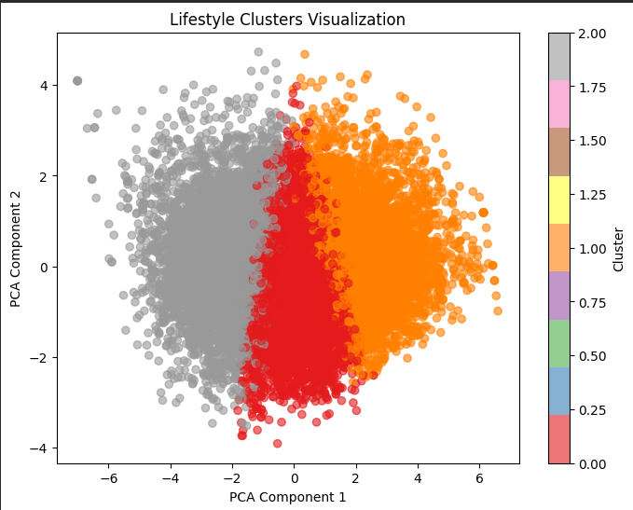
Cluster Visualization:

Slide 19
Cluster Interpretation:
Cluster 0 (Balanced and Active): Represents individuals with relatively higher physical activity, good social engagement, and fewer stress indicators. This group aligns with high overall wellbeing.
Cluster 1 (High-Achievement/Lower Rest): These individuals tend to show strong achievement but report more lost vacation days, suggesting possible work overload and a challenge in maintaining balance despite high drive.
Cluster 2 (Low-Engagement/Higher Stress): Characterized by lower activity, lower purpose-driven variables, and higher shouting frequency. This profile strongly aligns with lower wellbeing patterns.

Slide 20
Conclusion: Key Analytical Takeaways
Lifestyle and wellbeing variables form distinct behavioral dimensions, with Purpose/Achievement being the strongest.
Work-life balance is highly predictable from lifestyle and demographic indicators (R^2 = 0.956).
Purpose-driven (LIVE_VISION) and active habits (DAILY_STEPS) strongly improve wellbeing.
Stress-related variables (LOST_VACATION, DAILY_SHOUTING) are the most significant detractors of wellbeing.
Adults naturally group into three meaningful lifestyle clusters, confirming that targeted intervention strategies are possible.

Slide 21
THANK YOU
Questions?

