Slide 1

[Tablet Test Launch Findings]

Slide 2
Milestone summary: Tablet pilot launched
How we got there…
Notes:
Notes:
The tablet pilot launched at both locations
The weekend before we ran a successful test run at one location
Hard work of many team members over the course of a few months
Now, let’s take a look at how successful it was

Slide 3
Overview – Evaluation & Indicators
Did we achieve our goals?
Were customers satisfied?
In order to evaluate the tablet launch, we asked guests to complete a survey on the tablet at the end of their visit.
Notes:
Notes:
We made a list of evaluation questions around how we wanted to measure success
It included questions around tablet experience, satisfaction, visit length, if they experienced any technical issues, and more
We administered the survey by offering it on the tablet after they pay

Slide 4
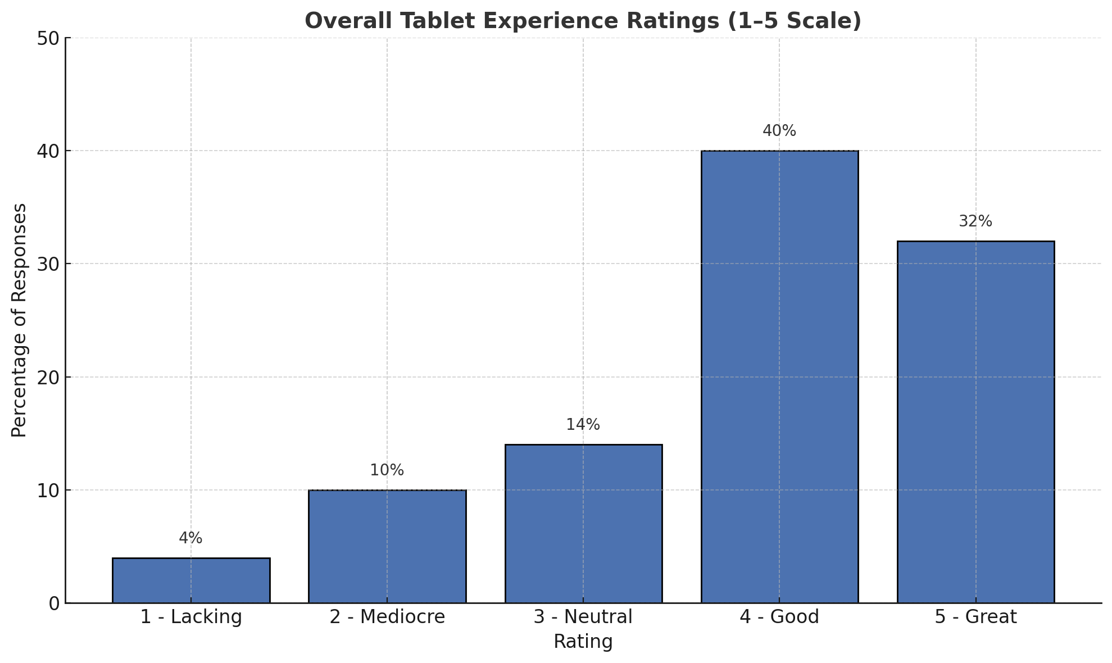
Findings
The visual is a plot of a data point from our survey which clearly shows that most customers rated their experience positively, with 72% selecting 4 (Good) or 5 (Great). This implies that a majority of customers were satisfied with the test launch experience
Notes:
Notes:
Guests were generally satisfied with their experience, but there’s room for improvement
Other results included:
Guests preferred their experience with the tablets over a traditional waiter experience
Guests found the checkout process quick
There’s still work to do on improving speed
Guest orders are still being made incorrectly

Slide 5
Next Steps
Survey finding- Guests find it difficult navigating tablet
Recommendation- Work with Tablet vendor to switch to a layout that they’ll find much simpler
Notes:
Notes:
Guests reported that they were having difficulty with navigating the tablet
Guests reported that the tablets malfunctioned
One goal for the tablets was to improve customer experience
We’ll work with the tablet vendor to switch to a layout they’ll find simpler

Slide 6
Next Steps
Next Steps
Survey finding- Table turn time wasn’t reduced
Recommendation- Work with GMs to speed things up.
Notes:
Notes:
Guests noted that they were still waiting the usual time for their table
Guests noted that they were spending the same amount of time at the table
One goal for the tablets was to decrease visit time
We’ll work with the GMs to speed up visit time

