Slide 1
Used car sales Analysis
By: Kommuri Raju
Raj.kommuri2@gmail.com

Slide 2
Introduction:
“Car Deal” is a new company looking to expand the wings to do business on used cars.
Analysing the market before investing.
Looking at the competitors and available resource.

Slide 3
Market trend:
Gaps between the people economic capability.
Comfortable travelling, own car.
Pandemic – Safety transportation.

Slide 4
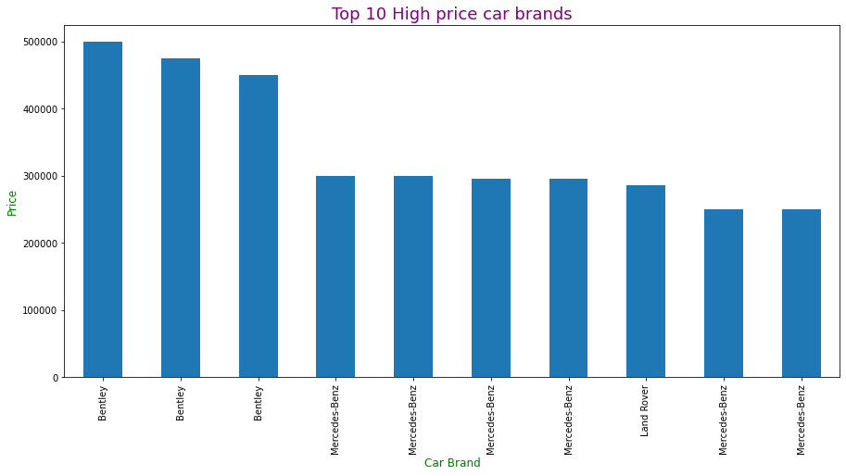
High Price cars: 1. Bentley 2. Mercedes-benz 3. LandRover

Slide 5
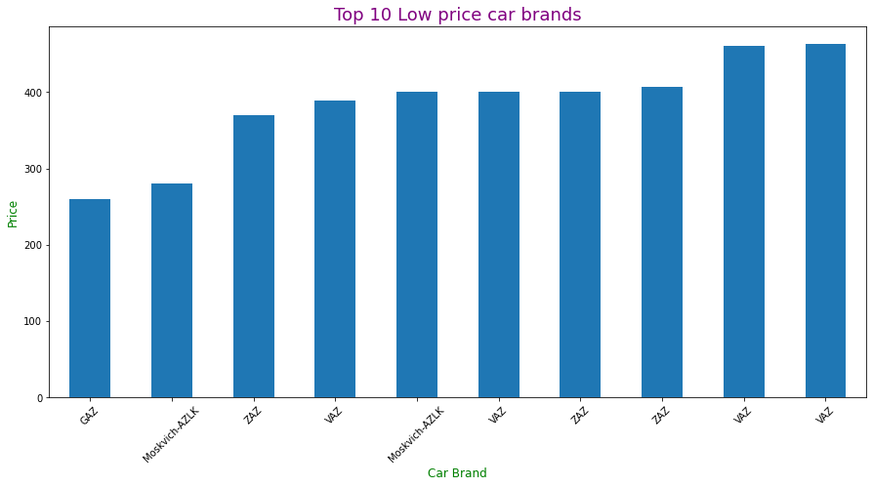
Low price Cars: 1. GAZ 2. Moskvich-AZLK 3. ZAZ and VAZ

Slide 6
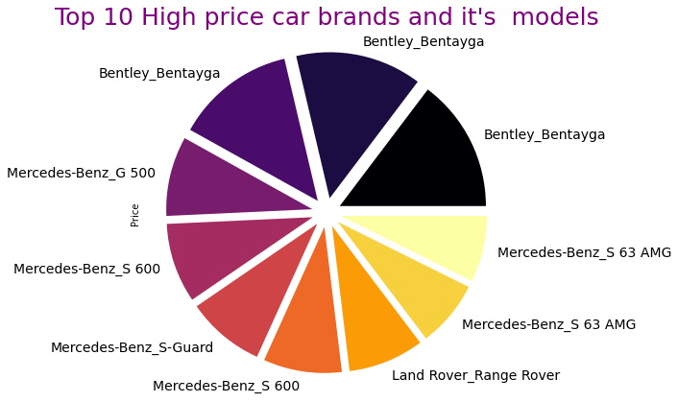

Slide 7
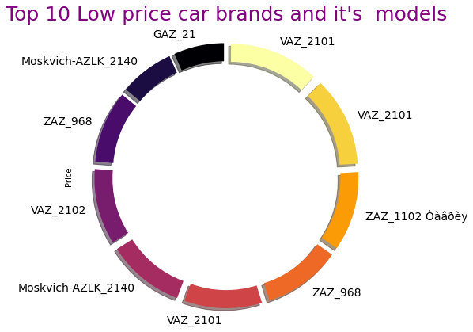
Cars and it’s model at low price.

Slide 8
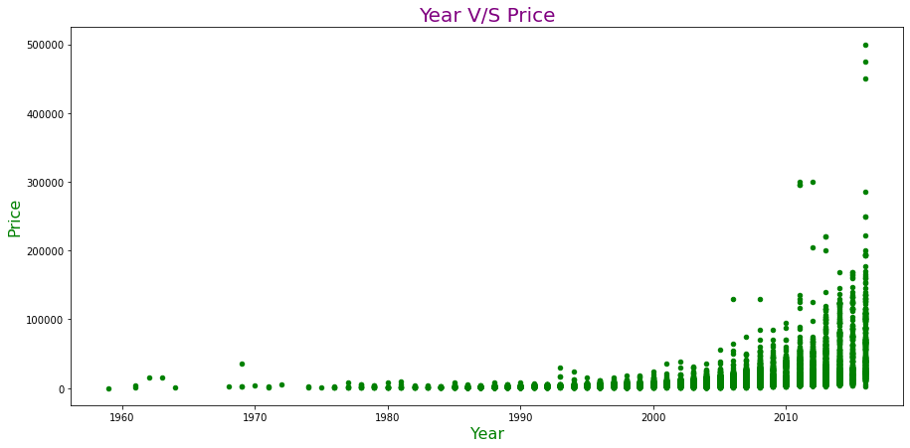
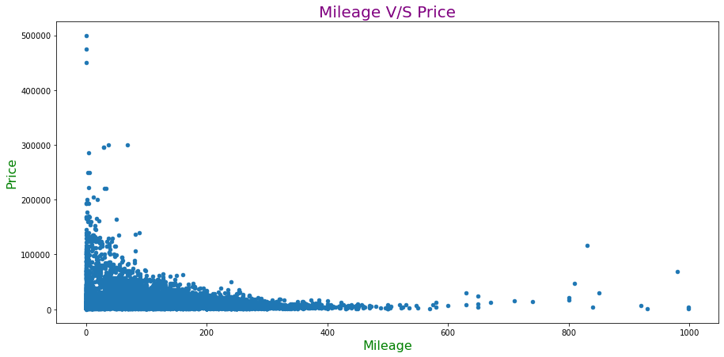
Car manufactured year is directly proportional to the Price.
Mileage is inversely proportional to the Price of the car.

Slide 9
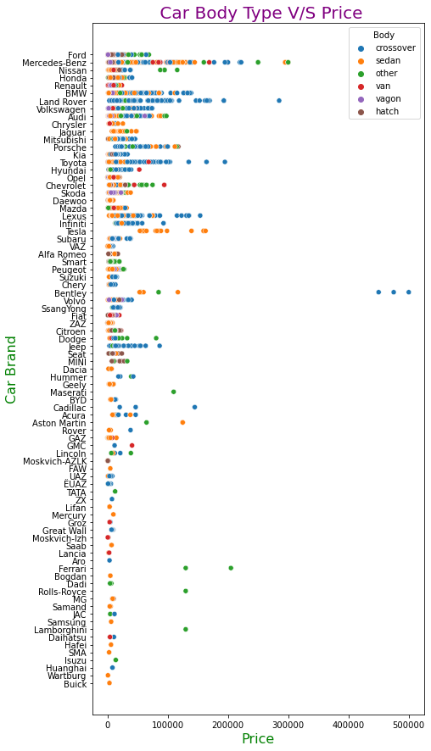
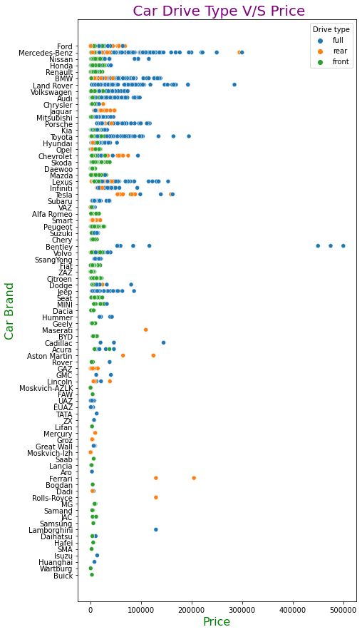
Body Type: 1. Crossover – Top 2. Sedan – Bottom Drive Type: 1. Full Drive – Top 2. Front - Bottom

Slide 10
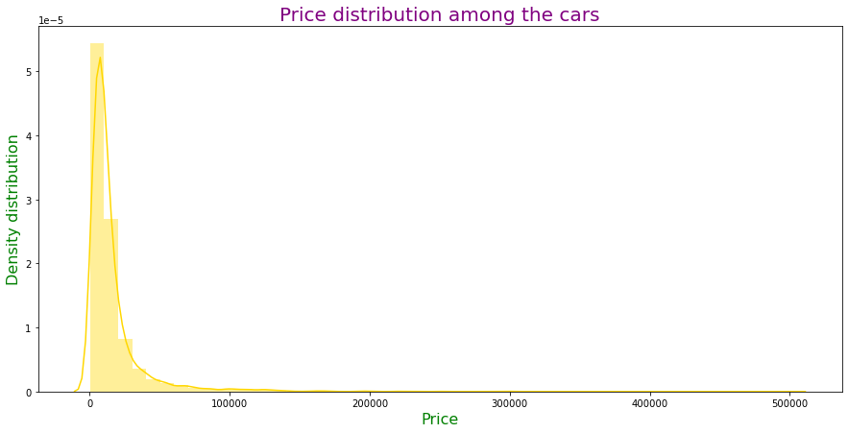
Price Range of all cars: 1. Most of the car prices are ranged between 10,000 – 30,0000. 2. Very less cars are pricing above 30,000.

Slide 11
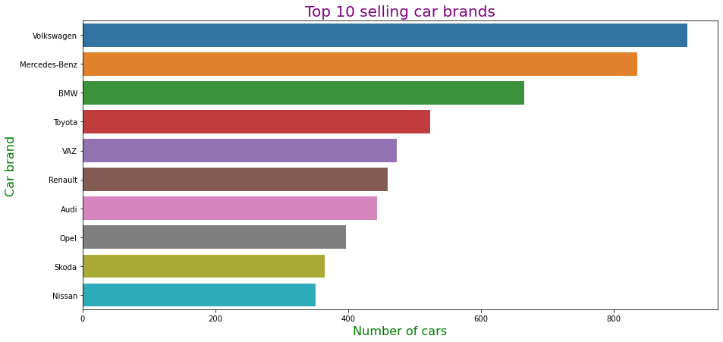
Top Selling Car Brands:

Slide 12
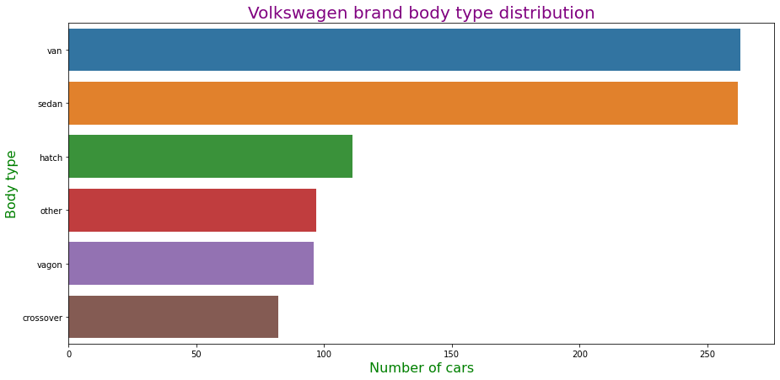
In the Volksvagen brand users are more interested to buy Van and Sedan body type cars.

Slide 13

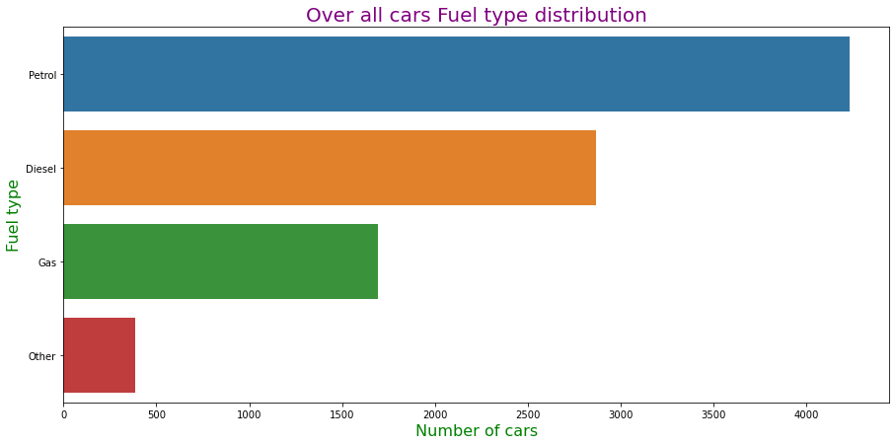
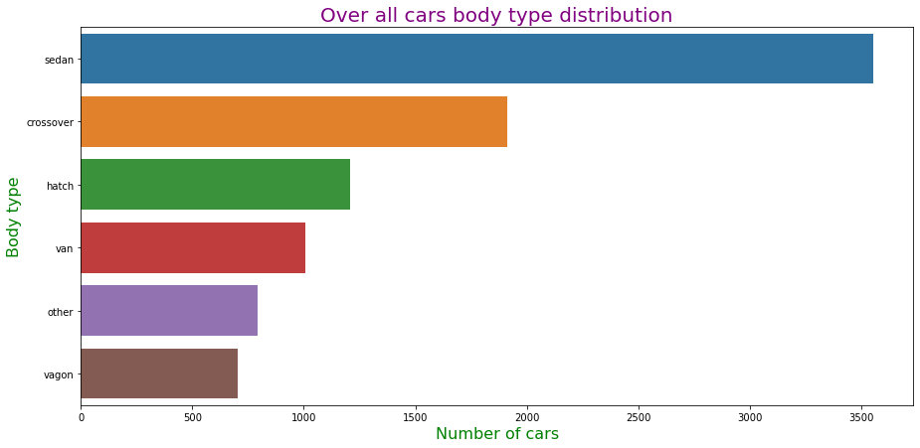
Most of the people are interested to purchase Petrol Engine cars.
Sedan body type attracting the maximum users after that Crossover.

Slide 14
Summary:
Most of the users are interested to purchase low price, Sedan body type and Petrol Engine cars.
Maximum cars are pricing range between 10000$ – 30000$
Volksvagen brand cars are leading the used car market.
Bently and Mercedes-benz cars are the highest price cars.
GAZ and Moskvich-AZLK brand cars are the lowest price cars.

Slide 15

Thank you

