Slide 1

A Distributed Playlist for Android

Slide 2


Arguing about Songs
Kompose solves this problem
Distributed Song App
https://www.flaticon.com/free-icon/musical-notes-symbols_11178#term=music&page=2&position=59
https://www.flaticon.com/free-icon/quarrel_284159#term=people arguing&page=1&position=1

Slide 3
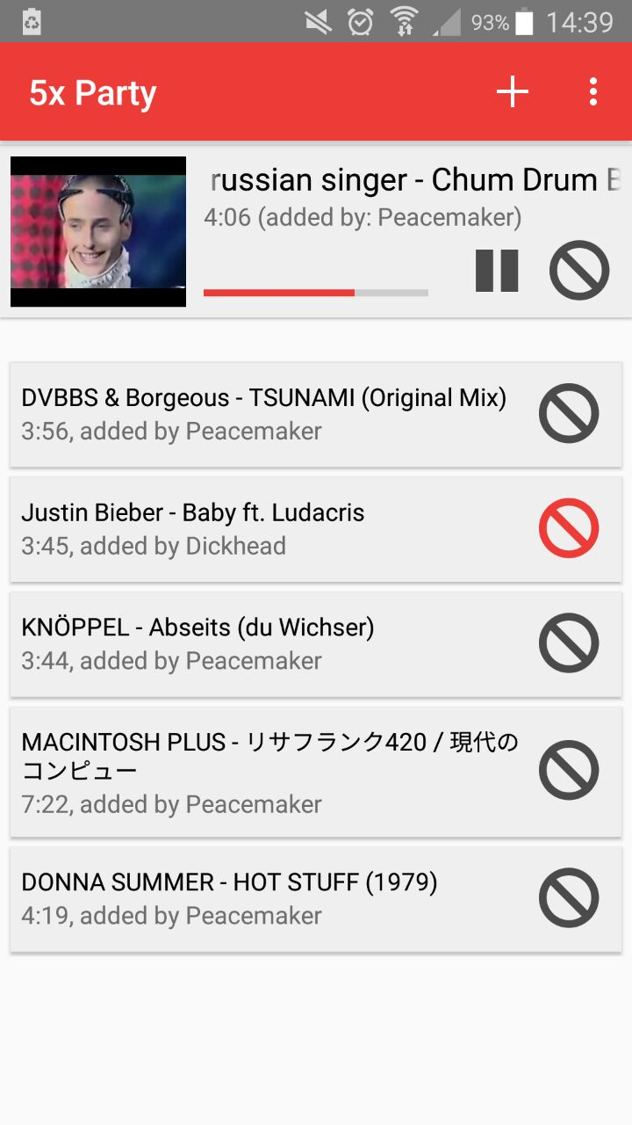
Settings
Add a new Song
Song which is playing
Down vote a song

Slide 4
And much more !!
Explore it yourself Come see us later

