Slide 1

https://www.flaticon.com/free-icon/musical-notes-symbols_11178

Slide 2

4x https://www.flaticon.com/free-icon/quarrel_284159
https://www.flaticon.com/free-icon/musical-notes-symbols_11178

Slide 3

THE DISTRIBUTED PLAYLIST

Slide 4
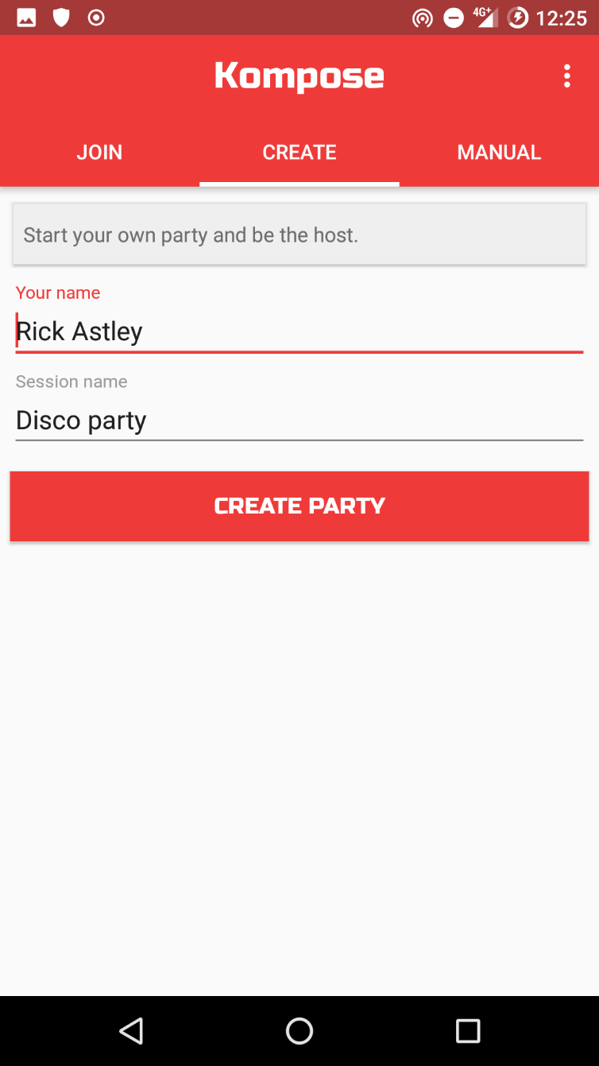
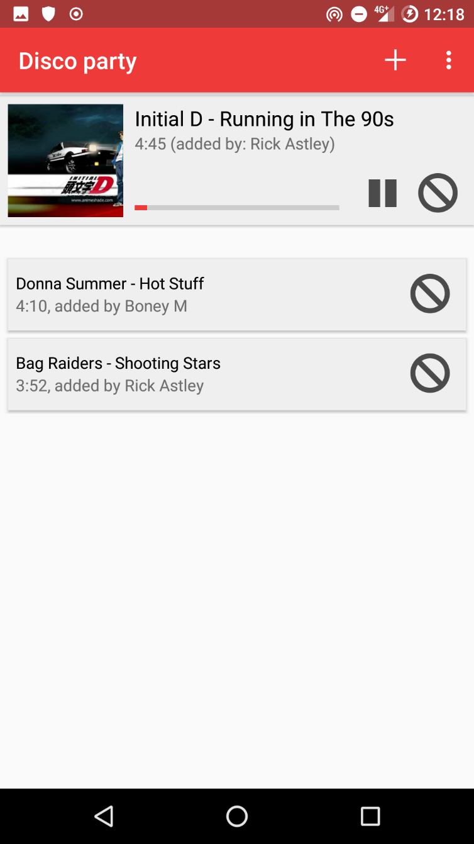

Slide 5
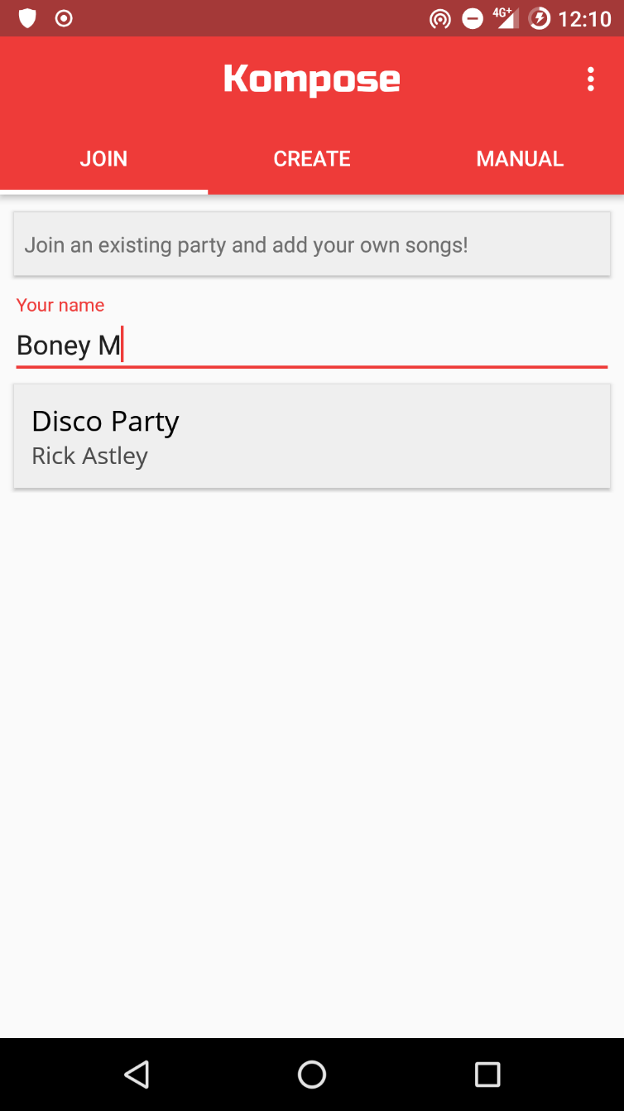
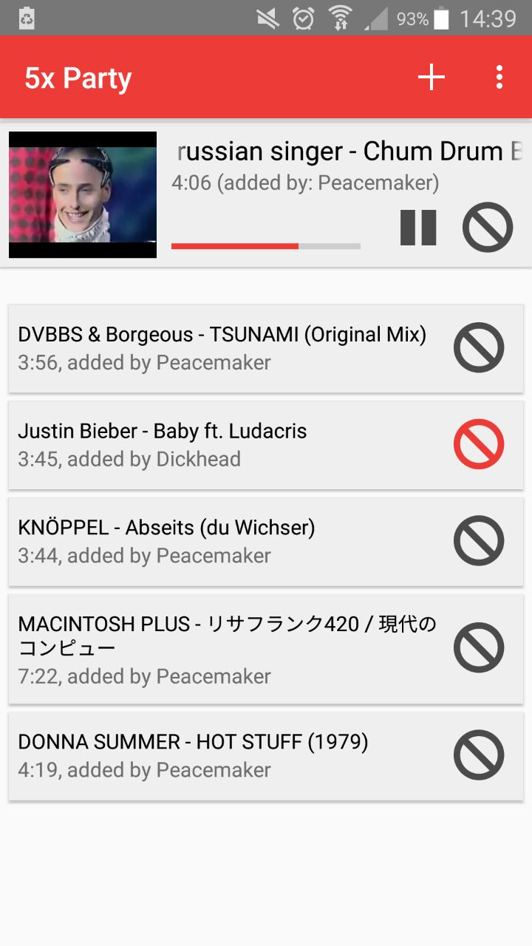
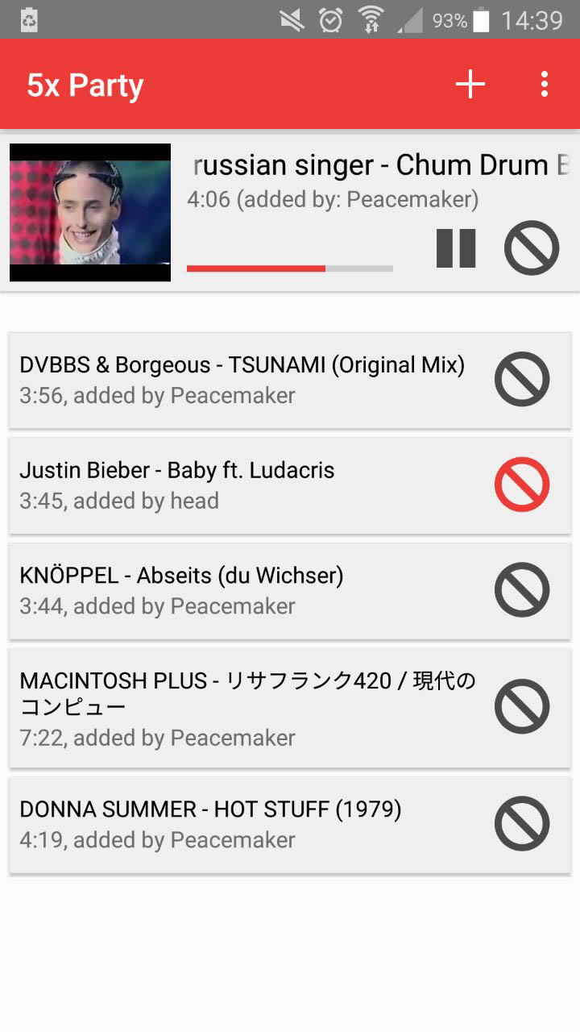


Slide 6
explore it yourself come see us later

