Slide 1
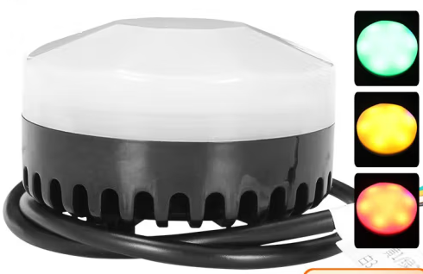
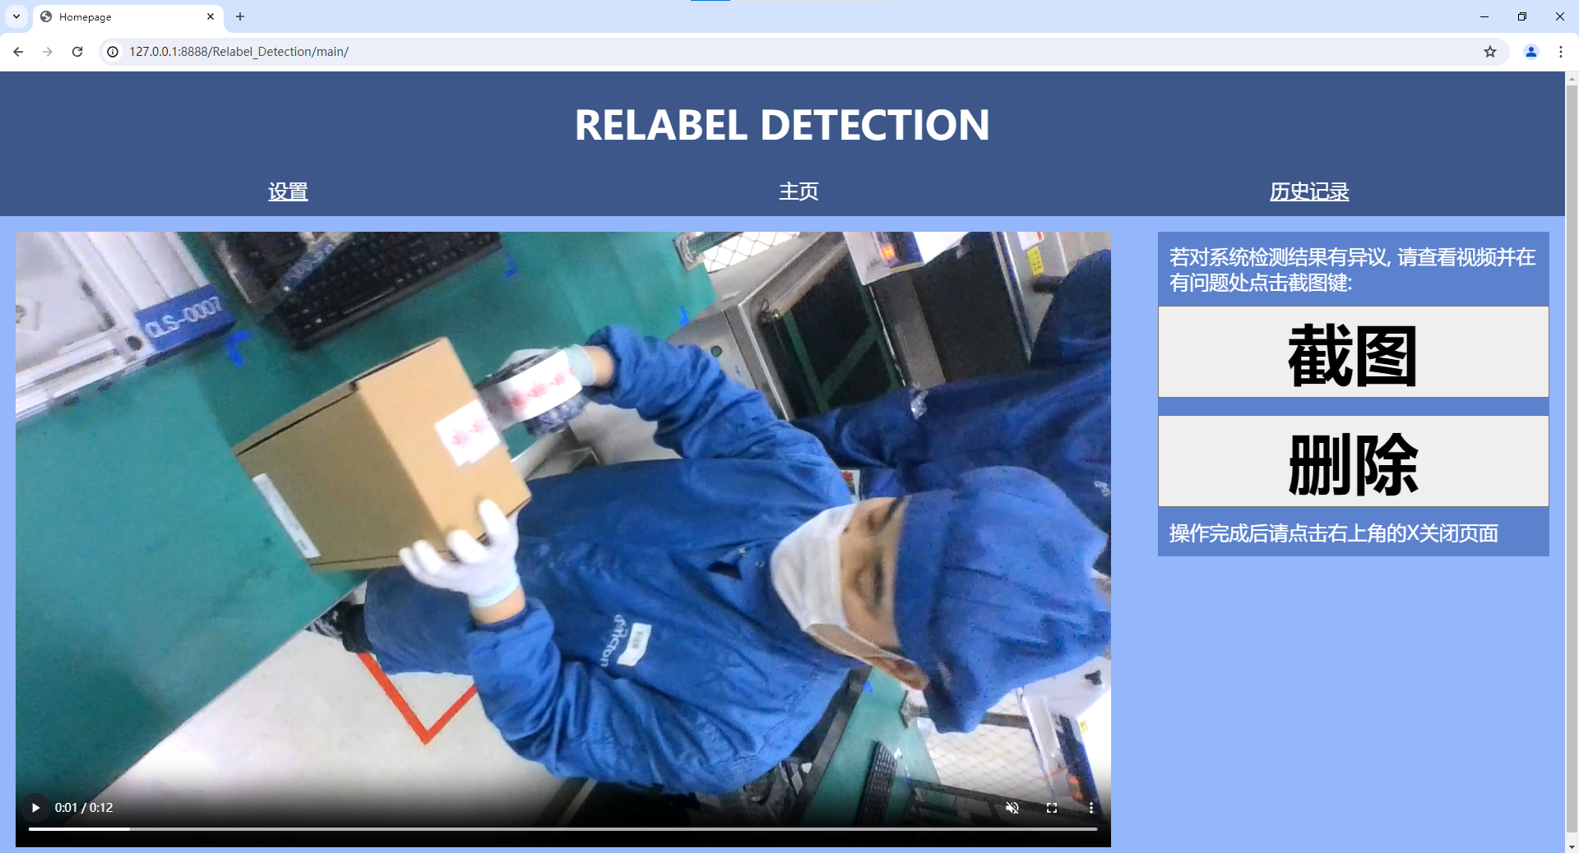
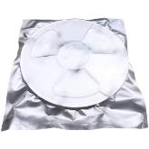


System Architecture
Relabel Station
System Pipeline
3
—— Relabel Detection
…… Auto Update
1
2
Stage4
Label
Train
Quantize
3
--------
Stage3
Results
User
Alarm
----
|
Check Unpass
2
×
×
×
4
Check
Pass
√
√
√
Stage2
Inference
Inference
Inference
Learnable
Self-update automatically due to the feedback
Accessible
Provides graphical interface to access all functions
Costless
Doesn’t require costly hardware
←DP
TR→
Stage1
Scan
Identify
Alarm

