Slide 1

Machine Learning Based Stock Direction Prediction
Long – Short Term Memory (LSTM) based model
CSET419 – Introduction to Generative Artificial Intelligence
Faculty Member – Mr. Prashant Kumar
By Komal Kumari (E23CSEU0784)
School of Computer Science Engineering and Technology |
Bennett University

Slide 2

The Core Problem
Predicting stock market is really challenging due to the it’s fast changing nature. Traditional approaches using fundamentals and technical indicators often struggle with short-term predictions.
This project focuses on intraday predictions using 3-minute candlestick data.
The objective is to predict the next 9- minute direction based on the last 60 minutes pattern.

Slide 3
Proposed Solution
A LSTM – based model was used to capture the patterns in the time series dataset. The dataset used is a 3-minute candlestick data with a 60-minute sliding window.
The learning was enhanced with 22 features to recognize patterns and movements.
Applied noise filtering threshold to ignore insignificant price movements.
Formulated the problem as classification task instead of predicting actual prices.
Evaluated performance using a backtesting framework.

Slide 4
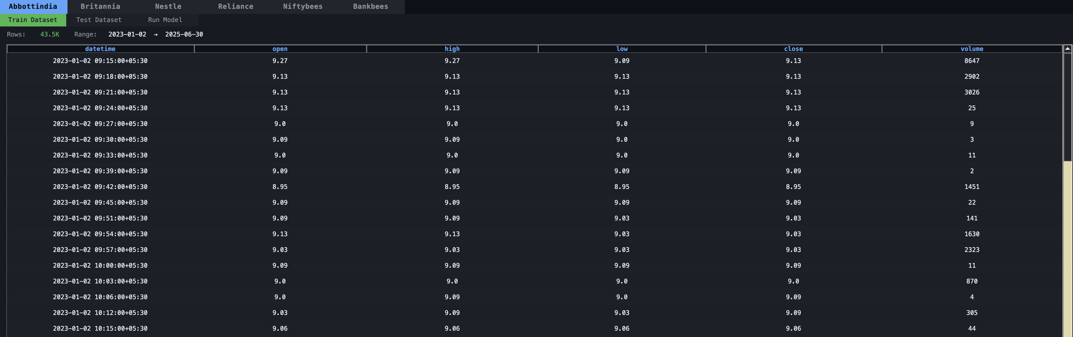
Data Collection & pre-processing
Data sourced using Angel One SmartAPI
Collected 3-minute candlestick data (OHLCV) for intraday
Introduced a noise filtering threshold (±0.05%), so that the movements between this range is treated as noise.
Converts raw price movement into clean directional signals

Slide 5
Feature Engineering
22 total features were created to provide a multi-dimensional view of the market
Price & Volume (5)
Open
High
Low
Close
Volume
Volatility & Risk (4)
Bollinger Band Width
ATR (Average True Range)
Rolling Standard Deviation
High-Low Range
Momentum & Trend (6)
RSI (Relative Strength Index)
RSI Fast
EMA Ratio
Price EMA Distance
Diff 1 (1-period price change)
Diff 5 (5-period price change)
Price Change & Dynamics (7)
Return 1
Return 5
Return 10
Candle Body
Volume Ratio
Raw Body
Raw Range

Slide 6
Model Architecture
Sequential Input: Takes 20 candles (60 minutes) as a single sequence.
Dual-Layer LSTM: Extracts temporal patterns and momentum from the sequence.
Dropout Layer: Clips unnecessary neural connections to prevent overfitting.
Sigmoid Output: Compresses the final logic into a single probability (0 to 1) for directional forecasting.

Slide 7
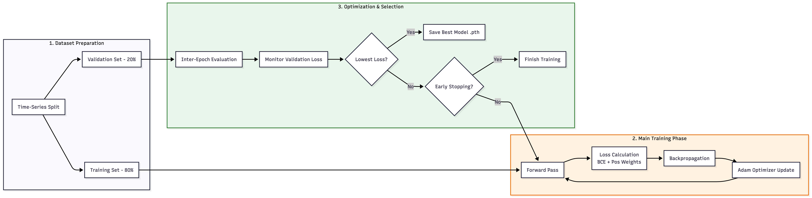
Training
Time-Series Split: We use the first 80% of data to train and the last 20% to validate, ensuring the model never "sees the future."
Best Model Persistence: Only the version of the model with the absolute lowest validation error is saved as best_stock_model.pth.
Early Stopping: If the model stops improving for 10 consecutive epochs, the system automatically cuts the training to prevent noise-fitting.

Slide 8
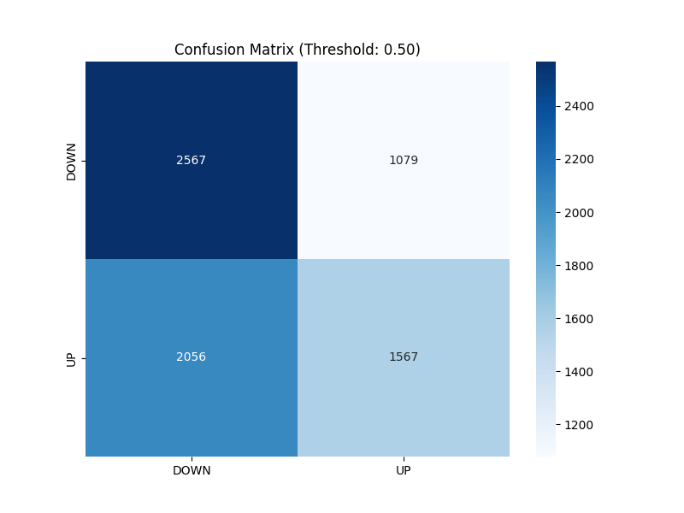
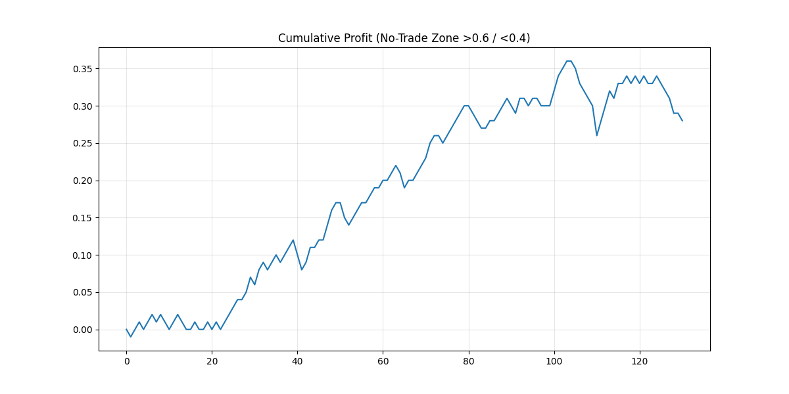
Evaluation & Backtesting
Dual-Audit Framework: We don't just use AI metrics (Accuracy), we use Financial metrics (Sharpe/Net Profit) to cross-verify the model.
Confusion Matrix: Shows exactly how many "True Positives" (correct Up predictions) vs "False Positives" (wrong Up predictions) the model made.
Equity Curve: This is the most realistic proof. It tracks the growth of ₹1 over the entire test period based on the model's 9-minute directional calls.

Slide 9
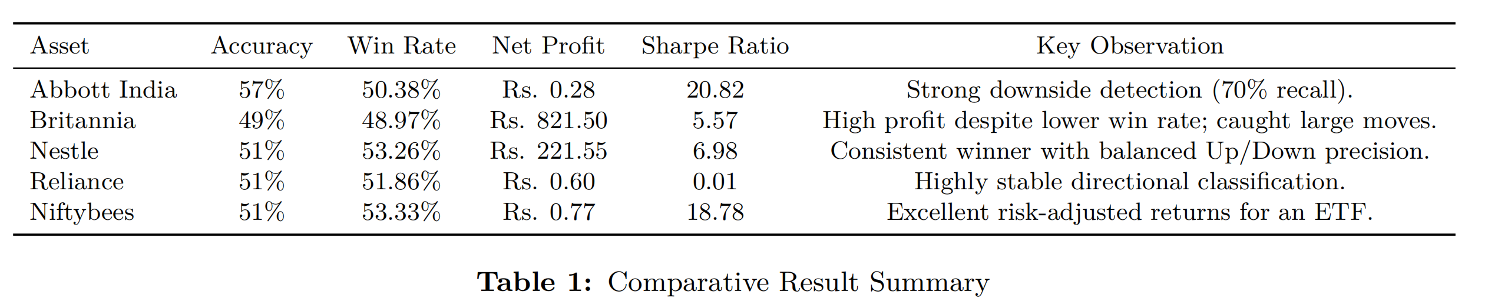
Conclusion & Result
The performance of the proposed LSTM-based framework was evaluated across five diverse datasets: Abbott India, Britannia, Nestle, Reliance, and the Niftybees ETF. The goal was to assess if the model could maintain a predictive edge in different volatility regimes and asset classes

Slide 10
Thank You

