Slide 1
SQ
indices
GDM
EWM
TOPSIS
Vision Proposal
IP
indices
Calculate the weight
Influence Analysis
Timeline
Short Term
Re-application
Of the Model
Medium Term
Verification
Validity Assessment
Gray Model
Long Term

Slide 2
Carbon dioxide in the atmosphere
forestland
tree
understory
Carbon sequestration
of forestland
Wood carbon sequestration
Carbon sequestration
of trees
Carbon sequestration
of understory
Forest products sequester carbon
Total forest carbon sequestration

Slide 3
Carbon storage per unit area
Maximum carbon absorption
Maximum carbon storage
age of tree

Slide 4
Ever-Increasing expenditure
Heavily Reliance On Public Funds
Higher
Education
System
Influences Of Epidemic Period
Heavily Reliance On Public Funds
Delayed-Completion Of Studies
Inequality Of Distribution

Slide 5


Achievement
Fairness
Coverage

Slide 6

EFFICIENCY
Higher Education Sector
INPUT
OUTPUT
National Economy

Slide 7
V
First level indicator | Abbreviation | Secondary indicators | Effect
Input | aee | The annual educational expenditure of the university on per student | +
 | hpg | Higher education expenditure as a percentage of GDP | *
 | pef | Public higher education expenditure as a proportion of fiscal expenditure | *
Output | dce | The degree of cooperation with the enterprises | +
 | ier | Improved employment rate compared with non-university degree | +
 | rur | Reduced unemployment rate compared with non-university degree | +
 | ri | reduced inactivity compared with non-university degree | +
 | ppa | proportion of PCT public applications | +
 | top10 | the top 10% of the cited literatures accounted for the proportion | +
Efficiency | pef | public expenditure as a percentage of university funding | *
 | str | average student-teacher ratio in institutions | *
First level indicator | Abbreviation | Secondary indicator | Effect
Coverage | pcy | The proportion of college students in the youth group | +
 | rmu | Ratio of masters to undergraduates | +
 | grc | Growth rate of higher education coverage in the past 30 years | +
Fairness | pfe | The proportion of student families in higher education expenditures | *
 | pou | The publicity of universities | +
Achievement | ad-a | Ability distribution-A | +
 | ad-b | Ability distribution-B | +
 | ad-c | Ability distribution-C | -
 | ad-d | Ability distribution-D | -
 | dgr | Doctoral graduation rate | +

Slide 8
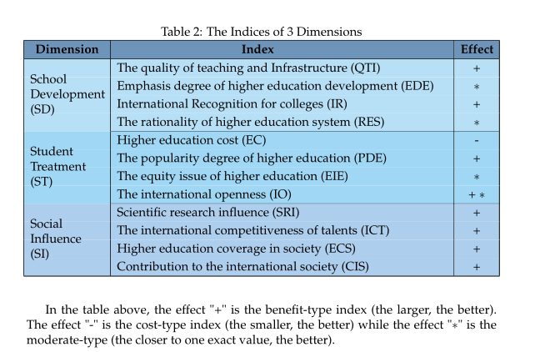
First level indicator | Abbreviation | Secondary indicators | Effect
Input | aee | The annual educational expenditure of the university on per student | +
 | hpg | Higher education expenditure as a percentage of GDP | *
 | pef | Public higher education expenditure as a proportion of fiscal expenditure | *
Output | dce | The degree of cooperation with the enterprises | +
 | ier | Improved employment rate compared with non-university degree | +
 | rur | Reduced unemployment rate compared with non-university degree | +
 | ri | reduced inactivity compared with non-university degree | +
 | ppa | proportion of PCT public applications | +
 | top10 | the top 10% of the cited literatures accounted for the proportion | +
Efficiency | pef | public expenditure as a percentage of university funding | *
 | str | average student-teacher ratio in institutions | *

Slide 9
Coverage
Fairness
Achieve
ment
Input
Output
Efficiency

Slide 11
的我

Slide 12
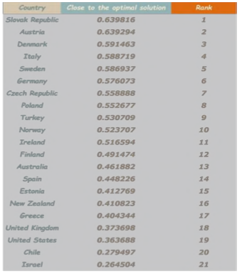
Country | Close to the optimal solution | Rank
Slovak Republic | 0.6398 | 1
Austria | 0.6392 | 2
Denmark | 0.5914 | 3
Italy | 0.5887 | 4
Sweden | 0.5869 | 5
Germany | 0.5761 | 6
Czech Republic | 0.5589 | 7
Poland | 0.5527 | 8
Turkey | 0.5307 | 9
Norway | 0.5237 | 10
Ireland | 0.5165 | 11
Finland | 0.4914 | 12
Australia | 0.4619 | 13
Spain | 0.4482 | 14
Estonia | 0.4127 | 15
New Zealand | 0.4108 | 16
Greece | 0.4043 | 17
United Kingdom | 0.3737 | 18
United States | 0.3637 | 19
Chile | 0.2794 | 20
Israel | 0.2645 | 21

Slide 15

Standardize tuition system, expand overall enrollment
Re-confirm the metrics and re-distribute subsidy to students in privation
Bound enterprises with higher education institutions
Establish higher education institution union
Control the epidemic
Revive national economy
2021
2040
2070
2100

Slide 17
初始值：S0、CN0、TP0、P0，置U=0，U₀=500
随机产生采伐向量g
计算S(g), CN(g),TP(g),P(g)
约束条件
N
进行选择、交叉、变异操作，保留可行解，计算CS*=CS、FE*=FE 、EB*=EB
W=W+1
W>500
Y
可行解，计算CS 、 FE 、 EB
Exit
CS*>CS且FE*>FE 且EB*>EB
U=U+1
U>U+U₀
N
输出最优解: CS*、FE * 、EB *

