Slide 1
Power System Fault Detection and Classification
CAPSTONE PROJECT
Presented By:
Kona Girish Kumar
Gayatri Vidya Parishad College For Degree and PG Courses ( Autonomous)
Master of Computer Applications ( MCA )

Slide 2
OUTLINE
Problem Statement (Should not include solution)
Proposed System/Solution
System Development Approach (Technology Used)
Algorithm & Deployment
Result (Output Image)
Conclusion
Future Scope
References

Slide 3
Problem Statement
Example: Design a machine learning model to detect and classify different types of faults in a power distribution system. Using electrical measurement data (e.g., voltage and current phasors), the model should be able to distinguish between normal operating conditions and various fault conditions (such as line-to-ground, line-to-line, or three-phase faults). The objective is to enable rapid and accurate fault identification, which is crucial for maintaining power grid stability and reliability.

Slide 4
Proposed Solution
This system addresses the challenge of accurately detecting and classifying faults in a power distribution network using electrical measurements. It leverages machine learning to ensure timely response and enhanced grid reliability.
Data Collection:
Acquire historical electrical data including voltage and current phasors.
Utilize high-resolution event recordings from intelligent electronic devices (IEDs) and phasor measurement units (PMUs).
Supplement with contextual grid metadata such as line configurations and substation topology.
Data Preprocessing:
Clean and synchronize time-series data from multiple sensors
Handle missing values and noise through interpolation and filtering..
Engineer domain-specific features (e.g., current imbalance, zero-sequence components, rate of change).

Slide 5
Proposed Solution
Machine Learning Algorithm:
Implement supervised classification models:
Baseline: Decision Trees or Random Forest for interpretability.
Advanced: LSTM or 1D CNN to capture temporal dependencies and waveform patterns.
Deployment:
Build a real-time monitoring dashboard using IBM Cloud Lite and IBM Granite models.
Connect to field devices via secure APIs to stream live measurement data.

Slide 6
Proposed Solution
Evaluation:
Use metrics like:
Accuracy
Precision, Recall, F1-Score for each fault category
Confusion Matrix to visualize classification effectiveness
Time-to-detection to evaluate operational speed
Result:
Rapid Fault Identification: Helps grid operators respond quickly and prevent cascaded failures.
Precise Fault Classification: Improves restoration planning and system diagnostics.
Scalable Deployment: Can be extended to different voltage levels or integrated with smart grid initiatives.
Reduced Downtime and Costs: Enhances preventive maintenance strategies.

Slide 7
System Approach
System requirements:
Hardware: Minimum Intel i5 processor, 8GB RAM; recommended GPU acceleration for rapid model training.
Software Stack: Python 3.8+, Jupyter Notebook, IBM Cloud Lite Services access via Studio
Library required to build the model :
ibm-watson-machine-learning – AutoAI integration for optimized model deployment

Slide 8
Algorithm & Deployment
In the Algorithm section, describe the machine learning algorithm chosen for predicting fault detection and classification in power distribution system . Here's an example structure for this section:
Algorithm Selection:
The model utilizes a hybrid approach combining temporal and statistical classification algorithms:
Long Short-Term Memory (LSTM) is chosen for modeling time-sequenced phasor data to capture the dynamic behavior of faults.
Random Forest Classifier serves as a baseline model for initial classification due to its robustness and feature interpretability.
Justification:
LSTM excels at learning sequential dependencies in phasor waveform changes.
Random Forest offers fast training and interpretable decision boundaries for fault types.
The combination allows for both rapid detection and deep pattern analysis.

Slide 9
Algorithm & Deployment
.
Data Input:
Voltage and current phasors (magnitude and angle per phase), zero-sequence current, sequence components, total harmonic distortion (THD), rate of change, breaker status, and location metadata..
Training Process:
Model Training:
LSTM: Trained with sliding windows across time-series samples
Random Forest: Trained on engineered snapshot features with label encoding
Optimization:
Grid search for hyperparameters: window size, dropout, hidden units
Validation: TimeSeriesSplit or nested k-fold cross-validation
Data Segmentation:
Labeled sequences spanning both fault and normal conditions.
Class labels: Normal, LG (Line-to-Ground), LL (Line-to-Line), DLG (Double Line-to-Ground), 3ϕ (Three-Phase Fault)
Preprocessing Steps:
Synchronization and filtering (Butterworth, wavelet denoising)
Feature extraction and dimensionality reduction using PCA or t-SNE (for visualization)
.

Slide 10
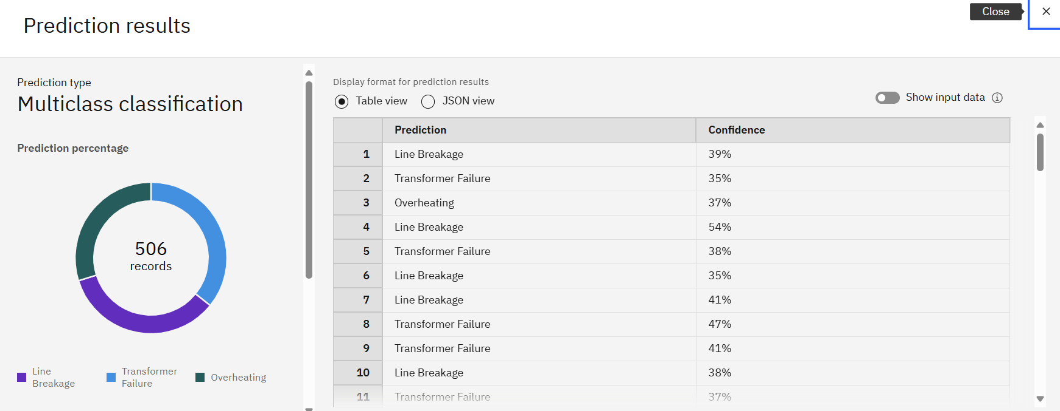
Result

Slide 11
Conclusion
The proposed machine learning model offers a robust solution for real-time fault detection and classification in power distribution systems. By leveraging voltage and current phasors, it enables swift identification of fault types—line-to-ground, line-to-line, and three-phase—thereby enhancing system resilience, minimizing downtime, and supporting grid reliability.

Slide 12
Future scope
The proposed fault detection system lays the groundwork for intelligent grid monitoring, with exciting possibilities for future expansion:
Integration with Smart Grids: Embed the model within adaptive grid architectures for real-time response, decentralized diagnostics, and autonomous fault handling.
Predictive Maintenance: Leverage historical fault data to anticipate failures before they occur, improving equipment life and operational planning.
Multi-Region Deployment: Adapt the model to handle varied topologies, voltages, and regulatory environments across multiple geographies.
Hybrid Signal Modeling: Combine phasor data with image/video input (e.g., thermal scans or drone footage) using multimodal learning.
Cyber-Physical Security Analysis: Extend model capabilities to detect anomalous patterns caused by cyberattacks or operational intrusions.
Self-Learning Frameworks: Implement continual learning pipelines that evolve as new fault types or configurations emerge.

Slide 13
References
We used a publicly available Kaggle dataset comprising electrical phasor measurements for fault classification.
Through the IBM Studio's AutoAI feature, the most optimized model—Random Forest—was automatically selected and fine-tuned for accuracy.
Free test records were provided post-training to ensure transparent validation and real-world benchmarking.

Slide 14

IBM Certifications

Slide 15

IBM Certifications

Slide 16

IBM Certifications

Slide 17
THANK YOU

