Slide 1

Project 2 Presentation
Jesse Draper

Slide 2
Security Policy
Validate Input Data
Heed Compiler warnings
Architect and design for security policy
Keep it simple
Default Deny
Adhere to the principle of least privilege
Sanitize data sent to other systems
Practice defense in depth
Use effective quality assurance techniques
Adopt a secure coding standard

Slide 3
Overview
Do not read uninitialized memory
Do not define a c style variadic function
Do not attempt to create a std::string from a null pointer
Prevent sql injection
Properly deallocate dynamically allocated resources
Use static assertions to teste the value of a constant expression
Handle all exceptions
Guarentee that storage for strings has sufficient space for character data and the null terminator
Close files when they are no longer needed
Do not use std::rand() for generating pseudorandom numbers

Slide 4
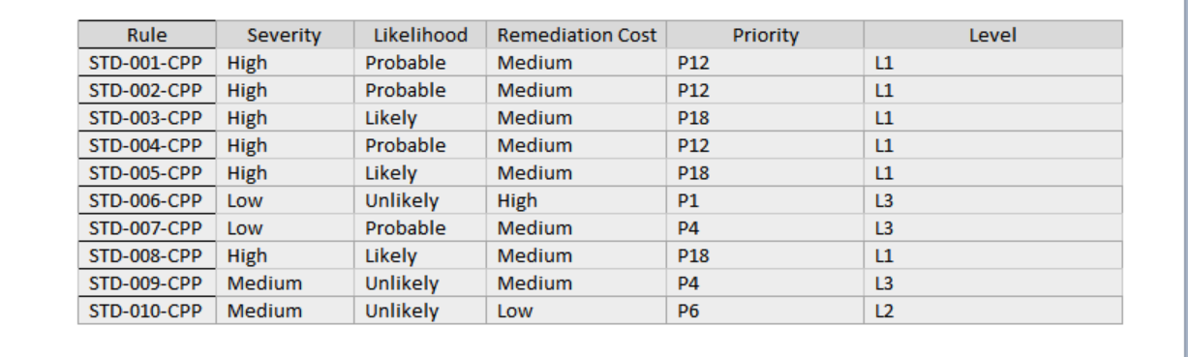
Severity
The higher the level of severity, the higher it should be prioritized over lower-level threats

Slide 5
Encryption strategy
Encryption at rest: Data that is stored on devices or accessed remotely needs to be protected. That is why data at rest on servers/databases must always be encrypted if it can be accessed. Various tools exist as well as storage device encryption to ensure the integrity of the data in question.
Encryption in flight: While in transit data can be vulnerable. Properly managing the requests and the inputs from users can help deter chances of corruption. Internal measures such as encrypting the data and properly handling can be used, as well as exterior measures such as firewall and authentication to protect remote accessing.
Encryption in use: Whenever new data is created it is important to properly format and store this information. This involves hashing or encrypting the information and properly storing it. Managing user access to the program can limit ill-intent to manipulate new data within a system and properly storing can make it adequately protected along with the rest of the information

Slide 6
Triple A-framework
Authentication : is necessary to confirm identity of a user/admin within the system. There are usually keys or passwords required to authenticate within a system. MFA is another tool that can greatly improve the accendibility of those authorized within the system. Ensuring that users have been authenticated greatly improves the overall security of data that these authenticated individuals have access to.
Authorization: give access rights to a system that otherwise average individuals would not be entitled to. By limiting access to crucial components within a system it allows for more vulnerable or sensitive information to be protected behind these right. This is one of the reasons why default denying privileges is a common practice within the industry and allows confidential data to have an additional level of security within the application protecting it.
Accounting: is necessary to implement to handle transactions within the system. Accurately tracking incoming and outgoing requests as well as system permissions can help confirm the accountability within a system. This also allows the system administrators to track user activity when necessary.

Slide 7
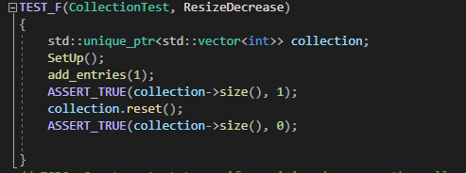
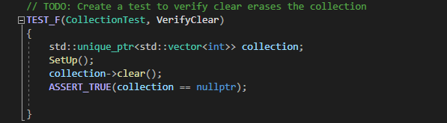
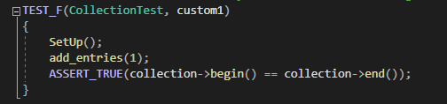
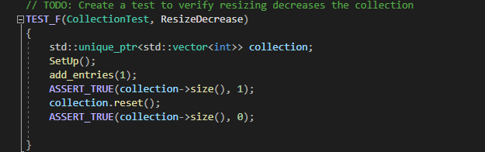
Unit testing

Slide 8
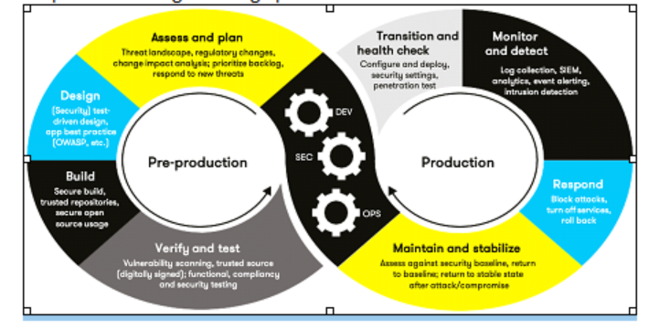
Automation
Automation is crucial in enforcing and defining these security standards within pre-production as well as production.
We can implement many of the practices in the entirety of coding practices throughout development. During designing and building, good coding practices and proper routing/handling can provide solid frameworks for activity within an application.
We can verify and test results of these via assertion and health checking. From there, monitoring the systems and maintaining becomes a core responsibility of the team.

Slide 9
tools
Astree: Fast and precise analyses
runtime error
non-interference analysis
automatically generated report files
Parasoft C/C++ test: integrated tools for testing c and c++ code (VS studio/eclipse plugin)
supports software development
static/dynamic code analysis
runtime error testing
RuleChecker: Can be used to analyze handwritten or generated source code with complex memory usage
supports MISRA, SEI CERT, and ISO/IEC standards

Slide 10
Risks and benefits
Pros
Early implementation allows for easier integration with minimized costs
Proactive defense strategies are flexible and constantly improving
Overall defense stronger
Cons
Initial costs increase
More expertise to properly implement
Adds complexity

Slide 11
Recommendations
Follow up on discoveries with tools and testing
Security as a foundation
Proactively implementing proper unit testing
Expectation of addressing to discrepancies

Slide 12
Conclusion
Validate Input Data
Heed Compiler Warnings
⦁ Architect and Design for Security Policies
⦁ Keep It Simple
⦁ Default Deny
⦁ Adhere to the Principle of Least Privilege
⦁ Sanitize Data Sent to Other Systems
⦁ Practice Defense in Depth
⦁ Use Effective Quality Assurance Techniques
⦁ Adopt a Secure Coding Standard

Slide 13
References
https://www.absint.com/rulechecker/index.htm
https://www.parasoft.com/products/parasoft-c-ctest/
https://www.absint.com/astree/index.htm

