Slide 1
PlugPart To The Cloud
By Team Yellow

Slide 2

PlugPart
Our Customer, a standard run off the mill spare parts dealer , supplying all kinds of parts for automobiles new and used.
Since Its establishment as a local B2B has been meeting the needs of small time automechanic workshops.
Recently they decided to scale up their business and jump on the Global Stage with AWS.

Slide 3

Our Solution

Slide 4
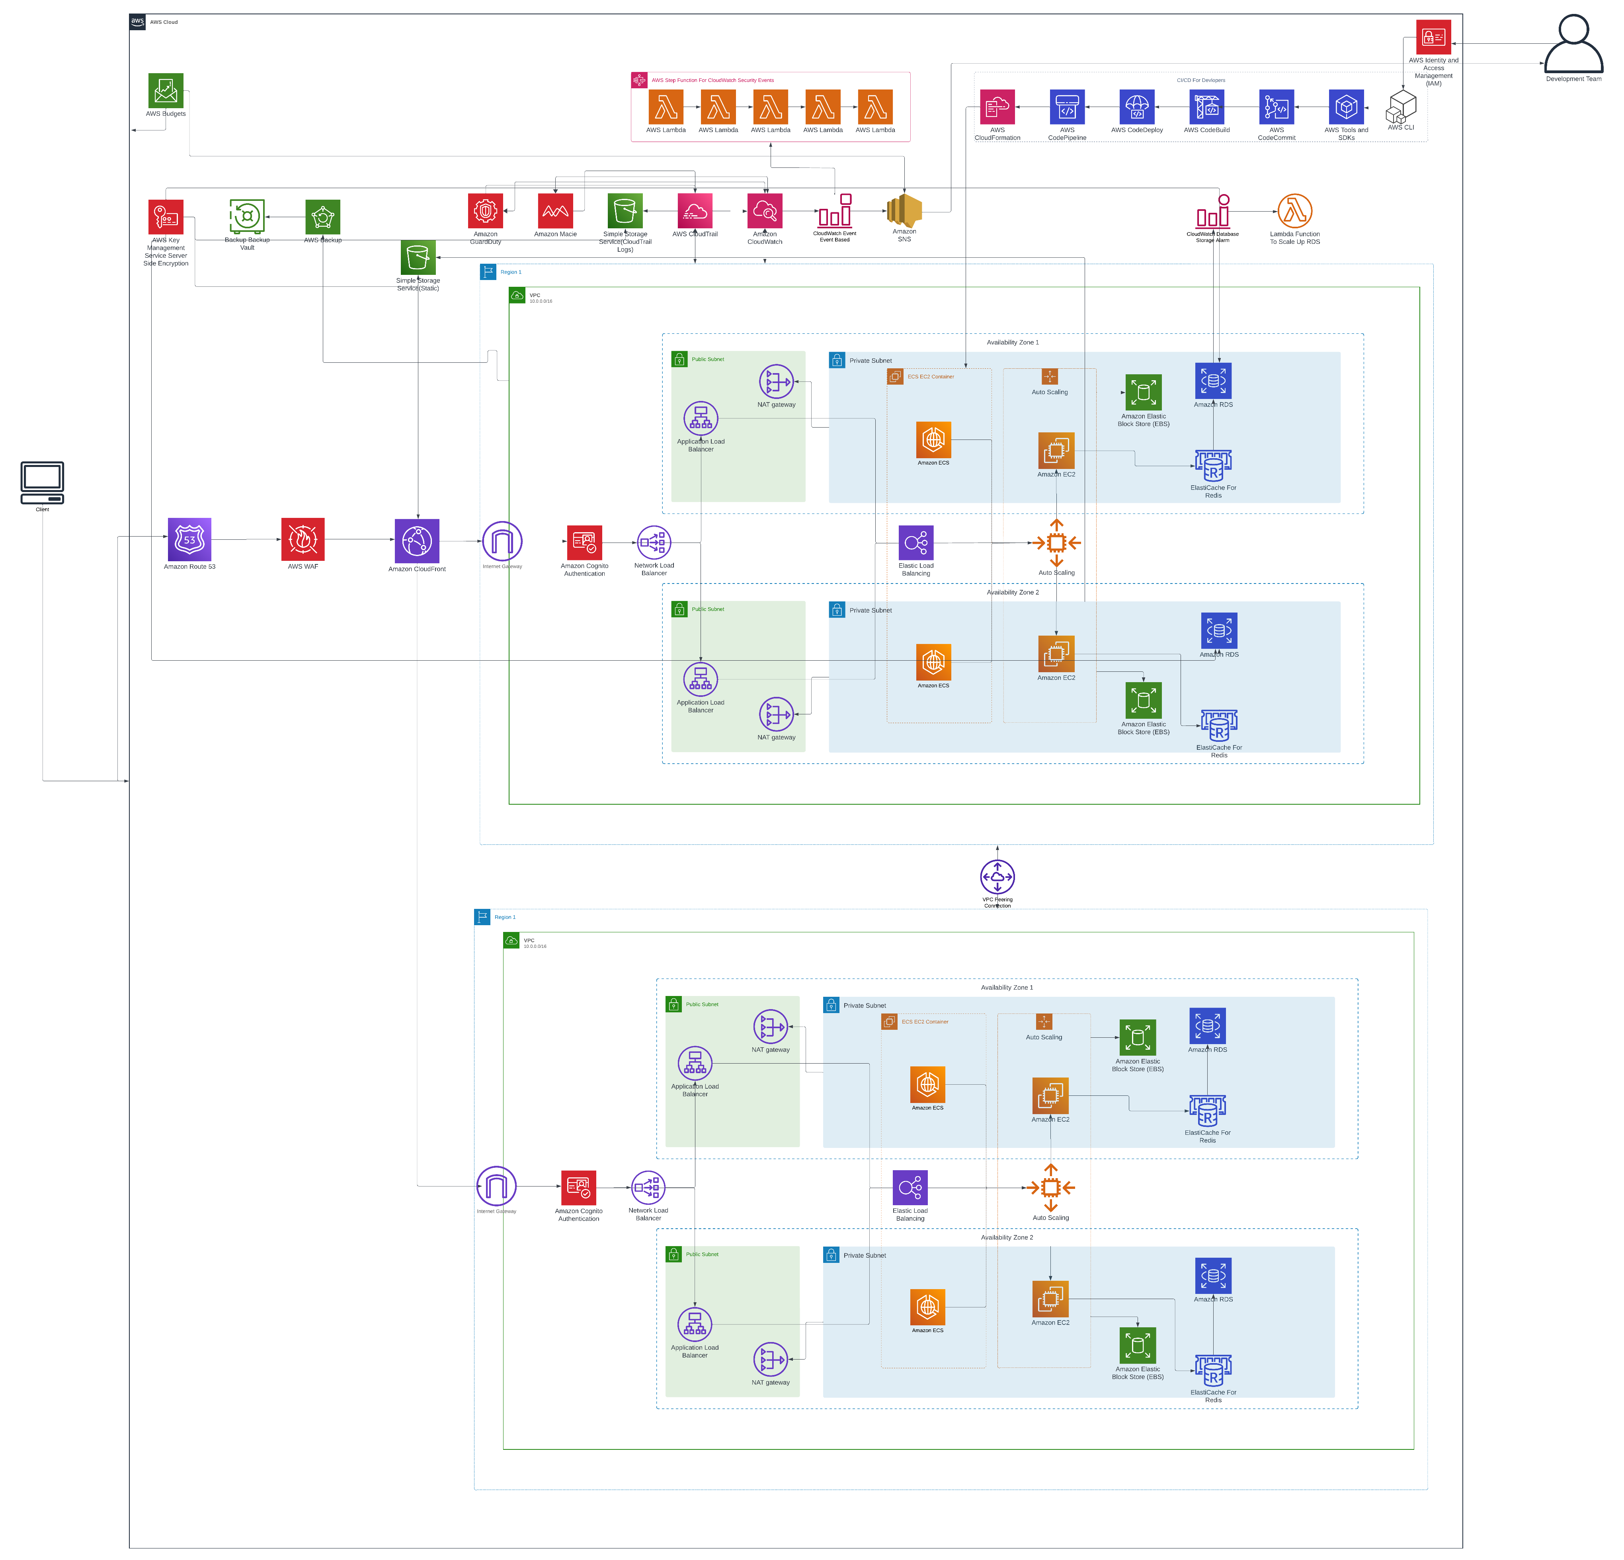
Solution Architecture

Slide 5
Well Architected Framework
01
02
03
04
05
06
Operational Excellence
Security
Reliability
Performance Efficiency
Cost Optimization
Sustainability

Slide 6
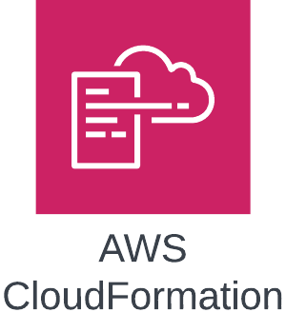
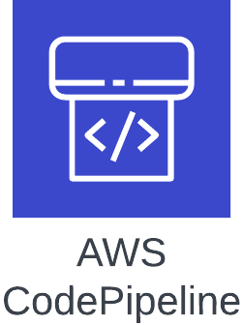
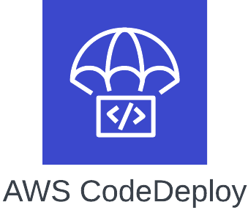

Operational Excellency
Implementing a CI/CD pipeline using
AWS CodeCommit
AWS CodeBuild
AWS CodeDeploy
AWS CodePipeline
AWS CloudFormation
Perform Operations as Code
Using AWS lambda to respond to Operational events like security events
Using AWS lambda to scale up RDS
Anticipate failure
Use AWS CloudWatch

Slide 7
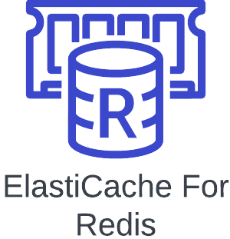
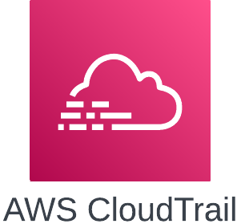
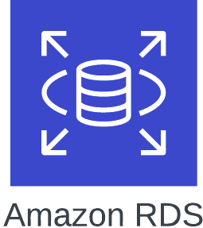
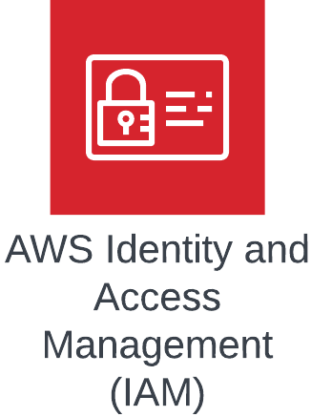
Security
Strong Identity Foundation
AWS IAM
AWS Cognito
Traceability
AWS CloudTrail
Keep people away from data
Placing RDS instances and ElastiCaches in Private Subnets

Slide 8

Reliability
Scale horizontally to increase aggregate workload availability
Stop guessing capacity
AWS EC2 Auto Scaling
Automatically recover from failure and Improved Availability
Deploy Architecture to multiple Regions and Availability Zones.

Slide 9
Performance Efficiency
AWS EC2 Auto Scaling
Amazon CloudFront
AWS EBS
AWS S3
AWS RDS
AWS ElasticCache

Slide 10

Cost Optimization
Implement Cloud Financial Management
AWS Budgets

Slide 11
Sustainability
Use Managed services
AWS RDS
Maximum Utilization
EC2 Auto Scaling

Slide 12
Da Billz
How much are we paying?

Slide 13
$4548.00
$1037.15
$16993.80
Upfront Cost
Monthly cost
12 months

Slide 14
Thanks! (Applaud we)

