Slide 1



Project:
Mart Management
and Billing Software

Slide 2

Overview:
Introducing our Mart Management & Billing System software—it's like a helpful assistant for stores! Our project makes it easy to manage employees, keep track of products, and handle sales—all safely stored on your computer. You don't even need the internet for it to work; our system is cool like that. With a robust local database, handling product info and employees is super easy. Admins can quickly add new employees and products. Creating invoices is a straightforward process, conveniently done directly on your computer. And here's a nifty feature: employees get a special OTP code sent to their email for extra security. If an employee forgets their password? No problem! Employees can change it themselves! Step into the future of Mart Management—easy, convenient, and made just for you!

Slide 3

Technologies:
Integrated Development Environment (IDE): Visual Studio served as our primary IDE for coding, debugging, and building our robust desktop application.
Database Management: Utilizing SQL Server Local DB for efficient and secure data storage, ensuring seamless integration with our C++ CLI-based desktop application.
Programming Language: Our Mart Management & Billing System is developed using C++ CLI, a powerful extension of C++ that enables seamless integration with the .NET Framework.
User Interface (UI): Windows Form is like the friendly face of our application. It helps us design buttons, screens, and all the things you see and click in our Mart Management & Billing Software.

Slide 4

Group Members
Konain Raza
Abdul Moiz

Slide 5
UI Snippets

Slide 6
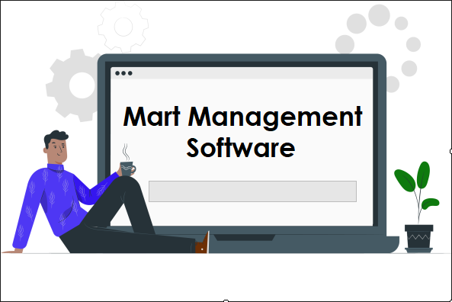
Loading Screen

Slide 7
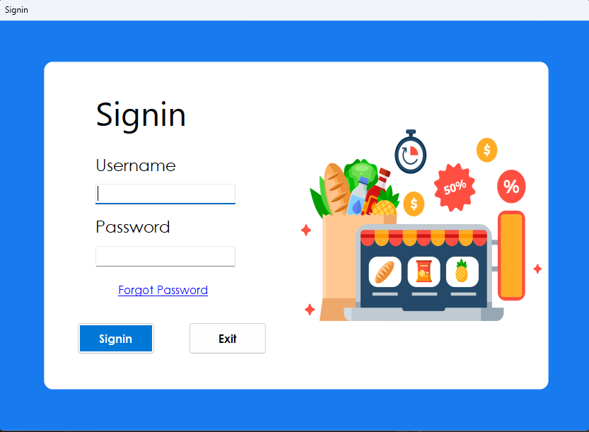
Signin Page

Slide 8
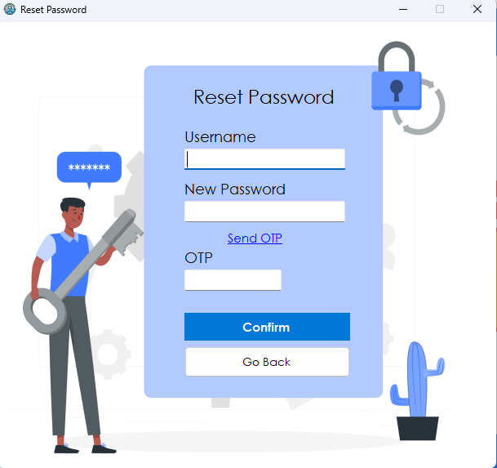
Reset Password Page

Slide 9
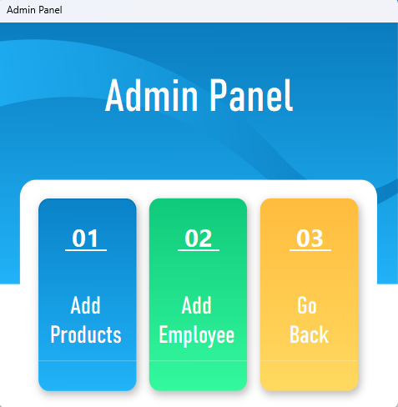
Admin Panel

Slide 10
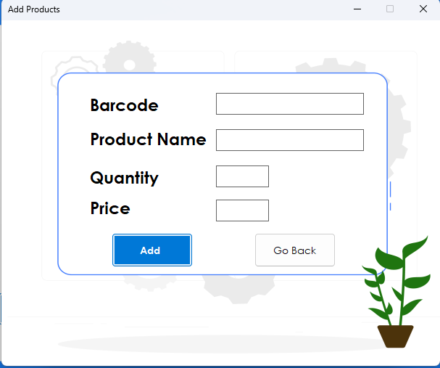
Add Products Page

Slide 11
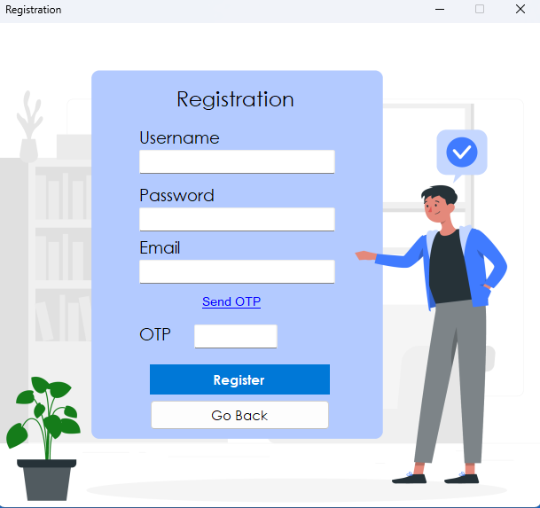
Add Employee Page

Slide 12
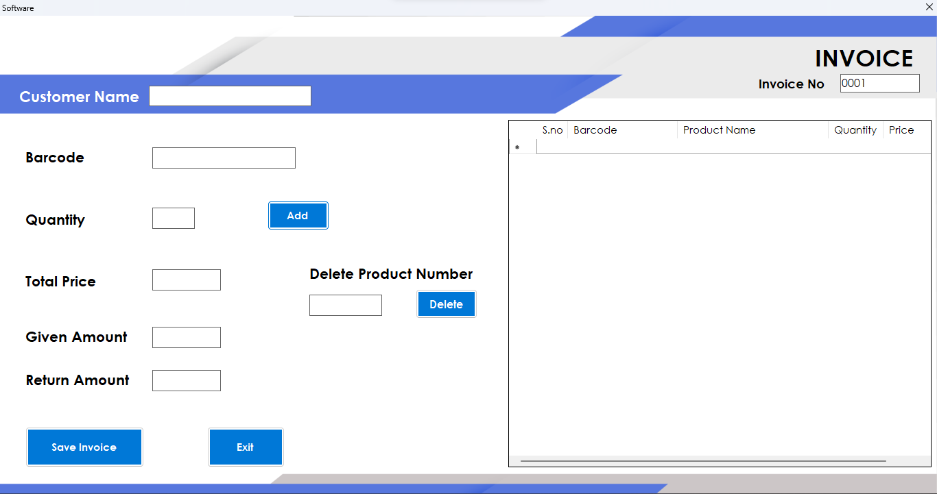
Billing System Page

Slide 13

Let's Go!

Slide 14


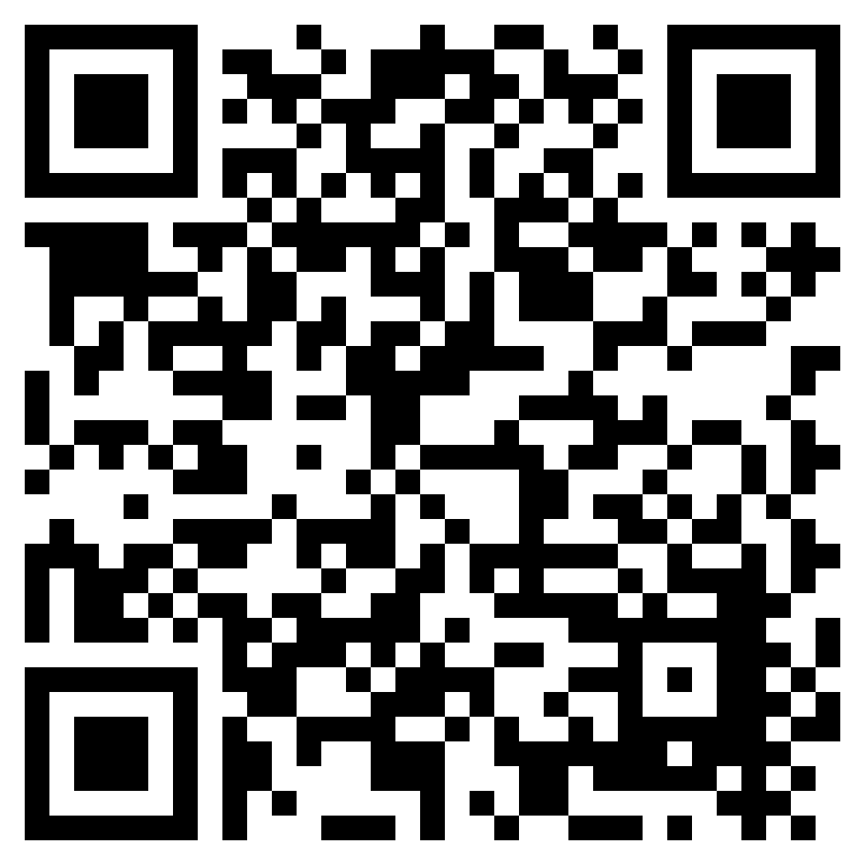
If you like this project and want to use it on your computer, scan this QR code to download our software
Thankyou

