Slide 1



Rust TEE
Side Channel Resistant Crypto Library for TEE
Final Project Inspection
Group member: Yongkang Sun, Kunlong Zhang

Slide 2

Outline
SGX - Side Channel Attack
DATA is compatible with SGX
MIRAI Verification - RSA

Slide 3
SGX-Side Channel Attack

Slide 4
Can SGX defend against side channel attacks?
Unfortunately NO
- Preventing side channel attacks is a matter for the enclave developer.
https://www.intel.com/content/www/us/en/developer/articles/technical/intel-sgx-and-side-channels.html

Slide 5
Cache attack
Flush+Reload:
Not work
Enclave doesn’t share memory with other process
Prime+Probe:
Work
Implemented by Johannes G ̈otzfried to attack an eclave which running a AES T-table implementation

Slide 6
TLB
Flush+Reload:
Work
Attack the PTE managed by OS
Coarser granularity (32KB, 8 PTE in one cache line)

Slide 7
Controlled-Channel Attack
Page-level attack
Untrusted OS modify the present bit to trigger page fault to get the information of memory accesses

Slide 8
Interrupt-driven Attack
Instruction level
Using the frequent timer interrupt of the Advanced Programmable Interrupt Controller (APIC) to suspend the enclave executation with an asynchronous exit event (AEX)
Modify the access bit of enclave’s PTE to get the information of enclave execution

Slide 9
DATA is compatible with SGX

Slide 10
Is DATA compatible with SGX
DATA compatible with SGX
DATA Threat Model:
- Accurately observe full, noisy-free address traces
- Sequence of instruction pointers
- addresses of instructions
- Addresses of the operands accessed by each instruction
Interrupt-driven Attack can help data get the information it wants at instruction level

Slide 11
MIRAI Verification - RSA

Slide 12
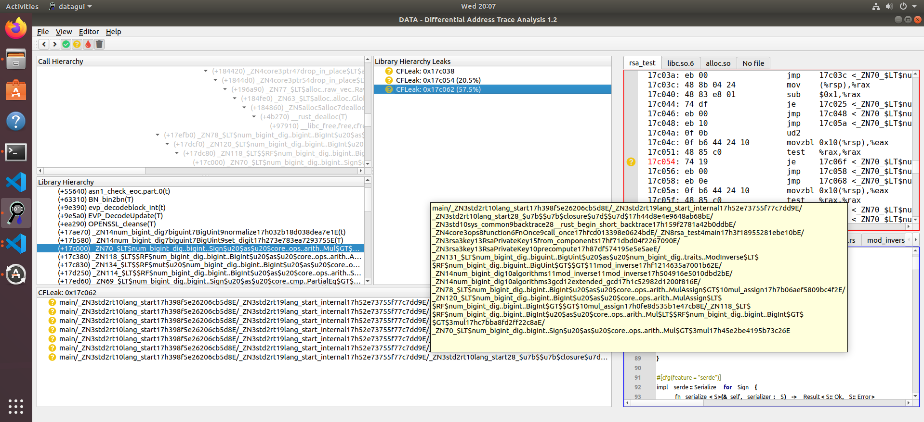
The first function: multiply of 2 bits

Slide 13
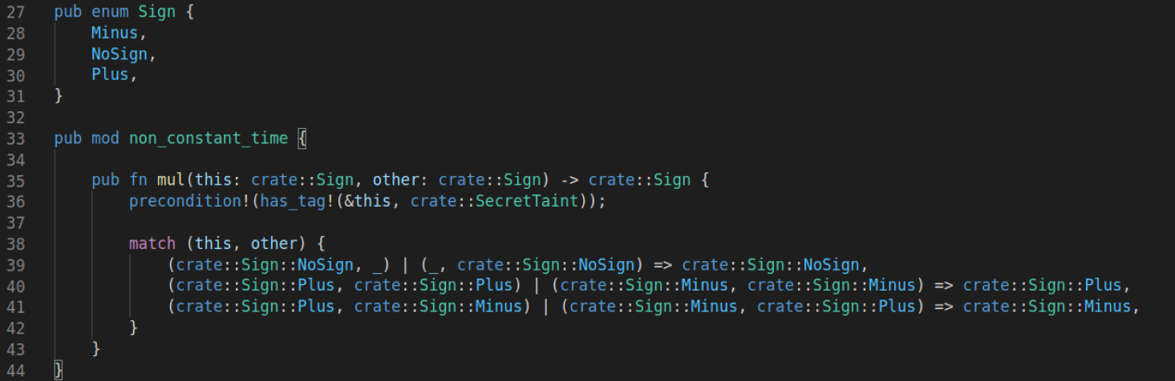
The first function: multiply of 2 bits

Slide 14
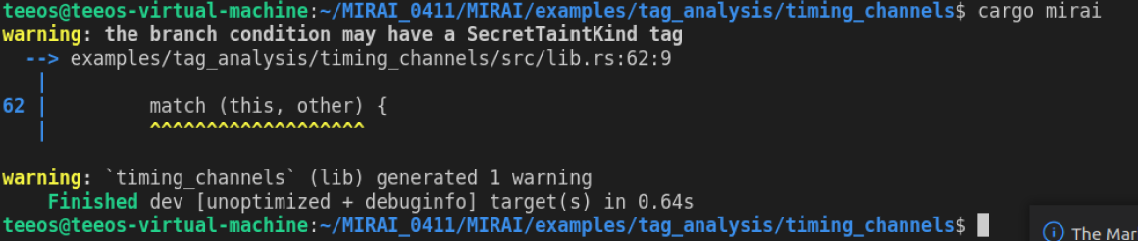
The first function: multiply of 2 bits

Slide 15
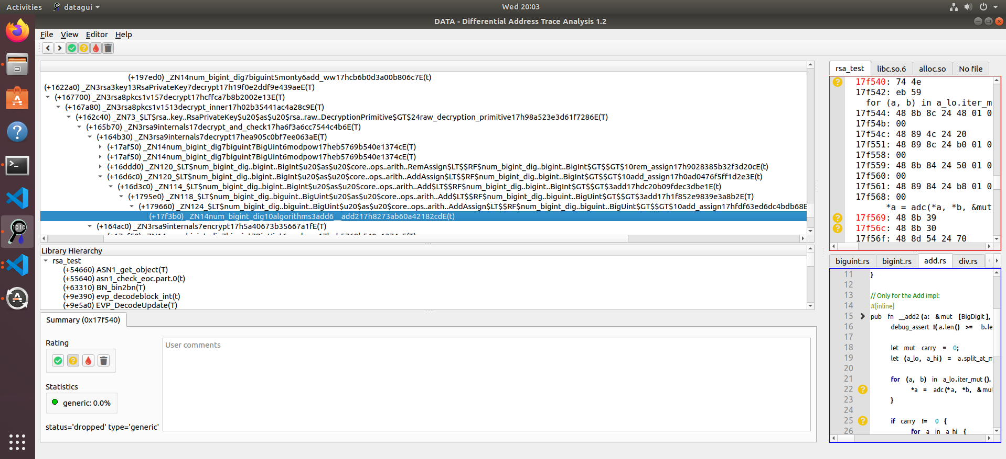
The second function: addition of two big integer

Slide 16
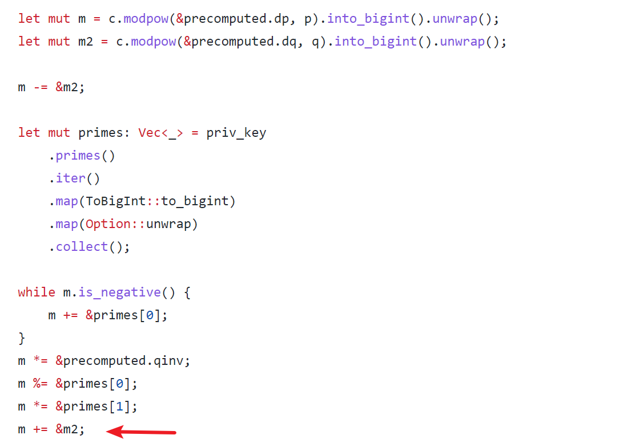
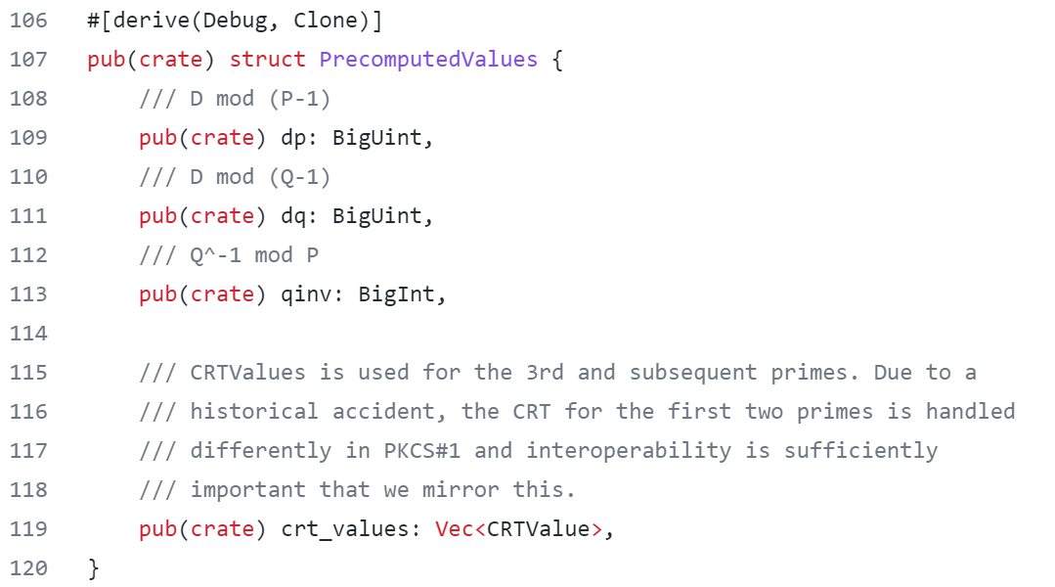
The second function: addition of two big integer

Slide 17
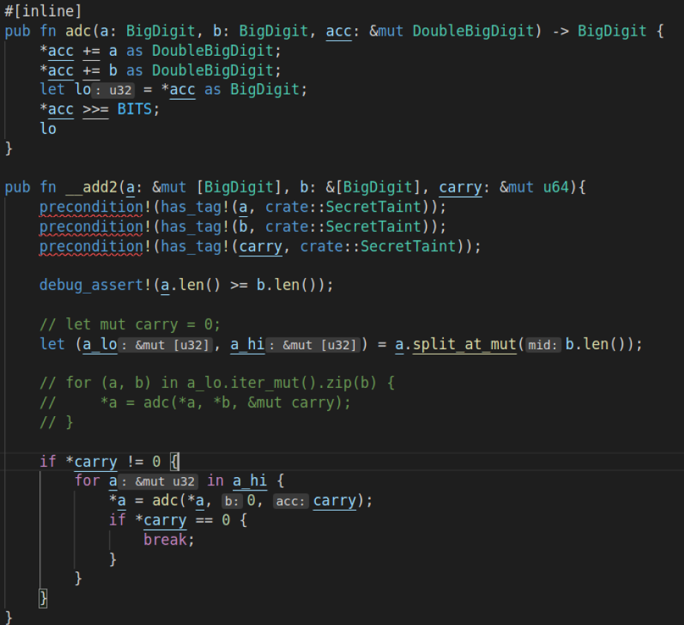
The second function: addition of two big integer

Slide 18
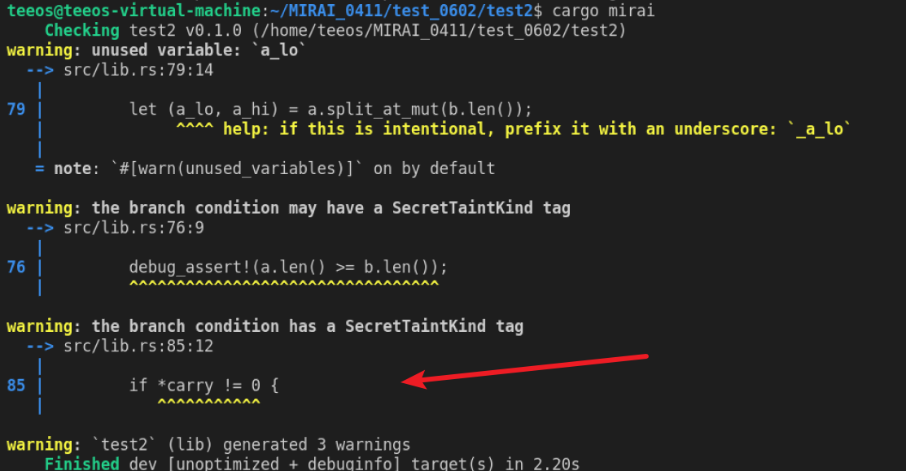
The second function: addition of two big integer

Slide 19
Thank you！

