Slide 1

TEE OS Based on Rust
——Side Channel Resistant Crypto Library For TEE OS
11911409 孙永康 11911104 王辰宇

Slide 2
CONTENTS
1
Background introduction
2
Main Objective
3
Schedule
4

Slide 3
01
Background introduction
TEE, Rust Crypto Library & Side Channel Attack

Slide 4
TEE(Trusted Execution Environment)
请输入您的标题内容
A trusted execution environment (TEE) is a secure area of a main processor. It guarantees code and data loaded inside to be protected with respect to confidentiality and integrity.(Wikipedia)
Hardware support: Intel SGX, AMD TrustZone.etc
In this project, Intel SGX is used.

Slide 5
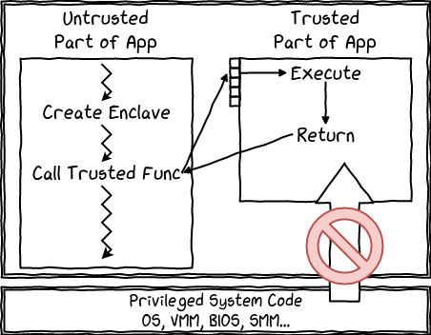
TEE(Trusted Execution Environment)
请输入您的标题内容
Intel SGX Intel Software Guard Extensions (SGX) is a set of security-related instruction codes that are built into some modern Intel central processing units (CPUs)
( https://blog.quarkslab.com/overview-of-intel-sgx-part-1-sgx-internals.html)

Slide 6
Rust Crypto Library
请输入您的标题内容
Why Rust?
Rust provides excellent memory safety.
An existing Crypto Lib implemented by Rust, including symmetric/asymmetric cryptography, hash algorithm, digital signature.etc
https://github.com/RustCrypto

Slide 7
Side Channel Attack
请输入您的标题内容
In computer security, a side-channel attack is any attack based on information gained from the implementation of a computer system, rather than weaknesses in the implemented algorithm itself (e.g. cryptanalysis and software bugs)
examples:
cache side-channel attack
timing attack
power-analysis attack
...

Slide 8
02
Main Objective

Slide 9
Main Objective
请输入您的标题内容
Our main object of this project is to create a Rust language crypto library with side channel resistance.
The basic method we use is to prune and modify a current existed crypto library. And make it side channel resistant.

Slide 10
Thinds We Need to Do
请输入您的标题内容
Firstly, Learn background knowledge about TWO basic crypto algorithms (RSA, ECDSA) and summarize existing side channel attacks to these algorithms.
Secondly, Learn and summarize some methods to mitigate the side channel attack.
Finally, Apply the mitigate method we learn into the existing RUST crypto library, and find ways to test its ability to resist SCA.

Slide 11
03
Schedule

Slide 12
Schedule
Currently
Until Week 10
We have learnd some basic concepts of TEE and Rust programming language
Finish learning background knowledge of Side-Channel Attacks. Trying to find ways to perform a side channel attacks to these existed library.
Until Week 13
Test and Debug the ability of RSA and ECDSA resisting SAC.
Until Week 8:
Finish learning existing Rust crypto library. Prune and try to use this existing library inside TEE (Intel SGX).
Until Week 12
Until Week 15
Finish learning methods to resist side channel attacks, and try to modify the most commonly used two algorithms: RSA and ECDSA.
Complete other algorithms. Test the performance and ability of our modified library.

Slide 13







THANK YOU !

