Slide 1
PLAYTAPE · OPEN SOURCE
I vibecoded an open-source
DAW for kids
(and a real one for myself, first). Built almost entirely by talking to an AI coding agent — not by typing the code.
LOUD
Konstantinos Skopas · Koncave Design Studio
MIT Licensed · github.com/<you>/tape-daw

Slide 2
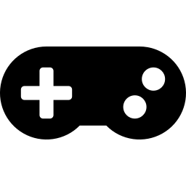

THE PROBLEM
Kids' music apps are stuck between two failure modes
Gamified into a chore
A toy, not an instrument
Streaks, XP, notifications — practice turns into a treadmill instead of a reason to make something.
Cute interface, but nothing that produces a recording a kid — or you — would actually want to keep.
We wanted neither.
PLAYTAPE — 2

Slide 3


THE BET
One real engine. Two doors.
SHARED ENGINE
recording · mixing · export · project format
TAPE
PLAYTAPE
The full portastudio. 8 tracks, non-destructive FX, fast offline export.
The kids' edition. Same engine, a shelf of cassettes, three stages.
Same project file, both directions — PLAYTAPE isn't a toy you throw away, it's a gateway.
PLAYTAPE — 3

Slide 4
PRODUCT TOUR
Home is a shelf, not a file browser
Every song is a cassette. Tap a blank one to start; a finished mix earns a small foil sticker — the entire reward system.
PLAY
ARRANGE
STUDIO
ages ~5-7
ages ~8-11
12+ and grown-ups
Giant record & play. One knob per track. Nothing to break.
Clips, loops, punch-in, a drum grid, three macro knobs.
Full mixer, pedal FX, stems, MP3, MIDI learn.
Nothing is ever locked. A kid picks their own stage — every time, on every song.
PLAYTAPE — 4

Slide 5



DESIGN PHILOSOPHY
Built around Montessori principles, not decoration
Self-directed progression
The kid chooses their own stage, every time — it's a filter on the UI, not a gate to unlock.
Isolation of difficulty
Play stage is just record + listen. Nothing else is on screen to accidentally break.
Control of error
Every action undoes. Nothing is destructive — mistakes are just a Ctrl+Z away.
One small reward, on purpose
A finished song earns a foil sticker. No points, no streaks, no popups — that's the whole system.
PLAYTAPE — 5

Slide 6

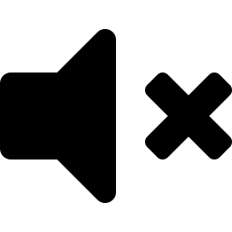

ACCESSIBILITY
Neurodivergent-first, not bolted on afterward
Calm Mode
Kills every animation and blinking light in the app, and honors your OS's reduce-motion setting automatically.
A loudness ceiling, always on
A limiter runs unconditionally — nothing can suddenly get painfully loud, by design, not as a setting.
Big, forgiving targets
Every control is sized for a hand still learning precision with a mouse or touchscreen.
A layout that holds still
Nothing rearranges itself mid-session. What's where stays where.
PLAYTAPE — 6

Slide 7
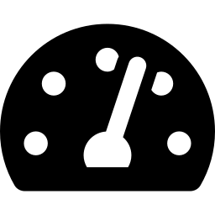
FEEL
Controls that feel like something
A ring you can feel
Knurled texture, rendered entirely in CSS — no image assets.
Real detents
Clicks through discrete steps and snaps magnetically to its home position.
A value arc
An orange arc fills around the knob as you turn it — readable at a glance.
LOUD
A real knob, in CSS: knurled ring, click detents, a value arc.
Physical-feeling controls matter most for a tactile learner — or a kid who's never used a mouse for anything precise before.
PLAYTAPE — 7

Slide 8
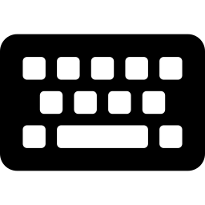

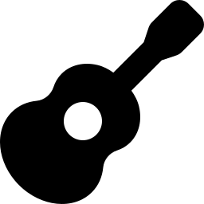
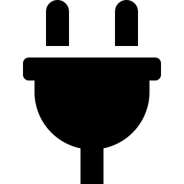
INSTRUMENTS
Play it three ways, from zero setup
Keys
Drums
Pocket Synth
MIDI
4-voice synth
16-step grid
glide & glissando
any USB keyboard
Mouse, computer keyboard, or a real MIDI keyboard — with velocity, no drivers, no setup screen.
PLAYTAPE — 8

Slide 9
VIBECODING, HONESTLY
How it was
actually built
Three real bugs. What they taught us.

Slide 10
BUG #1
It “worked.” It was just glacial.
Bouncing a 3-minute mix took 25+ seconds. The mixer was building every audio effect for every track — even the ones switched off.
17.8s
↓
2.2s
~8x faster · zero change in the output
Fix: skip bypassed effect nodes entirely when rendering offline.
PLAYTAPE — 10
Notes:
Deeper detail: OfflineAudioContext was constructing a full node graph (biquad filters, convolvers, compressors, delay lines) per track regardless of whether that effect's toggle was on. Building those nodes and connecting them has real CPU cost even when their effect is a no-op. The fix conditionally omits a node from the graph entirely when its control is bypassed, rather than building it and setting a bypass gain to zero.

Slide 11
BUG #2 — THE BEST STORY
One dropped quote mark
Because all UI wiring ran as one script, that single error silently killed everything written after it:
id="drumBtn title="Drum machine"
↑ the closing quote never made it in
Close buttons ✗
Escape key ✗
That's not a cosmetic typo — it makes the browser return nothing when the app looks up that button by id. The very next line of code does:
Click-outside-to-close ✗
$('drumBtn').onclick = openDrums
Drag & drop import ✗
...on a button that doesn't exist — which throws.
Unsaved-changes warning ✗
PLAYTAPE — 11
Notes:
The bug hid through a full round of testing because the tests called the underlying JS functions directly (e.g. openDrums()) to verify behavior, rather than clicking the actual on-screen button — so the exception that killed the rest of the script's wiring never fired during verification. It was only caught when the human user clicked a modal's close button in real use and reported it. Textbook gap between 'the code runs' and 'the feature works.'

Slide 12
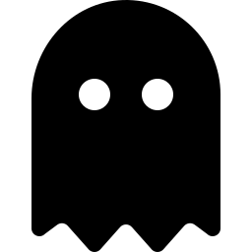

BUG #3
The install that wasn't
Every automated check said the app had updated. The actual desktop icon kept opening yesterday's version.
The AI's writes
Desktop writes
Landed in a private, virtualized copy — invisible outside its own process.
The real thing — exactly what the shortcut actually opens.
Fix: deliver to a real, non-virtualized location — and log every launch so failures are diagnosable, not silent.
PLAYTAPE — 12

Slide 13
THE LESSON
What vibecoding is actually good at — honestly
Genuinely good at
Not proven at, yet
Iteration speed on UI and features
Finding performance issues a human might not think to profile
Fearless refactors with fast feedback
Testing the way a real user actually clicks
Catching platform-specific sandboxing quirks
Replacing a human who pushes back on “it works”
The human was the test suite. Fine at this scale — not proven at a bigger one.
PLAYTAPE — 13

Slide 14
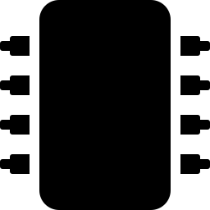
UNDER THE HOOD
No bundler, no Node, no Electron — on purpose
AudioWorklet
OfflineAudioContext
Web MIDI
JSON + WAV
Sample-accurate recording
Fast, non-blocking export
Hardware keyboards, zero drivers
Project files, no proprietary format
Packaging: a Python launcher + a .bat installer → a Desktop icon that opens a real browser window.
No Electron, no bundled Chromium — the machine already has a real browser. Single HTML file per app: open it in ten years, it still runs.
PLAYTAPE — 14

Slide 15

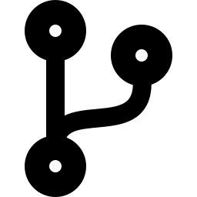
OPEN SOURCE
MIT licensed.
Fork it, break it, teach with it.
github.com/<you>/tape-daw
Contributions welcome — see CONTRIBUTING.md
Roadmap: translations, a Raspberry Pi bridge for real physical knobs & LEDs
Go press the big red button.
PLAYTAPE — 15

Slide 16
Thank you.
Questions?
Konstantinos Skopas · Koncave Design Studio · github.com/<you>/tape-daw

