Slide 1
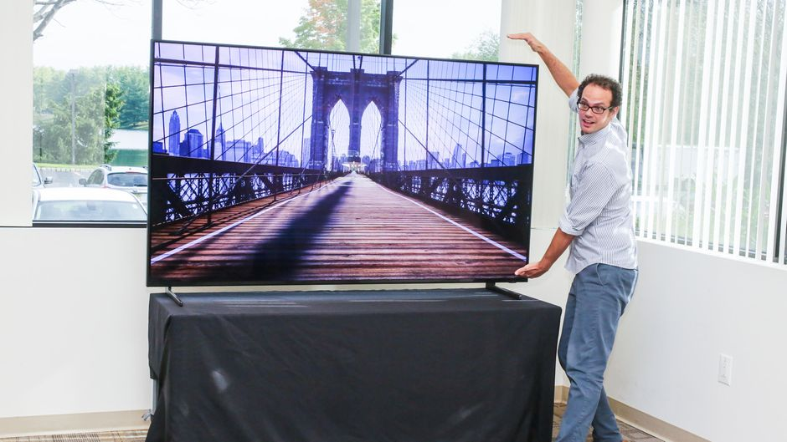

Slide 2
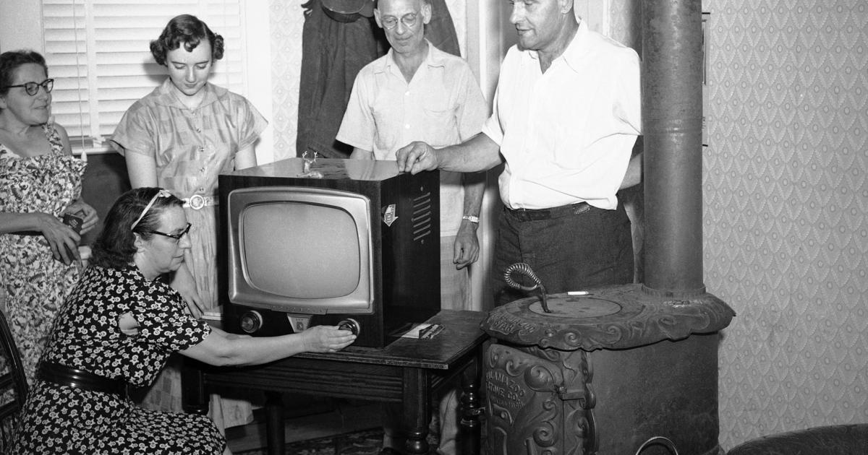
THE TV SIZE IS DEREASED AS COMPARED TO MODERN TECHNOLOGY

Slide 3
