Slide 1
SIGN LANGUAGE TO TEXT AND SPEECH CONVERSION

Slide 2

CONTENTS
Chapter 1: Introduction and Abstract
Chapter 2: Domain and Modules
Chapter 3: System Development
Chapter 4: Tools Requirements
Chapter 5: Advantages and Disadvantages
Chapter 6: Performance Analysis and Diagram
Chapter 7: Conclusions And Future Enhancement
Chapter 8: References

Slide 3
ABSTRACT
Sign language is a rich and deeply ingrained form of communication that has been used for centuries to bridge communication gaps between individuals with hearing impairments and the hearing world. Its historical significance and the innate human need for expression make it a fascinating subject of study. In the modern age, technology has opened up new possibilities for enhancing sign language communication through innovative methods. We have embarked on a journey to harness the power of neural networks to develop a real-time system for finger spelling in American Sign Language (ASL). This endeavor is driven by the recognition that ASL is not only one of the oldest but also one of the most natural forms of language expression. By leveraging the capabilities of convolutional neural networks (CNNs), we aim to revolutionize the way we perceive and interpret ASL gestures.
Our approach involves automatic gesture recognition from camera images, a field brimming with potential in the realm of computer vision. Using a CNN-based methodology, we seek to decode the intricate hand gestures that are intrinsic to human communication. Central to our methodology is the extraction of critical information, such as hand position and orientation, from camera-captured images. This data serves as the foundation for both training and testing our CNN model. Our pipeline begins with the application of filtering techniques to enhance the clarity of the hand gestures within the images. Once the hand has been meticulously processed through these filters, it undergoes classification, where the CNN predicts the corresponding class of the hand gesture. The predictive power of the CNN is nurtured through the use of calibrated images for training, ensuring that the model becomes increasingly proficient in recognising ASL finger-spelling gestures.

Slide 4
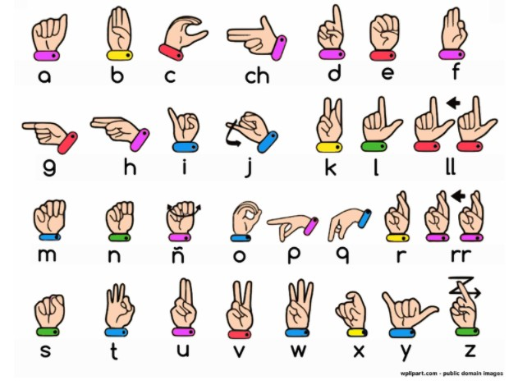
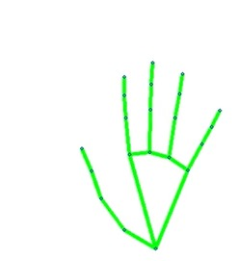
INTRODUCTION
American sign language is a predominant sign language. Since the only disability D&M people have is communication-related, they cannot use spoken languages; hence, the only way for them to communicate is through sign language. Communication is the process of exchanging thoughts and messages in various ways, such as through speech, signals, behaviour , and visuals. Deaf and dumb (D&M) people make use of their hands to express different gestures to express their ideas to other people. Gestures are nonverbally exchanged messages, and these gestures are understood with vision. This nonverbal communication between deaf and dumb people is called sign language. In our project, we basically focus on producing a model that can recognize fingerspelling-based hand gestures in order to form a complete word by combining each gesture. The gestures we aim to train are as given in the image below.
NEXT SIGN

Slide 5
DOMAIN
Convolutional Neural Network (CNN)
CNN is a class of neural networks that are highly useful in solving computer vision problems. They found inspiration from the actual perception of vision that takes place in the visual cortex of our brain. They make use of a filter/kernel to scan through the entire pixel values of the image and make computations by setting appropriate weights to enable detection of a specific feature. CNN is equipped with layers like convolution layer, max pooling layer, flatten layer, dense layer, dropout layer and a fully connected neural network layer. These layers together make a very powerful tool that can identify features in an image. The starting layers detect low level features that gradually begin to detect more complex higher-level features
Unlike regular Neural Networks, in the layers of CNN, the neurons are arranged in 3 dimensions: width, height, depth.
The neurons in a layer will only be connected to a small region of the layer (window size) before it, instead of all of the neurons in a fully-connected manner.
Moreover, the final output layer would have dimensions(number of classes), because by the end of the CNN architecture we will reduce the full image into a single vector of class scores.
Convolutional Layer
Pooling Layer
Max Pooling
Average Pooling
Fully Connected Layer

Slide 6
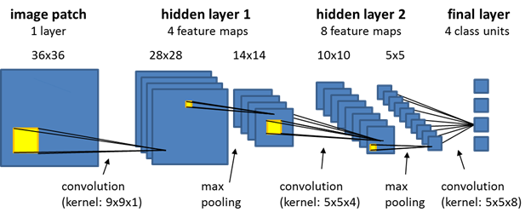
DOMAIN
Convolutional Layer:
In convolution layer I have taken a small window size [typically of length 5*5] that extends to the depth of the input matrix.
The layer consists of learnable filters of window size. During every iteration I slid the window by stride size [typically 1], and compute the dot product of filter entries and input values at a given position.
As I continue this process well create a 2-Dimensional activation matrix that gives the response of that matrix at every spatial position.
That is, the network will learn filters that activate when they see some type of visual feature such as an edge of some orientation or a blotch of some color.

Slide 7
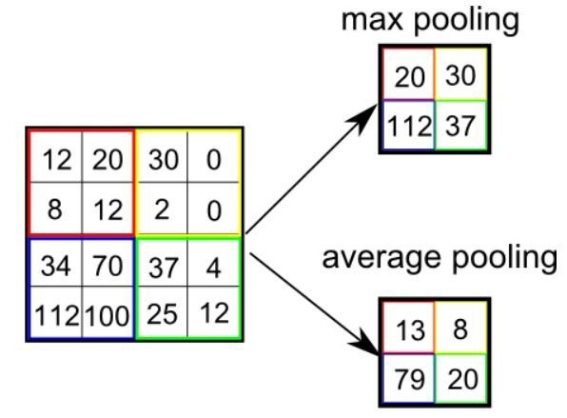
Pooling Layer:
We use pooling layer to decrease the size of activation matrix and ultimately reduce the learnable parameters.
There are two types of pooling:
a. Max Pooling:
In max pooling we take a window size [for example window of size 2*2], and only taken the maximum of 4 values.
Well lid this window and continue this process, so well finally get an activation matrix half of its original Size.
b. Average Pooling:
In average pooling we take average of all Values in a window.

Slide 8
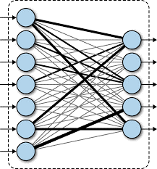
Fully Connected Layer:
In convolution layer neurons are connected only to a local region, while in a fully connected region, well connect the all the inputs to neurons.
The preprocessed 180 images/alphabet will feed the keras CNN model. Because we got bad accuracy in 26 different classes thus, We divided whole 26 different alphabets into 8 classes in which every class contains similar alphabets: [y,j][c,o][g,h][b,d,f,I,u,v,k,r,w][p,q,z][a,e,m,n,s,t]
All the gesture labels will be assigned with a probability.
The label with the highest probability will treated to be the predicted label.So when model will classify [aemnst] in one single class using mathematical operation on hand landmarks we will classify further into single alphabet a or e or m or n or s or t.
Finally, we got 97% Accuracy (with and without clean background and proper lightning conditions) through our method. And if the background is clear and there is good lightning condition then we got even 99% accurate results

Slide 9
MODULES
Data Acquisition :
It uses electromechanical devices to provide exact hand configuration, and position. Different glove-based approaches can be used to extract information. But it is expensive and not user friendly.
In vision-based methods, the computer webcam is the input device for observing the information of hands and/or fingers. The Vision Based methods require only a camera, thus realizing a natural interaction between humans and computers without the use of any extra devices, thereby reducing costs.
The main challenge of vision-based hand detection ranges from coping with the large variability of the human hand’s appearance due to a huge number of hand movements, to different skin-color possibilities as well as to the variations in viewpoints, scales, and speed of the camera capturing the scene.
Data pre-processing and Feature extraction:
In this approach for hand detection, firstly we detect hand from image that is acquired by webcam and for detecting a hand we used media pipe library which is used for image processing. So, after finding the hand from image we get the region of interest (Roi) then we cropped that image and convert the image to gray image using OpenCV library after we applied the gaussian blur .
The filter can be easily applied using open computer vision library also known as OpenCV. Then we converted the gray image to binary image using threshold and Adaptive threshold methods.
We have collected images of different signs of different angles for sign letter A to Z. in this method there are many loop holes like your hand must be ahead of clean soft background and that is in proper lightning condition then only this method will give good accurate results but in real world we don’t get good background everywhere and we don’t get good lightning conditions too.
So to overcome this situation we try different approaches then we reached at one interesting solution in which firstly we detect hand from frame using mediapipe and get the hand landmarks of hand present in that image then we draw and connect those landmarks in simple white image

Slide 10
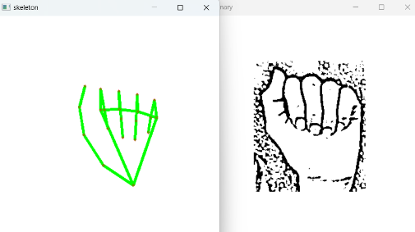
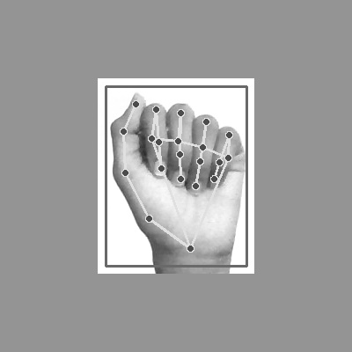
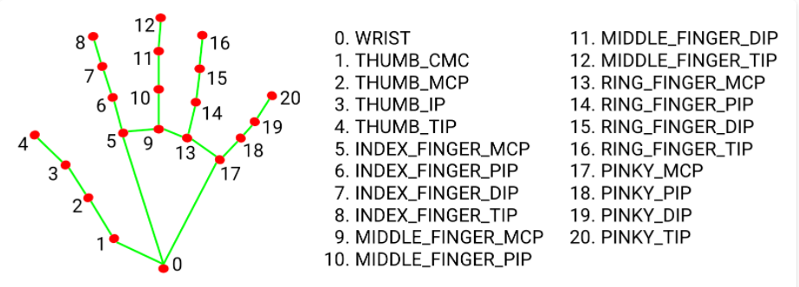
MODULES

Slide 11
SYSTEM DEVELOPMENT
SYSTEM DEVELOPMENT
The system you've developed sounds impressive and valuable, especially in the context of bridging the communication gap for individuals using American Sign Language (ASL). Let's break down the key components and features of your system:
Gesture Recognition: You've implemented a gesture recognition system that translates known ASL finger-spelling gestures into words. This is a crucial feature as it allows individuals using ASL to communicate with the broader community effectively.
Pyttsx3 Library: You've integrated the pyttsx3 library to convert recognized words into speech. This text-to-speech (TTS) capability enhances the user experience by providing audible feedback, essentially simulating a real-life dialogue.
Real-Time Interaction: Your system appears to operate in real-time, making it suitable for interactive communication. This feature is vital for natural and spontaneous conversations.
Inclusivity: By providing both visual recognition of ASL gestures and audible speech output, your system promotes inclusivity by enabling individuals with hearing impairments to communicate with those who may not be proficient in ASL.
User-Friendly: A system that mimics real-life dialogue is user-friendly and intuitive. Users can easily understand and engage with the technology, which is essential for its adoption and success.
Scalability: Depending on your design and implementation, your system may have the potential for scalability. It could potentially expand to recognize and translate a broader range of ASL signs and gestures, enhancing its utility.
Accessibility: The system's accessibility features make it a valuable tool for people with hearing impairments, allowing them to participate more fully in various aspects of life, including education, employment, and social interactions.
Technology Integration: The integration of computer vision (for gesture recognition) and TTS (for speech output) showcases the power of technology in addressing real-world challenges and improving the quality of life for individuals with disabilities.

Slide 12
TOOLS REQUIREMENTS
SOFTWARE REQUIREMENTS
Operating system : Windows
Supporting software : Python,Pycharm
HARDWARE REQUIREMENTS
Hard Disk : 40 GB
Processor : Intel Core i5 7th Gen 2.50 GHz
Floppy Drive : 1.44 Mb
Monitor : Any monitor or laptop and webcam
RAM : 4 GB

Slide 13
ADVANTAGES
Enhanced Communication for Deaf and Dumb Individuals: The system significantly improves communication for individuals with hearing and speech impairments. It enables them to convey their messages effectively using sign language, which is then translated into both text and speech formats for better understanding.
Inclusivity: The system promotes inclusivity by bridging the communication gap between individuals who understand sign language and those who do not. It ensures that everyone can engage in meaningful conversations.
Ease of Use: The system's user-friendly interface and real-time processing make it accessible to a wide range of users, regardless of their technical expertise.
Educational Benefits: It can be a valuable educational tool for teaching and learning American Sign Language. Students and teachers can use it to practice and improve their sign language skills.
Independence: Deaf and dumb individuals gain a degree of independence by having a tool that allows them to communicate more freely with the hearing world.

Slide 14
DISADVANTAGES
Complexity of ASL: American Sign Language is a rich and complex language with numerous signs and variations. Developing a comprehensive recognition system can be challenging, and the system may not cover all ASL signs and gestures.
Training Data: The accuracy and effectiveness of the system heavily depend on the quality and quantity of training data. Collecting a diverse and extensive dataset for training can be time-consuming and resource-intensive.
Technical Limitations: The system relies on computer vision and machine learning technologies, which may have limitations in recognizing subtle hand gestures or variations in lighting conditions.
Cost: Developing and maintaining such a system, including the necessary hardware and software components, can be expensive.
Dependency on Technology: Users become dependent on the system for communication, which may lead to challenges if the technology malfunctions or is unavailable.

Slide 15
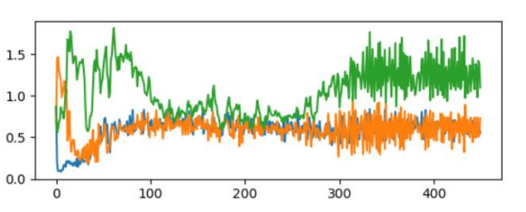
PREFORMANCE ANALYSIS
It is not easy to evaluate the performance of a generative model based on any metric and mostly humans at the end have to decide whether the generated content is good or not and whether or not it holds any particular meaning. However, we can judge the discriminator model in its ability to distinguish real images from fake ones. now compared to ordinary convolutional models where high accuracy means better results it isn’t true in the case of generative models. If the discriminator has very high accuracy in distinguishing real images from fake ones then that implies generator hasn’t done a very good job in creating images that represent the dataset well. In the situation of a perfect equilibrium the discriminator should have an accuracy of 50% that is it has to take a random guess to determine whether the generated image is fake or not implying the generator has created images so good that are indistinguishable from the original images. The closer an accuracy is to 50% the better task the generator has done in creating images.

Slide 16
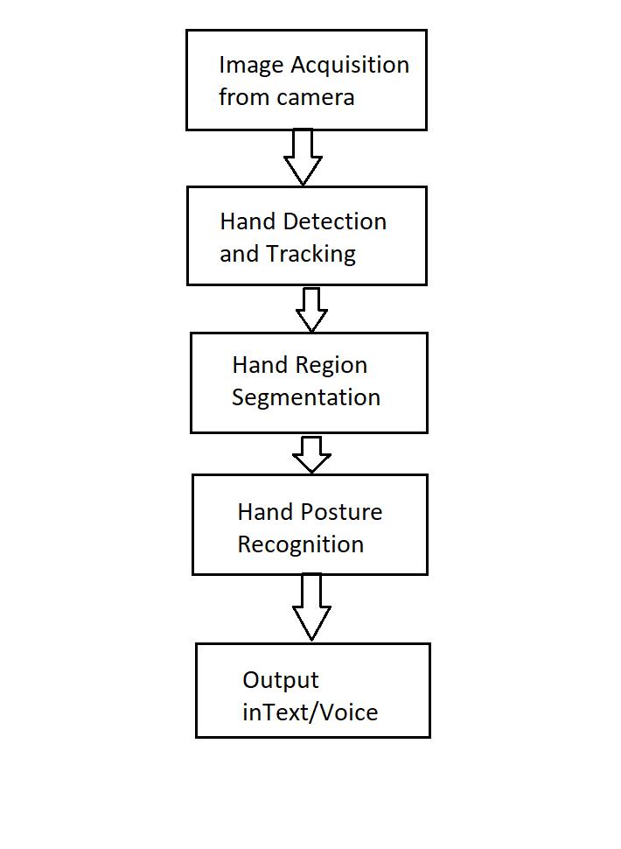
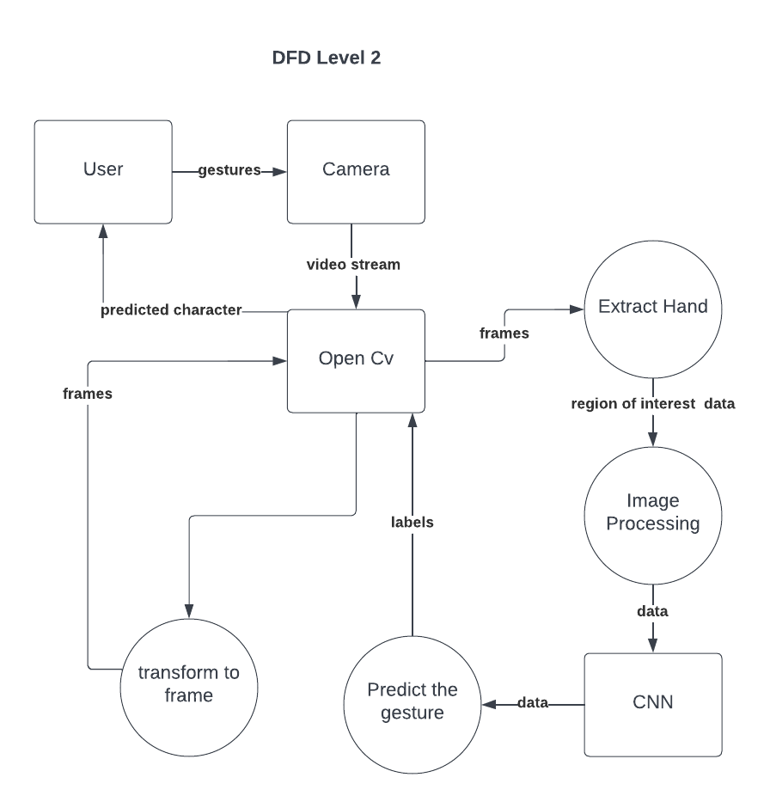
FLOW CHART
SYSTEM ARCHITECTURE

Slide 17
PREFORMANCE ANALYSIS
Recognition Accuracy: Accurate recognition of ASL gestures is paramount. Measure the system's precision, recall, and F1-score to determine how well it correctly translates gestures into text and speech. Identify and address any common recognition errors.
Real-Time Responsiveness: Evaluate the system's real-time responsiveness. Measure the time it takes from capturing a gesture to generating text and speech output. Ensure that the system responds quickly for natural and interactive communication.
User Satisfaction: Conduct user testing and gather feedback from both deaf and dumb individuals and those unfamiliar with ASL. Assess the overall user experience, including the quality of speech output and user satisfaction with the system's performance.
Robustness and Variability: Test the system's robustness by subjecting it to various conditions, including different lighting, hand orientations, and signing styles. Ensure that the system performs consistently and accurately across diverse scenarios.
Data Quality and Diversity: Analyze the quality and diversity of the training data used to train the CNN model. Ensure that the dataset is representative of the full range of ASL signs and gestures. Consider collecting additional data to improve recognition.
Scalability and Accessibility: Assess the system's scalability to accommodate more users and an expanding ASL vocabulary. Ensure that the system remains accessible to individuals with varying levels of technical expertise and abilities.

Slide 18
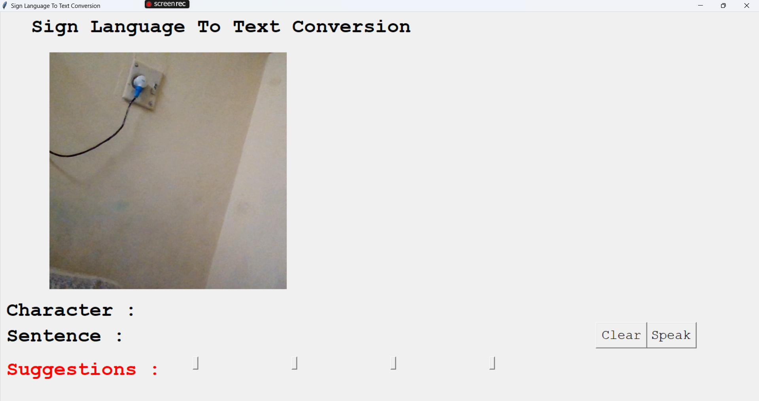
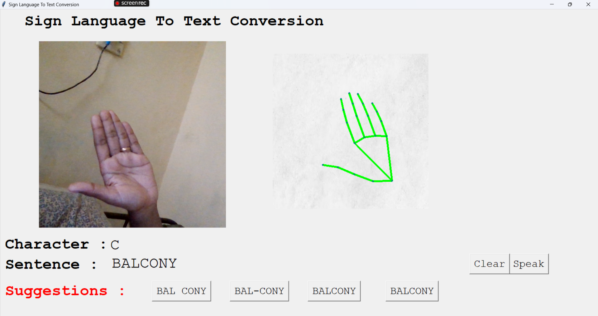
SNAPSHOTS

Slide 19
CONCLUSION
In conclusion, the development of a computer system harnessing Convolutional Neural Networks (CNNs) for American Sign Language (ASL) gesture recognition and text-to-speech (TTS) conversion represents a pivotal advancement in promoting communication inclusivity. This innovative system not only empowers individuals with hearing and speech impairments to convey their thoughts effortlessly through ASL gestures but also fosters understanding among those who may not be well-versed in sign language. Its user-friendly interface and real-time processing ensure accessibility for a diverse audience, making communication more accessible and natural. While acknowledging challenges such as ASL complexity and data requirements, this technology's transformative potential in breaking down communication barriers and enhancing the quality of life for individuals with disabilities underscores the profound impact of innovation in creating a more inclusive and connected world.
FUTURE ENHANCEMENT
User-Centric Focus: Prioritize enhancements that improve the user experience (UX). Gather user feedback, conduct usability tests, and implement changes that make the system more intuitive and user-friendly.
Security and Compliance: Continuously enhance security measures to protect user data and system integrity. Regularly update security protocols, perform vulnerability assessments, and ensure compliance with relevant regulations.
Scalability and Performance: Plan for future growth by optimizing system performance and scalability. Implement solutions that can handle increased user loads and traffic, such as cloud-based scaling and database optimizations.
Innovation and Adaptation: Stay ahead of the curve by exploring emerging technologies and trends. Consider how AI, machine learning, and automation can enhance your system's capabilities and adapt to changing user needs.
Documentation and Support: Invest in clear and up-to-date documentation for both users and developers. Provide robust customer support channels to assist users with issues, questions, and troubleshooting.

Slide 20
REFERENCES
[1] L. Kau, W. Su, P. Yu and S. Wei, "A real-time portable sign language translation system," 2015 IEEE 58th International Midwest Symposium on Circuits and Systems (MWSCAS), Fort Collins, CO, 2015, pp. 1-4, doi: 10.1109/MWSCAS.2015.7282137.
[2] S. Shahriar et al., "Real-Time American Sign Language Recognition Using Skin Segmentation and Image Category Classification with Convolutional Neural Network and Deep Learning," TENCON 2018 - 2018 IEEE Region 10 Conference, Jeju, Korea (South), 2018, pp. 1168-1171, doi: 10.1109/TENCON.2018.8650524.
[3] M. S. Nair, A. P. Nimitha and S. M. Idicula, "Conversion of Malayalam text to Indian sign language using synthetic animation," 2016 International Conference on Next Generation Intelligent Systems (ICNGIS), Kottayam, 2016, pp. 1-4, doi: 10.1109/ICNGIS.2016.7854002.
[4] M. Mahesh, A. Jayaprakash and M. Geetha, "Sign language translator for mobile platforms," 2017 International Conference on Advances in Computing, Communications and Informatics (ICACCI), Udupi, 2017, pp. 1176-1181, doi: 10.1109/ICACCI.2017.8126001.
[5] S. S Kumar, T. Wangyal, V. Saboo and R. Srinath, "Time Series Neural Networks for Real Time Sign Language Translation," 2018 17th IEEE International Conference on Machine Learning and Applications (ICMLA), Orlando, FL, 2018, pp. 243-248, doi: 10.1109/ICMLA.2018.00043.
[6] D. Kelly, J. Mc Donald and C. Markham, "Weakly Supervised Training of a Sign Language Recognition System Using Multiple Instance Learning Density Matrices," in IEEE Transactions on Systems, Man, and Cybernetics, Part B (Cybernetics), vol. 41, no. 2, pp. 526-541, April 2011, doi: 10.1109/TSMCB.2010.2065802.

Slide 21


