Slide 1

Name : Mulani Alfiya Aslam
Roll No : 26
Name : Nimbhore Harshada Milind
Roll No : 27
Subject : Web Service

Slide 2
Seminar
On
CORBA

Slide 3
Content
What is CORBA?
The Object Management Group (OMG)
CORBA History
CORBA Architecture
Applications
Some major projects using CORBA
Advantages
Disadvantages
Conclusion

Slide 4
What is CORBA?
CORBA (Common Object Request Broker Architecture) is a distributed Object-oriented client/server platform.
It includes:
An object-oriented Remote Procedure Call (RPC) mechanism.
Object services (such as the Naming or Trading Service).
Language mappings for different programming languages.
Interoperability protocols.
Programming guidelines and patterns.

Slide 5
The Object Management Group (OMG)
The OMG was formed in 1989 to create specifications for open Distributed computing.
Its mission is to "... Establish industry guidelines and object management Specifications to provide a common framework for distributed Application development.“
The OMG is the world’s largest software consortium with more than 800 member organizations.
Specifications published by the OMG are free of charge. Vendors of CORBA technologies do not pay a royalty to the OMG.
Specifications are developed by consensus of interested submitters.

Slide 6
CORBA History
OMG (Object Management Group)
Established in 1989 with 8 members
Object Management Architecture is a set of standards deliver the common architectural framework on which applications are built.
CORBA’s role in OMA is to implement the ORB functions.

Slide 7
CORBA History…
CORBA 1.0
Was introduced and adopted in December 1990.
It was followed in early 1991 by CORBA 1.1, which defined the Interface Definition Language (IDL) as well as API for applications to communicate with an ORB.

Slide 8
CORBA History…
CORBA 1.x was an important first step is providing distributed object interoperability, but wasn’t a complete specification.
As a result, a CORBA ORB from one vendor could not communicate with an ORB from another vendor, a restriction that severely limited interoperability among distributed objects.
CORBA 2.0 is adopted in December 1994.

Slide 9
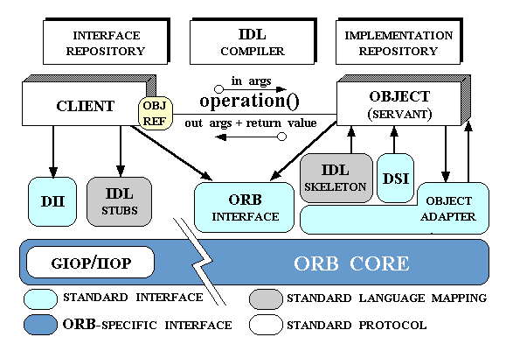
CORBA Architecture

Slide 10
CORBA Application
Design and write the object interfaces.
Generate stubs and skeletons, and other required support classes.
Write the server object implementations.
Use the client-side Java compiler to compile both the Java code that you have written, and the Java classes that were generated by the IDL compiler.
Generate a JAR file to contain the classes and any other resource files that are needed.

Slide 11
Some major projects using CORBA
Distributed Object Management Integration System(DOMIS)
Dialogos' ORB based applications using ICL's DAIS ORB.
University of Minnesota's DAMSEL Project ( Dynamic Mul- timedia specification Language ) uses CORBA and Java
The Sunrise project and the TeleMed subproject

Slide 12

Advantages
CORBA supports many existing languages (alone/mixed).
CORBA supports distribution and Object Orientation.
CORBA is an industry standard ; it creates competition among vendors and ensures quality implementations.
CORBA provides out-of-the-box multi-vendor inter- operability and portability.
CORBA offers many services called CORBA Services.

Slide 13

Disadvantages
CORBA is still growing, and not fully mature.
The standard lacks many features required for putting large scale applications.
Though specific vendor implemen- tations provide some of these features, they are not part of the standard today.

Slide 14
Conclusion
The main conclusion is that CORBA can be used to implement group communication services and thereby achieve interoperability in a heterogeneous computing environment.
However, there is a substantial performance cost.

Slide 15
Reference
www.google.com
www.wikipedia.com
www.studymafia.org

Slide 16
Thanks

