Slide 1
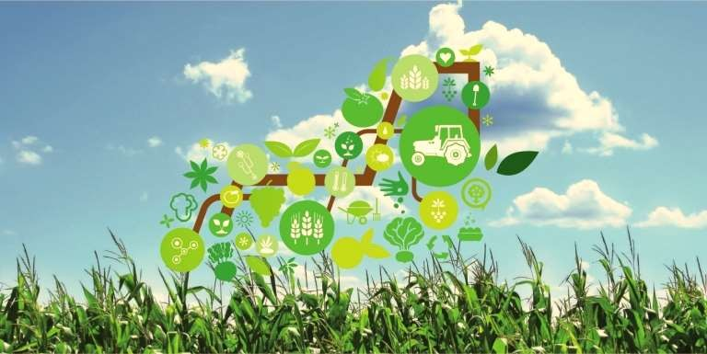
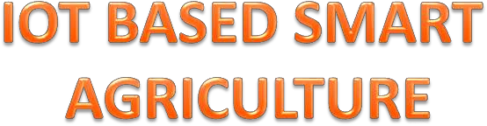

Slide 2
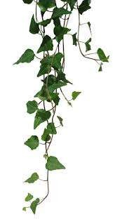

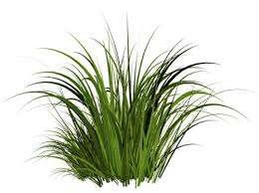
What is IOT?
Why IOT?
IOT in agriculture
Applications
Implemented method
Advantages and disadvantages
Conclusion

Slide 3

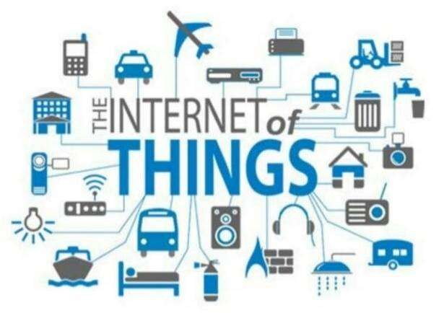
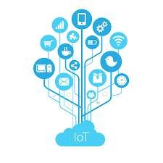
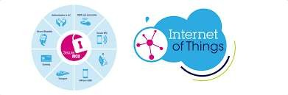

What is IOT?
IOT is short for Internet of Things
The Internet of Things(IOT) is inter-networking
of physical devices. This system has ability to
transfer data over a network without requiring human-to-human or human-to-computer interaction.

Slide 4

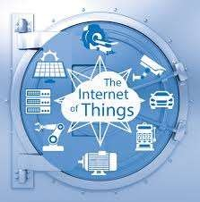

IOT has many applications in agriculture, smart Cities, smart home, healthcare, business sectors, Traffic monitoring , Transport and logistics etc
This is a growing mega trend that will influence
everything from businesses to our daily personal lives.
Here we are mainly focussing on agriculture as it plays a vital role in development of our country’s economy.

Slide 5
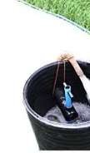
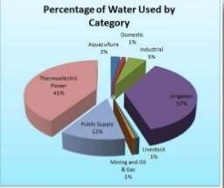
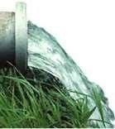
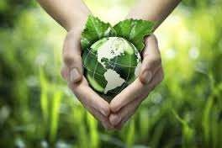
IOT IN AGRICULTURE
Today, India ranks second in the world in farm output 64% of cultivated land dependent on monsoons.
Irrigation accounts for 55-75% of water usage in India.
Nearly 60% of the water used in irrigation is wasted.
we conserve water by using soil moisture sensors.

Slide 6
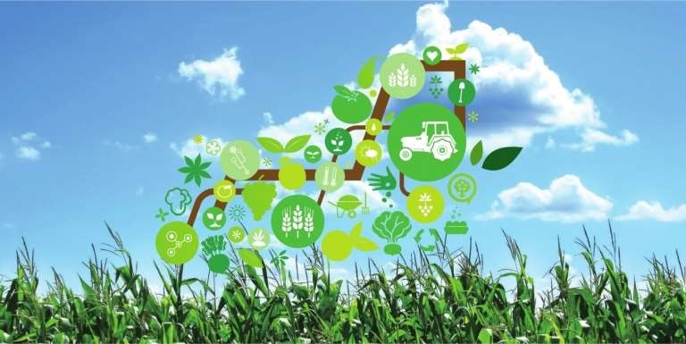
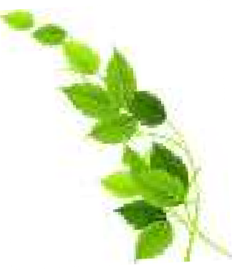
IOT APPLICATION IN AGRICULTURE
Crop water management
Pest management and control works
Precision agriculture
Food production and safety etc.,

Slide 7

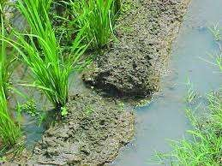
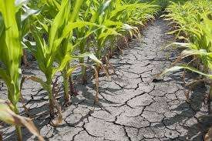
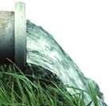
CROP WATER MANAGEMENT
Usually the farmer pumps the water more or less to cultivate the land.
This may result in wastage of water or insufficiency to
the crops.
sends an alerting message to the farmer when the moisture level increases or decreases.

Slide 8
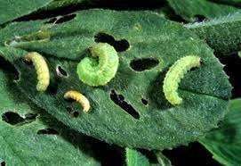
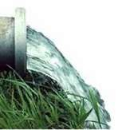
PEST MANAGEMENT AND CONTROL WORKS
Often farmers hardwork are destroyed by
predators(pests) that results in huge loss to farmers.
To prevent such situation AGRICULTURE INTERNET OF THINGS has a system that detects the motion
of predators using PIR sensors.
This information can be used by the farmers to reduce damage done by predators.
➢

Slide 9
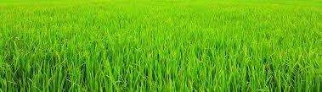
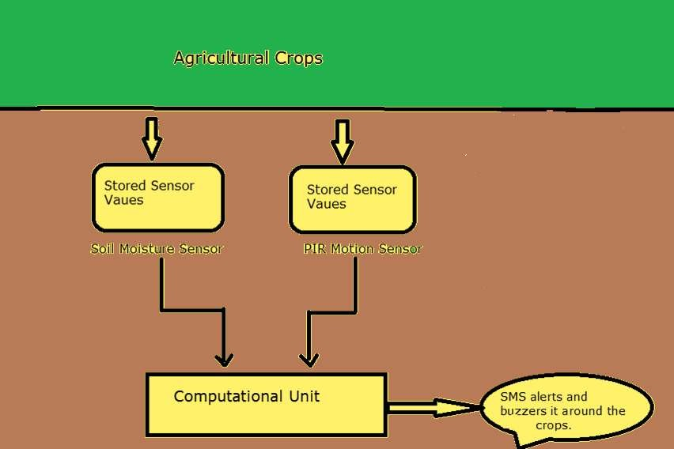
CROP

Slide 10
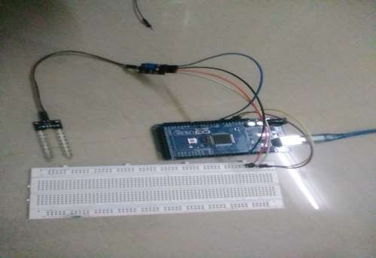
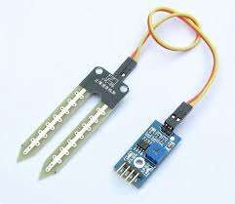
A sensor that will sense the moisture level in the land (sand) called
SOIL MOISTURE SENSOR.

Slide 11
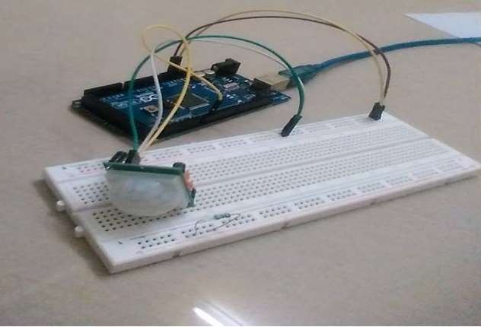
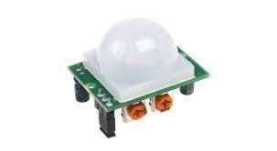
A PIR based motion detector is used to sense movement of people,animals or other objects.

Slide 12

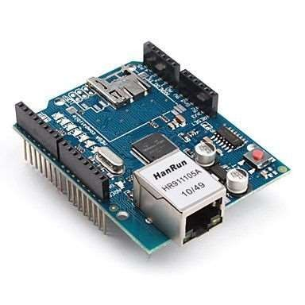
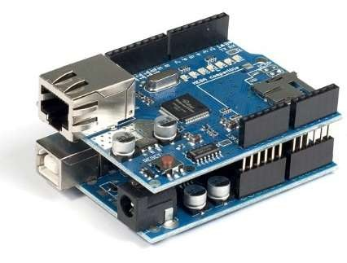
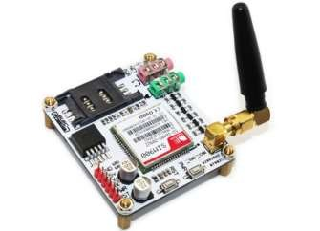
Both SOIL MOISTURE SENSOR and PIR SENSOR are connected to the Arduino to perform an action.
Arduino will send the data to the data base using Ethernet shield and if emergency it also send message to the user by using a device called GSM module.

Slide 13


Cost effective method
Optimize water use
Sustain high-yielding
High quality crop production
Need for each soil
type is calibrated

Slide 14
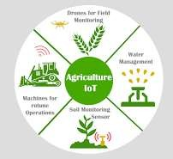
There are many other applications of IOT in agriculture

Slide 15

We can predict soil moisture level and motion of predators.
Irrigation system can be monitored .
Damage caused by predators is reduced.
Increased productivity.
Water conservation.
Profit to farmers.

Slide 16



