Slide 1
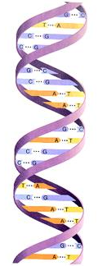
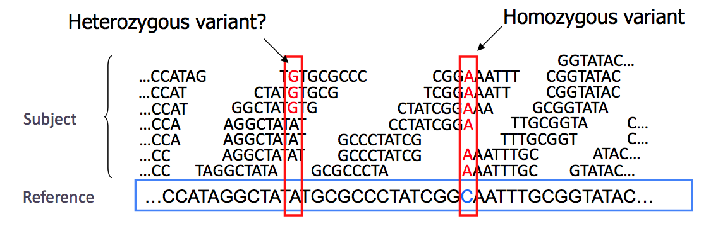
Introduction
Methods
In the same way that a technological transformation occurred where computers the size of entire rooms evolved into mobile devices that can fit into our pockets, a genomics revolution is currently ongoing as DNA sequencing technology shifts from million dollar instruments to inexpensive mobile sensors. The potential uses of these sensors range from diagnosing genetic conditions in doctors’ offices, to analyzing the DNA of pathogens discovered in the Amazon rainforest, to improving the overall yield of crops that are grown.
iGenomics is my new mobile DNA sequence analysis application that is optimized to run as efficiently as possible on iPads and other mobile devices. This is the first application ever to be able to screen genomes and identify variants on a mobile device through an implementation in Objective-C. The long-term prediction is that iGenomics will become the main platform for DNA sequence analysis in a remote setting.
The significantly lower amount of processing power contained within an iPad limits the data processing power available compared to super-computers that have been traditionally used to process genomes. That being stated, iGenomics uses the multiple cores of the iPad and advanced algorithms such as the Burrows-Wheeler Transform to rapidly analyze DNA sequences. Viral genomes such as the influenza virus can be analyzed in a matter of seconds while microbial genomes including many disease-causing pathogens can be analyzed in a matter of minutes.
Constructing the Burrows-Wheeler Transform (BWT):
-The Burrows-Wheeler transform is constructed by lexicographically sorting the cyclic permutations of the inputted genome with a dollar sign (has a lexicographical value less than any letter in the English alphabet) on its end
-The BWT has a unique trait known as Last-First Property in which the rank of a character in the last column is the same rank as that corresponding character in the first column
Creating the BWT for GATTACA
Unsorted Cyclic Permutations of GATTACA
Sorted Cyclic Permutations of GATTACA
G | A | T | T | A | C | A | $
A | T | T | A | C | A | $ | G
T | T | A | C | A | $ | G | A
T | A | C | A | $ | G | A | T
A | C | A | $ | G | A | T | T
C | A | $ | G | A | T | T | A
A | $ | G | A | T | T | A | C
$ | G | A | T | T | A | C | A
$ | G | A | T | T | A | C | A
A | $ | G | A | T | T | A | C
A | C | A | $ | G | A | T | T
A | T | T | A | C | A | $ | G
C | A | $ | G | A | T | T | A
G | A | T | T | A | C | A | $
T | A | C | A | $ | G | A | T
T | T | A | C | A | $ | G | A
Matching Read Segments:
The Last-First Property can be leveraged to allow for exact matching DNA sequences to a reference genome
Background
Exact Matching GAT to GATTACA
Prior to the aligning and analyzing of DNA strands, these samples of DNA must be sequenced using a bench-top sequencing apparatus. This type of machine requires special preparation for the DNA to be read in. The DNA must first be extracted from the cells of the sample biological substance/organism and split into smaller random pieces using sound waves at a specific frequency. These newly split strands of DNA are color-coded in a specific manner so that the sequencing machines can read in the DNA and categorize each base as an A, C, G, or T. Once all of the DNA has been read in by the sequencing device, the DNA data, called reads, is saved in a file on the connected computer or server network. This file solely consists of the raw read data, the quality of each read, and the name of each read.
The DNA sequencing device provides no way to align the reads to a reference genome, so that is done on a computer or linked set of servers. The software used for the aligning requires both a reads file and and a reference genome (the DNA sequence the reads will aligned to) file. The DNA analyzing takes place and an export file containing alignment data and mutation information is generated. Until iGenomics, there has been no mobile version of any of this alignment software.
$ | .. | A
A | .. | C
A | .. | T
A | .. | G
C | .. | A
G | .. | $
T | .. | T
T | .. | A
$ | .. | A
A | .. | C
A | .. | T
A | .. | G
C | .. | A
G | .. | $
T | .. | T
T | .. | A
$ | .. | .. | .. | A
A | .. | .. | .. | C
A | .. | .. | .. | T
A | .. | .. | .. | G
C | .. | .. | .. | A
G | A | T | .. | $
T | .. | .. | .. | T
T | .. | .. | .. | A
Dynamic Programming to Compute Edit Distance:
-Edit Distance refers to the number of substitutions, insertions, or deletions necessary to turn string A into string B
-Computing the Edit Distance table is useful for matching reads to the reference genome because there tends to be a low but present error rate when reads are sequenced, and edit distance computation can account for this
Computing Edit Distance for GATTTACA to GATTACA
 |  | G | A | T | T | T | A | C | A
 | 0 | 1 | 2 | 3 | 4 | 5 | 6 | 7 | 8
G | 1 | 0 | 1 | 2 | 3 | 4 | 5 | 6 | 7
A | 2 | 1 | 0 | 1 | 2 | 3 | 4 | 5 | 6
T | 3 | 2 | 1 | 0 | 1 | 2 | 3 | 4 | 5
T | 4 | 3 | 2 | 1 | 0 | 1 | 2 | 3 | 4
A | 5 | 4 | 3 | 2 | 1 | 1 | 1 | 2 | 3
C | 6 | 5 | 4 | 3 | 2 | 2 | 2 | 1 | 2
A | 7 | 6 | 5 | 4 | 3 | 3 | 3 | 2 | 1
GATTTACA
GATT-ACA
Creating the Coverage Profile and Variant Identification:
-Exact match and edit distance computation works by aligning one read at a time, so after attempting to align every read to the genome, a coverage profile can used to summarize the alignments.
-Mutations, or variants, are identified by observing differences at a given position between the reference genome and the base-pairs found at that same position
The double-helix structure of DNA has distinct traits:
A (Adenine) always pairs with T (Thymine)
C (Cytosine) always pairs with G (Guanine)
A single strand of a DNA molecule can be analyzed to obtain the data for entire molecule
The final edit distance
Reference | G | A | A | T | G | G | C
Found | G | A | A | T | G | C | C
A | 0 | 3 | 3 | 0 | 3 | 0 | 0
C | 0 | 0 | 0 | 0 | 0 | 3 | 3
G | 3 | 0 | 0 | 0 | 0 | 0 | 0
T | 0 | 0 | 0 | 3 | 0 | 0 | 0
DNA serves as the core for building cells and therefore producing the traits of the body
Instruments that sequence DNA do make mistakes
This is due to the quality of the read decreasing over the read length
Usually when a single read differs from the reference genome, there was probably just a sequencing error
As more reads begin to differ from the reference, it becomes increasingly likely that there is a mutation(s) rather than a mistake
http://www.tutorvista.com/content/biology/biology-iii/cellular-macromolecules/deoxyribose-nucleic-acid.php

