Slide 1
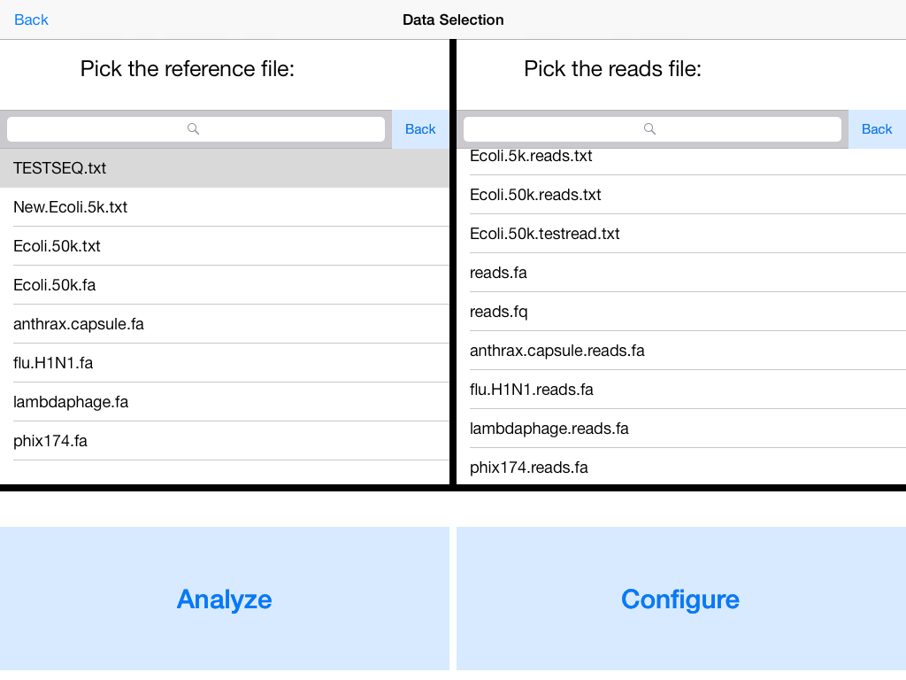
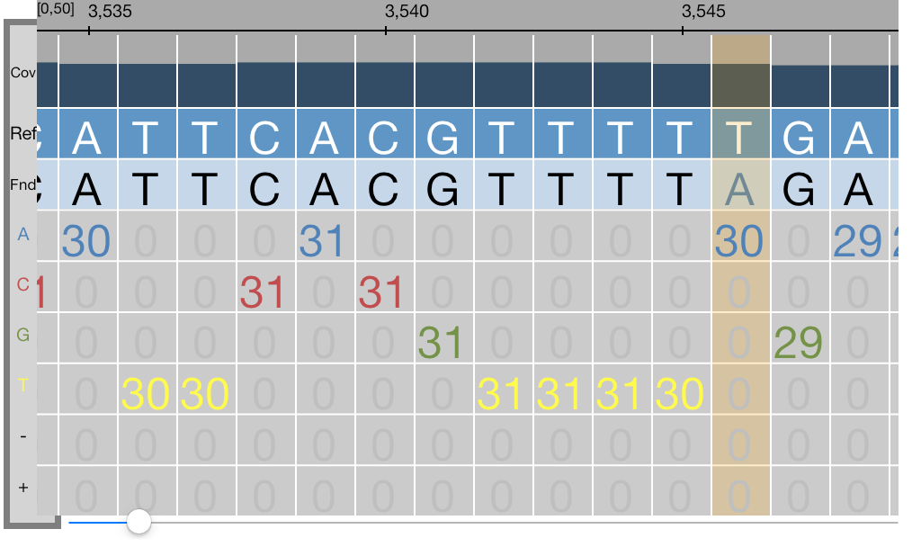
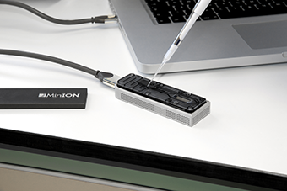
Visualization and Interactive Analysis
The unique features of a touch-screen device allow for interactive features not previously available in DNA analysis applications. All of these features are designed with natural movement in mind, achieving the ease-of-use goal of the iGenomics application.
Results
 | iGenomics (Running on iPad 2) | DNA Analysis Software run on High-End Servers
Mobile | ✓ | X
RAM Available | 512 MB | 1.5 TB
Storage Available | 16 GB | 5 PB
Read Alignment Accuracy | 100% | 100%
Genome | Category | Genome Length | Number of Reads | Description
Phi X174 | Bacteriophage | 5386 bp | 1,615 | First sequenced genome
Swine Flu (H1N1) | Virus | 13,305 bp | 3,991 | Common human pathogen
Lambda Phage | Bacteriophage | 48,503 bp | 14,550 | Very closely studied virus genome
Bacillius antracis PXO2 Plasmid | Bacteria | 94,830 bp | 28,449 | Encodes for the anthrax capsule
As expected, the read alignment runtime for any given genome and edit distance increases linearly with genome length. This linear increase is due to the fact that the time taken for read alignment using the BWT is essentially independent of the genome’s size. Also, the time taken for the entire Bacillius antracis PXO2 Plasmid (94,830 bp) genome to be analyzed on an iPad 2 was approximately two minutes.
Future Applications of iGenomics
The future holds great potential for further developments involving iGenomics and the mobile DNA analysis field as a whole. Recent groundbreaking inventions such as the flash drive-sized MinION™ by Oxford Nanopore Technologies that allows for DNA sequencing through a device smaller than previously possible are leading the field as a whole towards faster and more portable DNA sequencing and analysis than ever before. iGenomics is leading the shift in the analysis portion of this, and once DNA sequencing apparatuses that read directly into mobile devices come out, the process of sampling, aligning, and analyzing DNA will be completely mobile.
https://www.nanoporetech.com
References
Burrows M, Wheeler DJ (1994) A Block Sorting Lossless Data Compression
Algorithm. Technical Report 124. Digital Equipment Corporation.
Langmead B, Salzberg S. (2012) Fast gapped-read alignment with Bowtie 2. Nature
Methods. 9:357-359.
Mason, CE, Elemento, O. (2012) Faster sequencers, larger datasets, new challenges.
Genome Biology. 13:314

