Slide 1
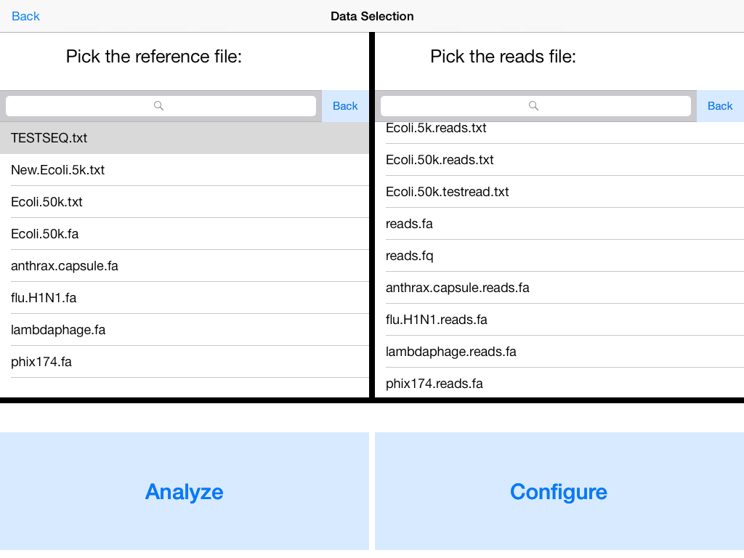
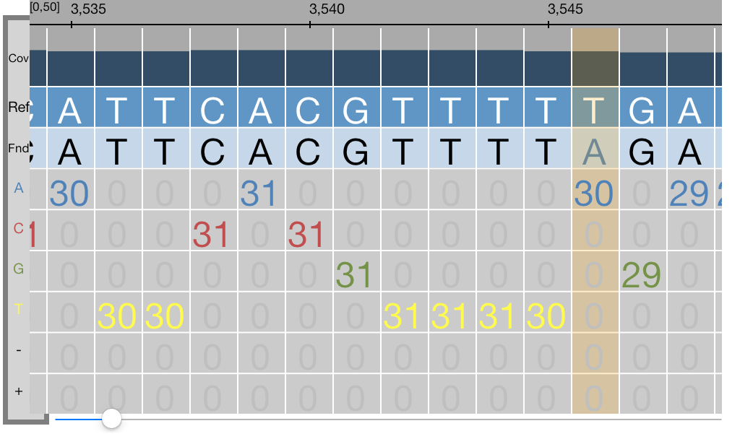
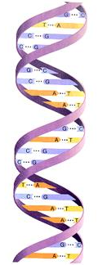
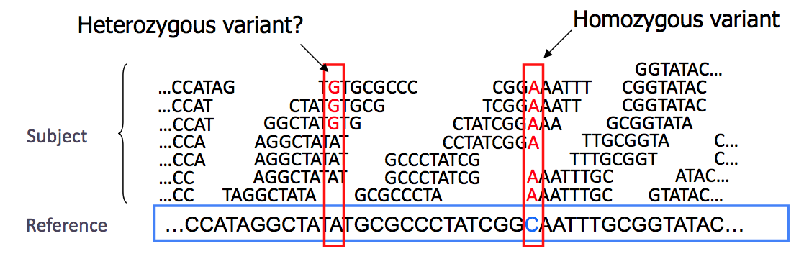
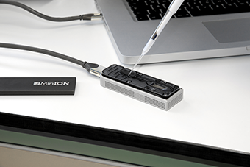
iGenomics: Mobile DNA Sequence Analysis
Aspyn Palatnick
Introduction
Methods
Visualization and Interactive Analysis
In the same way that a technological transformation occurred where computers the size of entire rooms evolved into mobile devices that can fit into our pockets, a genomics revolution is currently ongoing as DNA sequencing technology shifts from million dollar instruments to inexpensive mobile sensors. The potential uses of these sensors range from diagnosing genetic conditions in doctors’ offices, to analyzing the DNA of pathogens discovered in the Amazon rainforest, to improving the overall yield of crops that are grown.
iGenomics is my new mobile DNA sequence analysis application that is optimized to run as efficiently as possible on iPads and other mobile devices. This is the first application ever to be able to screen genomes and identify variants on a mobile device through an implementation in Objective-C. The long-term prediction is that iGenomics will become the main platform for DNA sequence analysis in a remote setting.
The significantly lower amount of processing power contained within an iPad limits the data processing power available compared to super-computers that have been traditionally used to process genomes. That being stated, iGenomics uses the multiple cores of the iPad and advanced algorithms such as the Burrows-Wheeler Transform to rapidly analyze DNA sequences. Viral genomes such as the influenza virus can be analyzed in a matter of seconds while microbial genomes including many disease-causing pathogens can be analyzed in a matter of minutes.
Constructing the Burrows-Wheeler Transform (BWT):
-The Burrows-Wheeler transform is constructed by lexicographically sorting the cyclic permutations of the inputted genome with a dollar sign (has a lexicographical value less than any letter in the English alphabet) on its end
-The BWT has a unique trait known as Last-First Property in which the rank of a character in the last column is the same rank as that corresponding character in the first column
The unique features of a touch-screen device allow for interactive features not previously available in DNA analysis applications. All of these features are designed with natural movement in mind, achieving the ease-of-use goal of the iGenomics application.
Creating the BWT for GATTACA
Unsorted Cyclic Permutations of GATTACA
Sorted Cyclic Permutations of GATTACA
G | A | T | T | A | C | A | $
A | T | T | A | C | A | $ | G
T | T | A | C | A | $ | G | A
T | A | C | A | $ | G | A | T
A | C | A | $ | G | A | T | T
C | A | $ | G | A | T | T | A
A | $ | G | A | T | T | A | C
$ | G | A | T | T | A | C | A
$ | G | A | T | T | A | C | A
A | $ | G | A | T | T | A | C
A | C | A | $ | G | A | T | T
A | T | T | A | C | A | $ | G
C | A | $ | G | A | T | T | A
G | A | T | T | A | C | A | $
T | A | C | A | $ | G | A | T
T | T | A | C | A | $ | G | A
Results
Background
 | iGenomics (Running on iPad 2) | DNA Analysis Software run on High-End Servers
Mobile | ✓ | X
RAM Available | 512 MB | 1.5 TB
Storage Available | 16 GB | 5 PB
Read Alignment Accuracy | 100% | 100%
Matching Read Segments:
The Last-First Property can be leveraged to allow for exact matching DNA sequences to a reference genome
Prior to the aligning and analyzing of DNA strands, these samples of DNA must be sequenced using a bench-top sequencing apparatus. This type of machine requires special preparation for the DNA to be read in. The DNA must first be extracted from the cells of the sample biological substance/organism and split into smaller random pieces using sound waves at a specific frequency. These newly split strands of DNA are color-coded in a specific manner so that the sequencing machines can read in the DNA and categorize each base as an A, C, G, or T. Once all of the DNA has been read in by the sequencing device, the DNA data, called reads, is saved in a file on the connected computer or server network. This file solely consists of the raw read data, the quality of each read, and the name of each read.
The DNA sequencing device provides no way to align the reads to a reference genome, so that is done on a computer or linked set of servers. The software used for the aligning requires both a reads file and and a reference genome (the DNA sequence the reads will aligned to) file. The DNA analyzing takes place and an export file containing alignment data and mutation information is generated. Until iGenomics, there has been no mobile version of any of this alignment software.
Exact Matching GAT to GATTACA
$ | .. | A
A | .. | C
A | .. | T
A | .. | G
C | .. | A
G | .. | $
T | .. | T
T | .. | A
$ | .. | A
A | .. | C
A | .. | T
A | .. | G
C | .. | A
G | .. | $
T | .. | T
T | .. | A
$ | .. | .. | .. | A
A | .. | .. | .. | C
A | .. | .. | .. | T
A | .. | .. | .. | G
C | .. | .. | .. | A
G | A | T | .. | $
T | .. | .. | .. | T
T | .. | .. | .. | A
Genome | Category | Genome Length | Number of Reads | Description
Phi X174 | Bacteriophage | 5386 bp | 1,615 | First sequenced genome
Swine Flu (H1N1) | Virus | 13,305 bp | 3,991 | Common human pathogen
Influenza A (H3N2) | Virus | 13,382 bp | 4,014 | Common human pathogen
Lambda Phage | Bacteriophage | 48,503 bp | 14,550 | Very closely studied virus genome
Bacillius antracis PXO2 Plasmid | Bacteria | 94,830 bp | 28,449 | Encodes for the anthrax capsule
Dynamic Programming to Compute Edit Distance:
-Edit Distance refers to the number of substitutions, insertions, or deletions necessary to turn string A into string B
-Computing the Edit Distance table is useful for matching reads to the reference genome because there tends to be a low but present error rate when reads are sequenced, and edit distance computation can account for this
The double-helix structure of DNA has distinct traits:
A (Adenine) always pairs with T (Thymine)
C (Cytosine) always pairs with G (Guanine)
A single strand of a DNA molecule can be analyzed to obtain the data for entire molecule
Computing Edit Distance for GATTTACA to GATTACA
As expected, the read alignment runtime for any given genome and edit distance increases linearly with genome length. This linear increase is due to the fact that the time taken for read alignment using the BWT is essentially independent of the genome’s size. Also, the time taken for the entire Bacillius antracis PXO2 Plasmid (94,830 bp) genome to be analyzed on an iPad 2 was approximately two minutes.
 |  | G | A | T | T | T | A | C | A
 | 0 | 1 | 2 | 3 | 4 | 5 | 6 | 7 | 8
G | 1 | 0 | 1 | 2 | 3 | 4 | 5 | 6 | 7
A | 2 | 1 | 0 | 1 | 2 | 3 | 4 | 5 | 6
T | 3 | 2 | 1 | 0 | 1 | 2 | 3 | 4 | 5
T | 4 | 3 | 2 | 1 | 0 | 1 | 2 | 3 | 4
A | 5 | 4 | 3 | 2 | 1 | 1 | 1 | 2 | 3
C | 6 | 5 | 4 | 3 | 2 | 2 | 2 | 1 | 2
A | 7 | 6 | 5 | 4 | 3 | 3 | 3 | 2 | 1
GATTTACA
GATT-ACA
DNA serves as the core for building cells and therefore producing the traits of the body
http://www.tutorvista.com/content/biology/biology-iii/cellular-macromolecules/deoxyribose-nucleic-acid.php
The final edit distance
Future Applications of iGenomics
Creating the Coverage Profile and Variant Identification:
-Exact match and edit distance computation works by aligning one read at a time, so after attempting to align every read to the genome, a coverage profile can used to summarize the alignments.
-Mutations, or variants, are identified by observing differences at a given position between the reference genome and the base-pairs found at that same position
The future holds great potential for further developments involving iGenomics and the mobile DNA analysis field as a whole. Recent groundbreaking inventions such as the flash drive-sized MinION™ by Oxford Nanopore Technologies that allows for DNA sequencing through a device smaller than previously possible are leading the field as a whole towards faster and more portable DNA sequencing and analysis than ever before. iGenomics is leading the shift in the analysis portion of this, and once DNA sequencing apparatuses that read directly into mobile devices come out, the process of sampling, aligning, and analyzing DNA will be completely mobile.
Instruments that sequence DNA do make mistakes
This is due to the quality of the read decreasing over the read length
Usually when a single read differs from the reference genome, there was probably just a sequencing error
As more reads begin to differ from the reference, it becomes increasingly likely that there is a mutation(s) rather than a mistake
Reference | G | A | A | T | G | G | C
Found | G | A | A | T | G | C | C
A | 0 | 3 | 3 | 0 | 3 | 0 | 0
C | 0 | 0 | 0 | 0 | 0 | 3 | 3
G | 3 | 0 | 0 | 0 | 0 | 0 | 0
T | 0 | 0 | 0 | 3 | 0 | 0 | 0
References
Burrows M, Wheeler DJ (1994) A Block Sorting Lossless Data Compression
Algorithm. Technical Report 124. Digital Equipment Corporation.
Langmead B, Salzberg S. (2012) Fast gapped-read alignment with Bowtie 2. Nature
Methods. 9:357-359.
Mason, CE, Elemento, O. (2012) Faster sequencers, larger datasets, new challenges.
Genome Biology. 13:314
https://www.nanoporetech.com

