Slide 1
Interactive Sales Dashboard
Prepared by Deekshitha

Slide 2
Objective
The objective of this dashboard is to provide business stakeholders with key insights into sales performance, profit margins, and product quantities. The dashboard is designed to be interactive, allowing filtering by various dimensions to make informed decisions.

Slide 3
Dataset & Tools Used
Dataset: Walmart Sales Data
Tools Used:
- Power BI for data visualization
- DAX for calculated measures
- Basic data cleaning in Power Query

Slide 4
Key KPIs
- Total Sales: Sum of all sales revenue
- Total Profit: Sum of all profits
- Total Quantity: Sum of items sold
- Profit Margin: Profit/Sales ratio

Slide 5
Insights from Dashboard
- High sales with consistent profit margin of 15%
- Strong product movement with over 12K items sold
- Profit and sales trends can be further analyzed by adding time-series charts and slicers for categories and regions

Slide 6
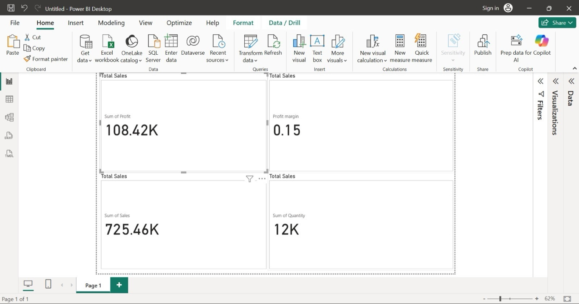
Dashboard Screenshot

