Slide 1
Image compression:
On-demand systems seeking minimal latency.
Vrijsen Kobe
Coach: Vanrobaeys Katelijn Supervisor: Deals Jef

Slide 2
Graduation work
Graphics
Software
Files
Textures
Loading time
Compression
Optimisation techniques for mobile

Slide 3
Web pages
Not everything is an app
Environments change
Web pages are universal
Chrome OS
iPhone

Slide 4
On-demand Systems
Web pages
Games
Adverts
Chats
Etc.
Timing not known
Resources not known
Request > Response

Slide 5
Image compression
Important
Large
Ubiquitous
Long loading times
Visual delays

Slide 6
Analysis
Request
Response
Download
Processing
Ready
Lag
Network latency
Network bandwidth
Resource size
Decompression time
Buffer update time

Slide 7

Analysis
Network
Network speed
File size

Slide 8
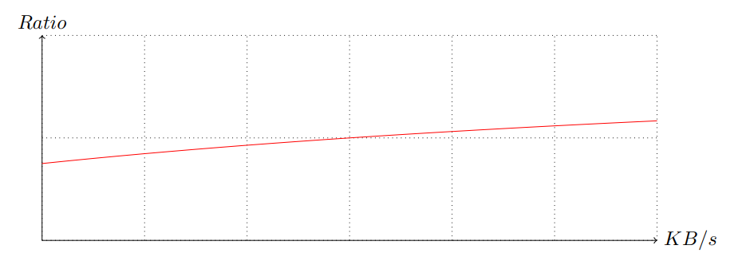
Analysis
Network
Comparing two functions

Slide 9

Analysis
Decompression
Time complexity
Initialisation
Error

Slide 10
Benchmark
Source
|
Archive
|
Soucre
Size
Time
Size
Time

Slide 11
Benchmark
Executables
Contraint
Environment
Script
Reference implementation
Single threaded
RAM disk
PowerShell

Slide 12
Formats
Web formats
Jpeg
PNG
WebP
Jpeg XL
AVIF
Not lossless
Lossless
"Format for the Web"
(Google. 2012)
Recent JPEG format
Free HEVC (AV1) codec

Slide 13
Formats
General formats
(Deflate) LZ77
Gzip
LZMA
bzip2
PPMd
.png .gif .zip ...
.gz
.xz .7z
.bz
.7z

Slide 14
Formats
Niche formats
Flic
Qlic
Qic
Kvick
EMMA
Alexander Rhatushnyak
(Rhatushnyak. 2010)
DCGC
(MSU Media Group. 2020)

Slide 15
Benchmark
7
500
16000
~5 minutes
~7 hours
~? Days
Quick test
Decent test
Thorough test

Slide 16
Benchmark

Slide 17
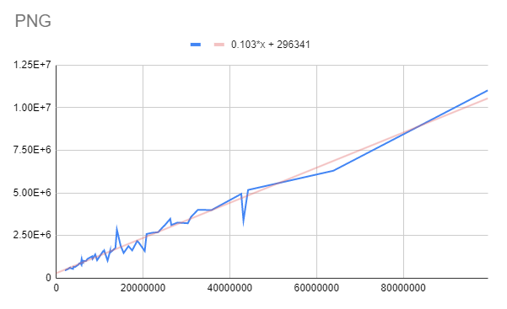
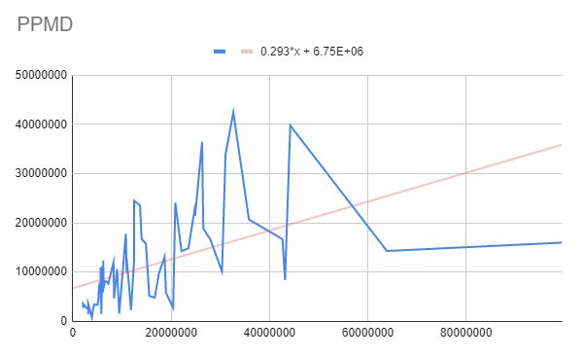

Complexity
Source file size
Decompression time

Slide 18
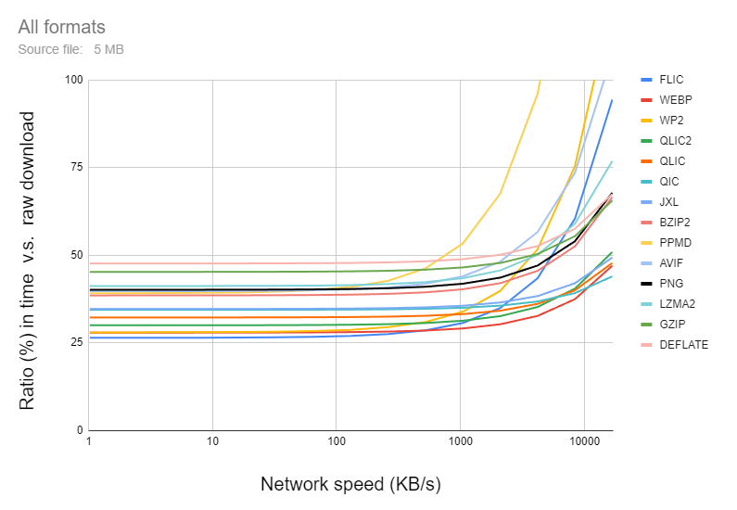
Model
Variable network

Slide 19
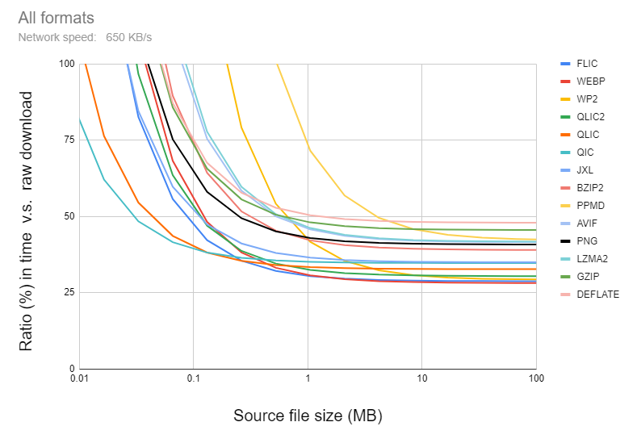
Model
Variable size

Slide 20
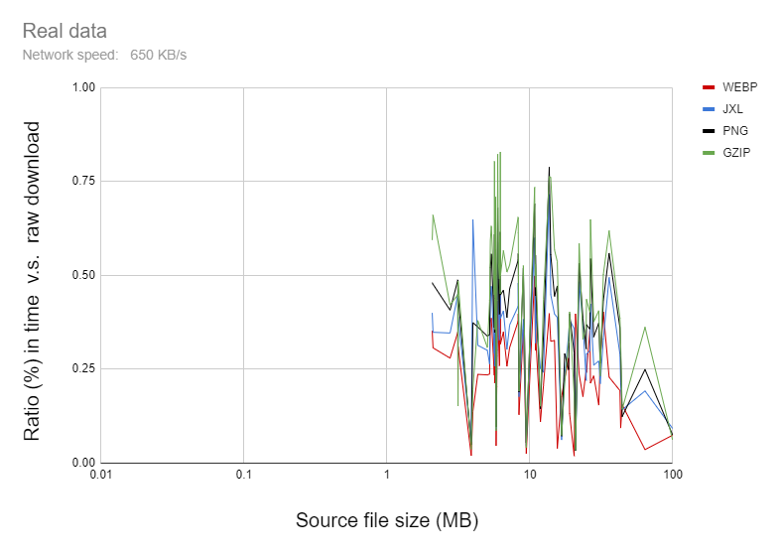
Real data

Slide 21
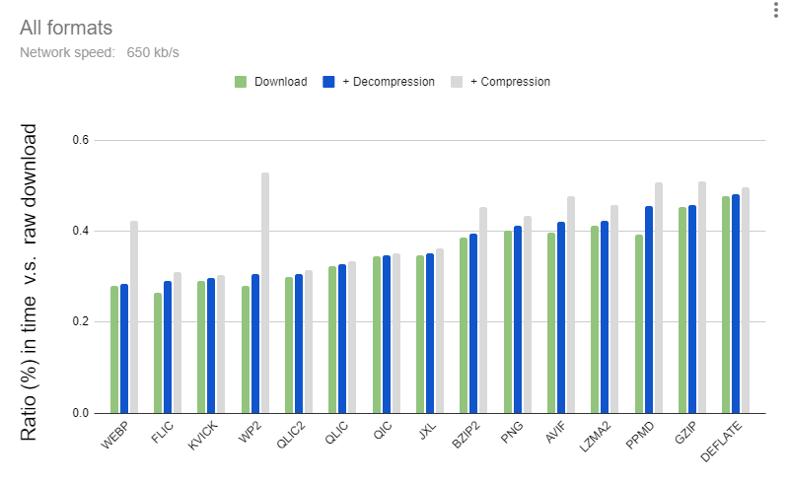
Ranking
Combined average

Slide 22
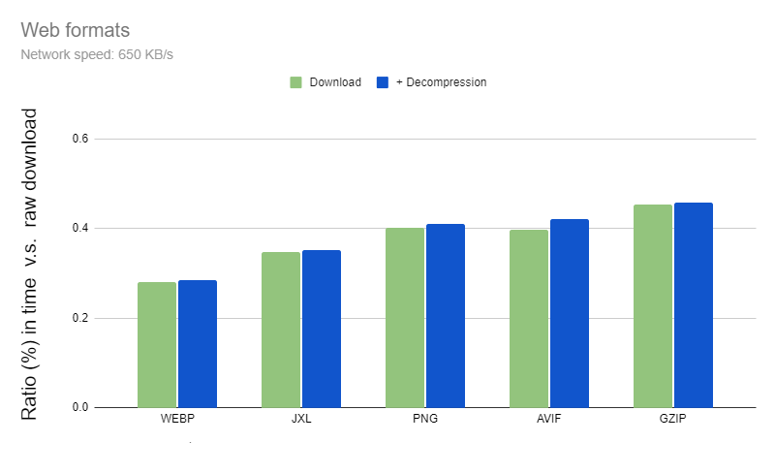
Ranking
Combined average

Slide 23
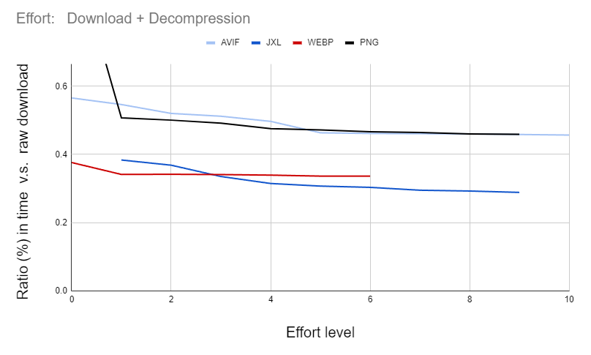
Effort

Slide 24
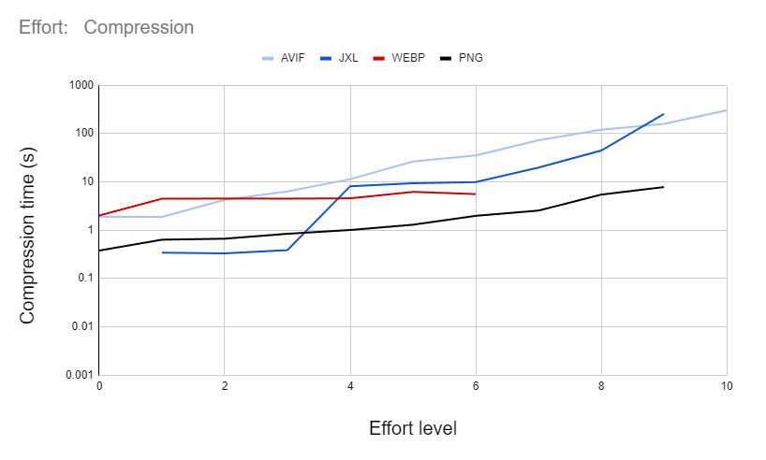
Effort
Compression time

Slide 25
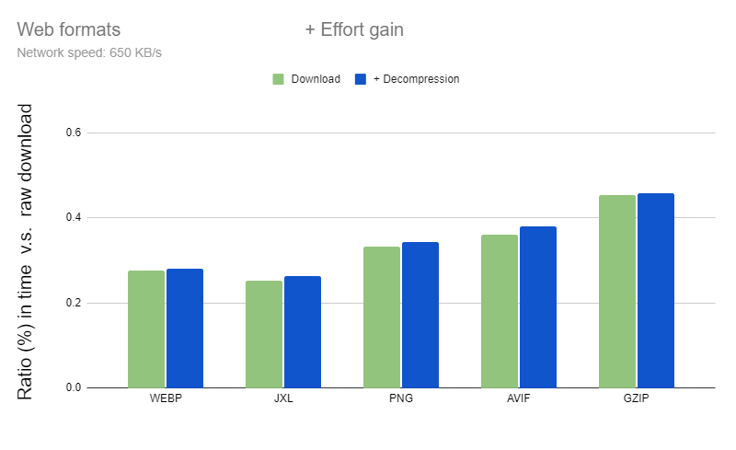
Effort

Slide 26
Conclusion
Jpeg XL
WebP
Flic
Best (absolute)
Best (browser support)
Honourable mention

Slide 27
Questions ?

