Slide 1

Muhammad Sameer | Muhammad Shahneel |Muhammad Arham | Muhammad Abdullah | Muhammad Ibad
BidNest Project - Comprehensive Analysis
BidNest is a comprehensive online auction platform built with ASP.NET Core 8.0 and Entity Framework. It facilitates real-time bidding on various items with separate interfaces for administrators, sellers, and buyers.

Slide 2
Muhammad Sameer | Muhammad Shahneel |Muhammad Arham | Muhammad Abdullah | Muhammad Ibad
Technical Stack
Framework
Database
Authentication
ASP.NET Core 8.0 MVC
SQL Server with Entity Framework Core
Cookie-based authentication
Real-time
Frontend
Security
SignalR for live bidding
Razor Views with Bootstrap, JavaScript
BCrypt for password hashing
File Handling
Image upload and management system

Slide 3
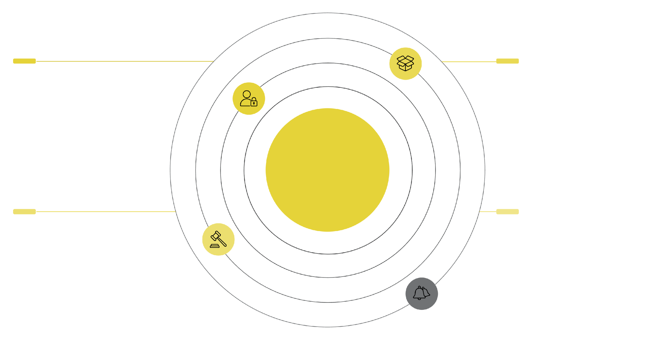




Muhammad Sameer | Muhammad Shahneel |Muhammad Arham | Muhammad Abdullah | Muhammad Ibad
Database Architecture: Core Entities
Users & Roles
Items & Categories
Accounts with role-based access (Admin, User)
Listings grouped by category with images
Auction Platform Entities
Bids & Watchlist
Notifications & Ratings
Bidding history and saved items tracking
Alerts, messages, feedback and contact
Users (with role-based access)
Items (auction listings)
Bids (bidding records)
Categories (item categorization)
Roles (Admin, User)
ItemImages (product photos)
Watchlist (saved items)
Notifications (system alerts)
Ratings (user feedback)
ContactMessages (support system)

Slide 4
Muhammad Sameer | Muhammad Shahneel |Muhammad Arham | Muhammad Abdullah | Muhammad Ibad
System Architecture: Admin Panel
Dashboard & Management
Category Management
Index.cshtml - Main admin dashboard with statistics
Categories.cshtml - Category listing and management
Users.cshtml - User management and overview
CategoryDetails.cshtml - Individual category information
UserDetails.cshtml - Individual user profile management
CreateCategory.cshtml - Add new categories
ViewUserProfile.cshtml - Detailed user profile view
EditCategory.cshtml - Modify existing categories
Item Management
DeleteCategory.cshtml - Remove categories
MergeCategories.cshtml - Combine similar categories
Items.cshtml - All items listing with filters
CategoryHierarchy.cshtml - Category structure view
ItemDetails.cshtml - Detailed item information
CreateItem.cshtml - Create new auction items
Communication & Monitoring
EditItem.cshtml - Modify existing items
Messages.cshtml - Contact messages from users
DeleteItem.cshtml - Remove items from system
MessageDetails.cshtml - Individual message view
PendingApprovals.cshtml - Review items awaiting approval
Bids.cshtml - Monitor all bidding activity

Slide 5

Muhammad Sameer | Muhammad Shahneel |Muhammad Arham | Muhammad Abdullah | Muhammad Ibad
System Architecture: Seller & User/Buyer Panels
Seller Panel (5 Pages)
User/Buyer Panel (12 Pages)
Dashboard.cshtml - Seller overview with earnings, active listings, recent bids
Login.cshtml - User authentication
Register.cshtml - New user registration
Create.cshtml - List new items for auction
Profile.cshtml - User profile display
MyItems.cshtml - Manage all seller's listings
EditProfile.cshtml - Modify user information
Edit.cshtml - Modify pending auction items
ChangePassword.cshtml - Security management
Analytics.cshtml - Comprehensive sales analytics and reports
AccessDenied.cshtml - Authorization error page
MyBids.cshtml - User's bidding history
Watchlist.cshtml - Saved/favorite items
MyMessages.cshtml - Communication with support
Dashboard.cshtml - Buyer overview with active bids, watchlist
Browse.cshtml - Browse available auctions
ItemDetails.cshtml - Detailed item view with bidding

Slide 6
Muhammad Sameer | Muhammad Shahneel |Muhammad Arham | Muhammad Abdullah | Muhammad Ibad
System Architecture: Auction, Search & Public Pages
Auction System (7 Pages)
Search & Discovery (3 Pages)
Public Pages (3 Pages)
Details.cshtml - Main auction page with real-time bidding
Index.cshtml - Main search interface
Index.cshtml - Homepage with featured auctions
Advanced.cshtml - Advanced search with filters
Active.cshtml - Currently active auctions
About.cshtml - Platform information
Categories.cshtml - Category-based browsing
Contact.cshtml - Contact form and support
Ending.cshtml - Auctions ending soon
Completed.cshtml - Finished auctions
History.cshtml - Auction history and results
Bid.cshtml - Bidding interface
MyBids.cshtml - Personal bidding history

Slide 7










Muhammad Sameer | Muhammad Shahneel |Muhammad Arham | Muhammad Abdullah | Muhammad Ibad
Core Functionalities
Real-time Bidding System
User Management
Item Management
Live bid updates using SignalR
Role-based access control (Admin/User)
Multi-image upload support
Automatic auction expiration handling
Profile management and authentication
Category-based organization
Winner determination and notification
User blocking and moderation tools
Approval workflow for new listings
Bid increment validation
Registration and login system
Status tracking (Active, Pending, Sold, Expired)
Analytics & Reporting
Communication System
Seller performance metrics
Contact message handling
Monthly earnings reports
User notifications
Category-wise statistics
Admin-user communication
Bidding activity monitoring

Slide 8




Muhammad Sameer | Muhammad Shahneel |Muhammad Arham | Muhammad Abdullah | Muhammad Ibad
Business Process Flow
User Registration & Authentication
Seller Workflow
Registration → Email Verification → Profile Setup → Role Assignment
Create Listing → Admin Approval → Active Auction → Bidding Period → Auction End → Winner Determination → Payment Processing
Buyer Workflow
Admin Workflow
Browse Items → Add to Watchlist → Place Bids → Monitor Auctions → Win/Lose Notification → Transaction Completion
Monitor Platform → Approve Listings → Manage Users → Handle Disputes → Generate Reports → System Maintenance

Slide 9
Muhammad Sameer | Muhammad Shahneel |Muhammad Arham | Muhammad Abdullah | Muhammad Ibad
Key Features
Advanced Search & Filtering
Comprehensive Analytics
Text-based search
Sales performance tracking
Category filtering
Monthly earnings reports
Price range filtering
Category performance analysis
Status-based filtering
User activity monitoring
Advanced search combinations
Security Features
Real-time Updates
Password hashing with BCrypt
Live bidding updates
Role-based authorization
Auction countdown timers
Session management
Instant notifications
Input validation and sanitization
Dynamic price updates

Slide 10
Muhammad Sameer | Muhammad Shahneel |Muhammad Arham | Muhammad Abdullah | Muhammad Ibad
Project Summary: BidNest
BidNest is a sophisticated online auction platform that solves the problem of conducting secure, transparent, and efficient online auctions.
Problem Solved: Traditional auction systems lack real-time capabilities, proper user management, and comprehensive analytics. BidNest addresses these issues by providing:
Admin Panel Contribution: Ensures platform integrity through user and content moderation, provides comprehensive system oversight and analytics, manages categories and maintains platform organization.
Seller Panel Contribution: Empowers sellers with easy listing tools and detailed analytics, provides performance insights and earnings tracking, streamlines the selling process from creation to completion.
User Panel Contribution: Offers intuitive bidding interface with real-time updates, provides comprehensive bid tracking and watchlist functionality, ensures secure account management and transaction history.
The platform creates a complete ecosystem where administrators maintain order, sellers can effectively market their items, and buyers can participate in transparent, competitive auctions with confidence. The real-time bidding system, comprehensive analytics, and multi-role architecture make BidNest a complete solution for online auction management.

