Slide 1

Ethernet Its relevancy and its uses Wiktor Kochanek, Luca Brodo, Gordan Konevski

Slide 2
Delineation

Slide 3
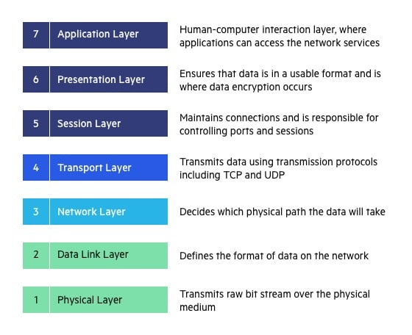
7 Layer Model

Slide 4
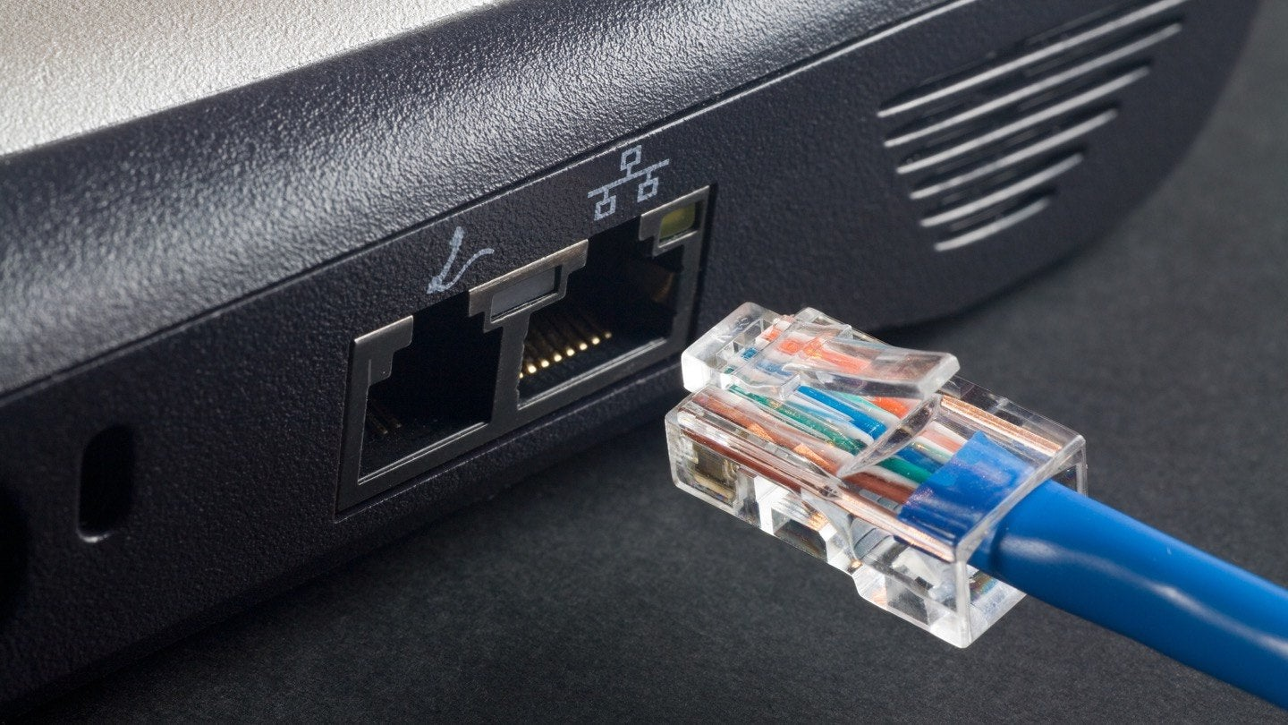

Slide 5
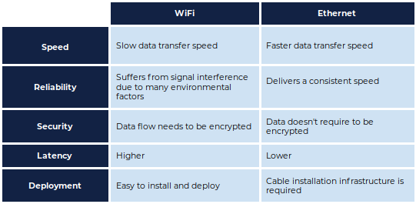

Slide 6
Technicalities

Slide 7
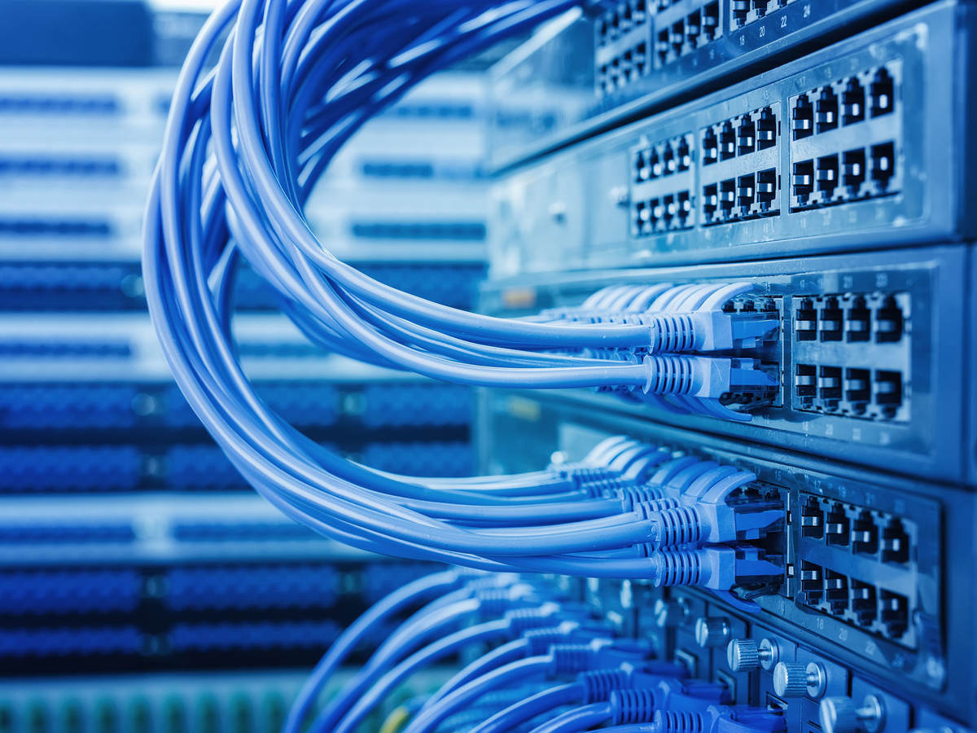

Slide 8
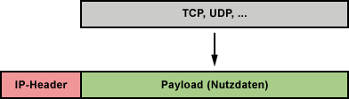

Slide 9
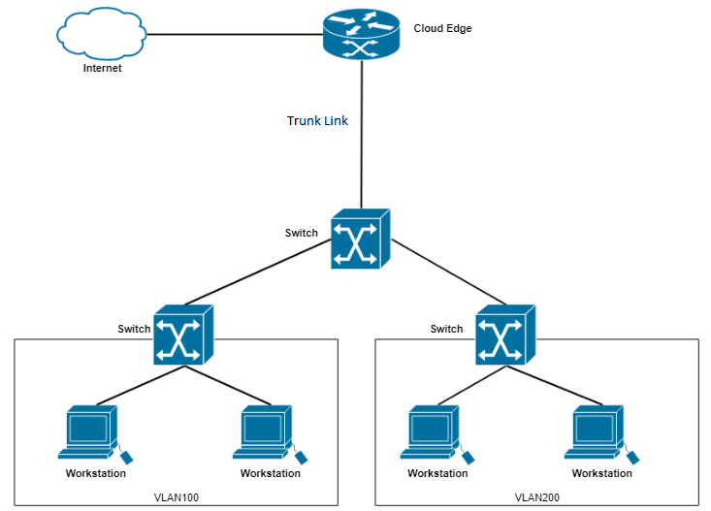

Slide 10
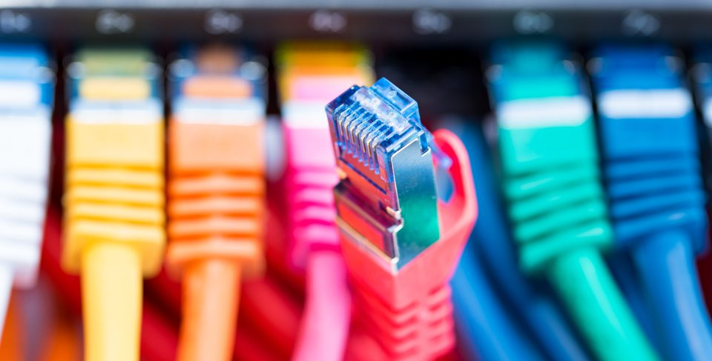

Slide 11
Time-Triggered Ethernet

Slide 12
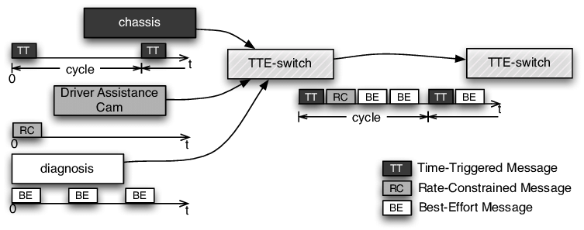

Slide 13
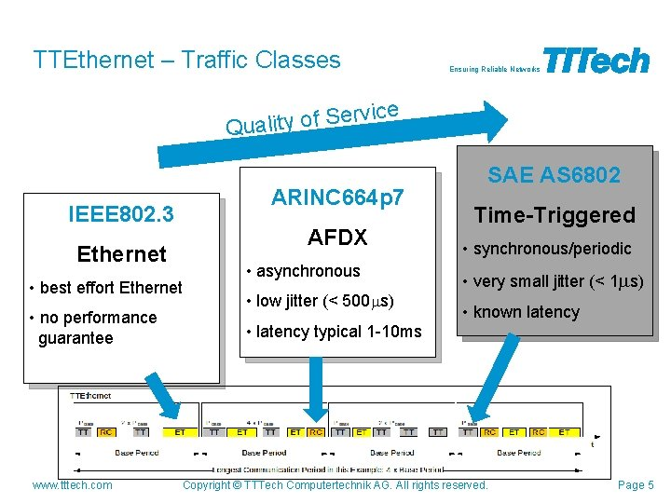

Slide 14
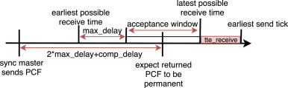

Slide 15
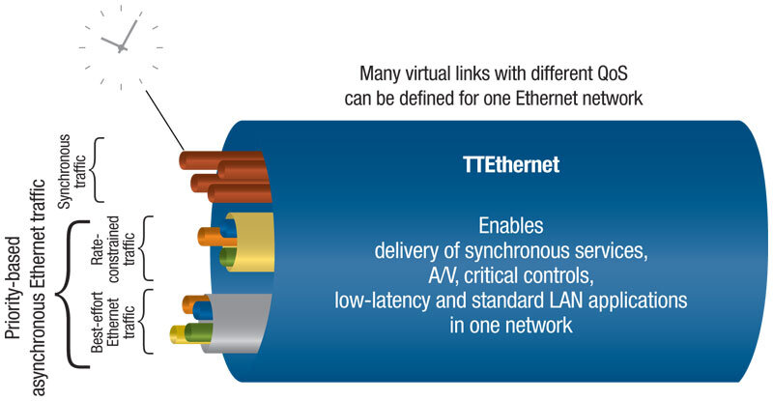

Slide 16
The End

Slide 17
Used Material
https://www.imperva.com/learn/wp-content/uploads/sites/13/2020/02/OSI-7-layers.jpg
https://www.comms-express.com/blog/what-does-an-ethernet-cable-do/#:~:text=The%20most%20common%20use%20for,or%20a%20network%20to%20work.
https://www.xerox.com/sites/default/files/research-center-xerox-parc-large-969x686_0.jpg
https://www.ul.com/sites/g/files/qbfpbp251/files/styles/hero_boxed_width/public/2019-02/Network%20cables%20plugged%20into%20servers.jpg?itok=8sWimoS3
https://www.esa.int/var/esa/storage/images/esa_multimedia/images/2013/11/ttethernet/14424343-1-eng-GB/TTEthernet_article.jpg
https://web.archive.org/web/20140328151014/http://www.tttech.com/fileadmin/content/general/secure/TTEthernet/TTTech-TTEthernet-Scalable_Real-Time_Ethernet_Platform-Whitepaper.pdf
https://www.elektronik-kompendium.de/sites/net/bilder/08112712.gif
https://success.trendmicro.com/solution/1123306-creating-cloud-edge-virtual-lan-configuration-in-routing-mode
https://sm.mashable.com/t/mashable_in/help/p/please-use/please-use-ethernet-cables-whenever-you-can-please_qjv5.960.jpg

