Slide 1
Study of Diabetes in MES13 cells RNA-seq Analysis with R Packages DEGseq and DSS LG, HG and TIIA
Wenji Li
Davit Sargsyan
September 2018

Slide 2
RNA-seq Sample Details
FastQ files were processed by Renyi (mes13_featurecounts_Dec2017_david.csv) in December 2017
Table contains 24,421 genes found in 3 samples: LG, HG and TIIA
Removed genes with low counts (< 21 across all 7 samples). 13,954 genes left.
Applied DEGseq (“Identify Differentially Expressed Genes from RNA-seq data”, Likun Wang et al)
Notes:
Renyi’s workflow?

Slide 3
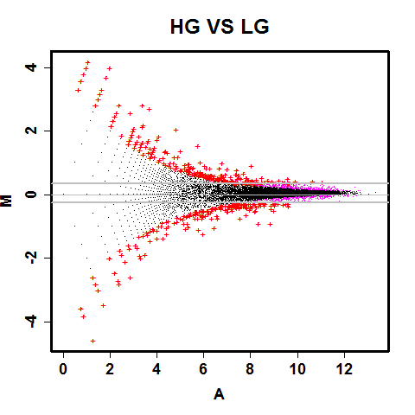
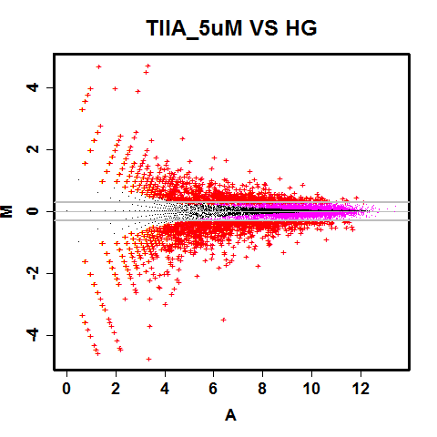
DEGseq normalization, log2 differences of at least 0.3 (1.23 fold-change)

Slide 4
DESeq2 FPM normalization, log2 differences of at least 0.3 (1.23 fold-change)
P-values from DEGseq

Slide 5
263
124
1,393
207
89
ADD rectangular heatmaps – top 50 up and top 50 down for each of the treatments (not the differences), also same for the differences.
1,120

Slide 6
Methyl-seq Sample Details
Applied DSS package
Notes:
Renyi’s workflow?

Slide 7
State the numbers in the figure description (legend)

Slide 8
ADD TABLE with mu +/- SD
NOTE: SEM is negligible

Slide 9
Add a table of the genes + legend. Add the following 4 genes to the figure and the list:
Fgl2
Gulo/(GLO)
Kcnip2/KChIP2
Bmp8b

Slide 10
Add a table of the genes + legend. Add the following 4 genes to the figure and the list:
Fgl2
Gulo/(GLO)
Kcnip2/KChIP2
Bmp8b
Write up methodology.
Flip the lollipop plots for just these 4 genes. Reverse the X-axis so negatives are on the left.

