Slide 1
DIM and SFN on JB6

Slide 2
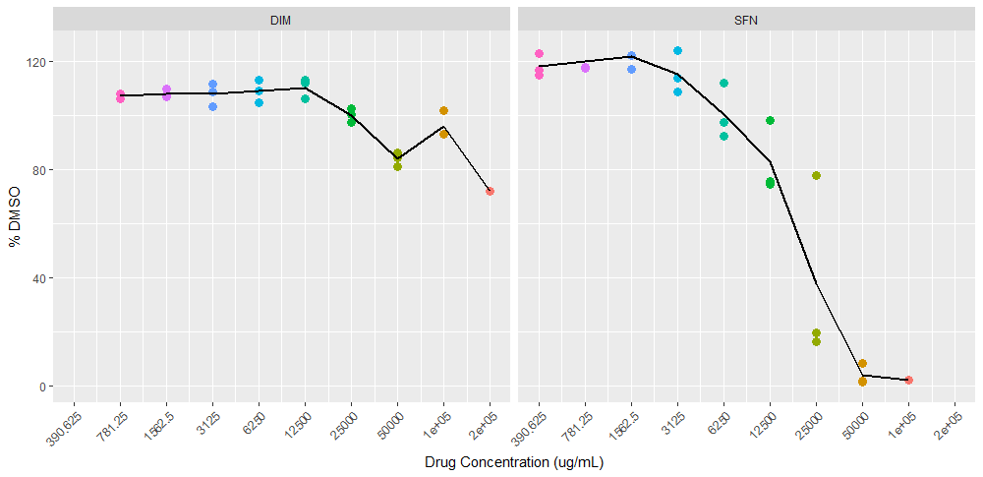
Efficacy: 24 Hours MTS

Slide 3
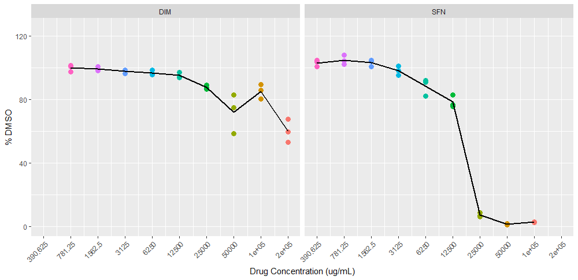
Efficacy: 48 Hours MTS

Slide 4
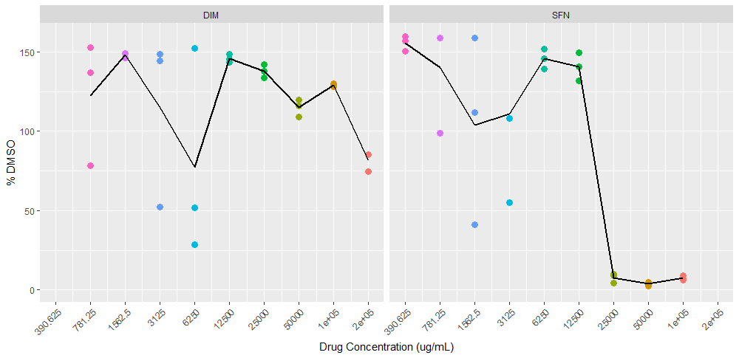
Efficacy: 72 Hours MTS

