Slide 1
Echinatin Screening With HepG2-C8 Cells
Davit Sargsyan, 01/03/2017

Slide 2
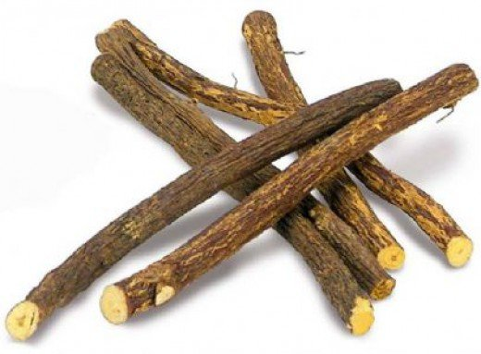
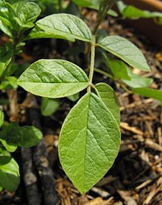
Echinatin
Treatment: echinatin, an extract from the roots and rhizomes of Glycyrrhiza uralensis (Chinese liquorice, Солодка уральская), and a potent Nrf2 activator
Positive Control: sulforaphane (SFN), an extract from cruciferous vegetables, and an Nrf2/HO-1 cascade activator (e.g. human THP1 macrophages)
Negative Controls: 0.1% dimethyl sulfoxide (DMSO) and trichostatin A (TSA, inhibits DNA transcription by removing acetyl group from histones)/5-aza-2'-deoxycytidine (5-aza, inhibits DNA methylation)

Slide 3
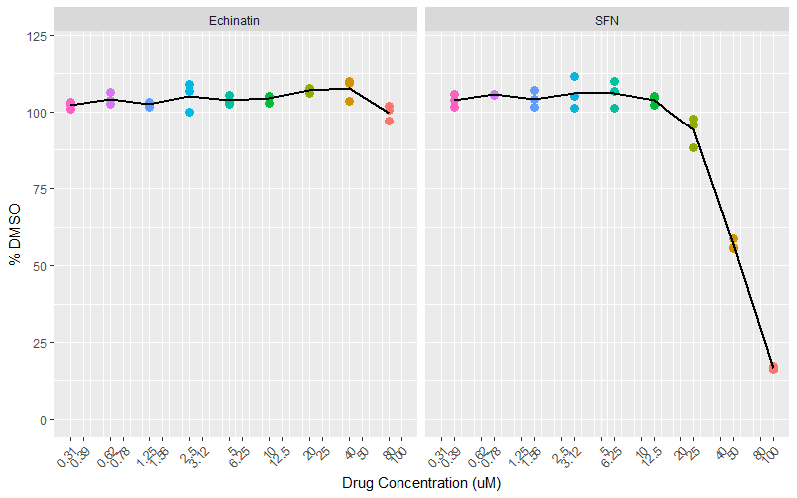
Efficacy: 24 Hours MTS (09/26/2016)

Slide 4
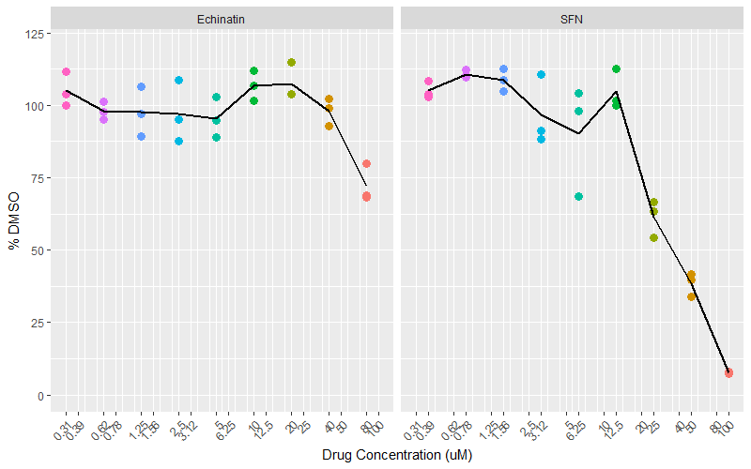
Efficacy: 48 Hours MTS (09/27/2016)

Slide 5
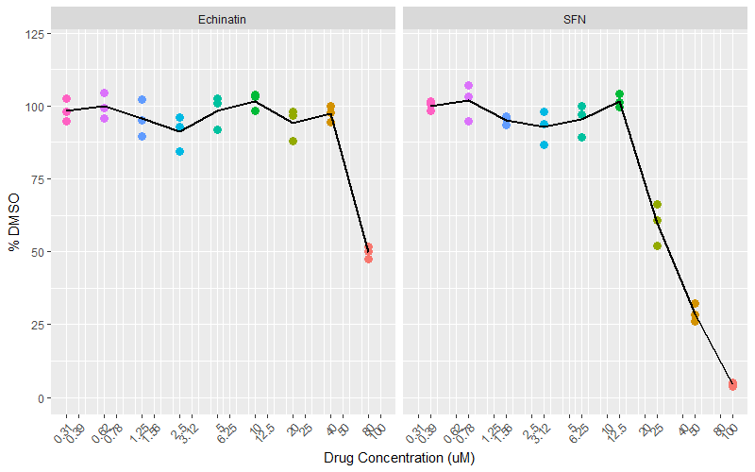
Efficacy: 72 Hours MTS (09/28/2016)

Slide 6
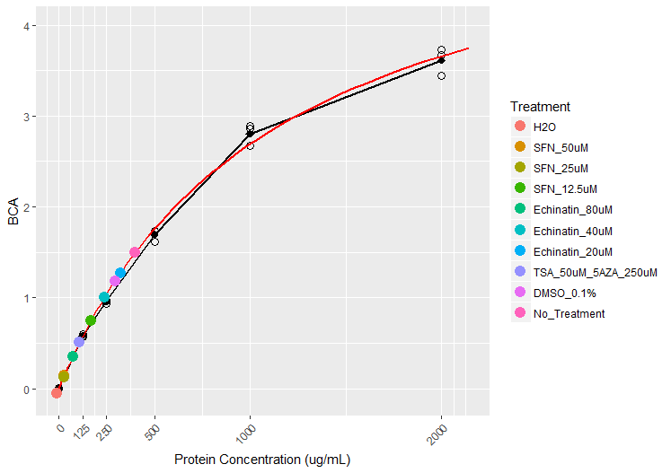
Protein Concentration Using Standard Curve (11/09/2016)
Treatment | BCA1 | BCA2 | BCA3
Albumine_0ug/mL | 0.058 | 0.061 | 0.056
Albumine_125ug/mL | 0.629 | 0.637 | 0.655
Albumine_250ug/mL | 1.026 | 1.032 | 0.994
Albumine_500ug/mL | 1.795 | 1.674 | 1.796
Albumine_1000ug/mL | 2.944 | 2.918 | 2.727
Albumine_2000ug/mL | 3.731 | 3.784 | 3.501
BCA_Only | 0.057 | 0.060 | 0.058
DMSO_0.1% | 1.027 | 1.325 | 1.373
Echinatin_20uM | 1.329 | 1.307 | 1.361
Echinatin_40uM | 1.227 | 0.965 | 0.990
Echinatin_80uM | 0.509 | 0.599 | 0.134
No_Treatment | 1.696 | 1.650 | 1.306
SFN_12.5uM | 0.716 | 0.742 | 0.958
SFN_25uM | 0.082 | 0.211 | 0.266
SFN_50uM | 0.223 | 0.286 | 0.105
TSA_50uM_5AZA_250uM | 0.435 | 0.744 | 0.518

Slide 7
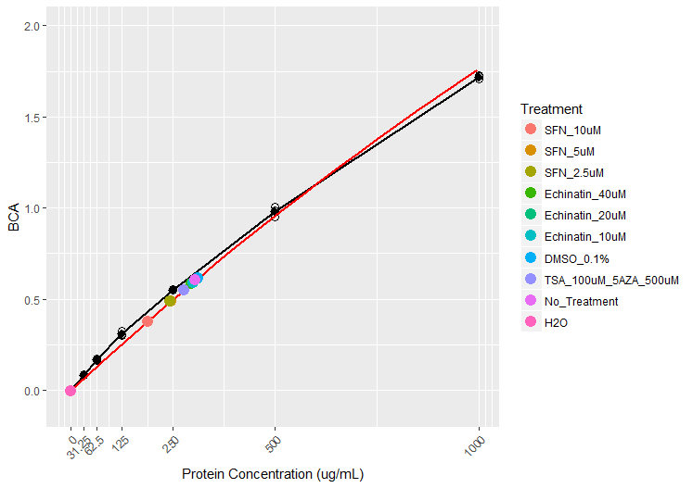
Protein Concentration Using Standard Curve (11/28/2016)
Treatment | BCA1 | BCA2 | BCA3
Albumine_2000ug/mL | 3.180 | 3.105 | 3.234
Albumine_1000ug/mL | 1.826 | 1.806 | 1.822
Albumine_500ug/mL | 1.085 | 1.050 | 1.104
Albumine_250ug/mL | 0.650 | 0.647 | 0.651
Albumine_125ug/mL | 0.423 | 0.400 | 0.403
Albumine_62.5ug/mL | 0.273 | 0.269 | 0.261
Albumine_31.25ug/mL | 0.186 | 0.182 | 0.181
Albumine_0ug/mL | 0.098 | 0.097 | 0.098
SFN_10uM | 0.483 | 0.474 | 0.472
SFN_5uM | 0.597 | 0.593 | 0.577
SFN_2.5uM | 0.592 | 0.587 | 0.577
Echinatin_40uM | 0.693 | 0.695 | 0.657
Echinatin_20uM | 0.719 | 0.723 | 0.688
Echinatin_10uM | 0.695 | 0.697 | 0.677
DMSO_0.1% | 0.732 | 0.713 | 0.693
TSA_100uM_5AZA_500uM | 0.645 | 0.680 | 0.616
No_Treatment | 0.713 | 0.700 | 0.692
H2O | 0.094 | 0.095 | 0.099

Slide 8
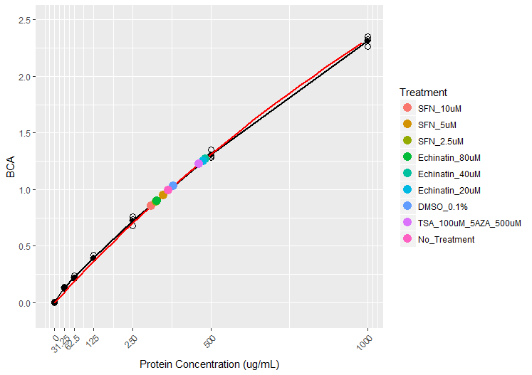
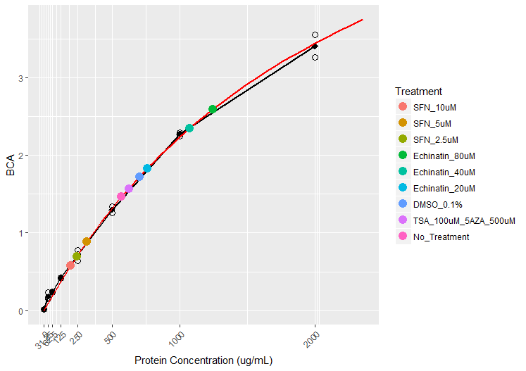
Protein Concentration Using Standard Curve
12/07/2016
12/22/2016

Slide 9
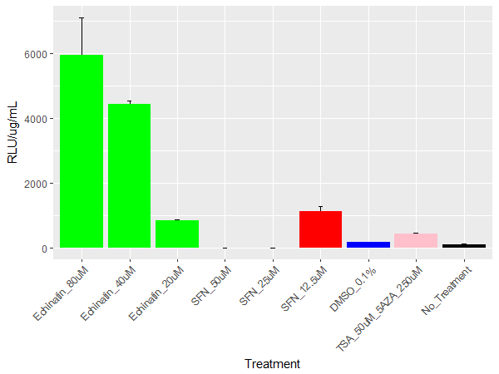
Protein Activity (11/09/2016)
Seeded: 11/03/2016
Treated: 11/05/2016
RLB and frozen (-20): 11/06/2016
Collected, ran out of Luciferase assay, stored in -20: 11/07/2016
Processed: 11/09/2016
Treatment | Mean BCA | Predicted Concentration (ug/mL) | RLU1 | RLU2 | RLU3 | Mean RLU3 | SD of RLU/Pred. Conc | RLU/ug/mL | Pct_DMSO
Echinatin_80uM | 0.36 | 74.67 | 397441.00 | 544907.00 | 391136.00 | 444494.67 | 1165.35 | 5952.79 | 3564.52
Echinatin_40uM | 1.00 | 239.19 | 1090729.00 | 1059081.00 | 1037314.00 | 1062374.67 | 112.29 | 4441.48 | 2659.55
Echinatin_20uM | 1.27 | 322.62 | 258199.00 | 268078.00 | 279614.00 | 268630.33 | 33.22 | 832.65 | 498.59
SFN_50uM | 0.15 | 29.53 | 53.00 | 44.00 | 40.00 | 45.67 | 0.23 | 1.55 | 0.93
SFN_25uM | 0.13 | 25.68 | 40.00 | 34.00 | 32.00 | 35.33 | 0.16 | 1.38 | 0.82
SFN_12.5uM | 0.75 | 169.09 | 218421.00 | 168789.00 | 185508.00 | 190906.00 | 149.35 | 1129.03 | 676.06
DMSO_0.1% | 1.18 | 293.55 | 47651.00 | 49732.00 | 49687.00 | 49023.33 | 4.05 | 167.00 | 100.00
TSA_50uM_5AZA_250uM | 0.51 | 109.49 | 45744.00 | 49406.00 | 44221.00 | 46457.00 | 24.34 | 424.32 | 254.08
No_Treatment | 1.49 | 397.41 | 40597.00 | 44112.00 | 43126.00 | 42611.67 | 4.56 | 107.22 | 64.21

Slide 10
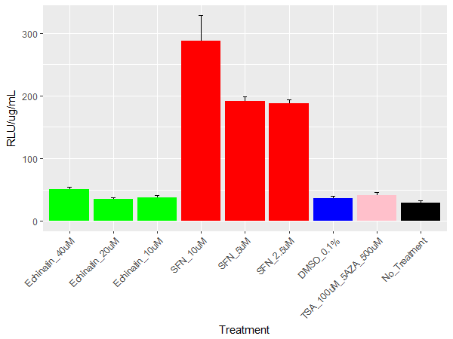
Protein Activity (11/28/2016)
Seeded: 11/23/2016
Treated: 11/25/2016
RLB and frozen (-70): 11/26/2016
Collected and processed: 11/28/2016
Treatment | Mean BCA | Predicted Concentration (ug/mL) | RLU1 | RLU2 | RLU3 | Mean RLU3 | SD of RLU/Pred. Conc | RLU/ug/mL | Pct_DMSO
Echinatin_40uM | 0.58 | 294.58 | 16123.00 | 14832.00 | 13370.00 | 14775.00 | 4.68 | 50.16 | 138.08
Echinatin_20uM | 0.61 | 309.67 | 10129.00 | 11745.00 | 10546.00 | 10806.67 | 2.71 | 34.90 | 96.08
Echinatin_10uM | 0.59 | 298.93 | 10163.00 | 12451.00 | 11008.00 | 11207.33 | 3.87 | 37.49 | 103.22
SFN_10uM | 0.38 | 187.16 | 60683.00 | 55024.00 | 45522.00 | 53743.00 | 40.93 | 287.15 | 790.56
SFN_5uM | 0.49 | 245.60 | 47020.00 | 48844.00 | 45145.00 | 47003.00 | 7.53 | 191.38 | 526.88
SFN_2.5uM | 0.49 | 243.72 | 45457.00 | 47378.00 | 44411.00 | 45748.67 | 6.17 | 187.71 | 516.79
DMSO_0.1% | 0.61 | 311.03 | 12463.00 | 10572.00 | 10857.00 | 11297.33 | 3.28 | 36.32 | 100.00
TSA_100uM_5AZA_500uM | 0.55 | 276.27 | 13024.00 | 10043.00 | 10568.00 | 11211.67 | 5.76 | 40.58 | 111.73
No_Treatment | 0.60 | 305.25 | 9878.00 | 8608.00 | 7727.00 | 8737.67 | 3.54 | 28.62 | 78.81

Slide 11
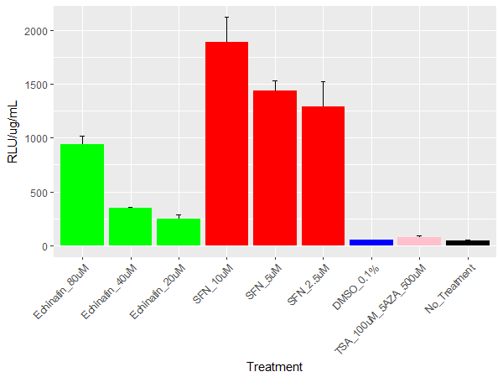
Protein Activity (12/07/2016)
Seeded: 12/07/2016
Treated: 12/08/2016
RLB and frozen (-70): 12/09/2016
Collected and processed: 12/29/2016
Treatment | Mean BCA | Predicted Concentration (ug/mL) | RLU1 | RLU2 | RLU3 | Mean RLU3 | SD of RLU/Pred. Conc | RLU/ug/mL | Pct_DMSO
Echinatin_80uM | 0.90 | 327.55 | 293519.00 | 291865.00 | 337076.00 | 307486.67 | 78.27 | 938.73 | 1825.85
Echinatin_40uM | 1.27 | 481.98 | 174076.00 | 167182.00 | 168141.00 | 169799.67 | 7.75 | 352.29 | 685.22
Echinatin_20uM | 1.25 | 474.11 | 100486.00 | 122292.00 | 136936.00 | 119904.67 | 38.69 | 252.90 | 491.90
SFN_10uM | 0.85 | 309.36 | 511725.00 | 650826.00 | 592758.00 | 585103.00 | 225.84 | 1891.34 | 3678.69
SFN_5uM | 0.95 | 348.13 | 481687.00 | 479411.00 | 536788.00 | 499295.33 | 93.33 | 1434.21 | 2789.56
SFN_2.5uM | 0.89 | 324.67 | 333326.00 | 458829.00 | 464708.00 | 418954.33 | 228.58 | 1290.40 | 2509.84
DMSO_0.1% | 1.03 | 379.80 | 18515.00 | 21003.00 | 19063.00 | 19527.00 | 3.44 | 51.41 | 100.00
TSA_100uM_5AZA_500uM | 1.22 | 461.37 | 27045.00 | 41956.00 | 38757.00 | 35919.33 | 17.01 | 77.85 | 151.42
No_Treatment | 0.99 | 364.21 | 16885.00 | 19439.00 | 19102.00 | 18475.33 | 3.81 | 50.73 | 98.66

Slide 12
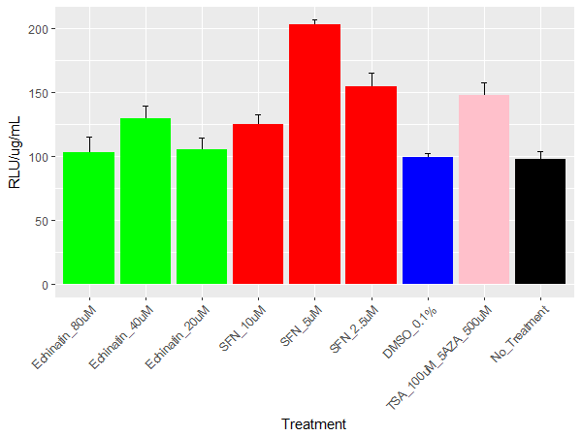
Protein Activity (12/22/2016)
Seeded: 12/22/2016
Treated: 12/24/2016
RLB and frozen (-70): 12/27/2016
Collected and processed: 12/29/2016
Treatment | Mean BCA | Predicted Concentration (ug/mL) | RLU1 | RLU2 | RLU3 | Mean RLU3 | SD of RLU/Pred. Conc | RLU/ug/mL | Pct_DMSO
Echinatin_80uM | 2.59 | 1245.00 | 120996.00 | 117874.00 | 145583.00 | 128151.00 | 12.19 | 102.93 | 103.52
Echinatin_40uM | 2.35 | 1074.03 | 147179.00 | 132155.00 | NA | 139667.00 | 9.89 | 130.04 | 130.78
Echinatin_20uM | 1.83 | 762.92 | 84007.00 | 71802.00 | 85025.00 | 80278.00 | 9.64 | 105.22 | 105.82
SFN_10uM | 0.58 | 196.82 | 26212.00 | 24416.00 | 23212.00 | 24613.33 | 7.67 | 125.05 | 125.77
SFN_5uM | 0.88 | 315.16 | 65353.00 | 63620.00 | 63411.00 | 64128.00 | 3.38 | 203.48 | 204.64
SFN_2.5uM | 0.70 | 241.85 | 35677.00 | 40447.00 | 36313.00 | 37479.00 | 10.71 | 154.97 | 155.85
DMSO_0.1% | 1.72 | 702.85 | 70298.00 | 67641.00 | 71721.00 | 69886.67 | 2.95 | 99.43 | 100.00
TSA_100uM_5AZA_500uM | 1.57 | 624.55 | 85787.00 | 93389.00 | 98298.00 | 92491.33 | 10.09 | 148.09 | 148.94
No_Treatment | 1.47 | 572.40 | 55156.00 | 52667.00 | 59942.00 | 55921.67 | 6.46 | 97.70 | 98.25

