Slide 1
Skin cancer Prevention by Sulforaphane (SFN) in UVB-Induced Skin cancer Mouse Model
Methyl-seq Analysis with R Package DSS
Davit Sargsyan
March 2018

Slide 2
Results
237,858 CpG clusters identified and annotated
After removing 2,548 rows with all zeros, 235,310 CpG clusters left
Principal components analysis (PCA) and clustering by Euclidean distance (heatmap with dendrograms) show that tumor samples were significantly different from the rest
Additionally, analysis of non-tumor samples suggested clustering of samples by timepoints and separation of controls form treatments.

Slide 3
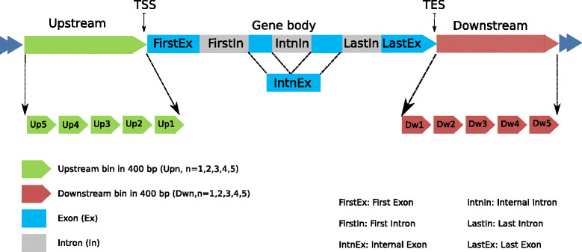
https://rd.springer.com/article/10.1186/s13059-014-0408-0

Slide 4
Notes:
<number>

Slide 5
All Samples

Slide 6
No Tumor
Notes:
Change sample names
<number>

Slide 8
RED: hypermethylated in UVB
GREEN: hypomethylated in UVB

