Slide 1
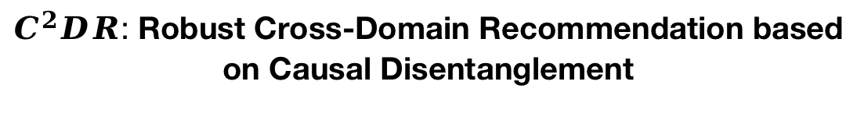
$C^{2}DR$: Robust Cross-Domain Recommendation based on Causal Disentanglement
Menglin Kong

Slide 2
Introduction:
Research Scope:
Numerous recommender models have been developed based on leveraging the rich information captured from users’ historical interactions .
Traditional recommendation systems encounter difficulties for new users who have no any prior interaction history, giving rise to the prevalent cold-start problem.
With users increasingly participating in multiple domains, there is a potential to utilize information from different domains to alleviate the data sparsity and cold-start challenges. This insight has led to the development of Cross-Domain Recommendation (CDR).

Slide 3
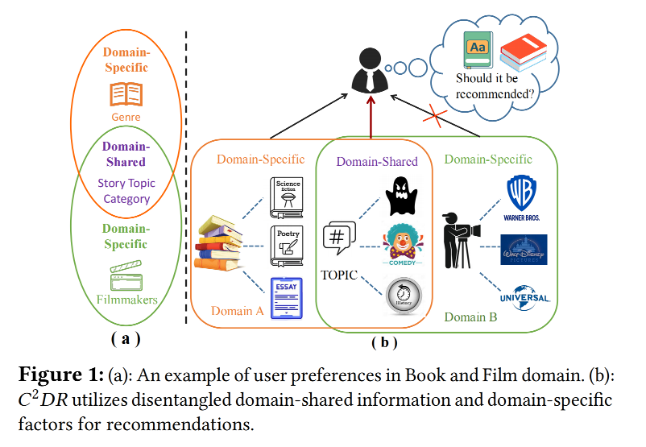
Introduction:
Research Gap:
Existing approaches often place excessive emphasis on the assumption of domain in-variance, presuming that the data distribution remains unchanged in each domain.
1. This assumption can be problematic, as the characteristics and distributions of user/item data can vary significantly across domains.
2. User preferences are expressed through distinct behaviors in different domains, transferring domain-shared information can yield positive effects for other domains, while transferring domain-specific information may introduce negative transfer issues.
We argue that the optimal approach is to capture and transfer the most relevant factors, specifically the domain-shared information, to boost recommendations in other domains.

Slide 4
Introduction:
Contributions:
Presenting a causal perspective on solving cross-domain recommender systems and introducing a causal graph formulation for robust recommendation. To the best of our knowledge, this work is the first attempt to address CDR from a causal standpoint.
Proposing a novel model called 𝐶2𝐷𝑅 that trains the CDR ac_x0002_cording to the causal graph. The model employs domain classifier and sample re-weight techniques to distangle domain shared information and domain-specific information. By selectively transferring only the domain-shared information, we enhance the recommendation performance of the model.
Experimental results on three real-world recommendation datasets demonstrate the effectiveness and robustness of the proposed method. 𝐶2𝐷𝑅 also provides possibilities for understanding how causal variables affect the recommendation outcomes in each domain.

Slide 5
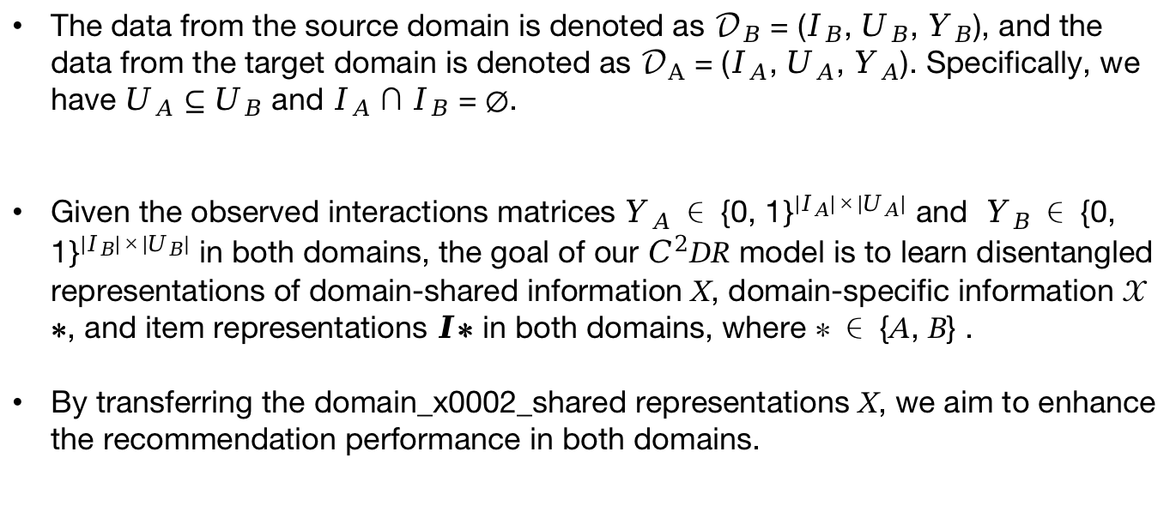
Preliminary:
The data from the source domain is denoted as $𝒟_{B}$ = ($I_{B}$, $U_{B}$, $Y_{B}$), and the data from the target domain is denoted as $𝒟_{A}$ = ($I_{A}$, $U_{A}$, $Y_{A}$). Specifically, we have $U_{A}$ ⊆ $U_{B}$ and $I_{A}$ ∩ $I_{B}$ = ∅.
Given the observed interactions matrices $Y_{A}$ ∈ {0, 1$\}^{{|I}_{A}|×{|U}_{A}|}$and $Y_{B}$ ∈ {0, 1$\}^{{|I}_{B}|×{|U}_{B}|}$ in both domains, the goal of our $C^{2}$𝐷𝑅 model is to learn disentangled representations of domain-shared information 𝑋, domain-specific information 𝒳∗, and item representations $I$∗ in both domains, where ∗ ∈ {𝐴, 𝐵} .
By transferring the domain_x0002_shared representations 𝑋, we aim to enhance the recommendation performance in both domains.

Slide 6
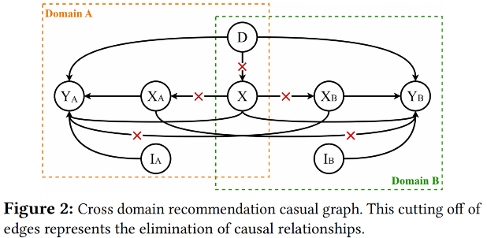
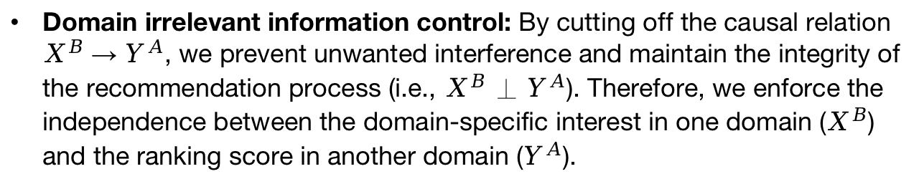

Proposed methods:
Causal Look at CDR:
Domain-shared information extraction: By cutting off the causal relation 𝐷 → 𝑋, we achieve statistical independence between 𝑋 and 𝐷 (i.e., 𝐷 ⊥ 𝑋). , i.e., 𝑃 (𝑋 |𝐷 = 0) = 𝑃 (𝑋 |𝐷 = 1).
Domain-specific information extraction: By cutting off the causal relations 𝑋 → $X^{A}$ and 𝑋 → $X^{B}$, we ensure the independence of these variables (i.e., $X^{A}$ ⊥ $X^{B}$, 𝑋 ⊥ $X^{B}$, 𝑋 ⊥ $X^{A}$).
Domain irrelevant information control: By cutting off the causal relation $X^{B}$ → $Y^{A}$, we prevent unwanted interference and maintain the integrity of the recommendation process (i.e.,${ X}^{B}$ ⊥ $Y^{A}$). Therefore, we enforce the independence between the domain-specific interest in one domain ($X^{B}$) and the ranking score in another domain ($Y^{A}$).

Slide 7
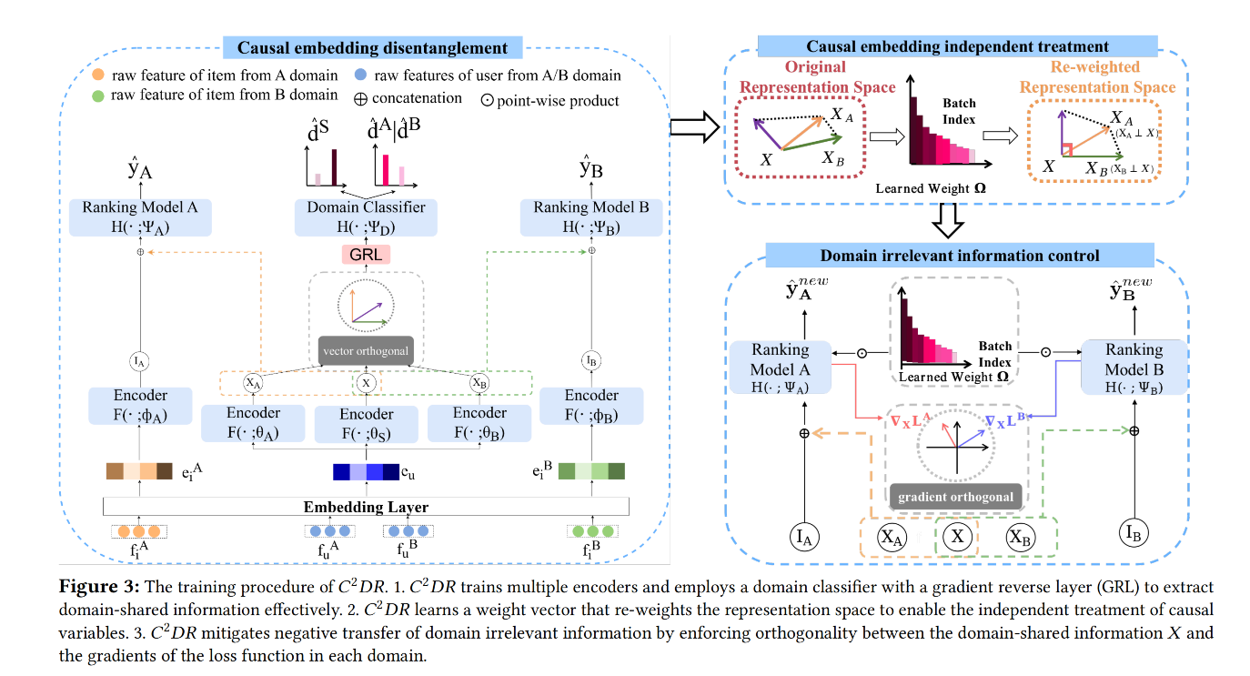

Proposed methods:
$C^{2}$𝐷𝑅 framework:

Slide 8
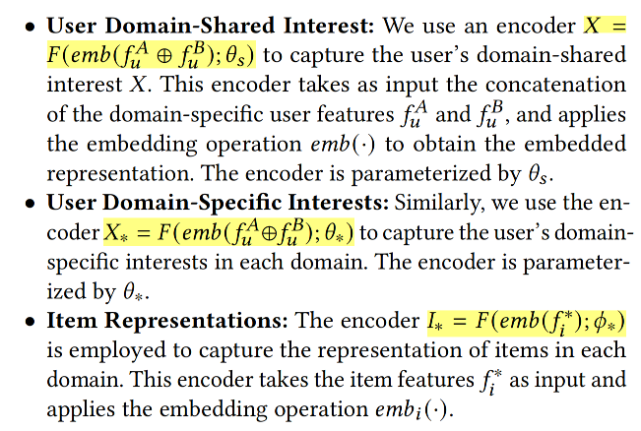



Proposed methods:
Causal representation learning:
Output with respect to user and item:
Loss:

Slide 9



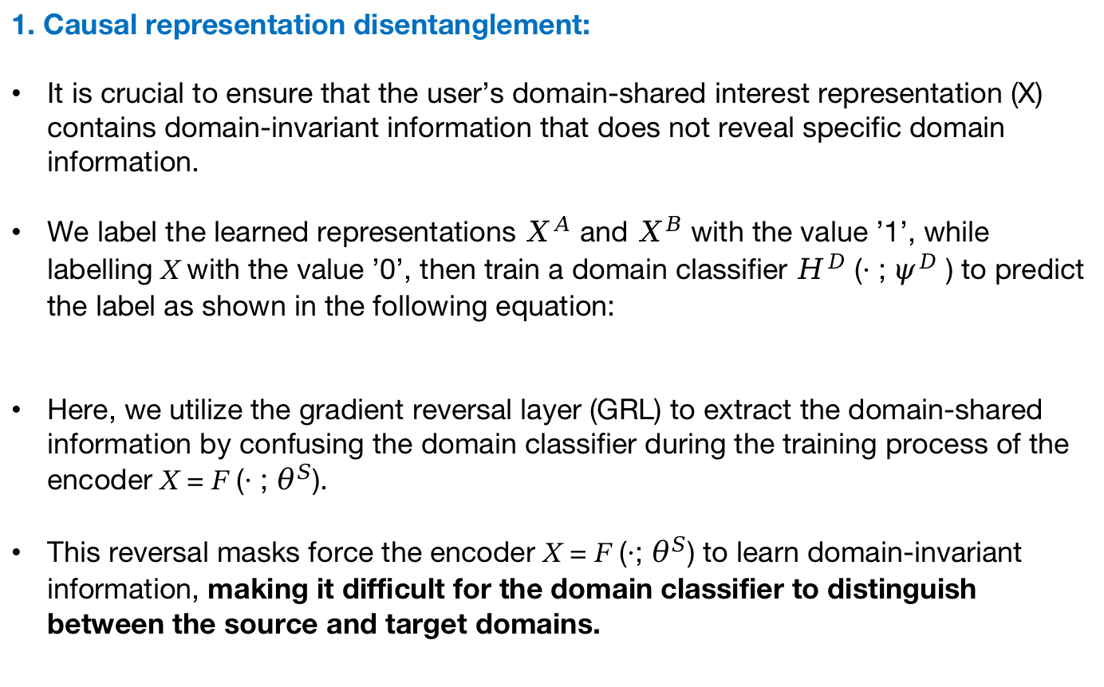
Proposed methods:
1. Causal representation disentanglement:
It is crucial to ensure that the user’s domain-shared interest representation (X) contains domain-invariant information that does not reveal specific domain information.
We label the learned representations $X^{A}$ and $X^{B}$ with the value ’1’, while labelling 𝑋 with the value ’0’, then train a domain classifier $H^{D}$ (· ; $ψ^{D}$ ) to predict the label as shown in the following equation:
Here, we utilize the gradient reversal layer (GRL) to extract the domain-shared information by confusing the domain classifier during the training process of the encoder 𝑋 = 𝐹 (· ; $θ^{S}$).
This reversal masks force the encoder 𝑋 = 𝐹 (·; $θ^{S}$) to learn domain-invariant information, making it difficult for the domain classifier to distinguish between the source and target domains.
$GRL(X) = X ,\frac{∂GRL(X)}{∂X}$ = -$I$

Slide 10

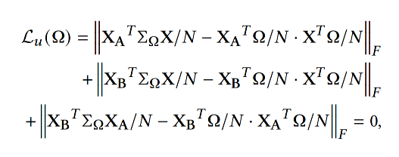
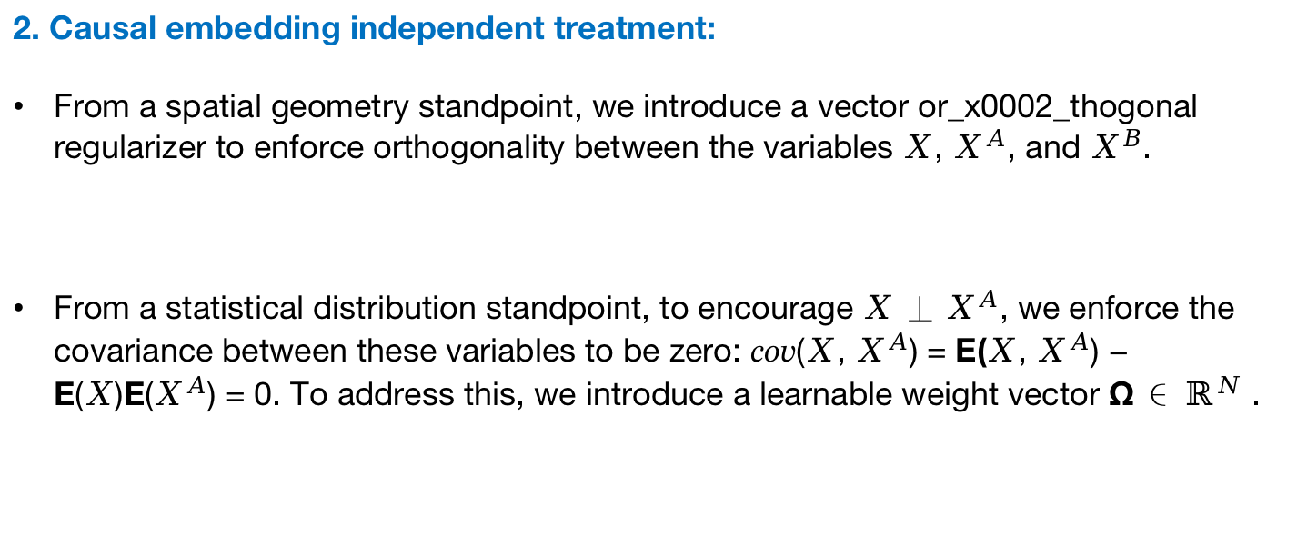
Proposed methods:
2. Causal embedding independent treatment:
From a spatial geometry standpoint, we introduce a vector or_x0002_thogonal regularizer to enforce orthogonality between the variables $X$, $X^{A}$, and $X^{B}$.
From a statistical distribution standpoint, to encourage $X$ ⊥ $X^{A}$, we enforce the covariance between these variables to be zero: 𝑐𝑜𝑣($X$, $X^{A}$) = E($X$, $X^{A}$) − E($X$)E($X^{A}$) = 0. To address this, we introduce a learnable weight vector Ω ∈ $ℝ^{N}$ .

Slide 11
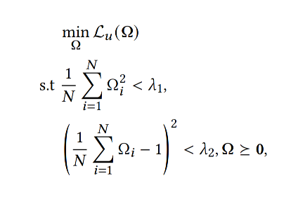
Proposed methods:
2. Causal embedding independent treatment:
To simplify the calculation, we transform Equation and optimize the learnable weight Ω by minimizing the following objective:

Slide 12



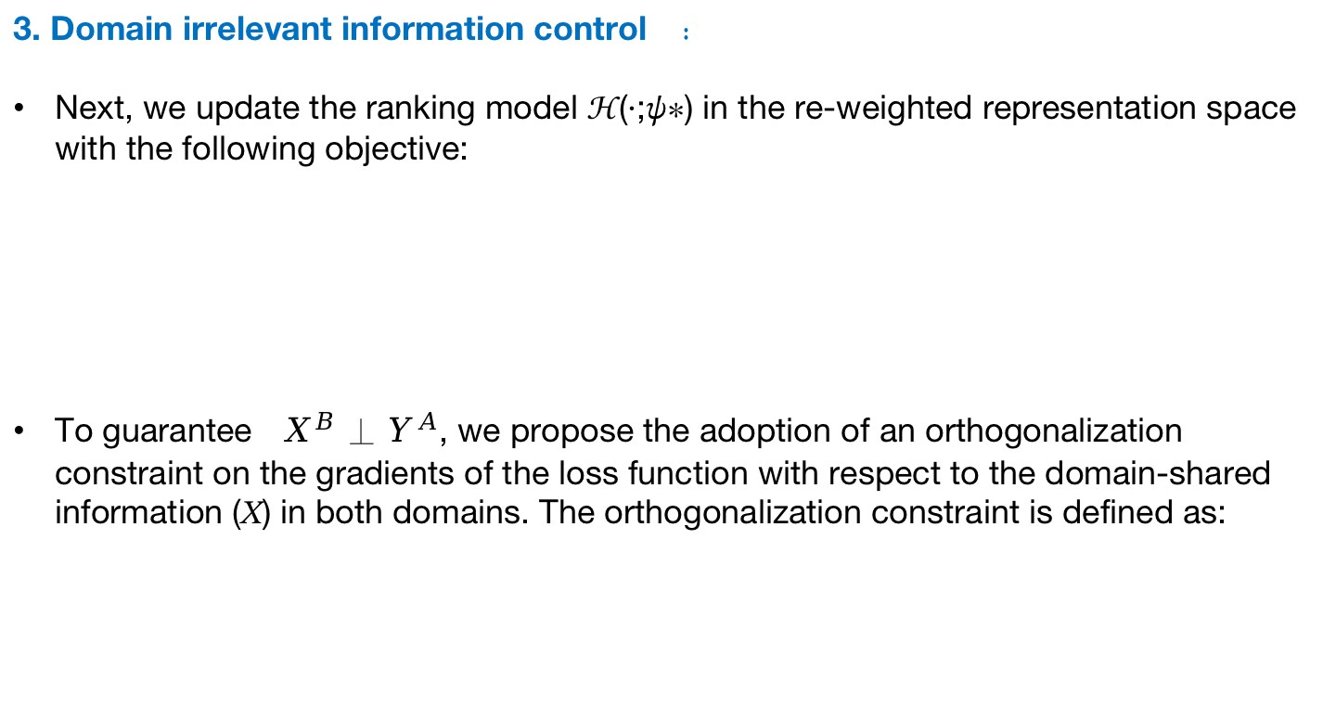
Proposed methods:
3. Domain irrelevant information control ：
Next, we update the ranking model ℋ(·;𝜓∗) in the re-weighted representation space with the following objective:
To guarantee ${ X}^{B}$ ⊥ $Y^{A}$, we propose the adoption of an orthogonalization constraint on the gradients of the loss function with respect to the domain-shared information (𝑋) in both domains. The orthogonalization constraint is defined as:

Slide 13
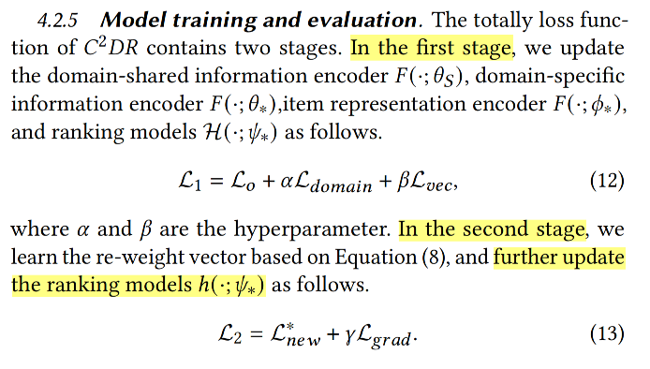
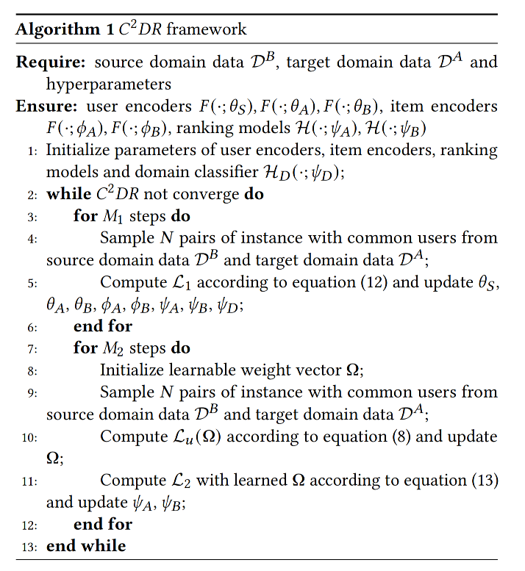
Proposed methods:
Training Procedure:

Slide 14
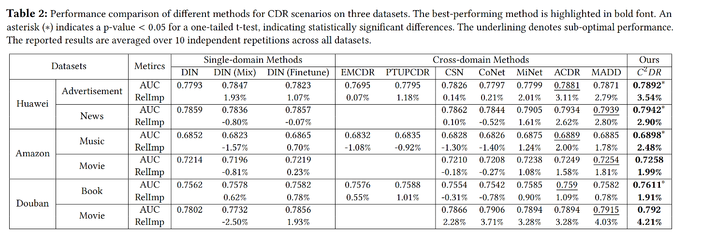
Experiments:
Main Results:
The semantic correlation of data in different domains has a significant impact on the performance of CDR models.
The improvement of model performance in the source domain is not as significant as in the target domain.
Domain information disentanglement plays a crucial role in achieving robust CDR performance.

