Slide 1
Finding dead and bad AHDC wires
Kong Tu
Brookhaven National Laboratory
ALERT service task · 576 AHDC wires · 1112 runs (21317–23061)
github.com/KongTu/deadChannel-ALERT-CLAS12
Notes:
Goal: a per-run list of bad AHDC channels, reproducible, ready for a database.

Slide 2
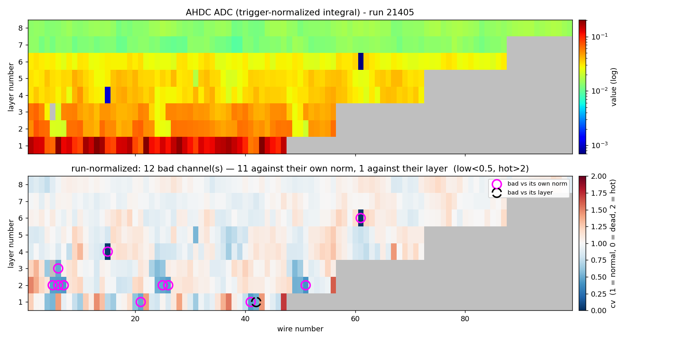
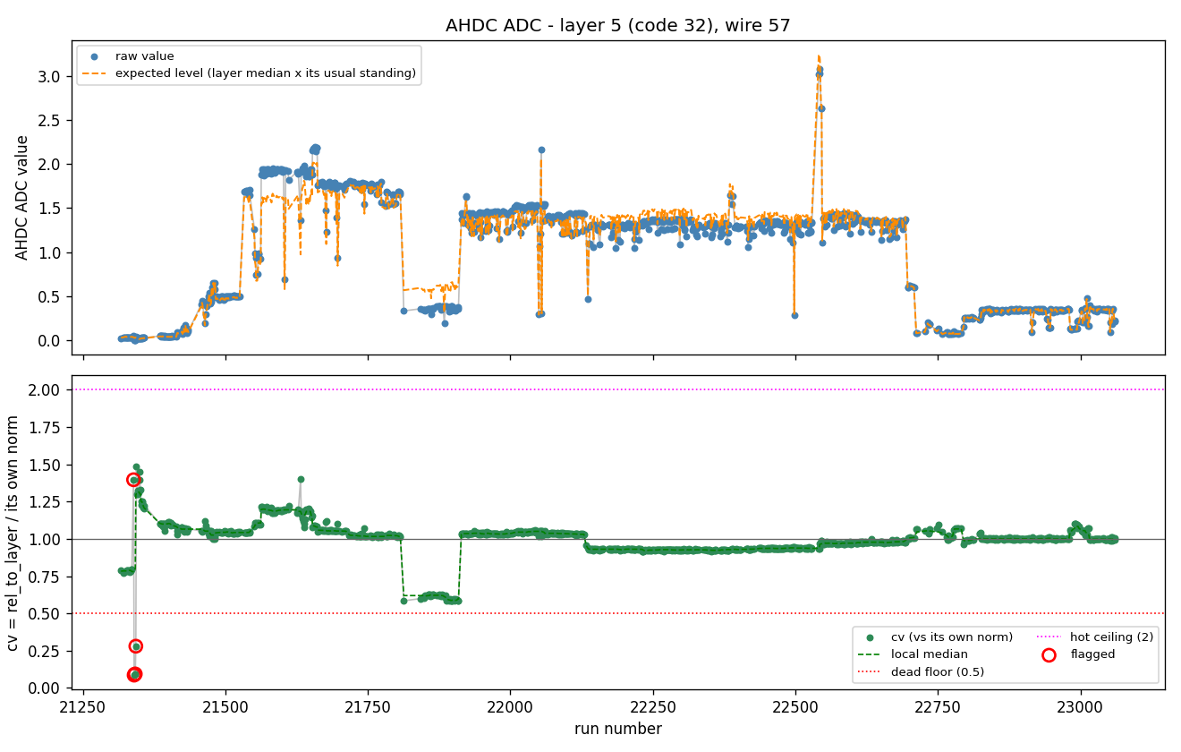
Quick examples
Total 576 wires
(per wire)
(per run)
Total 1112 runs

Slide 3
THE METHOD
The quantities, and the five cuts
The CLAS12 timeline gives, for every run, the ADC integral of each wire normalized to the trigger count. 8 layers, {47,56,56,72,72,87,87,99} = 576 wires.
Quantities
Five cuts — an entry is flagged if any fires
value
the wire’s ADC integral in this run
low/dead
cv < 0.5
under half its own normal
lay_med
median value over that layer’s wires, this run
low vs layer
rel_to_layer < 0.5
under half its neighbours
rel_to_layer
value / lay_med — vs its neighbours
hot
cv > 2.0
twice its own normal
own_norm
median of rel_to_layer over its healthy runs
hot vs layer
rel_to_layer > 2.0
twice its neighbours
cv
rel_to_layer / own_norm — vs itself
outlier
25 % change
vs the runs around it
brightness
the run’s overall level (run quality only)
Notes:
rel_to_layer and cv are both ratios formed from within-run quantities, so a run-wide factor cancels; own_norm and local_median do span many runs. Thresholds are the defaults, moved together by --dead-frac and --hot-frac.

Slide 4
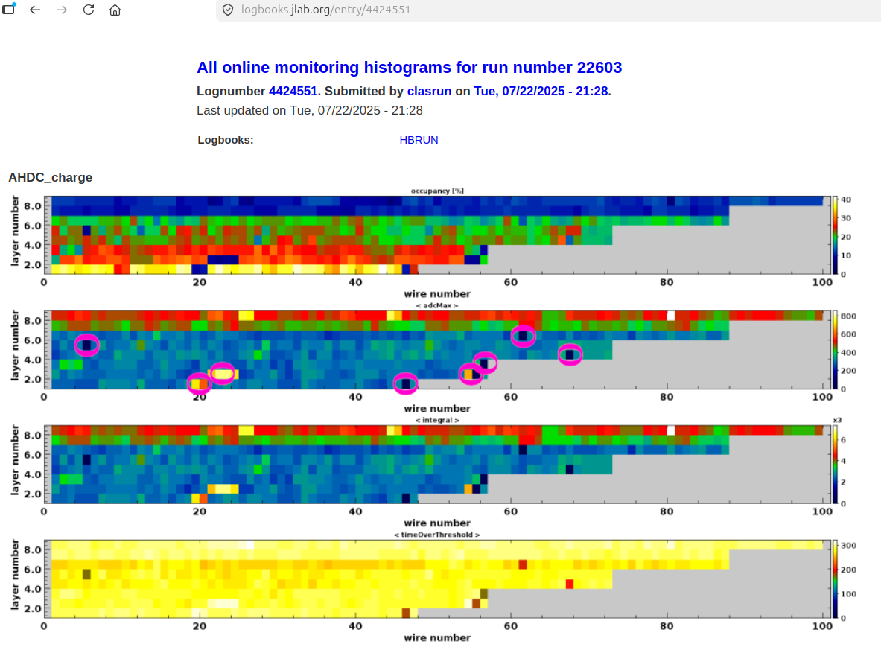
Let’s test it.
Raphael Dupre picked a random run and circled the bad/dead channels.

Slide 5
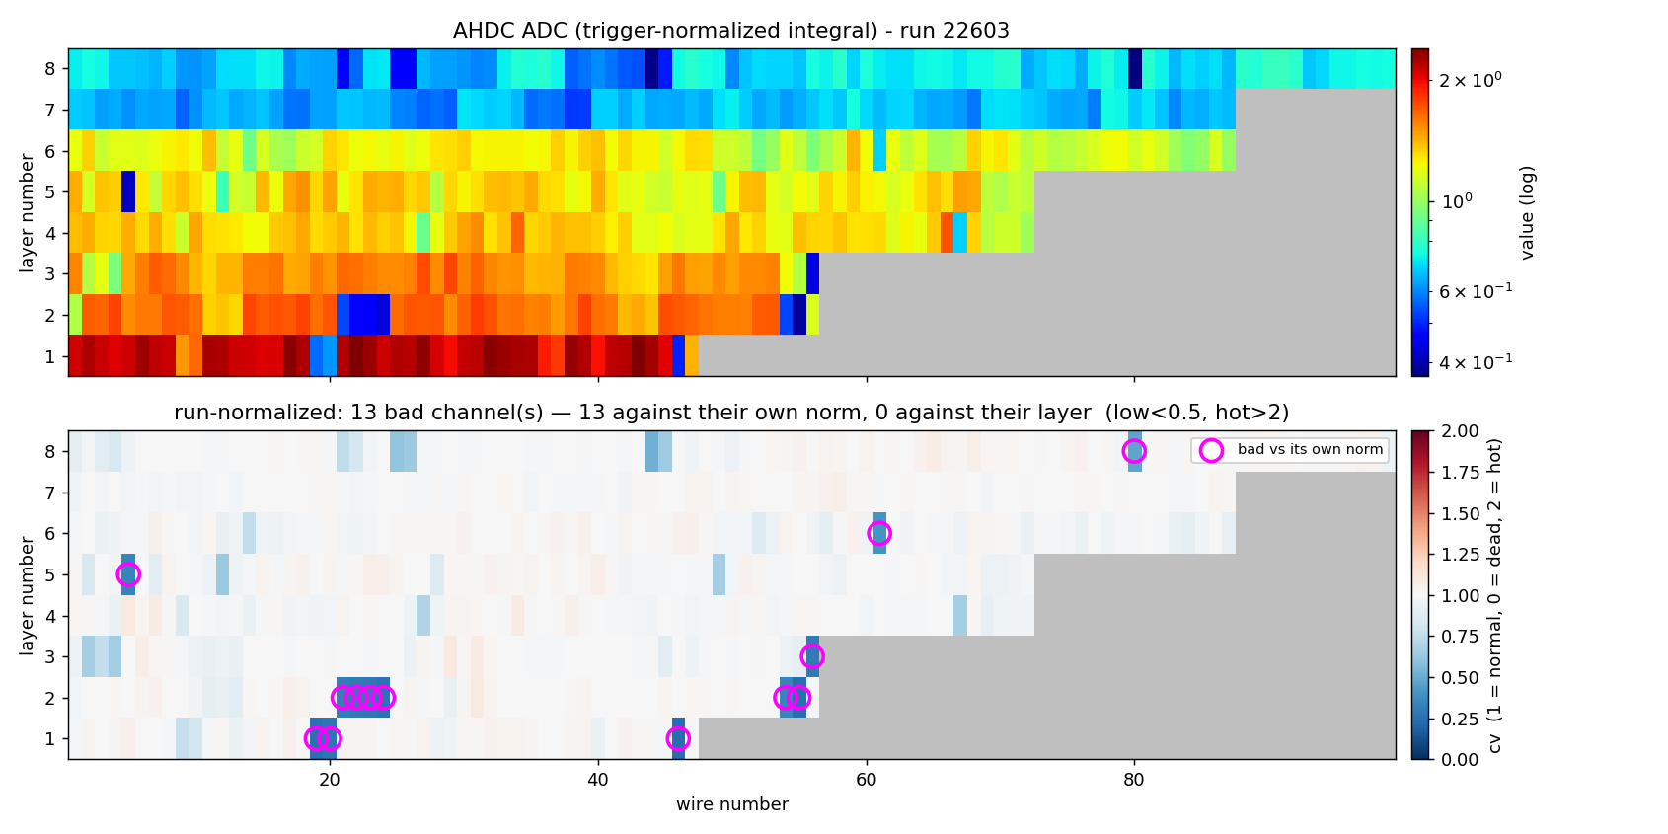
WALK-THROUGH
One run: 22603, 13 bad of 576
channel
r/layer
own
cv
verdict
L1 W1
0.97
0.99
0.98
—
L1 W19
0.26
1.03
0.26
low/dead
L1 W46
0.23
0.96
0.24
low/dead
L6 W61
0.57
1.40
0.41
low/dead
L4 W67
0.52
0.78
0.66
near cut
L4 W67 is the one Raphael picked but not this work. It is at the edge of the cut, which can be easily tuned.
Top: raw value, log scale, grey where the wire does not exist. Bottom: cv, white at 1 — magenta rings are bad vs their own norm, black dashed vs their layer.
The algorithm seems to work very well to pick the bad wires.
Notes:
This is the case that justifies keeping reference B.

Slide 6
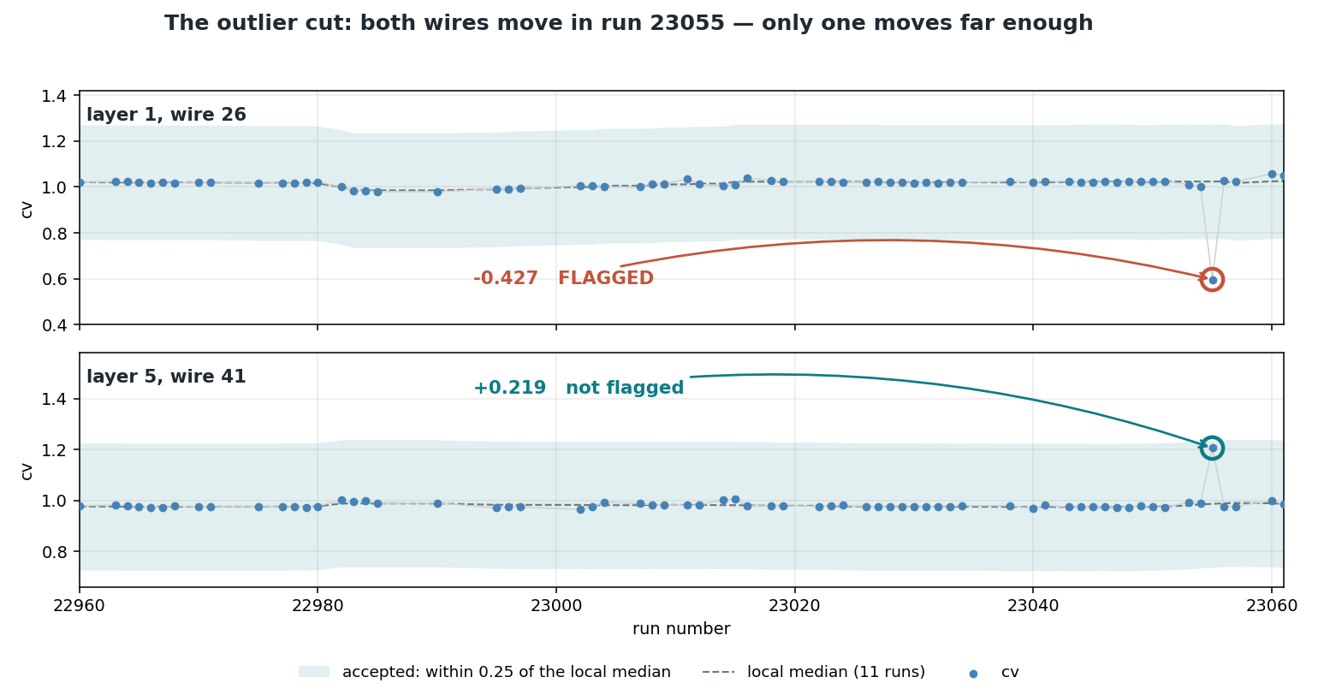
THE OUTLIER CUT
In practice: a 25 % change
Where 25 % comes from
threshold 5 × scale 0.05
Notes:
robust_z = (cv - local_median)/scale with threshold 5; since scale is the 0.05 floor for every wire this is exactly |cv - local_median| > 0.25. The band in the figure is that cut. Both wires move in run 23055: L1 W26 by -0.427 and is flagged, L5 W41 by +0.219 and is not. The spread is a median of absolute deviations rather than a sigma, so one extreme run cannot inflate the yardstick meant to measure it.

Slide 7
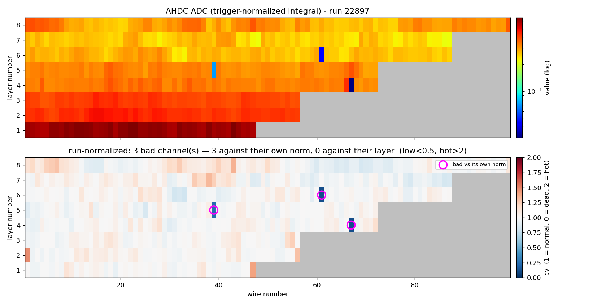
Another example with low overall ADC values
Run 22897 — the detector delivered a quarter of its usual charge
616,724 / 616,724
The same wire, two runs
layer 1, wire 1
run 22603
run 22897
brightness
0.99
0.26
value
2.095
0.623
rel_to_layer
0.97
0.99
cv
0.98
1.00
A third of the charge, and both references read the same.
Top: every wire reads low in absolute terms. Bottom: after the ratios, the map is flat.
Notes:
The invariance is algebraic, not statistical: rel_to_layer is a ratio within one run, so a common factor cancels, and everything downstream is built from it. Verified by rescaling whole runs and checking all 616,724 verdicts. Across reliable runs the flag count does correlate with brightness (Spearman +0.4), but that is the campaign changing over time, not scale sensitivity.

Slide 8
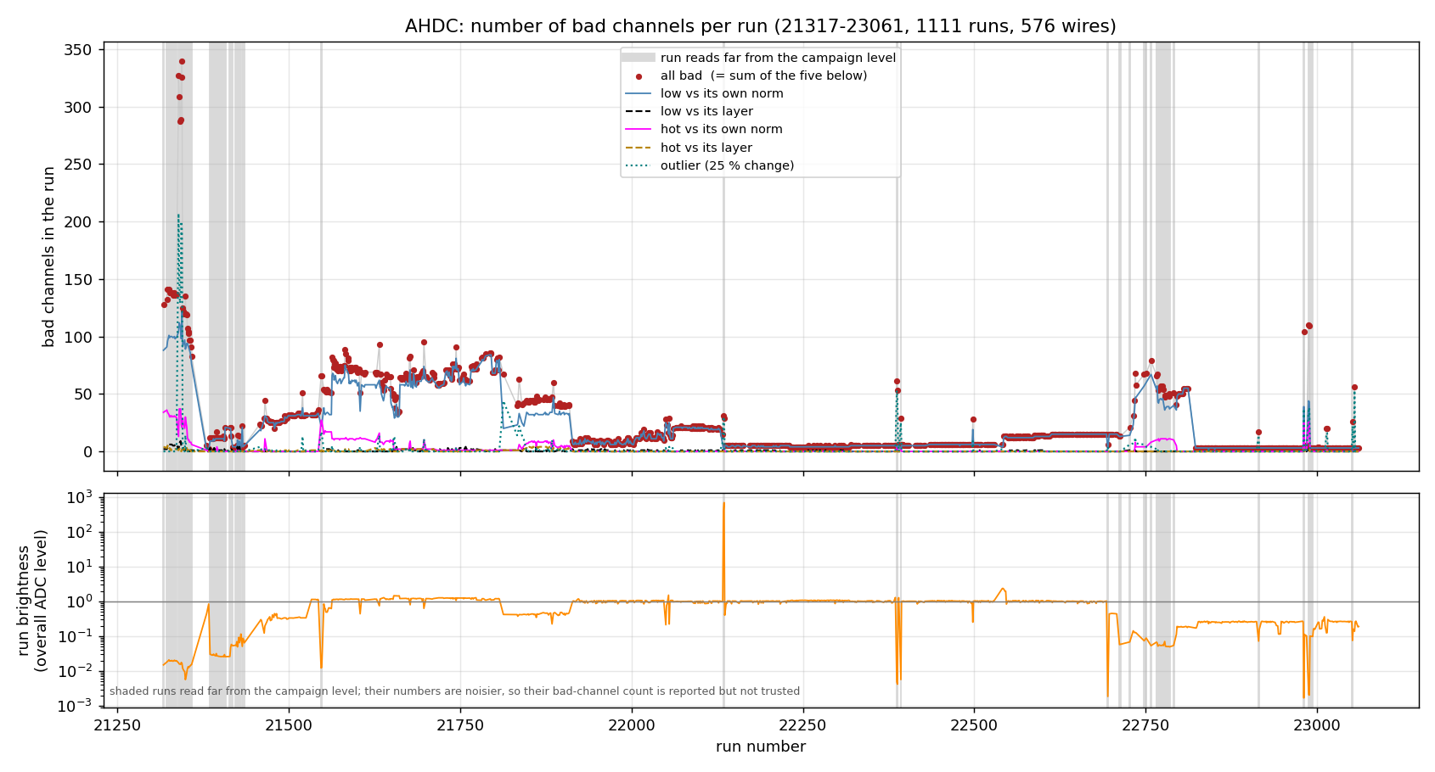
RESULTS
Across the campaign
run
bright
bad
21697
0.63
95
22249
1.09
4
22603
0.99
13
22897
0.26
3
23055
0.14
56
Storing it
1015 bad run-ranges over 298 wires. 47 % are a single run, but those carry only 2 % of all bad entries
The five lines are the five statuses and sum to the red points run by run. Flat stretches are stable periods; the steps between them are the runs to look up in the logbook. Grey bands: 109 runs reading far from the campaign level (107 low, median wire at ~3 % of usual; 2 high) — why is not in this data, and their numbers are 1.6× noisier, so their counts are shown but not trusted.
Notes:
Segmentation answers whether a run-range database model is workable. It is.

Slide 9
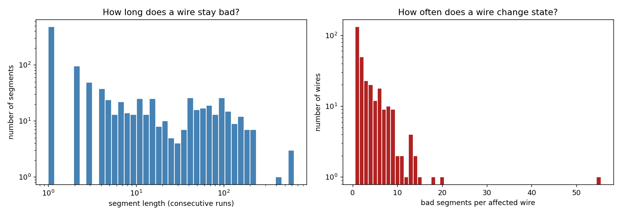
Statistics of the segments – how long and often a wire stay bad or change state
(not sure if this is useful, but the information can be extracted.)

Slide 10
THE REPOSITORY
Everything reproducible from one CSV
dump_alert_adc_csv.groovy
timeline HIPO → per-wire CSV (on ifarm)
Typical use
analyze_alert_adc.py
the analysis: maps, tables, summary, run ranges
# bad channels in one run
python analyze_alert_adc.py \
all.csv --run 22603
# per-run counts, campaign
python analyze_alert_adc.py \
all.csv --summary bad.png
# run ranges for the database
python analyze_alert_adc.py \
all.csv --segments seg.csv
ALGORITHM.md
the method, with worked numbers
README.md
install and run
all.csv
576 wires × 1112 runs
examples/
per-run reports for five runs
Open questions · thresholds are defaults, not tuned against the `experts` · how to store single-run exceptions · whether to fold in occupancy and adcMax alongside the integral
github.com/KongTu/deadChannel-ALERT-CLAS12
Notes:
Close on what is still open rather than on the file list.

