Slide 1

ISBA 2411 | FINAL TEAM PROJECT
MSBA Job Matching
Grounded NLP decision support for career advisors
Search | Fit | Evidence | Human review
Yitong Wang | Zhike Yan
1
Notes:
[Sources]
Illustrative image generated for this presentation with OpenAI image generation.
Project claims: repository README and committed evaluation outputs.

Slide 2
The advisor must separate fit, uncertainty, and risk
A useful system improves a specific decision: forward, hold, or investigate.
FORWARD
HOLD
INVESTIGATE
Strong entry-level analytics fit supported by title, skills, and location evidence.
Senior, engineering-heavy, or clearly misaligned roles require a conservative screen.
Incomplete fields or missing authorization language require human follow-up.
Role fit and work authorization are related in workflow, but they are not the same prediction task.
2
Notes:
Explain the three advisor actions. Emphasize that the system supports triage rather than making immigration or hiring decisions.
[Sources]
- docs/problem_statement.md
- docs/governance_risk_appendix.md
[/Sources]

Slide 3
Label quality, not data volume, is the bottleneck
The final model uses the full training split and audits all 785,741 source rows.
785,741
100,000
77,135
230
original public job records
stratified project sample
deduplicated training rows
unique authorization candidates
3
Notes:
The public role-fit corpus is already large. We completed a full-source authorization scan and packaged the evidence candidates for advisor review.
[Sources]
- data_jobs_msba_project_sample_100k_metadata.json
- models/job_fit_tfidf_svc_metrics.json
- outputs/authorization_evidence_audit.json
[/Sources]

Slide 4
Each milestone changed the final technical decision
M2
M3
M4
M5
Represent
Adapt
Integrate
Validate
TF-IDF + MiniLM
20k validation
Zero-shot + few-shot +
true PEFT LoRA
80k-trained classifier +
retrieval + policy gates
Leakage audit, tests,
demo, and governance
4
Notes:
M3 established that adaptation helps. M4 then tested a wider model and data choice and found that a lightweight linear model trained on the full split is both stronger and easier to ship.
[Sources]
- outputs/milestone2_baseline_results.json
- outputs/milestone3_adaptation_results.json
- outputs/final_model_comparison.json
[/Sources]

Slide 5
Two input modes prevent a subtle but costly task error
Search requests retrieve candidates; only job postings receive a role-fit label.
1
2
3
4
5
ROUTE
RETRIEVE
CLASSIFY
GOVERN
REVIEW
Search request or job posting
80k index + hard constraints + dedupe
77,135-row TF-IDF SVM
Calibrated margin + policy gates
Cited evidence and final action
A high role-fit score can never override an explicit authorization restriction.
5
Notes:
Walk left to right. The mode router prevents a search sentence from being misclassified as a posting. Verifiable search constraints are enforced before ranking. The policy layer uses class-specific calibrated margins, then handles missing fields and authorization independently from role fit.
[Sources]
- docs/architecture.md
- msba_job_matcher/core.py
- models/review_policy.json
[/Sources]

Slide 6
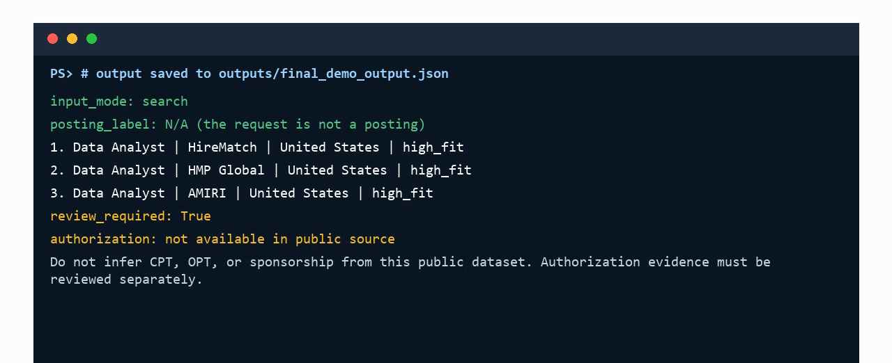
A real search returns constrained, inspectable evidence
6 audit queries -> 36 results -> 0 hard-constraint violations -> 0 duplicate company-title pairs
6
Notes:
[Sources]
Screenshot extracted from the project-owned recorded demo, demo/final_demo_video.mp4.
Audit metrics: outputs/search_constraint_audit.json.

Slide 7
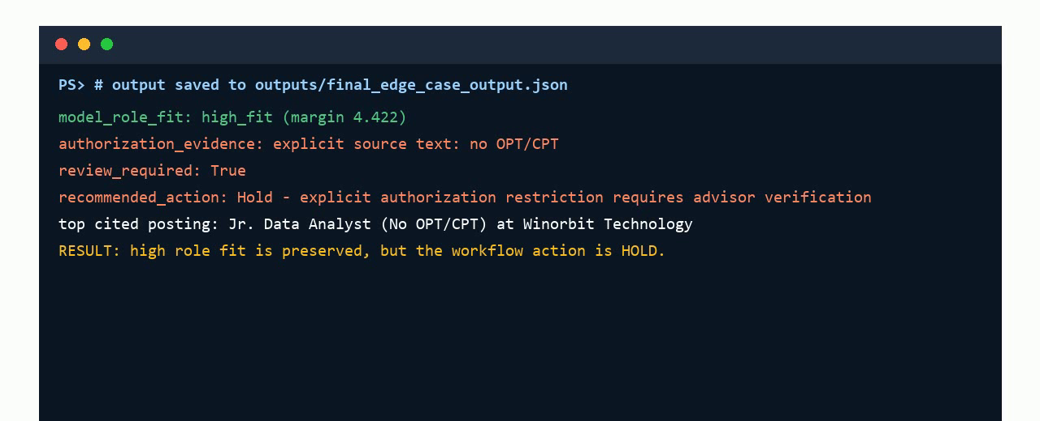
High role fit never overrides an explicit restriction
No OPT/CPT -> HOLD. Missing core fields -> UNCLEAR + REVIEW.
7
Notes:
[Sources]
Screenshot extracted from the project-owned recorded demo, demo/final_demo_video.mp4.
Governance outputs: outputs/final_casebook_outputs.json.

Slide 8
More data worked; extra complexity did not
98.4%
fixed-set macro F1
97.9%
novel-text macro F1
0
unsupported authorization claims
The final 3.8 MB model trains in under one minute.
8
Notes:
State the comparison directly. What did not work best was adding model complexity while using only 2,000 weakly labeled rows: LoRA improved on the baseline but stopped at 87.3 percent macro F1. What worked was a word-and-character model trained on all 77,135 deduplicated rows. The lesson is not that linear models always win; it is that data utilization and reproducibility mattered for this structured weak-label task.
[Sources]
- outputs/milestone2_baseline_results.json
- outputs/milestone3_adaptation_results.json
- outputs/final_evaluation_results.json
- models/job_fit_tfidf_svc_metrics.json
[/Sources]

Slide 9
The remaining risk is label validity, not model capacity
FIXED 4K ERRORS BY TRUE LABEL
DEPLOYMENT RULE
high_fit
3
Treat 0.984 as weak-label agreement, not advisor accuracy.
medium_fit
13
low_fit
8
Operational validation:
91.6% selective coverage
99.47% retained accuracy
36 search results, 0 violations
unclear
41
9
Notes:
The model makes 65 errors on the fixed weak-label set, so the production policy is calibrated on one 10,000-row half and audited on another. It retains 91.63 percent coverage at 99.47 percent weak-label accuracy. A separate six-query audit records zero hard-constraint violations across 36 search results.
[Sources]
- outputs/final_evaluation_results.json
- models/review_policy.json
- outputs/search_constraint_audit.json
- outputs/temporal_validation_results.json
[/Sources]

Slide 10
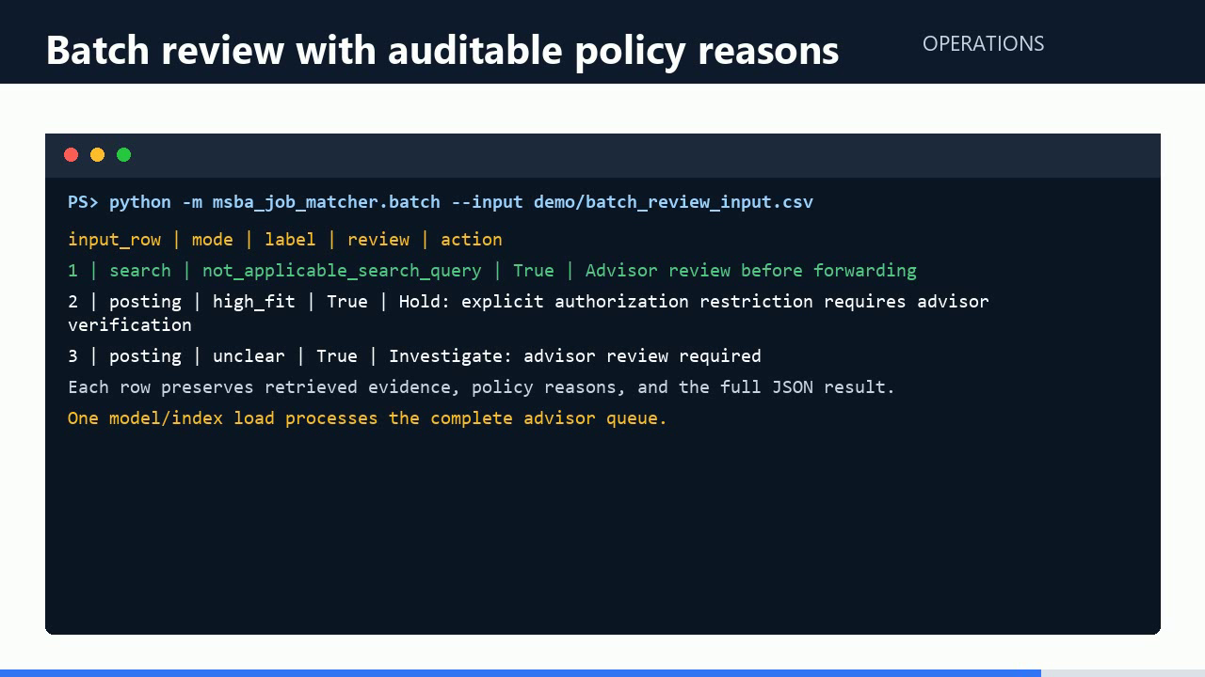
RECOMMENDATION
Ready for a supervised Career Center pilot
Deploy with guardrails
Prioritize, do not auto-reject
Keep advisor confirmation
Measure time saved and overrides
98.4% = weak-label agreement
Next: label the 1,000-row advisor queue and measure real workflow value.
10
Notes:
[Sources]
Screenshot extracted from the project-owned recorded demo, demo/final_demo_video.mp4.
Recommendation and metrics: repository README and committed evaluation outputs.

