Slide 1
Data Analytics Project 1
Electric Vehicles
Group Members
Ge Shen (Ethan), Wing yu Lui, Sushil Baskota, Jingbo Zhao, Dashrath Bhandari

Slide 2
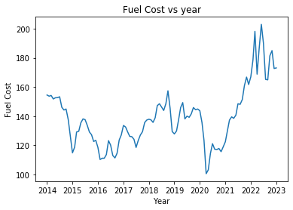
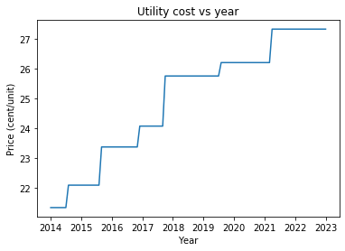
An uniform raise in the price of power cost while the price of fuel get fluctuated
However, in last eleven years, fuel price has overtaken the power cost.
Percentage raised in power cost is 33% and that of fuel is 56%.
Electricity and fuel cost in Australia in the past 10 years
Will electric vehicles (EV) be more worth buying in the coming years?

Slide 3
Overview
Fuel Efficiency
Global market growth
AU market growth
Charging Station in AU
Compare the performance of engine in both electric and traditional vehicles
Understanding the EV growth in the world
The difference between EV car sales in Australia compared to other country
A possible reason of lower EV growth in Australia

Slide 4
Fuel Efficiency Analysis
EV Efficiency
Unit - 1 kWh/100 miles
V.S
Gasoline Vehicle Efficiency
Unit - miles per gallon
1 kWh/100 miles = 0.3 kilowatt-hours per 100 miles
Then, MPG = 235.21 / (kWh/100 miles)
Fuel Efficiency Unit: MPG(miles/gallon)
Date Reference: www.fueleconomy.gov

Slide 5
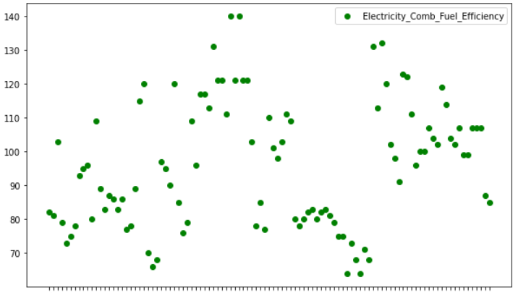
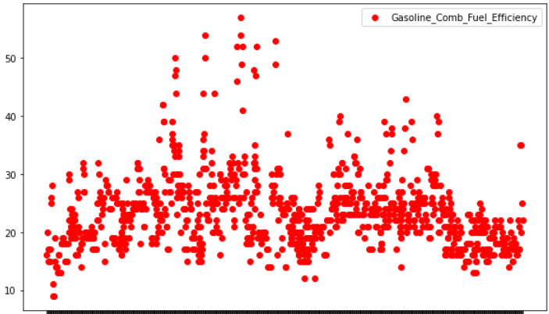
Fuel Efficiency Analysis
City_FE
Hwy_FE
Comb_FE
Fuel Efficiency Unit: MPG(miles/gallon)
Electric Vehicle Models
Traditional Vehicle Models
Date Reference: www.fueleconomy.gov

Slide 6
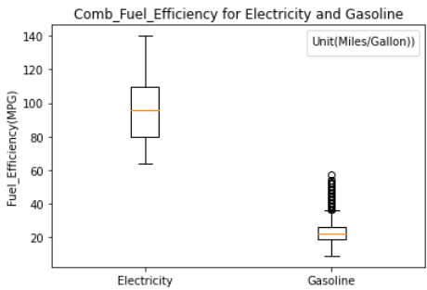
Fuel Efficiency Analysis
Higher MPG →→→ Higher Fuel Efficiency
Lower Energy Cost for the Owner
97
Small Carbon Footprint
22
Fast Acceleration, higher top speed, and lower emissions
Date Reference: www.fueleconomy.gov

Slide 7
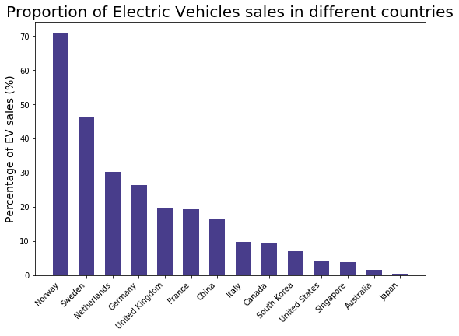
EV cars sales in different countries (2021)
More EV car buyers in European countries decided to purchase EV in 2021
Only 1.6% of general Australian car buyers decided to purchase a new electric vehicles in 2021
A very low percentage compared to other countries

Slide 8
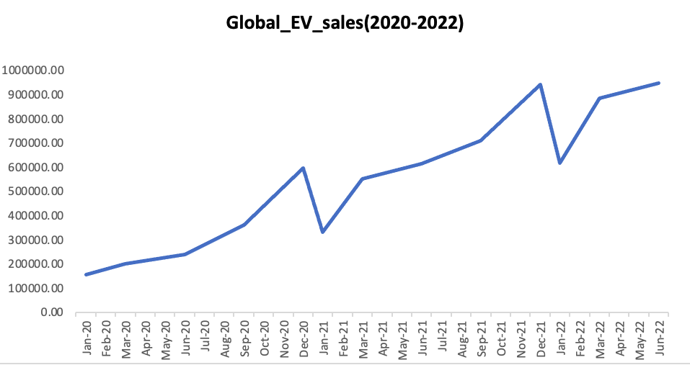
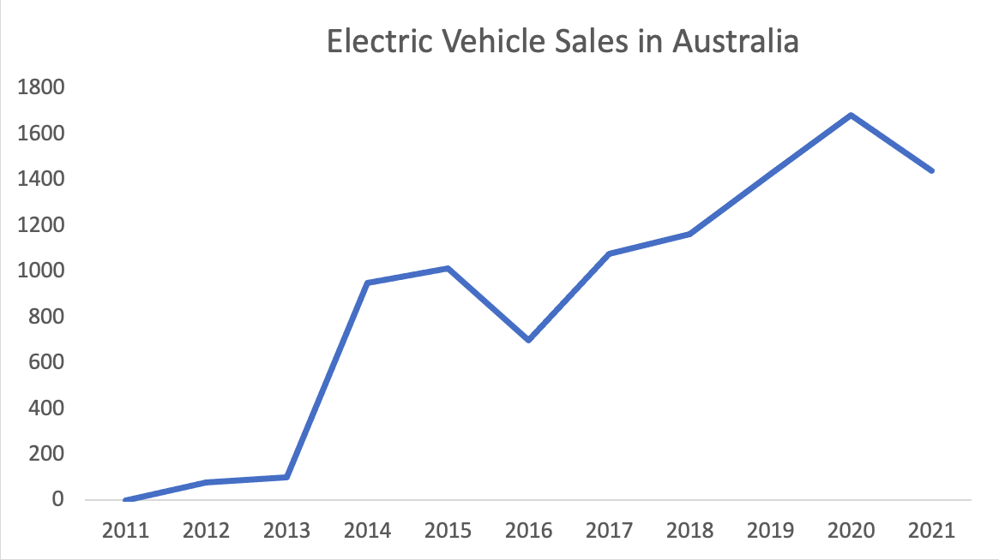
Global and Australia EV sales
Global EV sales: 428 % increased in between Jan 2020 - June 2022
EV sales increasing, but during COVID-19 has impacted the sales between Dec 20 and Jan 2021 as well as the same timeframe in 2021/2022
Australia: 14.54% decreased in between 2020 - 2021

Slide 9
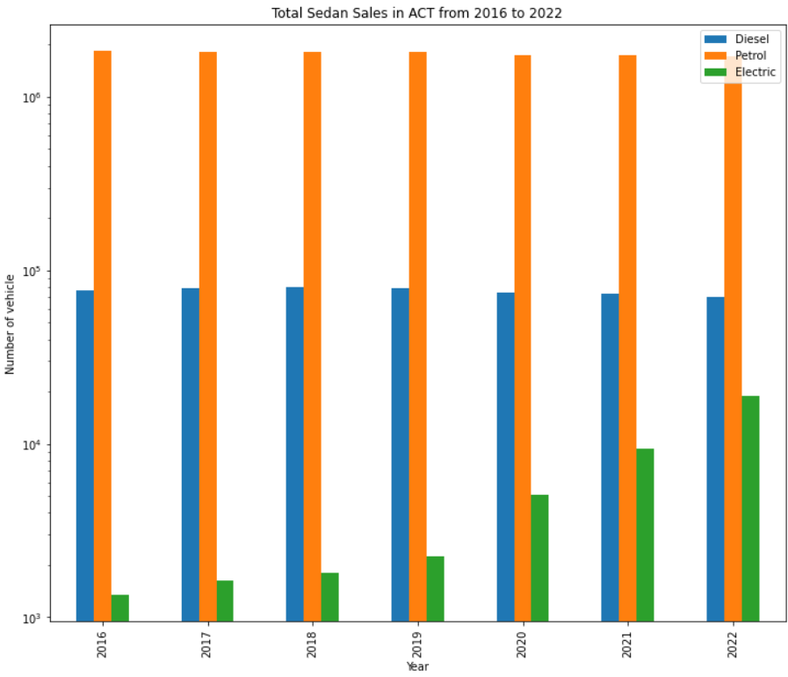
Zoom into Australian Capital Territory (ACT)
ACT is one of the earliest states in AU to put forward the “zero emissions vehicles strategy”
Assume sedan is the type of vehicle for normal family usage
Logarithmic scaled y-axis is applied to get a better view
Petrol vehicle sales
Diesel vehicle sales
Electric vehicle sales

Slide 10
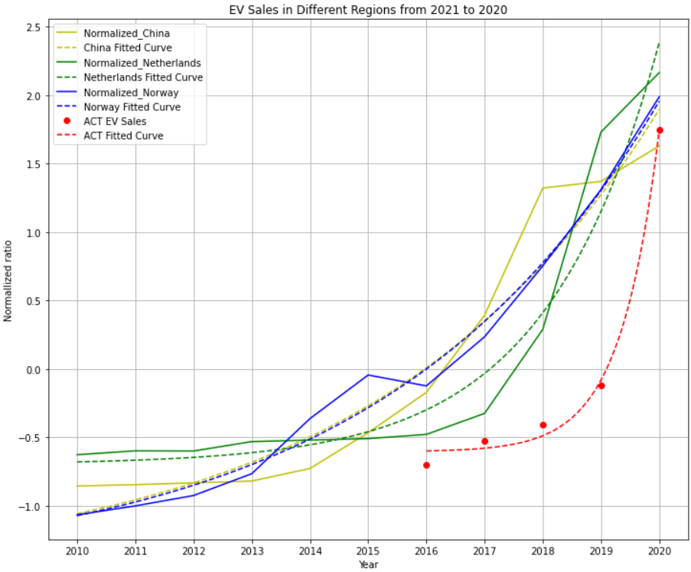
Comparing ACT EV sales with other regions in the world
Normalized data by z-score normalization to compare among different regions
Chose to use exponential regression because of the increasing trends
ACT is following the same trend with the sample regions
If the tendency remains, we would expect an exponential growth in the next few years

Slide 11
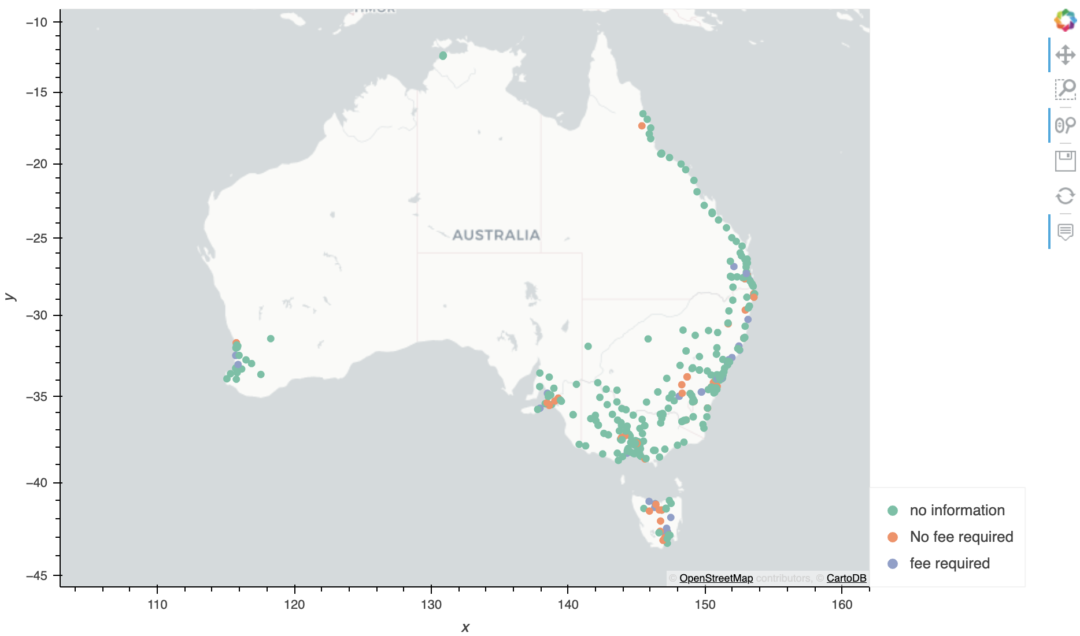
Charging Station location in Australia From Geoapify
Geoapify
493 location found (after removing duplicate):
- Charging Station Name
- City (Australia)
- State (Australia)
- Latitudes
- Longitudes
- Fee required/no fee required
Params:
100km radius
Charging stations
Output limits: 60
Table of longitudes and latitudes for Australia cities
Charging fee required: 66 sites
No Charging fee required: 69 sites
No information: 358

Slide 12
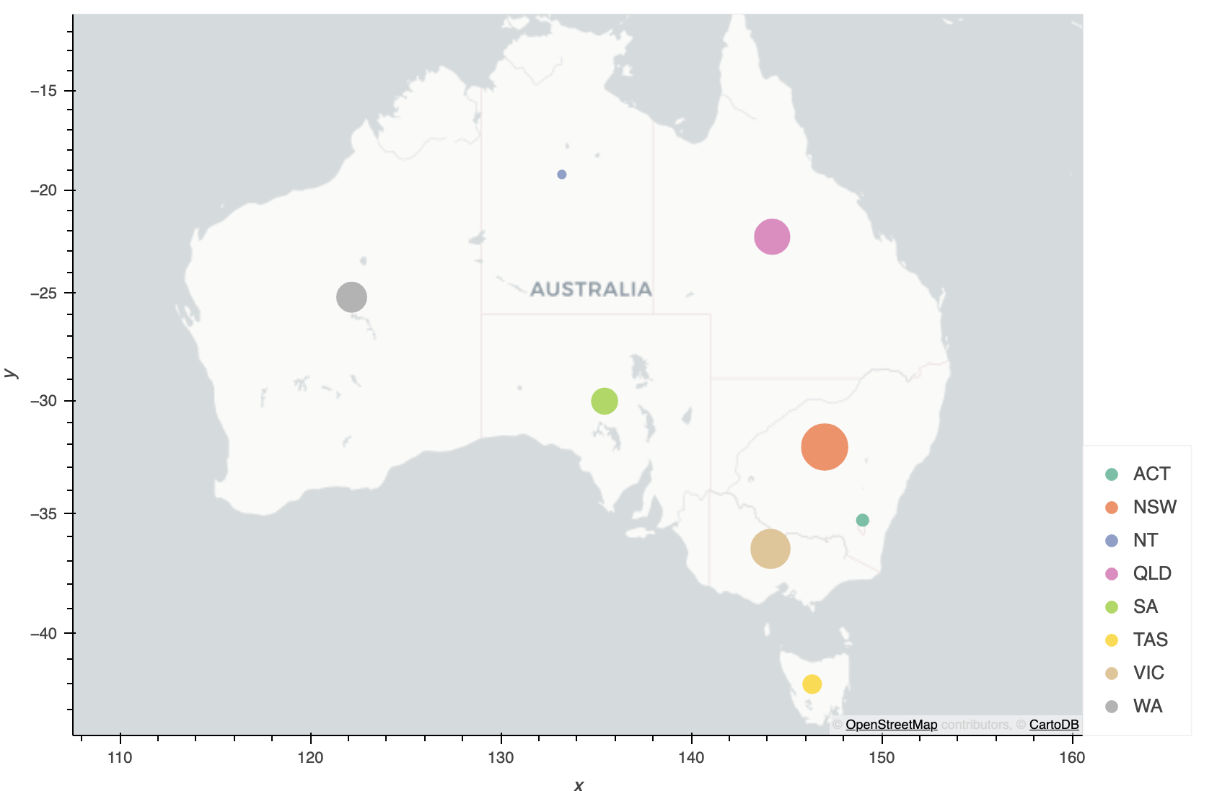
Charging Station in different state
Data is from EV council
A total of 1409 charging stations in Australia
NSW has the most number of charging station

Slide 13
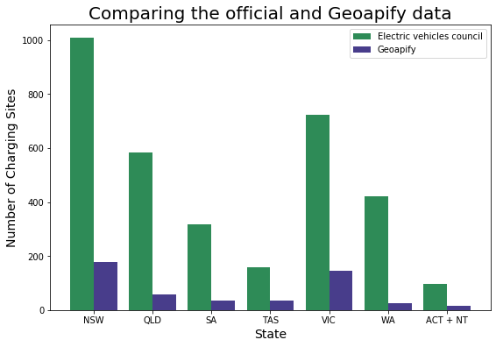
Comparison of the official and API data
Missing a lot of data in the API
No official site can easily obtained the location of charging station

Slide 14
Discussion
Electrical Vehicles | Traditional Vehicles
Higher fuel efficiency | Low fuel efficiency
Better performance | Low performance
Lower maintenance and running cost | High maintenance and running cost
Growing market | Saturated market
Despite that driving electric vehicles is beneficial in different aspect, Australian EV sales still falling behind to the other counties.
Insufficient charging stations across the countries
No easy or efficient way to locate the charging stations

Slide 15
Future Studies
Environmental:
CO2 emission of EV and traditional cars
Noise pollution
Air quality
Government:
The effectiveness of the government policy in different countries
How much tax incentives for EV will affect the buyers to get a EV rather than traditional cars
Can our government can learn from other countries
Any other infrastructures can be built before the big influx of EV

