Slide 1

A MINI PROJECT ON DATA STRUCTURES AND ALGORITHMS
SUBMITTED BY-
DIVYANSHU KUMAR(19-14-035)
ADITYA HAZARIKA(19-14-038)
SWAPNIL DAS(19-14-016)
MUKIB KHAN (19-14-034)
RATUL MAZUMDAR(19-14-037) SUNIL UPADHYAY (19-14-022)
BIDISHA GOGOI(19-14-065)
KALPATARU NARAH(19-14-067)
ANKIT JHAWAR(19-14-166)
RATUL PEGU(15-14-068)

Slide 2
Title and Description
The title of the project is “Phone Book Code Using Linked List”
Phonebook is a very simple mini project that can help you understand the basic concepts of functions and data structure. This application will teach you how to add, list, modify or edit, search and delete data to/from the file.
Adding new records, listing them, modifying them and updating, search for contacts saved, and deleting the phonebook records are the basic functions which make up the main menu of this Phonebook application.
Personal information such as name, phone number are asked while adding a record into the Phonebook. Thee records can then be modified, listed, searched for and removed.

Slide 3
Layout of Presentation
This program involves the following Operations:
1.Declaration Of Linked List And Its Function
2.Start Function
3.Adding Contacts
4.Displaying The Contacts
5.Searching The Contacts By Number
6.Seaching The Contacts By Names
7.Updating The Contacts:
8.Deleting A Contact
9.Deleting All Contacts
10.Displaying The Number Of Contacts

Slide 4
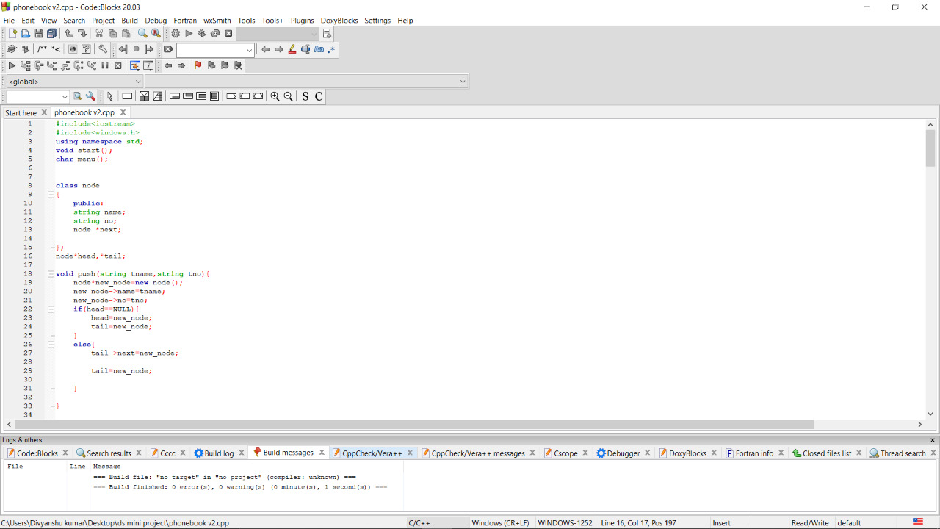
Declaration Of Linked List And Its Function:
This part of code involves the declaration of linked list and its function for its implementation in the whole program.

Slide 5
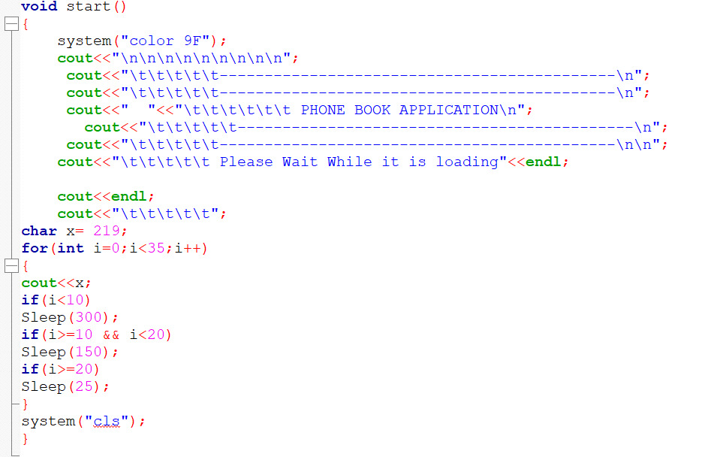
Start Function:
Its works is to display the loading bar at the beginning of the Phone Book Application
Then by using system(“cls”) the output screen gets cleared.

Slide 6
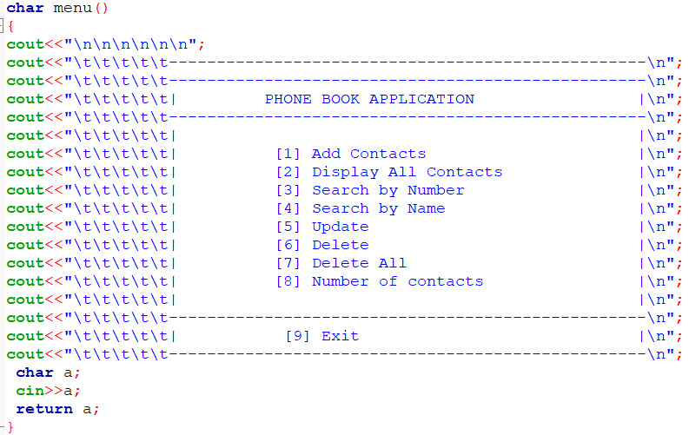
Menu function:

Slide 7
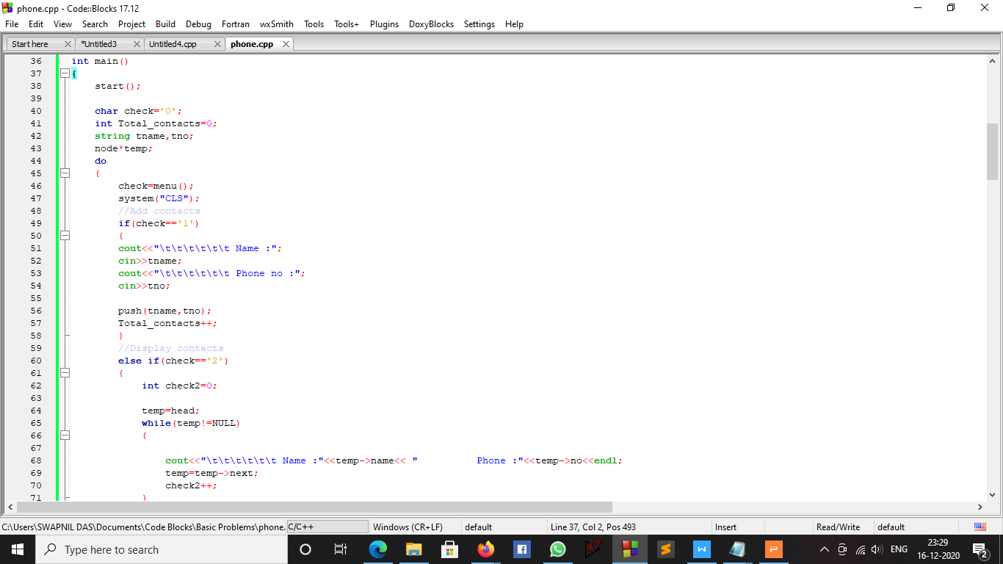
Adding Contacts:
This part of code contributes to the addition of contacts to the application by pressing '1'.

Slide 8
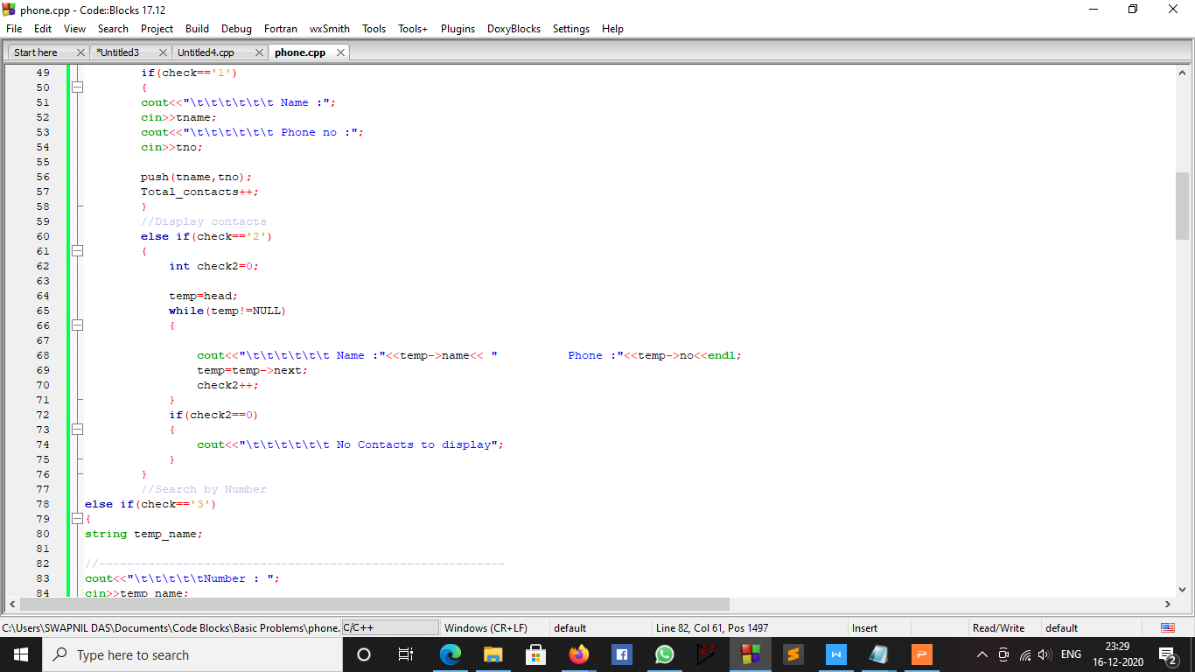
Displaying The Contacts:
This part of code contributes to display the contacts stored in the application by pressing '2'.

Slide 9
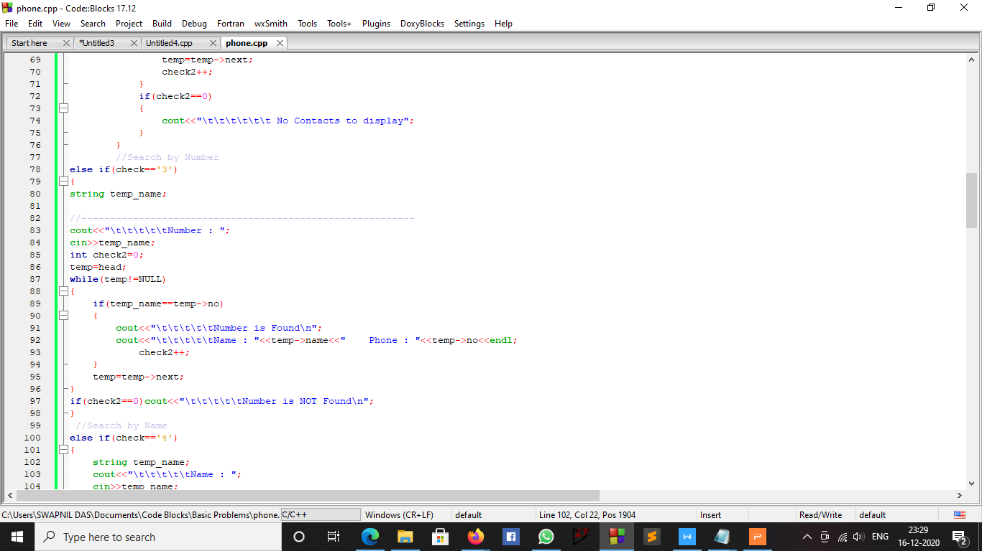
Searching The Contacts By Number:
This part of code contributes to search the contacts by numbers stored in the application by pressing '3'.

Slide 10
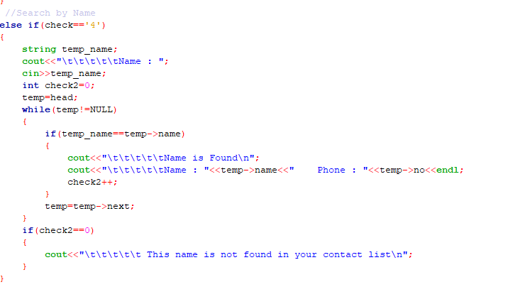
Seaching The Contacts By Names :
This part of code contributes to search the contacts by names stored in the application by pressing '4'.

Slide 11
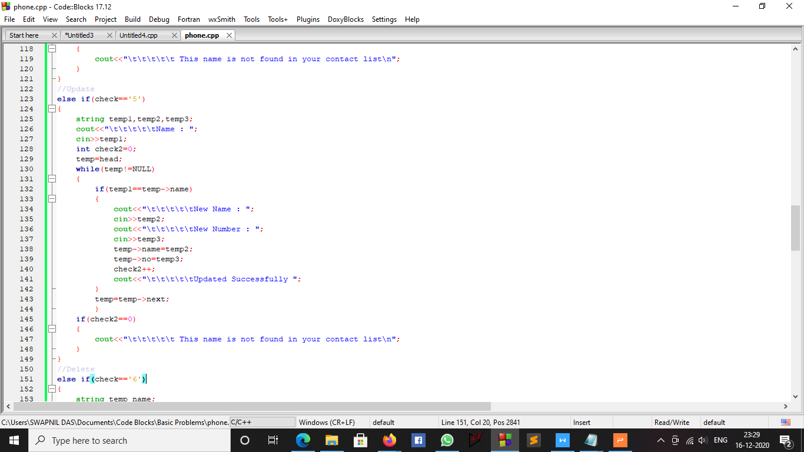
Updating The Contacts:
This part of code contributes to update the contacts stored in the application by pressing '5'.

Slide 12
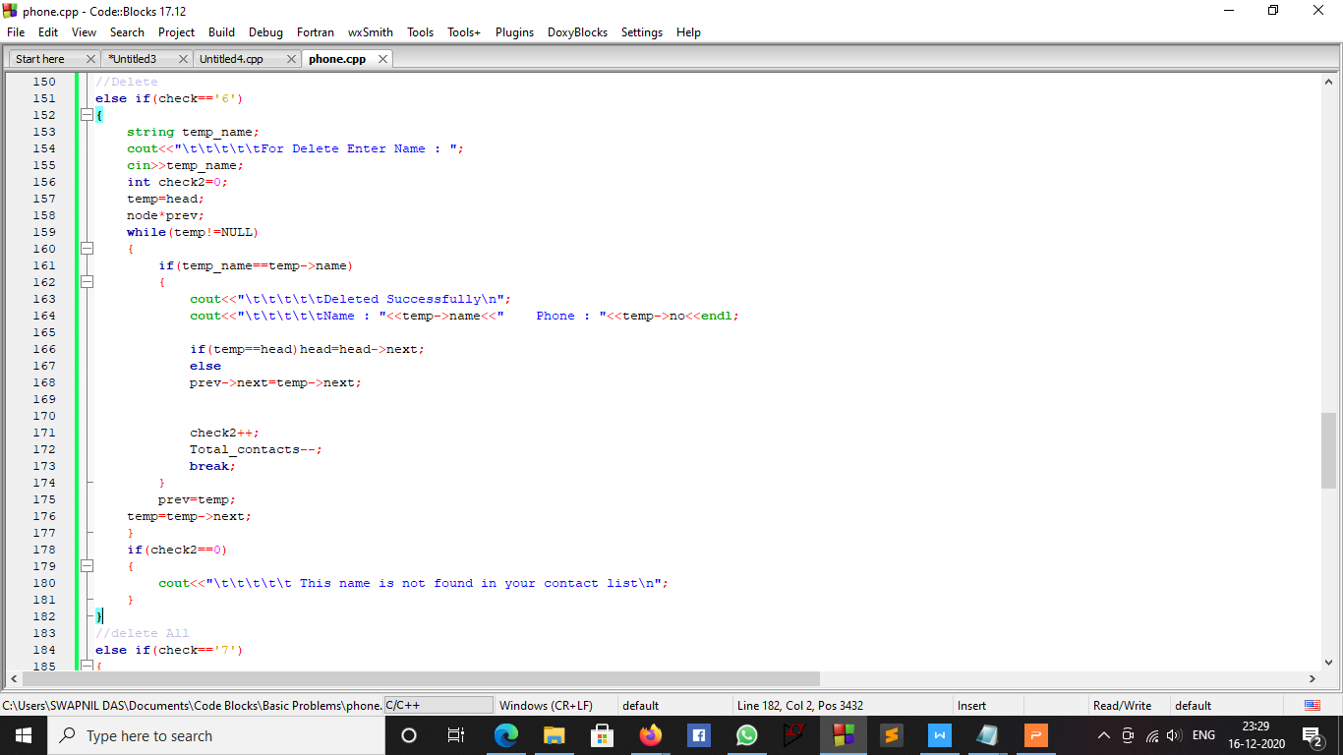
Deleting A Contact:
This part of code contributes to delete a particular contact stored in the application by pressing '6'.

Slide 13
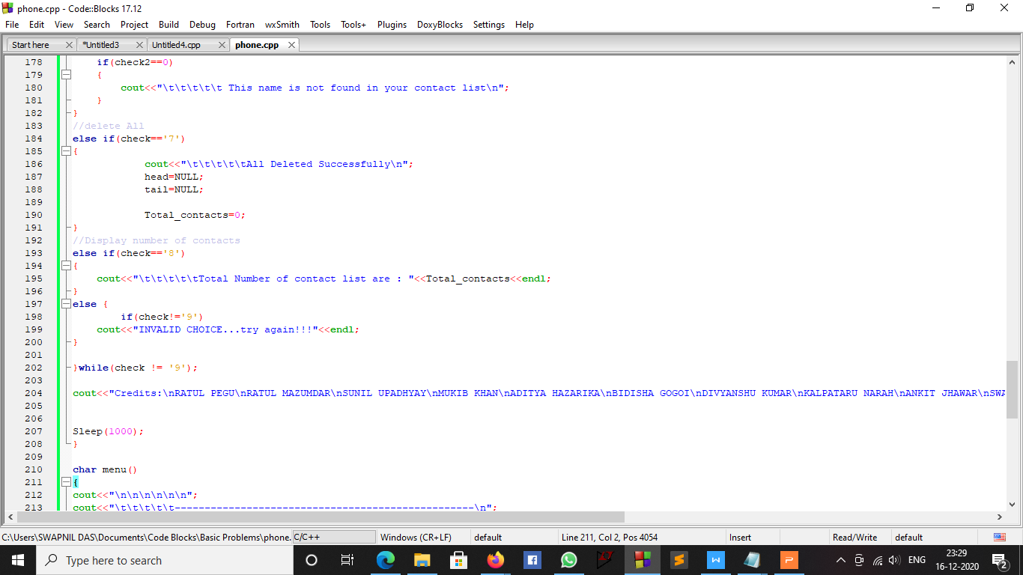
Deleting All Contacts:
This part of code contributes to delete all contacts stored in the application by pressing '7'.

Slide 14
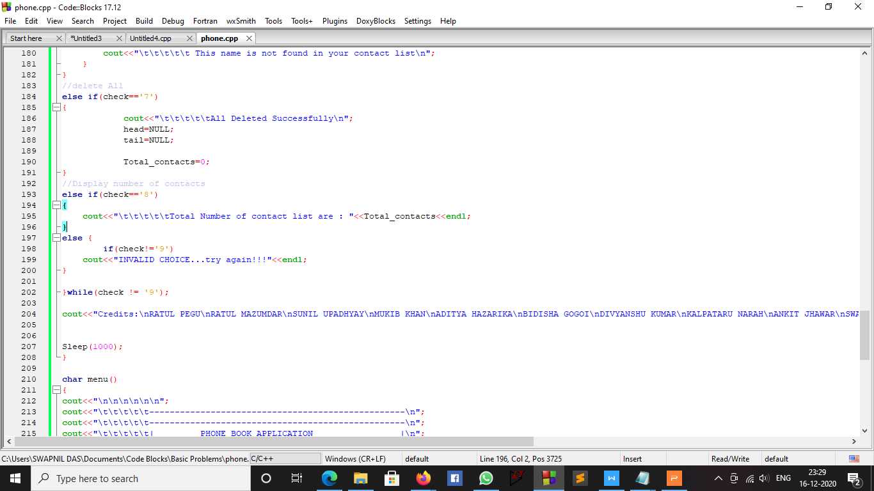
Displaying The Number Of Contacts:
This part of code contributes to show the number of contacts stored in the application by pressing '8'.

Slide 15
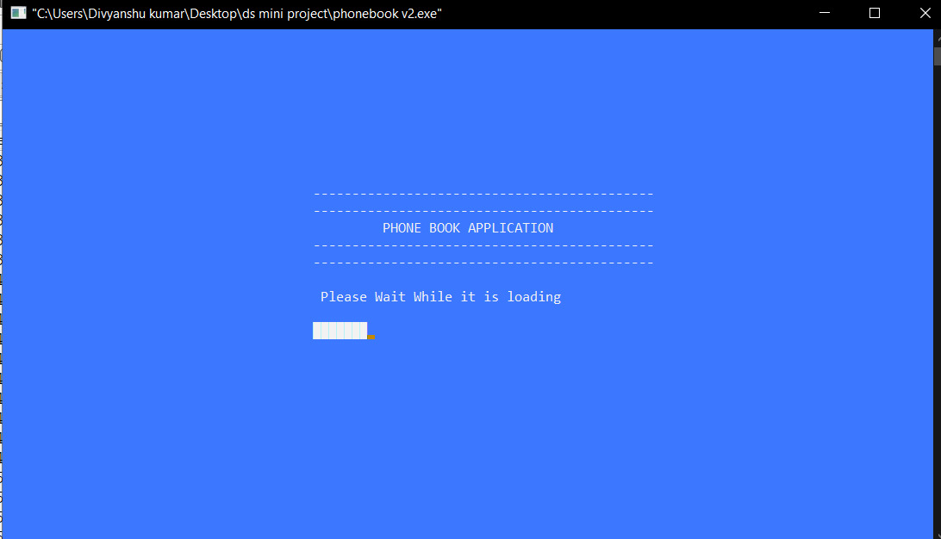
Outputs:

Slide 16
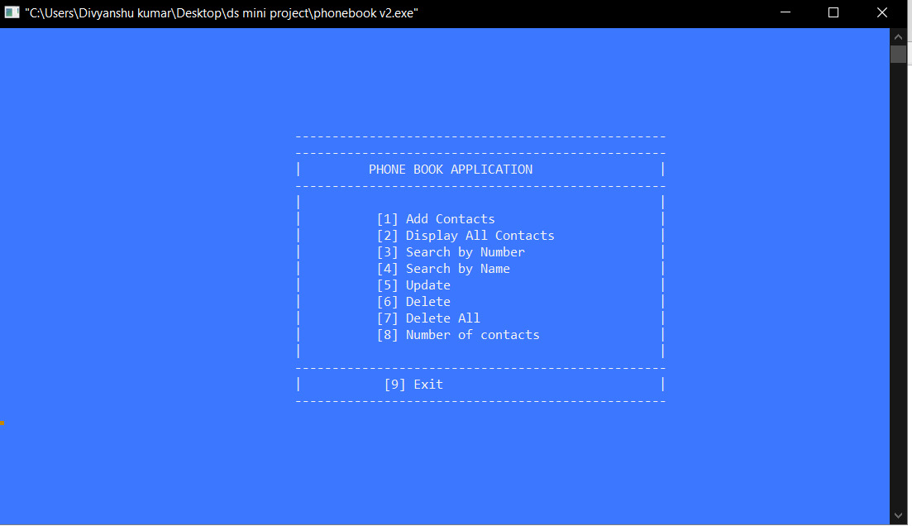

Slide 17
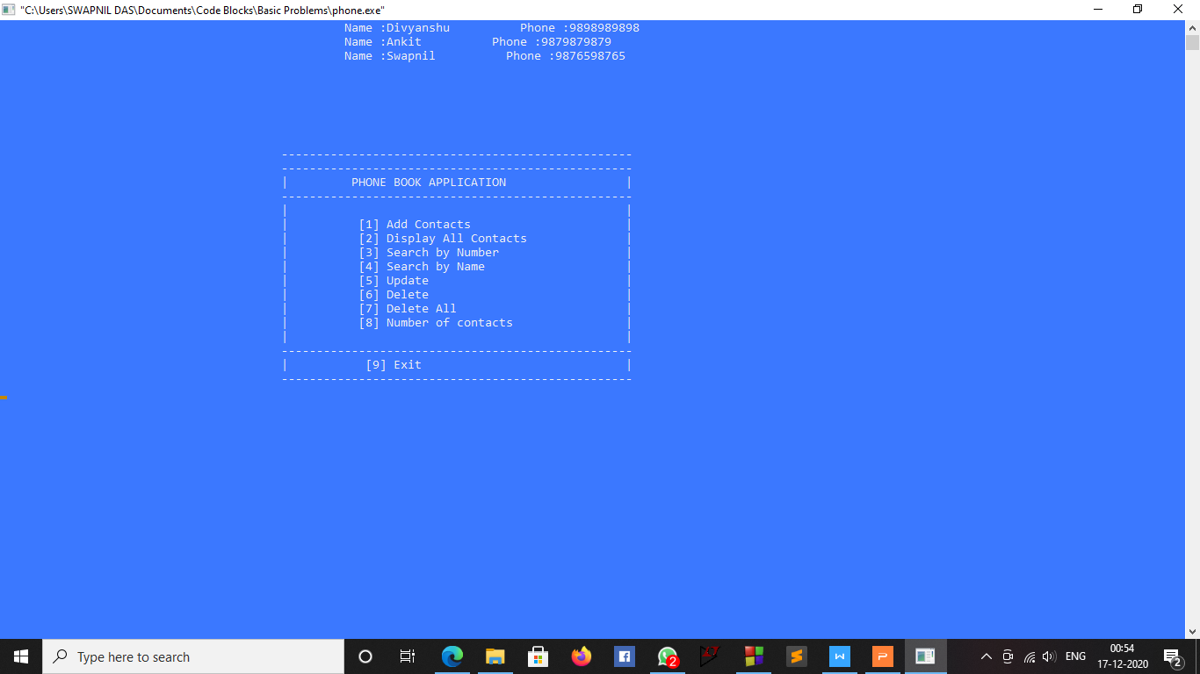

Slide 18


Slide 19
